Slide 1
Fall 2018 CSBC SAFE BOATING
TRACKING SURVEY
Consumer Research Results
Final Report
        Prepared for: Canadian Safe Boating Council
        Prepared by: McCullough Associates
        Date: September 11, 2018

Slide 2
Table of Contents
Slide #
Introduction 3
  Research Objectives & Methodology 4
Summary of Key Findings & Implications 6
Detailed Findings 21
  Boating Participation 22
  Awareness of Safe Boating Messages 27
  Sources of Awareness of Safe Boating Messages 40
  Safe Boating Attitudes / Behaviours 52
  Wearing Lifejackets 58
  Drinking and Boating 64
  Using Cannabis and Boating 70
Appendix 82

Slide 3
Introduction

Slide 4
Research Objectives
Measure & track awareness of safe boating messages communicated by the CSBC’s annual boating safety campaign.
  Identify how well specific campaign messages are being communicated, in the areas of “Wearing PFDs”, “drinking & boating”, “preparedness”, “cold water” and “boating education”.
  Identify who the campaign is reaching and opportunities to improve its reach & impact.
  Aided awareness of selected elements of the 2018 campaign – outdoor “Got Time” / “Tired of Waiting” / “Unexpected Happens” Lifejacket poster ads; outdoor “Start Boating this Summer” poster ads; and four boating safety Cards.
Measure & track boating safety attitudes and behaviours among Canadian boaters, and how they have been affected by awareness of the CSBC campaign messages.
Measure baseline boating safety attitudes toward, and usage of, cannabis while boating, in advance of the October 2018 legalization of access to recreational cannabis.
  Including understanding and reaction to: a new ‘Boat Sober’ message & logo; and two potential new ‘Boat Sober’ poster ad concepts for 2019.

Slide 5
Research Methodology
National online survey via Ipsos eNation Canada omnibus survey.
Fieldwork conducted August 29 – September 5, 2018.
n = 1,000 Canadian adults, nationally representative of the Canadian population.
Most Safe Boating Tracking survey questions asked of n = 445 subgroup of the Canadian population who participate in recreational boating activities at least occasionally
  Including pleasure powerboating/cruising/waterskiing/wakeboarding, fishing from a boat, riding a personal watercraft, canoeing, kayaking, stand-up paddleboarding, sailing, windsurfing/kiteboarding &/or boating in other unpowered craft.
On a sample size of 1,000, results are accurate 19 times out of 20 to within +/-3%.
On a sample size of 445, results are accurate 19 times out of 20 to within +/-5%.
Circles and squares are used throughout this report to indicate differences that are significant at the 95% confidence level. Differences that are “approaching significance” (80% confidence level) are indicated with dotted circles and squares.
Solid arrows are used to indicate changes that are significant at the 95% level. Dotted arrows indicated changes that are “approaching significance.”
  Black arrows indicate significant changes vs the previous wave at the same time of year.
  Green arrows indicate significant changes for comparisons between waves at seasonally different times of year, i.e. August 2018 vs. May 2018; May 2018 vs. August 2017; Aug 2017 vs. May 2016; and Aug 2015 vs. May 2014.

Slide 6
Summary –
Key Findings & Implications

Slide 7
Summary of Key Findings
Boating Participation:
  In Fall 2018, 42% of Canadian adults participate in recreational boating activities.
    Fishing, pleasure powerboating, canoeing and kayaking continue to be the most popular boating activities.
  Boating participation in Fall 2018 is down slightly from Fall 2017 and Spring 2018, but still in the same range as historical participation levels.
    This reflects slippage in Fall 2018 boating participation among older Canadians 55+ yrs, while participation is slightly higher among 18-34 yrs. No changes versus year ago by gender or regionally.
  One-quarter of Canadians are Non-Boaters interested in getting involved.
  And 12% of Canadians (30% of Boaters) are New Boaters who began boating in the last 2 years – slightly fewer New Boaters than last year (14%).

Slide 8
Summary of Key Findings
Awareness of Safe Boating Messages:
  Overall boater awareness of CSBC boating safety campaign messages was maintained at the higher levels achieved during the last 4 years since 2015; although down from the peak awareness achieved in Fall 2017.
    Almost three-quarters (72%) of boaters are aware of CSBC boating safety messages.
    And almost one-third (30%) of boaters are “highly aware” of 5 or more CSBC messages – in-line with the peak Fall 2017 level; and higher than all other years.
  Fall 2018 total campaign awareness was down from the Fall 2017 peak levels for several specific boating activity groups; especially with Paddlers and Powerboat Passengers.
  Total awareness remains strong with ‘New Boaters’ (77%), and boaters ‘Not Born in Canada’ (87%).
  Fall 2018 campaign awareness was down from year ago peak for 35-54 yrs, 55+ yrs, Females, and Atlantic, Ontario & Prairies regions. But mostly in-line with Spring 2018, 2016 & 2015 levels.
  Long-term, “highly aware” is underdeveloped with 35-54 yrs and in Quebec
  Still solid awareness in Fall 2018 for high priority “Don’t drink & boat” and “Wear lifejacket” messages, reaching the majority of boaters; strong in absolute although down from Fall 2017 peak. Also strong traction for “impaired boating is impaired driving” message.
  Seasonal increases since Spring 2018 for “Have right safety equipment onboard”, “Check the weather”, “Get boating license”, “Take a boating course” and “First reaction…” messages.
  Long-term, higher awareness levels achieved during the past 4 years since 2015, compared to earlier years, for most long-term CSBC messages.

Slide 9
Summary of Key Findings
Sources of Awareness of Safe Boating Messages:
  Fewer sources of awareness contributing overall in Fall 2018 vs. Fall 2017 peak, including less contribution from Word of Mouth / Spokespeople, News Coverage and Posters. However, “All Sources” is in-line with Spring 2018 and earlier years.
    Advertising awareness higher in Fall 2018 vs. Fall 2017 for Outdoor advertising; lower for Internet / website ads and Magazine ads. Net, overall Ad awareness in-line with Fall 2017 peak.
    Overall Online awareness unchanged in Fall 2018 vs. Fall 2017, although increases for some online sources since Spring 2018.
    Somewhat less awareness sourced from News coverage, Posters and Word of Mouth/Spokespeople in Fall 2018 vs. Fall 2017; however more spokespeople contribution from police.
  With boaters 35-54 and 55+ yrs, lower awareness of many top sources vs. year ago Fall 2017 peak.

Slide 10
Summary of Key Findings
Aided Awareness and Effectiveness of CSBC Safe Boating Materials:
  In Fall 2018, 28% of boaters say they had seen the CSBC “Got Time”, “Tired of Waiting” &/or “Unexpected Happens” Lifejacket Outdoor poster ads – up from the Fall 2017 & Spring 2018 awareness levels for “Got Time” & “Tired of Waiting”.
    Including aided awareness with almost half (48%) of New Boaters, and strong awareness across most boating activity sub-groups and boaters 18-34 yrs.
  Just under half (43%) of the New Boaters target group say they saw the “Start Boating This Summer” outdoor poster ads for StartBoating.ca in Fall 2018; in-line with the 46% who had seen them in Spring 2018.
    The “Start Boating This Summer” poster ads are effective in engaging New Boaters - the ads are relevant and interesting to them, and elicit good interest in visiting the StartBoating.ca website.
  One-third (31%) of boaters say they have seen one or more of the four CSBC Boating Safety Cards. Including 45% of New Boaters.
    The Boating Safety Cards are effective in providing relevant, well-received new information to Boaters. Most Boaters would like to see more of these cards on other boating safety topics.

Slide 11
Summary of Key Findings
Safe Boating Attitudes / Behaviours :
  There are decreases in Fall 2018 vs. the Fall 2017 peak for a number of desired boating behaviours across the 5 boating safety areas: Not Drink and Operate Boat; Wear Lifejackets; Vessel Preparedness; Cold Water Preparedness; and Boating Education.
  However, there have been long-term improvements in many desired boater attitudes and behaviours during the past 4 years since 2015, compared to earlier years.
  Fall 2018 decreases in desired boating safety intent / behaviours trace especially to younger boaters 18-34 yrs, Males and Fishers.
  Weaker drinking & boating intentions/ behaviours are broad-based across boating activities, being down for Fishers, Pleasure powerboaters, PWC riders, powerboat Drivers & Passengers, and Paddlers.
  Weaker Fall 2018 boater intentions to wear lifejackets trace especially to Fishers and Paddlers.
  By Region, the national boater decreases in desired boating safety intent / behaviours are most evident regionally in B.C.
  New Boaters:
    In Fall 2018, New Boaters (56%) are less likely than total Boaters (67%) to strongly agree they are “not going to operate a boat after consuming alcoholic beverages’.
    All other intentions of New Boaters are similar to Boaters in total.

Slide 12
Summary of Key Findings
Wearing Lifejackets:
  In Fall 2018, the proportion of boaters who say they ‘Always’ wear their lifejacket dropped back below the Fall 2017 peak level – in-line with Fall 2015 and Fall 2014.
    More boaters in Fall 2018 who say they ‘Usually’ wear their lifejacket, and fewer who say ‘Never’.
    Fall 2018 decreases in claimed lifejacket wearing vs. Fall 2017 peak are with boaters
    18-34 yrs & 55+ yrs, males and regionally in Quebec & B.C.
Drinking & Boating:
  In Fall 2018, the proportion of boaters who say they ‘Never’ drink before or while boating (55%) is down from Fall 2017 and Spring 2018 levels.
    More boaters in Fall 2018 who say they ‘Often’ or ‘Sometimes’ drink alcoholic beverages while boating, and fewer who say ‘Never’.
    Reduction in boaters saying they ‘Never’ drink before or while boating in Fall 2018 vs. Fall 2017 traces to 18-34 yrs, Males, and Ontario & Prairies regions.

Slide 13
Summary of Key Findings
Using Cannabis and Boating:
  Boaters expect to use cannabis more while boating, after legalization in October 2018, than they do now.
    However boaters say compliance to “never use cannabis before or while boating” is expected to be greater after legalization (74%) than “always wearing lifejacket” or “never drinking alcoholic beverages” while boating.
    One-quarter (26%) of boaters say they expect they will use cannabis while boating, at least occasionally.
  Canadian Boaters & Boating Intenders see using cannabis as being just as much of a concern for impairing ability to operate a boat, as Canadians in general see it as being for impairing ability to drive a vehicle.
  Boaters are concerned about the impacts of using cannabis and boating.
    Even amongst the sub-groups most likely to say they expect to use cannabis while boating after it is legalized, and who are most likely to say cannabis does not impair one’s ability to operate a boat (i.e. those 18-34 yrs, those who live in B.C., PWC riders, Sailors, New Boaters), there is majority agreement that it is “not safe to use cannabis while operating a boat” and that people “do not understand how using cannabis can increase boating safety risks”.

Slide 14
Summary of Key Findings
New “Boat Sober” Communications:
  Both the “Boat Sober” ‘slogan alone’, and the new ‘slogan & logo’ together were well understood, communicating their intended meaning correctly at a high level.
    The logo adds more takeaway re cannabis/drugs (in addition to alcohol), versus takeaway from the slogan alone.
    The “Boat Sober” ‘slogan & logo’ communicates clearly, with a message important to boaters; and contributes to reducing intentions to use cannabis while boating.
  Two new draft ‘Boat Sober’ poster ad concepts were shown to boaters to elicit their reactions, as input to 2019 CSBC Safe Boating campaign development.
    Both of the two new ‘Boat Sober’ poster ad concepts communicate effectively.
    The “Weed” ad elicits a stronger positive emotional reaction from boaters (more likable, believable, relevant and important message).
      The ‘Weed’ ad was liked for its clear, simple message; the ‘Weed’ pun; and its attractive, eye-catching visuals.
    The “Blow 10,000” ad more strongly provides new information.
      The ‘Blow 10,000’ ad was liked for its clear message; and the (new) information provided re: the potential to be fined / arrested.

Slide 15
Implications (for discussion)
The CSBC’s boating safety campaign has been very effective in getting its safety message out to more Canadian boaters during the past 4 years… long-term planning / resourcing is paying off.
  Higher message awareness levels achieved in 2015 (3rd year of prior 3-year plan), 2016, 2017 and 2018 (current 3-year plan) than all earlier years – for overall campaign awareness and for almost all of the CSBC’s specific safe boating messages.
  Awareness is particularly strong in last 2 years (2017 & 2018) for many of the CSBC’s long-term boating safety messages, including the top priority ‘Don’t drink and operate boats’ and ‘Wear lifejackets’ messaging. And quite strong 2017 / 2018 performance for ‘impaired boating is impaired driving’ newer message (which was introduced in 2015, with consistent communication focus since then).
  Past 2 years message awareness strength is broad-based – across boating activity groups including both Powerboaters and Non-powerboaters; and across demographic groups.
  More sources contributing to awareness in 2015 to 2018, with strengthened Online presence (websites & social media) building on continued contributions from traditional media.
Long-term impact on boaters’ attitudes and behaviours is also evident during the same planning timeframe.
  Long-term improvements in many desired boater attitudes and behaviours during the past 4 years since 2015, compared to earlier years.
… Maintaining continued, consistent communications “pressure” over time
– year-after-year and throughout the boating season – is working!
15

Slide 16
Implications (for discussion)
Having seen long-term progress, why was the peak seen in Fall 2017 not maintained into Fall 2018?
  Changes in the mix / profile of boaters in 2018 had an effect:
    The Fall 2018 shift in boater profile toward younger boaters and away from boaters 55+ years had a dampening effect on 2018 results, given 55+ yrs boaters have generally higher awareness of boating messages, and more compliant boating behaviours.
    The level of participation in Boating was down a bit in Fall 2018. We have seen in the past (2013, 2014) that when boating participation is down, safe boating awareness and behaviours have also been weaker.
    There were fewer New Boaters brought into the boating market in Fall 2018 than Fall 2017;
    and the 2018 New Boaters skewed younger and more male than in 2017.
    Younger boaters in particular generally have less compliant boating safety behaviours.
16

Slide 17
Implications (for discussion)
Having seen long-term progress, why was the peak seen in Fall 2017 not maintained into Fall 2018? (cont’d)
  Tracking measures in Spring 2018, after Safe Boating Awareness Week, were seasonally solid and seemed to provide good momentum for the rest of the 2018 boating season.
  For discussion…
  Were there any 2018 shortfalls vs. 2017, or executional issues, for any of the other major 2018 campaign elements that could have affected the end-of-season results, this year compared to last year? For example…
    Hooked on Lifejackets?
    Operation Dry Water?
    “Lifejackets” Outdoor Ad Campaign?
    News coverage?
    Poster placements?
    (marinas, retail stores)
  Less or different activities / efforts of other organizations / partners during the 2018 boating season?
    StartBoating outreach?
    Websites traffic / usage? (StartBoating.ca, SmartBoater.ca, CSBC.ca)
    Regional summer reps?
    Quebec?
17

Slide 18
Implications (for discussion)
2018 Outdoor poster ads were being noticed more during the boating season.
  Outdoor Lifejacket Ads were higher as ‘source of awareness’ in both Spring and Fall 2018.
  Higher aided ad awareness for Outdoor ads in Fall 2018.
  Any “impact” downside to not converting until August to “more than just cold water” messaging?
The new Boating Safety Cards communicate effectively and boaters are receptive to more of them, going forward.
There is an opportunity / need to strengthen communication of “don’t drink and operate boat” message, and compliance, with New Boaters.
  New Boater awareness of “don’t drink and operate boat” and “impaired boating is impaired driving” is much lower than for established Boaters.
  New Boaters are much more prone to ‘drink & boat’ than more established boaters; while their attitudes / behaviours are similar to boaters in total for other desired safe boating behaviours.
How to attract more boaters to the CSBC’s great safe boating websites?
    SmartBoater.ca and StartBoating.ca remain quite low as sources of awareness for safe boating messages.
    How did website visitation build, during this boating season?
    More StartBoating.ca, CSBC.ca and/or SmartBoater.ca ‘go there’ call to actions built into news coverage, social media, PSAs, online ads … like already done in “Start Boating this Summer” poster ads, and for “Unexpected Happens” Lifejacket ad, via survivethewait.ca microsite.
18

Slide 19
Implications (for discussion)
Cannabis and Boating:
  There is already significant use of cannabis while boating, and we can expect more cannabis use after legalization.
    However, still not as prevalent as “drinking & boating”.
  Boaters are likely to be supportive of, and influenced by, CSBC education efforts re: the effects and risks of using cannabis and boating.
    Large majority of boaters believe that using cannabis for non-medical purposes impairs one’s ability to operate a boat.
    Boaters (including cannabis users) are concerned about the impact of using cannabis and boating.
  The “Boat Sober” slogan & logo is a good platform to move forward with, for boating safety messaging regarding both “don’t drink and boat” and “don’t take drugs / smoke cannabis”.
    The slogan and logo “in tandem” better communicate inclusion of drugs / cannabis than the slogan on its own.
19

Slide 20
Implications (for discussion)
Cannabis and Boating (cont’d):
  The two new “Boat Sober” poster ad concepts that were tested, both communicate effectively.
  There may be an opportunity for a “1-2” punch…
    Consider leading with the “Weed” ad, as it elicits a stronger positive emotional reaction from boaters, in addition to being intrusive / grabbing viewers’ attention.
    Follow-up with “Blow 10,000” which will provide many boaters with new information about the magnitude of the consequences of being caught boating while impaired, whether by cannabis / drugs or alcohol.
      May have more impact a bit later, once law enforcement has proven / communicated their ability to test for cannabis as well as alcohol levels.
  Thoughts re: possible improvement opportunities for the “Weed” ad:
    Replace the existing “don’t” images and Boat Sober text with the Boat Sober “slogan & logo” in tandem.
    Include specific mentions of alcohol, cannabis and drugs.
  Thoughts re: improvement opportunities for the “Blow 10,000” ad:
    Reduce the “busy-ness” of the background visuals. Consider continuity / linkage with the “Weed” ad background visuals, if both to be used over time / sequentially.
    Show a younger “offender”, that would be more relatable to cannabis users.
  For both:
    Evolve the broad “prescription drugs” item to a descriptor that is more clearly / believably associated with impairment (e.g. maybe something like “prescription narcotics”, “narcotics / sedatives”).
20

Slide 21
Detailed Findings

Slide 22
Boating Participation

Slide 23
In Fall 2018, 42% of Canadian adults participate in recreational boating activities
Fishing, pleasure powerboating, canoeing and kayaking are the most popular boating activities.
August 2018 - % of Canadian adults participating in boating activities
at least occasionally - % of Total (n=1000)
Total Boaters (net)
Powerboating (net)
  Fishing (from boat, canoe, craft)
  Pleasure powerboating
  Drive powerboat
  Passengers
  Ride PWC
  Non-powerboating (net)
  Paddling (net)
    Canoeing
    Kayaking
    Standup paddleboarding
    Windsurfing/kiteboarding
  Sailing
  In other non-power craft
42
32
26
20
14
27
6
29
24
17
14
5
2
6
10
S1. Which of the following activities do you participate in, at least occasionally?

Slide 24
Boating participation in Fall 2018 is down slightly from Fall 2017 and Spring 2018, but still in the same range as historical participation levels.
Most specific boating activities are unchanged versus August 2017.
Personal Water Craft participation is up from August 2017, maintaining the higher participation seen in Spring 2018.
Canadian adults participating in boating activities - % of Total
= increase or decrease versus previous wave at same time of year
= cross-seasonal comparisons. i.e. Aug 2018 increase or decrease vs. May 2018; May 2018 vs. Aug 2017; Aug 2017 vs. May 2016; or August 2015 vs. May 2014.
S1. Which of the following activities do you participate in, at least occasionally?

Slide 25
Slippage in Fall 2018 boating participation among older Canadians 55+ yrs (from 40% to 26%); slightly higher among 18-34 yrs (57%). No changes versus year ago by gender or regionally.
Long-term, higher participation maintained during past 4 yrs (vs. 2014) among 18-34 yrs, 35-54 yrs, males, Atlantic Canada and Ontario.
The profile of Boaters continues to skew male, younger (even moreso in Fall 2018) and towards higher income (see Appendix profile info).
Canadian adults participating in boating activities - % of Total
Aug 2018
May 2018
46
60
46
37
56
38
55
39
47
50
48
Aug 2017
45
51
44
40
51
39
47
38
49
41
49
May 2016
42
56
40
33
46
39
41
38
42
43
50
Aug 2015
44
61
46
29
46
42
45
39
41
44
64
May 2015
46
57
45
37
53
39
52
37
43
55
54
2014
37
44
39
31
37
38
37
36
38
37
38
Total (1,000)
Age:
18-34 (270)
35-54 (385)
55+ (345)
Gender:
Male (485)
Female (515)
Region:
Atlantic (100)
Quebec (230)
Ontario (350)
Prairies (200)
B.C. (120)
42
57
46
26
48
37
50
35
46
39
41
= increase or decrease versus previous wave at same time of year
= cross-seasonal comparisons. i.e. Aug 2018 increase or decrease vs. May 2018; May 2018 vs. Aug 2017; Aug 2017 vs. May 2016; or August 2015 vs. May 2014.
S1. Which of the following activities do you participate in, at least occasionally?

Slide 26
One-quarter (25%) of Canadians are Non-Boaters interested in getting involved.
And 12% of Canadians (30% of Boaters) are New Boaters who began boating in the last 2 years – slightly fewer New Boaters than last year (14%).
The demographic profile of New Boaters is similar to established Boaters, except for being even more male (65%) and younger (59% 18-34 yrs) than total Boaters (55% male, 38% 18-34 yrs).
The demographic profile of interested Non-Boaters is less male (45%) / more female (55%), older (28% 55+ yrs), less in Ontario (32%) / more in Quebec (30%), and lower income ($56.4K) than total current Boaters (55% male, 45% female, 22% 55+ yrs, 42% Ontario, 20% Quebec, $72.5K average income).
Interested Non-Boaters and New Boaters - % of Total (n=1000)
25% of Total = 43% of Non-Boaters
- 13% Very Interested
- 30% Somewhat Interested
Non-Boaters Interested in participating in Boating
New Boaters
(who began Boating within past 2 yrs)
12% of Total = 30% of Boaters
- 16% this year (during 2018)
- 13% 1-2 yrs ago (2016 or 2017)
May-18
Aug-18
S1A. How interested would you be in participating in any of these boating activities in the next year or 2?
S1B. How long ago did you begin boating?

Slide 27
Awareness of
Safe Boating Messages

Slide 28
Overall boater awareness of CSBC boating safety campaign messages was maintained at the higher levels achieved during the last 4 years since 2015; although down from the peak awareness achieved in Fall 2017.
Almost three-quarters (72%) of boaters aware of CSBC boating safety messages. And almost one-third (30%) of boaters are “highly aware” of 5 or more CSBC messages – in-line with the peak Fall 2017 level; and higher than all other years.
% of boating activity participants who are Aware of boating safety messages
Total Boating (net) (n=445)
= increase or decrease versus previous wave at same time of year
= cross-seasonal comparisons. i.e. Aug 2018 increase or decrease vs. May 2018; May 2018 vs. Aug 2017; Aug 2017 vs. May 2016; or August 2015 vs. May 2014.
4. Which of the following boating safety messages have you seen or heard during the last few months? (eg. on TV, radio, in newspapers, magazines, on-line, etc.)

Slide 29
With Powerboaters, “total aware” of CSBC campaign messages was down slightly in Fall 2018 vs. year ago, but still in the strong awareness range achieved since 2015.
Depth of awareness with Powerboaters continues to strengthen over time, with one-third of boaters (34%) “highly aware” – in-line with the peak level achieved year ago in Fall 2017.
% of boating activity participants who are Aware of boating safety messages
Powerboating (net) (n=333)
13
4. Which of the following boating safety messages have you seen or heard during the last few months? (eg. on TV, radio, in newspapers, magazines, on-line, etc.)

Slide 30
With Non-powerboaters, including paddlers and sailors, “total aware” of CSBC campaign messages was down in Fall 2018 vs. year ago, but still in the strong awareness range achieved since 2015.
Depth of awareness with Non-Powerboaters continues to strengthen over time, with one-third of boaters (32%) “highly aware” – in-line with the peak level achieved year ago in Fall 2017.
% of boating activity participants who are Aware of boating safety messages
Non-powerboating (net) (n=322)
13
4. Which of the following boating safety messages have you seen or heard during the last few months? (eg. on TV, radio, in newspapers, magazines, on-line, etc.)

Slide 31
Fall 2018 total campaign awareness down from Fall 2017 peak levels for several boating activity groups; especially with Paddlers and Powerboat Passengers.
For “highly aware”, seasonally up from Spring 2018 and maintained in-line with Fall 2017 peak, except down vs. year ago with PWC riders.
Total awareness remains strong with ‘New Boaters’ (77% in Fall 2018), although also down vs. Fall 2017 (85%). New Boaters awareness of multiple messages (21% “highly aware”) is in-line with Fall 2017, although below boaters in total (30%). With boaters ‘Not Born in Canada’, both total awareness (87%) and highly aware (26%) are strong.
% of boating activity participants who are Aware of boating safety messages
Aug 2018
May 2018 |  | Aug 2017 |  | May 2016 |  | Aug 2015
Highly Aware | Total Aware | Highly Aware | Total Aware | Highly Aware | Total Aware | Highly Aware | Total Aware
26 | 78 | 36 | 81 | 29 | 73 | 28 | 74
29 | 82 | 43 | 80 | 29 | 74 | 31 | 74
27 | 83 | 39 | 86 | 28 | 74 | 29 | 77
29 | 79 | 38 | 81 | 27 | 72 | 29 | 71
20 | 84 | 58 | 89 | 33 | 77 | 24 | 72
24 | 72 | 32 | 83 | 23 | 77 | 24 | 74
41 | 87 | 29 | 76 | 31 | 89 | 36 | 80
Fishing (n=256)
Pleasure powerboating (n=206)
Drivers of powerboats (n=142)
Passengers (n=283)
Ride PWC (n=62)
Canoeing & Kayaking (n=280)
Sailing (n=58)
35
75
37
79
36
78
34
74
40
86
29
75
39
82
Highly Aware - % saw or heard 5+ messages
Total Aware - % saw or heard 1+ messages
4. Which of the following boating safety messages have you seen or heard during the last few months? (eg. on TV, radio, in newspapers, magazines, on-line, etc.)

Slide 32
Fall 2018 campaign awareness down from year ago peak for 35-54 yrs, 55+ yrs, Females, and Atlantic, Ontario & Prairies regions.
But mostly in-line with Spring 2018, 2016 & 2015 levels.
For “highly aware”, decreases vs. year ago peak level, with Females and in Quebec & Prairies regions. Seasonally up from Spring 2018 with 55+ yrs, Males and in Ontario. Long-term, “highly aware” underdeveloped with 35-54 yrs and in Quebec.
% of boating activity participants who are Aware of boating safety messages
Aug 2018
May 2018 |  | Aug 2017 |  | May 2016 |  | Aug 2015
5+ | 1+ | 5+ | 1+ | 5+ | 1+ | 5+ | 1+
27 | 80 | 28 | 84 | 24 | 81 | 26 | 79
17 | 69 | 25 | 78 | 16 | 65 | 22 | 71
29 | 72 | 46 | 81 | 31 | 67 | 31 | 70
23 | 79 | 30 | 82 | 22 | 71 | 27 | 76
24 | 67 | 36 | 79 | 24 | 72 | 24 | 72
22 | 80 | 31 | 87 | 27 | 80 | 12 | 73
13 | 69 | 28 | 68 | 29 | 78 | 14 | 71
27 | 80 | 37 | 87 | 21 | 70 | 28 | 71
21 | 62 | 35 | 79 | 16 | 64 | 31 | 75
32 | 77 | 24 | 79 | 25 | 71 | 35 | 82
Age:
18-34
35-54
55+
Gender:
Male
Female
Region:
Atlantic
Quebec
Ontario
Prairies
B.C.
33
82
22
62
42
72
33
78
27
64
29
70
19
70
38
72
25
65
32
85
Highly Aware - % saw or heard 5+ messages
Total Aware - % saw or heard 1+ messages
1. Which of the following boating safety messages have you seen or heard during the last few months? (eg. on TV, radio, in newspapers, magazines, on-line, etc.)

Slide 33
Still solid awareness in Fall 2018 for high priority “Don’t drink & boat” and “Wear lifejacket” messages, reaching the majority of boaters.
Strong traction for “impaired boating is impaired driving” message.
Awareness of “Don’t drink and boat” (net) messages among both New Boaters (52%) and Boaters Not Born in Canada (59%) is in-line with total Boaters. And also strong awareness of “Wear lifejackets” (net) messages among New Boaters (52%); and for boaters Not Born in Canada (59%).
% of total boaters who are Aware of each boating safety message (n = 445)
Aug 2018
Net: DRINKING & BOATING
Don’t drink alcoholic beverages if you are operating a boat.
Impaired boating is impaired driving. The laws for impaired driving of an automobile also apply to impaired operation of a boat.
Call 911 to report and help catch impaired boaters*.
One drink can change everything. Boat responsibly*.
57
42
40
26
29
3
Net: LIFEJACKETS
Wear your lifejacket.
If you fall into cold water and are already wearing your lifejacket, you'll have a better chance to survive.
Your first reaction when you fall unexpectedly into cold water is a deep gasp. Wearing a lifejacket keeps your head above water to avoid inhaling water and drowning.
If you're hooked on fishing, get your kids hooked on wearing lifejackets too.
52
44
21
17
14
Have the right safety equipment on board your boat to be prepared. Take a boating course to become a more knowledgeable boater.
Check the weather before you go and while out boating. Anticipate changing or unsuitable weather and wave conditions.
Everyone operating a motorized boat needs to get their 'boating license' (i.e. 'Pleasure Craft Operator Card’).
Take a boating course to become a more knowledgeable boater.
31
31
32
* “Call 911 to report and help catch impaired boaters” only asked in English Canada; and “One drink can change everything. Boat responsibly.” asked in French Canada.
23
4. Which of the following boating safety messages have you seen or heard during the last few months? (eg. on TV, radio, in newspapers, magazines, on-line, etc.)

Slide 34
Awareness for high priority “Don’t drink & boat” and “Wear Lifejacket” messages down in Fall 2018 from year ago peak, although still strong in absolute.
% of total boaters who are Aware of each boating safety message (n = 445)
May 2018 | Aug 2017 | May 2016 | Aug 2015
58 | 67 | 50 | 54
44 | 52 | 35 | 36
36 | 41 | 28 | 28
24 | 22 | 20 | 21
2 | 5 | 3 | 3
54 | 61 | 48 | 52
48 | 54 | 39 | 39
18 | 19 | 22 | 21
13 | 16 | 18 | 15
12 | 15 | 8 | 10
Aug 2018
Net: DRINKING & BOATING
Don’t drink alcoholic beverages if you are operating a boat.
Impaired boating is impaired driving. The laws for impaired driving of an automobile also apply to impaired operation of a boat.
Call 911 to report and help catch impaired boaters*.
One drink can change everything. Boat responsibly*.
57
42
40
26
29
26
27
23
24
3
Net: LIFEJACKETS
Wear your lifejacket**.
If you fall into cold water and are already wearing your lifejacket, you'll have a better chance to survive.
Your first reaction when you fall unexpectedly into cold water is a deep gasp. Wearing a lifejacket keeps your head above water to avoid inhaling water and drowning.
If you're hooked on fishing, get your kids hooked on wearing lifejackets too**.
52
44
21
17
14
* “Call 911 to report and help catch impaired boaters” only asked in English Canada; and “One drink can change everything. Boat responsibly.” asked in French Canada.
** Statement wording changed for August 2017.
4. Which of the following boating safety messages have you seen or heard during the last few months? (eg. on TV, radio, in newspapers, magazines, on-line, etc.)

Slide 35
Fall 2018 message awareness down from yr ago peak for “Don’t drink & operate boat” and “Wear your lifejacket” messages. Seasonal increases since Spring 2018 for “Have right safety equipment onboard”, “Check the weather”, “Get boating license”, “Take a boating course” and “First reaction…”.
Long-term, higher awareness levels achieved during the past 4 years since 2015, compared to earlier years, for most long-term CSBC messages.
% of total boaters who are Aware of each boating safety message (n = 445)
May 2018 | Aug 2017 | May 2016 | Aug 2015 | May 2015 | 2014
44 | 52 | 35 | 36 | 48 | 36 | 
48 | 54 | 39 | 39 | 42 | 34 | 
36 | 41 | 28 | 28 | n/a | n/a
27 | 34 | 24 | 29 | 30 | 24 | 
25 | 33 | 27 | 28 | 30 | 26 | 
27 | 33 | 26 | 29 | 32 | 26 | 
18 | 19 | 22 | 21 | 29 | 18 | 
18 | 23 | 21 | 22 | 27 | 18 | 
24 | 22 | 20 | 21 | 14 | 15 | 
13 | 16 | 18 | 15 | 15 | n/a
12 | 15 | 8 | 10 | n/a | n/a
Aug 2018
Don’t drink alcoholic beverages if you are
operating a boat
Wear your lifejacket**.
Impaired boating is impaired driving. The laws for impaired driving of an automobile also apply to impaired operation of a boat
Have the right safety equipment on board your boat
to be prepared
Check the weather before you go and while out boating. Anticipate changing or unsuitable weather and wave conditions
Everyone operating a motorized boat needs to get their “boating license” (i.e. “Pleasure Craft Operator Card”)
If you fall into cold water and are already wearing your lifejacket, you’ll have a better chance to survive
Take a boating course to become
a more knowledgeable boater
Call 911 to report and help catch impaired boaters*
Your first reaction when you fall unexpectedly into cold water is a deep gasp. Wearing a lifejacket keeps your head above water to avoid inhaling water and drowning
If you're hooked on fishing, get your kids hooked on wearing lifejackets too**
42
44
40
31
31
32
21
23
26
17
14
= increase or decrease versus previous wave at same time of year
= cross-seasonal comparisons. i.e. Aug 2018 increase or decrease vs. May 2018; May 2018 vs. Aug 2017; Aug 2017 vs. May 2016; or August 2015 vs. May 2014.
 = long-term increase for
2015-18 vs 2013-14
4. Which of the following boating safety messages have you seen or heard during the
last few months? (eg. on TV, radio, in newspapers, magazines, on-line, etc.)
* Statement change beginning August 2015
** Statement wording change for August 2017

Slide 36
Higher Fall 2018 vs. Fall 2017 awareness with Sailors for several messages. Lower Fall 2018 awareness for several messages with Fishers and PWC riders. Awareness higher with Pleasure Powerboaters than other groups.
% of Fall 2018 boating activity participants Aware of each boating safety message
Total Boaters
(445)
Fishers (256) | Pleasure Powerbtrs (206) | Boat Drivers (142) | Pas-sengers (283) | PWC (62) | Canoeing & Kayaking (280) | Sailing (58)
59 | 68 | 58 | 61 | 64 | 60 | 60
42 | 49 | 43 | 44 | 47 | 43 | 38
43 | 51 | 38 | 46 | 34 | 40 | 34
28 | 34 | 28 | 28 | 33 | 29 | 36
54 | 59 | 59 | 54 | 68 | 55 | 65
45 | 51 | 46 | 45 | 50 | 44 | 47
20 | 25 | 29 | 21 | 25 | 19 | 25
17 | 19 | 25 | 18 | 30 | 18 | 27
16 | 17 | 24 | 14 | 20 | 12 | 27
35 | 39 | 41 | 35 | 38 | 36 | 31
34 | 37 | 38 | 34 | 43 | 32 | 36
35 | 42 | 41 | 35 | 50 | 27 | 38
25 | 35 | 31 | 27 | 41 | 20 | 35
Net: DRINKING & BOATING*
Don't drink alcoholic beverages if you are operating a boat
Impaired boating is impaired driving. The laws for impaired driving of an automobile also apply to impaired operation of a boat*
Call 911 to report and help catch impaired boaters*.
Net: LIFEJACKETS*
Wear your lifejacket**.
If you fall into cold water and are already wearing your lifejacket, you'll have a better chance to survive
Your first reaction when you fall unexpectedly into cold water is a deep gasp. Wearing lifejacket keeps head above water to avoid inhaling water /drowning
If you're hooked on fishing, get your kids hooked on wearing lifejackets too.*
Have the right safety equipment on board your boat to be prepared.
Check the weather before you go and while out boating. Anticipate changing or unsuitable weather and wave conditions
Everyone operating a motorized boat needs to get their 'boating license' (i.e. 'Pleasure Craft Operator Card')
Take a boating course to become a more knowledgeable boater
57
42
40
26
52
44
21
17
14
31
31
32
23
* New nets / statements beginning August 2015
** Revised statement for August 2017
4. Which of the following boating safety messages have you seen or heard during the last few months? (eg. on TV, radio, in newspapers, magazines, on-line, etc.)

Slide 37
Lower awareness of the “Don’t drink & operate boat” message in Fall 2018 vs. Fall 2017 for 35-54 yrs, both males and females and Quebec & Ontario regions.
Awareness of this message remains relatively low in Quebec.
Also much lower awareness of this message with New Boaters (28%) vs. total Boaters (42%).
% of boaters aware of “Don’t drink & operate boat” message
May 2018 | Aug 2017 | May 2016 | Aug 2015 | May 2015 | 2014
41 | 48 | 32 | 31 | 44 | 30 | 
40 | 51 | 32 | 35 | 51 | 34 | 
52 | 59 | 43 | 48 | 50 | 45 | 
46 | 48 | 32 | 37 | 51 | 35 | 
41 | 58 | 38 | 36 | 44 | 37 | 
42 | 54 | 32 | 22 | 61 | 25 | 
34 | 42 | 39 | 27 | 38 | 36
52 | 57 | 35 | 44 | 54 | 36 | 
35 | 53 | 25 | 37 | 44 | 25 | 
47 | 50 | 42 | 39 | 47 | 56
Age:
18-34
35-54
55+
Gender:
Male
Female
Region:
Atlantic
Quebec
Ontario
Prairies
B.C.
Aug 2018
42
36
54
42
42
42
28
48
46
40
4. Which of the following boating safety messages have you seen or heard during the last few months? (eg. on TV, radio, in newspapers, magazines, on-line, etc.)

Slide 38
Higher awareness in Fall 2018 vs. Fall 2017 for “Impaired boating is impaired driving” message, for boaters in B.C. region; lower in Fall 2018 in Ontario.
Awareness of this message remains relatively low in Quebec.
Also much lower awareness of this message with New Boaters (21%) vs. total Boaters (40%).
% of boaters aware of “Impaired boating is impaired driving” message
Age:
18-34
35-54
55+
Gender:
Male
Female
Region:
Atlantic
Quebec
Ontario
Prairies
B.C.
Aug 2018
May 2018
34
30
45
33
39
30
29
41
26
46
Aug 2017
41
35
50
38
46
40
31
49
43
33
May 2016
20
25
42
26
29
31
28
25
29
32
Aug 2015
26
32
42
34
33
24
17
39
34
43





36
36
54
39
41
43
29
42
39
48
4. Which of the following boating safety messages have you seen or heard during the last few months? (eg. on TV, radio, in newspapers, magazines, on-line, etc.)

Slide 39
Lower Fall 2018 vs. Fall 2017 “Wear your lifejacket” message awareness with 35-54 yr olds, males & females, and Ontario & Prairies regions.
Long-term, higher awareness levels achieved during the past 4 years since 2015, compared to earlier years, with all.
Lower awareness of “wear your lifejacket” with New Boaters (33%) than Boaters in total (44%).
% of boaters aware of “Wear your lifejacket*” message
Age:
18-34
35-54
55+
Gender:
Male
Female
Region:
Atlantic
Quebec
Ontario
Prairies
B.C.
May 2018 | Aug 2017 | May 2016 | Aug 2015 | May 2015 | 2014
54 | 57 | 43 | 35 | 35 | 37 | 
39 | 44 | 37 | 39 | 50 | 27
51 | 62 | 35 | 48 | 41 | 41 | 
51 | 55 | 33 | 39 | 43 | 30 | 
43 | 53 | 45 | 39 | 40 | 38 | 
42 | 53 | 53 | 38 | 58 | 28 | 
36 | 40 | 37 | 36 | 36 | 36
55 | 58 | 38 | 38 | 44 | 35 | 
46 | 62 | 28 | 38 | 40 | 28 | 
49 | 53 | 48 | 43 | 41 | 41
Aug 2018
47
34
57
44
44
47
39
44
47
45
* Revised statement wording for August 2017
4. Which of the following boating safety messages have you seen or heard during the last few months? (eg. on TV, radio, in newspapers, magazines, on-line, etc.)

Slide 40
Sources of Awareness
of Safe Boating Messages

Slide 41
Fewer sources of awareness contributing overall in Fall 2018 vs. Fall 2017 peak, including less contribution from Word of Mouth / Spokespeople, News Coverage and Posters. However, “All Sources” is in-line with Spring 2018 and earlier years.
Sources of Awareness for Safe Boating Messages
% of total boaters (n = 445)
May 2018 | Aug 2017 | May 2016 | Aug 2015 | May 2015 | 2014
72 | 81 | 69 | 72 | 76 | 63
45 | 55 | 45 | 46 | 49 | 42
25 | 31 | n/a | n/a | n/a | n/a
20 | 25 | 19 | 18 | 25 | 12
20 | 27 | n/a | n/a | n/a | n/a
16 | 23 | 20 | 19 | 20 | 10
12 | 13 | 11 | 10 | 12 | 9
12 | 12 | 10 | 9 | 13 | 9
8 | 11 | 9 | 10 | 12 | 9
3 | 6 | 4 | 4 | 6 | n/a
9 | 11 | 8 | 11 | 12 | 9
17 | 9 | 16 | 16 | 13 | 21
11 | 11 | 15 | 12 | 11 | 16
Aug 2018
All Sources (Net)
Advertising / PSAs (Net)
Word of Mouth & Spokespeople (Net)
Online Websites & Social Media (Net)
News Coverage (Net)
Posters (Net)
Training Sessions re boating/water safety (Net)
In a TV program/documentary, eg. “Cold Water Boot Camp”, etc.
At an event (eg. boat shows, marina events, on-the-water demos, “Ready, Set, Wear It” events, etc.)
“Boat Notes”
Cards, brochures or pamphlets re boating/ water safety
None of these
Don’t know / Don’t recall
70
51
27
24
23
19
15
15
10
7
6
16
14
6. Which of the following are ways you have seen or heard about safe boating messages recently?

Slide 42
With boaters 35-54 and 55+ yrs, lower awareness of many top sources vs. year ago Fall 2017 peak.
Sources of Awareness for Safe Boating Messages – Aug 2018
% of total boaters (n = 445)
By Age
18-34 (158) | 35-54 (185) | 55+ (102)
81 | 61 | 68
57 | 44 | 55
38 | 19 | 23
31 | 24 | 12
25 | 17 | 32
25 | 15 | 16
22 | 12 | 8
22 | 10 | 11
11 | 5 | 16
8 | 9 | 2
5 | 6 | 5
10 | 24 | 12
9 | 15 | 20
Total
Boaters
All Sources (Net)
Advertising / PSAs (Net)
Word of Mouth & Spokespeople (Net)
Online Websites & Social Media (Net)
News Coverage (Net)
Posters (Net)
Training Sessions re boating/water safety (Net)
In a TV program/documentary, eg. “Cold Water Boot Camp”, etc.
At an event (eg. boat shows, marina events, on-the-water demos, “Ready, Set, Wear It” events, etc.)
“Boat Notes”
Cards, brochures or pamphlets re boating/ water safety
None of these
Don’t know / Don’t recall
70
51
27
24
23
19
15
15
10
7
6
16
14
6. Which of the following are ways you have seen or heard about safe boating messages recently?

Slide 43
Advertising awareness higher in Fall 2018 vs. Fall 2017 for Outdoor advertising; lower for Internet / website ads and Magazine ads. Net, overall Ad awareness in-line with Fall 2017 peak.
With New Boaters, lower Fall 2018 net ad sources awareness (42%) than Total Boaters (51%), which traces to lower New Boater awareness of most ad sources: TV ads (15%), Radio ads (13%), Internet ads (4%) and Magazine ads (4%). Equal to Total Boaters for Outdoor ads at 13%.
Sources of Awareness for Safe Boating Messages
% of total boaters (n = 445)
May 2018 | Aug 2017 | May 2016 | Aug 2015 | May 2015 | 2014
45 | 55 | 45 | 46 | 49 | 42
30 | 34 | 30 | 31 | 31 | 24
14 | 22 | 17 | 13 | 20 | 17
10 | 10 | 10 | 8 | 20 | 9
8 | 11 | 10 | 11 | 10 | 8
9 | 9 | 9 | 8 | 12 | 11
12 | 8 | 6 | 7 | 11 | 7
5 | n/a | n/a | n/a | n/a | n/a
7 | n/a | n/a | n/a | n/a | n/a
5 | n/a | n/a | n/a | n/a | n/a
Aug 2018
Advertising / PSAs (Net)
TV ads/PSAs
Radio ads/PSAs
Ads on internet/websites
Magazine ads
Newspaper ads
Outdoor (Net)
  Large outdoor billboards
  Paths/pkg lots, malls, transit shelters, bus stops
  In buses/subways/streetcars
51
32
20
7
7
7
13
5
8
4
6. Which of the following are ways you have seen or heard about safe boating messages recently?

Slide 44
Overall Online awareness unchanged in Fall 2018 vs. Fall 2017, although increases for some online sources since Spring 2018.
For New Boaters, similar awareness sourced from StartBoating.ca website (5%) as for total Boaters (4%). Less awareness generated via social media with New Boaters (9%) than with total Boaters (14%).
Sources of Awareness for Safe Boating Messages
% of total boaters (n = 445)
May 2018 | Aug 2017 | May 2016 | Aug 2015 | May 2015 | 2014
20 | 25 | 19 | 18 | 25 | 12
10 | 17 | 8 | 10 | 14 | 8
5 | 7 | 9 | 7 | 10 | 3
3 | 5 | n/a | n/a | n/a | n/a
4 | n/a | n/a | n/a | n/a | n/a
4 | 4 | 6 | 6 | 7 | 3
Aug 2018
Online Websites & Social Media (Net)
Social media (Facebook, Twitter, YouTube, etc.), other websites, etc.
SmartBoater.ca website
StartBoating.ca website
CSBC.ca / Cdn Safe Btg Council website
Other boating or water safety websites
24
14
7
4
6
6
6. Which of the following are ways you have seen or heard about safe boating messages recently?

Slide 45
Less News Coverage in Fall 2018 vs. Fall 2017, including less TV / Radio / Newspapers, and slightly less community newspapers / magazines coverage.
Somewhat less awareness sourced from Posters in Fall 2018 vs. Fall 2017, tracing to less marina posters.
Sources of Awareness for Safe Boating Messages
% of total boaters (n = 445)
May 2018 | Aug 2017 | May 2016 | Aug 2015 | May 2015 | 2014
20 | 27 | n/a | n/a | n/a | n/a
12 | 19 | 14 | 20 | 25 | 22
9 | 13 | n/a | n/a | n/a | n/a
5 | 6 | n/a | n/a | n/a | n/a
16 | 23 | 20 | 19 | 20 | 10
13 | 18 | 15 | 14 | 11 | 7
6 | 9 | 9 | 9 | 12 | 5
Aug 2018
News Coverage (Net)
News coverage including TV, radio or newspaper
Daily & community newspapers, magazine print articles
Online e-newspapers,
e-magazines or e-newsletters
Posters (Net)
Posters at marinas
Posters at retail stores
23
14
10
7
19
14
9
6. Which of the following are ways you have seen or heard about safe boating messages recently?

Slide 46
Somewhat less awareness generated by Word of Mouth and Spokespeople overall; however more contribution from police.
Police spokespeople contribution to awareness with New Boaters (14%) also strong (vs. 9% with total Boaters).
Sources of Awareness for Safe Boating Messages
% of total boaters (n = 445)
May 2018 | Aug 2017 | May 2016 | Aug 2015 | May 2015 | 2014
25 | 31 | n/a | n/a | n/a | n/a
19 | 22 | 21 | 20 | 24 | 15
6 | 9 | n/a | n/a | n/a | n/a
6 | 6 | n/a | n/a | n/a | n/a
Aug 2018
Word of Mouth & Spokespeople (Net)
Friends/family spoke about it
Marina/retail store spoke about it
Police/law enforcement spoke about it
27
20
7
9
6. Which of the following are ways you have seen or heard about safe boating messages recently?

Slide 47
In Fall 2018, 28% of boaters say they had seen the CSBC “Got Time”, “Tired of Waiting” &/or “Unexpected Happens” Lifejacket Outdoor poster ads – up from the Fall 2017 & Spring 2018 awareness levels for “Got Time” & “Tired of Waiting”.
Including almost half of New Boaters (48%).
Strong awareness across most boating activity sub-groups and 18-34 yrs.
Much lower awareness (9%) among Interested Non-Boaters.
 | Net: Yes: Definitely / probably
Total Boaters & Interested Non-Boaters | 20
Boaters | 28
Interested Non-Boaters | 7
New Boaters | 48
Born in Canada | 19
Not Born in Canada | 26
English | 23
French | 18
Male | 24
Female | 16
18 - 34 | 30
35 - 54 | 16
55+ | 14
Fishing | 29
Pleasure powerboating | 31
Drivers of powerboats | 37
Passengers | 26
Ride PWC | 39
Canoeing & kayaking | 33
Sailing | 46
“Got Time”/ “Tired of Waiting” / “Unexpected Happens” Poster Ads Awareness
– % of Total Boaters (n = 445)
Yes, definitely
Yes, probably
No
Aug 2018
May 2018
Aug 2017
11
10
12
28% Yes
23%
24%
17
14
12
72
77
76
9. Below are three posters you may or may not have seen before. You may have seen these posters outdoors on streets/paths/parking lots or at transit shelters/bus stops. Have you seen any (one or more) of these posters before today?

Slide 48
Just under half (43%) of the New Boaters target group say they saw the “Start Boating This Summer” outdoor poster ads for StartBoating.ca in Fall 2018; in-line with the 46% who had seen them in Spring 2018.
Much higher than for the secondary target of Interested Non-Boaters (6%).
New Boaters continue to be generally much more attuned to communications about boating safety. In Fall 2018, they also had high aided awareness of the “Got Time”/ “Tired of Waiting” / “Unexpected Happens” Lifejacket posters (48%), and high Fall 2018 aided awareness of the CSBC Boating Safety Cards(45%).
“Start Boating This Summer” Poster Ads Awareness
– % of New Boaters*
– % of Interested Non-Boaters
Yes, definitely
Yes, probably
No
Aug 2018 (262)
May 2018 (151)
Aug 2018 (262)
May 2018 (242)
15
22
1
3
43% Yes
46%
6%
11%
28
24
5
8
57
54
94
89
* New Boaters = Boaters who began boating within the last 2 years.
11a. Below are two poster ads that you may or may not have seen before. You may have seen these posters outdoors on streets/paths/ parking lots or at transit shelters/bus stops. Please take a look at these ads now. Have you seen either or both of these posters before today?

Slide 49
The “Start Boating This Summer” poster ads are effective in engaging New Boaters - the ads are relevant and interesting to them, and elicit good interest in visiting the StartBoating.ca website.
These are similar levels of positive reaction as achieved in Spring 2018 for these outreach poster ads.
The “Start Boating This Summer” poster ads are less impactful with Interested Non-Boaters.
Reaction to “Start Boating This Summer” Poster Ads - % of New Boaters (n=129)
% of Interested* Non-Boaters (n=262)
% Agree
Strongly | Total Agree
13 | 46
13 | 62
12 | 52
Total Agree
Ad told you something that had meaning to you personally
Ad made you interested in learning more about boating
You would visit the StartBoating.ca website after seeing this ad
34
73
33
75
58
25
73
Strongly Agree
Somewhat Agree
* New Boaters = Boaters who began boating within the last 2 years.
11b. Please take again at the same two posters. How strongly do you agree or disagree that each of the following statements applies to these poster ads?

Slide 50
One-third (31%) of boaters say they have seen one or more of the four CSBC Boating Safety Cards.
Including 45% of New Boaters.
Highest awareness among PWC riders (52%), Sailors (48%), Boat Drivers (39%) and Pleasure powerboaters (39%).
Much lower awareness among Interested Non-Boaters (10%).
“Boating Safety Cards” Awareness
– % of Boaters (n = 445)
– % of Interested Non-Boaters (n = 262)
Yes, definitely
Yes, probably
No
Aug 2018
12
1
31% Yes
10%
20
9
69
90
* New Boaters = Boaters who began boating within the last 2 years.
12a. Below are four boating safety cards or brochures you may or may not have seen before. You may have seen them at marinas, community events, boat shows, retail stores or other places. Please take a look at all 4 cards/brochures. Have you seen any of these cards before today?

Slide 51
The Boating Safety Cards are effective in providing relevant, well-received new information to Boaters. Most Boaters would like to see more of these cards on other boating safety topics.
New Boaters are similarly positive about the Cards, other than being more “irritated” and “confused” by them, despite liking them as much as Boaters in total.
Interested Non-boaters rate the Cards lower, particularly for being less relevant to them.
Reaction to “Boating Safety Cards”
% of Interested Non-Boaters (262) |  | % of New Boaters (129)
Strongly | Total Agree | Strongly | Total Agree
28 | 74 | 39 | 78
19 | 50 | 28 | 78
36 | 75 | 31 | 74
2 | 11 | 9 | 28
1 | 4 | 15 | 34
25 | 64 | 34 | 68
% of Boaters (n = 445)
I like these cards
The messages in these cards are relevant to me
I learned something new from these cards
These cards are confusing
These cads are irritating
I would like to see more cards like this about other boating safety topics/tips
39
75
36
75
35
74
5
14
6
14
36
67
Strongly Agree
Somewhat Agree
12b. Thinking about all of these cards/brochures together, whether you have seen them before today or not, how strongly do you agree or disagree that each of the following statements applies to the cards you just saw?

Slide 52
Safe Boating
Attitudes/Behaviours

Slide 53
Strong (top-2-box) majority boater intent/support for desired safe boating attitudes & behaviours re: not drinking & boating, wearing lifejackets, vessel preparedness and cold water. Lower for boating education.
Desired Safe Boating Attitudes/Behaviours - % agree they are doing or intend to do this year (n=445)
Aug 2018
Drinking & boating:
I am not going to drink any alcoholic beverages while operating a boat
I am not going to operate a boat after I have consumed alcoholic beverages
I am going to call 9-1-1 to report an impaired boater if I see one
Wearing your PFD:
I am going to strongly encourage everyone else who is out in a boat with me to wear their lifejacket
I will wear my lifejacket all the time when I’m out on the water in a boat
Preparedness:
I will always check my boat over every time before I go out on the water; including making sure I have enough lifejackets on board
I’m going to mentally run through a pre-departure checklist, every time I go out on the water
Cold water:
I’m going to make a point of being better prepared for the possibility of falling into cold water, by wearing my lifejacket
Boating education:
I’m going to make a point of getting more information, or taking a boating course to become a more knowledgeable boater
I already have my “boating license” (ie. Pleasure Craft Operator Card)
I have already taken a boating course or training beyond the “boating license” (PCOC) level
I don’t have my “boating license” (Pleasure Craft Operator Card) yet, but I’m going to get it this year
70
85
67
85
53
80
62
85
58
82
63
88
51
81
55
84
33
64
35
46
28
44
23
46
% strongly agree – top-2-box 9-10 rating on 10 pt scale
% agree – 6-10 rating on 10 pt scale
7. Please indicate how much you agree or disagree that each of these statements applies to you, ie. describes things you are doing or intend to do this year (on a scale from 1[Strongly disagree] to 10[Strongly agree])

Slide 54
Decreases in Fall 2018 vs. Fall 2017 peak for a number of desired boating behaviours across the 5 boating safety areas.
Long-term improvements in many desired boater attitudes and behaviours during the past 4 years since 2015, compared to earlier years.
Desired Safe Boating Attitudes/Behaviours - % strongly agree they are doing or intend to do this year
(top-2-box 9-10 rating on 10 pt scale) (n=445)
Drinking & boating:
I am not going to drink any alcoholic beverages while operating a boat
I am not going to operate a boat after I have consumed alcoholic beverages
I am going to call 9-1-1 to report an impaired boater if I see one
Wearing your Lifejacket:
I am going to strongly encourage everyone else who is out in a boat with me to wear their lifejacket
I will wear my lifejacket all the time when I’m out on the water in a boat
Preparedness:
I will always check my boat over every time before I go out on the water; including making sure I have enough lifejackets on board
I’m going to mentally run through a pre-departure checklist, every time I go out on the water
Cold water:
I’m going to make a point of being better prepared for the possibility of falling into cold water, by wearing my lifejacket
Boating education:
I’m going to make a point of getting more information, or taking a boating course to become a more knowledgeable boater
I already have my “boating license” (ie. Pleasure Craft Operator Card)
I have already taken a boating course or training beyond the “boating license” (PCOC) level
I don’t have my “boating license” (Pleasure Craft Operator Card) yet, but I’m going to get it this year
Aug 2018
May 2018 | Aug 2017 | May 2016 | Aug 2015 | May 2015 | 2014
73 | 80 | 69 | 76 | 77 | 73 | 
74 | 77 | 68 | 75 | 76 | n/a
54 | 57 | 50 | 53 | 57 | n/a
65 | 67 | 61 | 64 | 65 | 60
62 | 65 | 56 | 60 | 62 | 61
66 | 68 | 60 | 67 | 62 | 55 | 
53 | 52 | 48 | 53 | 52 | 49 | 
61 | 61 | 56 | 57 | 63 | 58 | 
37 | 35 | 28 | 29 | 30 | 25 | 
38 | 40 | 31 | 34 | 30 | 31 | 
33 | 30 | 28 | 26 | 27 | 24 | 
24 | 30 | 24 | 28 | 17 | 17 | 
70
67
53
62
58
63
51
55
33
35
28
23
= increase or decrease versus previous wave at same time of year
= cross-seasonal comparisons. i.e. Aug 2018 increase or decrease vs. May 2018; May 2018 vs. Aug 2017; Aug 2017 vs. May 2016; or August 2015 vs. May 2014.
 = long-term increase for 2015-18 vs 2013-14
7. Please indicate how much you agree or disagree that each of these statements applies to you, ie. describes things you are doing or intend to do this year (on a scale from 1[Strongly disagree] to 10[Strongly agree])

Slide 55
Fall 2018 decreases in desired boating safety intent / behaviours trace especially to younger boaters 18-34 yrs and males.
Desired Safe Boating Attitudes/Behaviours - % strongly agree they are doing or intend to do this year (top-2-box 9-10 rating on 10 pt scale) (n=445)
Aug 2018 |  | By Age |  |  |  | By Gender
Total Boaters (445) |  | 18-34 (158) | 35-54 (185) | 55+ (102) |  | Male (242) | Female (203)
 |  | 62 | 70 | 85 |  | 65 | 77
 |  | 56 | 72 | 78 |  | 61 | 75
 |  | 45 | 55 | 65 |  | 50 | 58
 |  | 46 | 67 | 80 |  | 57 | 68
 |  | 48 | 60 | 71 |  | 55 | 62
 |  | 55 | 64 | 75 |  | 59 | 68
 |  | 42 | 52 | 65 |  | 49 | 53
 |  | 43 | 56 | 76 |  | 51 | 61
 |  | 31 | 35 | 31 |  | 32 | 33
 |  | 31 | 35 | 43 |  | 42 | 27
 |  | 25 | 28 | 32 |  | 34 | 20
 |  | 20 | 27 | 23 |  | 23 | 24
Drinking & boating:
I am not going to drink any alcoholic beverages while operating a boat
I am not going to operate a boat after I have consumed alcoholic beverages
I am going to call 9-1-1 to report an impaired boater if I see one
Wearing your Lifejacket:
I am going to strongly encourage everyone else who is out in a boat with me to wear their lifejacket
I will wear my lifejacket all the time when I’m out on the water in a boat
Preparedness:
I will always check my boat over every time before I go out on the water; including making sure I have enough lifejackets on board
I’m going to mentally run through a pre-departure checklist, every time I go out on the water
Cold water:
I’m going to make a point of being better prepared for the possibility of falling into cold water, by wearing my lifejacket
Boating education:
I’m going to make a point of getting more information, or taking a boating course to become a more knowledgeable boater
I already have my “boating license” (ie. Pleasure Craft Operator Card)
I have already taken a boating course or training beyond the “boating license” (PCOC) level
I don’t have my “boating license” (Pleasure Craft Operator Card) yet, but I’m going to get it this year
70
67
53
62
58
63
51
55
33
35
28
23
7. Please indicate how much you agree or disagree that each of these statements applies to you, ie. describes things you are doing or intend to do this year (on a scale from 1[Strongly disagree] to 10[Strongly agree])

Slide 56
Other Sub-group Differences in Safe Boating Attitudes/Behaviours: Especially down with Fishers
By Boating Activities:
The Fall 2018 overall decrease in boating safety behaviours traces especially to Fishers. After improvements through 2017, their Fall 2018 intentions / behaviours are lower than Fall 2017 for: drinking and boating; wearing lifejackets; cold water preparedness; and having their boating license (PCOC).
However across boating activities, weaker drinking & boating intentions/ behaviours in Fall 2018, vs. both Fall 2017 & Spring 2018, are broad-based, being down for Fishers, Pleasure powerboaters, PWC riders, powerboat Drivers & Passengers, and Paddlers.
  Including fewer who strongly agree they will ‘not drink any alcoholic beverages while operating a boat’ :
  Fishers (67% in Fall 2018 vs. 79% in Fall 2017); Pleasure powerboaters (69% vs. 77%); PWC riders (58% vs. 78%); Drivers (63% vs. 74%), Passengers (69% vs. 80%).
  And fewer who strongly agree they will ‘not operate a boat after consuming alcoholic beverages’: Fishers (63% in Fall 2018 vs. 78% in Fall 2017); Pleasure powerboaters (64% vs. 79%); PWC riders (59% vs. 78%); Drivers (58% vs. 76%), Passengers (68% vs. 80%).
Weaker Fall 2018 boater intentions to wear lifejackets trace especially to Fishers and Paddlers. Including:
  Fewer Fishers who say they will ‘Wear their lifejacket all the time’ (58% Fall 2018 vs. 67% Fall 2017); and ‘Strongly encourage everyone else who is out in a boat with them to wear their lifejacket’ (59% vs. 69%).
  Fewer Paddlers who say they will ‘Wear their lifejacket all the time’ (53% Fall 2018 vs. 65% Fall 2017).
After an increase in Spring 2018, the Fall 2018 decrease in Cold Water preparedness (vs. both Fall 2017 & Spring 2018) traces to Fishers, Paddlers and powerboat Drivers. Fewer strongly agree they will try to ‘be better prepared for the possibility of falling into cold water, by wearing my lifejacket’:
  Fishers (51% in Fall 2018 vs. 65% in Fall 2017 / 65% in Spring 2018); Paddlers (53% vs. 60%/60%); and Drivers (51% vs. 61%/57%).

Slide 57
Other Sub-group Differences in Safe Boating Attitudes/Behaviours: Especially down in B.C.
By Region:
In Fall 2018 the national boater decreases in desired boating safety intent / behaviours are most evident regionally in B.C., where Fall 2018 intentions are down vs. Fall 2017 for drinking and operating boats, wearing lifejackets, cold water preparedness and pre-departure checklist preparedness.
Drinking & boating behaviours are weaker in Fall 2018 vs. Fall 2017 in B.C, Prairies, Ontario:
  Fewer boaters strongly agree they will ‘Not drinking alcoholic beverages while operating a boat’ in B.C. (50% in Fall 2018 vs. 81% in Fall 2017), Prairies (66% vs. 79%) and Ontario (75% vs. 83%).
  Fewer boaters strongly agree they will ‘not operate a boat after consuming alcoholic beverages’ in Ontario (69% in fall 2018 vs. 79% in Fall 2017).
Weaker Fall 2018 boater intentions to wear lifejackets traces to the West:
  Fewer boaters strongly agree they will ‘wear their lifejackets all the time’ in B.C. (42% in Fall 2018 vs. 66% in Fall 2017)and Prairies (56% vs. 70%).
New Boaters:
In Fall 2018, New Boaters (56%) are less likely than total Boaters (67%) to strongly agree they are “not going to operate a boat after consuming alcoholic beverages”.
All other intentions of New Boaters are similar to Boaters in total.
The Fall 2018 trends for New Boaters, as well as Boaters not Born in Canada, are similar to Boaters in total.

Slide 58
Wearing Lifejackets

Slide 59
In Fall 2018, the proportion of boaters who say they ‘Always’ wear their lifejacket dropped back below the Fall 2017 peak level – in-line with Fall 2015 (57%) and Fall 2014 (53%).
% of Boaters who say they Always wear a Lifejacket when Boating (n=509)
1. Overall, how often do you wear a lifejacket when in a boat?

Slide 60
In Fall 2018, compared to Fall 2017, there are more boaters who say they ‘Usually’ wear their lifejackets, and fewer who say ‘Always’.
How often boaters say they wear a lifejacket
% of total boaters (n=445)
54
23
10
10
3
59
24
9
1
7
63
17
9
8
3
56
25
10
2
7
57
22
11
7
3
5
59
23
11
2
53
23
12
10
3
10
5
57
26
2
50
24
13
10
3
47
25
15
10
3
52
27
12
7
2
56
24
11
6
3
55
26
11
1
6
Most of the Time
= increase or decrease versus previous wave at same time of year
= cross-seasonal comparisons. i.e. Aug 2018 increase or decrease vs. May 2018; May 2018 vs. Aug 2017; Aug 2017 vs. May 2016; or August 2015 vs. May 2014.
* 2008 – 2014 research conducted in May each year
1. Overall, how often do you wear a lifejacket when in a boat?

Slide 61
Fall 2018 decreases in claimed lifejacket wearing vs. Fall 2017 peak are with boaters 18-34 yrs & 55+ yrs, males, and regionally in Quebec & B.C.
Lowest wear rates are with younger boaters 18-34 yrs and in B.C.
New Boaters (60%) in line with Total Boaters (54%) for “Always” wear lifejacket.
% of boaters in each sub-group who say they “Always”
wear a lifejacket when out in a boat
May 2018 | Aug 2017 | May 2016 | Aug 2015 | Aug 2014 | 2012
59 | 63 | 56 | 57 | 53 | 47
50 | 52 | 51 | 49 | 46 | 41
65 | 64 | 58 | 63 | 53 | 61
64 | 72 | 61 | 61 | 58 | 50
59 | 66 | 56 | 60 | 54 | 46
59 | 59 | 56 | 54 | 50 | 49
53 | 61 | 67 | 66 | 62 | 65
56 | 81 | 55 | 62 | 56 | 44
61 | 52 | 54 | 55 | 45 | 45
65 | 69 | 46 | 58 | 56 | 49
55 | 63 | 67 | 54 | 50 | 47
Aug 2018
Total boaters
Age:
18-34
35-54
55+
Gender:
Male
Female
Region:
Atlantic
Quebec
Ontario
Prairies
B.C.
54
44
58
62
51
57
51
65
51
58
40
1. Overall, how often do you wear a lifejacket when in a boat?

Slide 62
Fall 2018 decreases in claimed lifejacket wearing for all boating activity groups except Sailors.
% of boating activity participants who say they “Always”
wear a lifejacket
May 2018 | Aug 2017 | May 2016 | Aug 2015 | Aug 2014 | 2012
59 | 63 | 56 | 57 | 53 | 47
64 | 65 | 55 | 62 | 53 | 49
54 | 61 | 44 | 46 | 42 | 43
58 | 69 | 49 | 52 | 48 | 44
59 | 61 | 53 | 55 | 48 | 47
64 | 66 | 49 | 50 | 49 | 50
59 | 62 | 60 | 58 | 56 | 46
59 | 54 | 70 | 66 | 50 | 46
Aug 2018
Total boaters (445)
Fishing (n=256)
Pleasure powerboating (n=206)
Drivers of powerboats (n=142)
Passengers (n=283)
Ride PWC (n=62)
Canoeing & Kayaking (n=280)
Sailing (n=58)
54
56
46
58
54
50
47
56
1. Overall, how often do you wear a lifejacket when in a boat?

Slide 63
By activity, fewer Fishers, Pleasure powerboaters and Paddlers say they ‘Always’ wear a lifejacket in Fall 2018 compared to Fall 2017. Lower than all previous waves for Pleasure boating and Paddling.
% of boaters who say they always wear a lifejacket
while fishing/ pleasure powerboating/ paddling
% of boaters by type
Aug 2018
Aug
2017
63
59
72
Aug
2015
47
62
72
Aug
2014
48
50
75
Fishing (n=212)
Pleasure boating in powerboat <6m (n=206)
Canoeing & Kayaking (n=266)
51
44
59
2a / b / c. How often do you wear a lifejacket when you are in a canoe or kayak? / fishing from a boat / pleasure boating in a powerboat under 6 metres in length for reasons other than fishing

Slide 64
Drinking and Boating

Slide 65
In Fall 2018, the proportion of boaters who say they ‘Never’ drink before or while boating (55%) is down from Fall 2017 and Spring 2018 levels.
% of Boaters who say they Never Drink while Boating (n=445)
3. Overall, which of the following applies to you personally when you are in a boat?

Slide 66
In Fall 2018, compared to Fall 2017, more boaters who say they ‘Often’ or ‘Sometimes’ drink alcoholic beverages while boating, and fewer who say ‘Never’.
How often boaters say they drink while boating*
% of total boaters (n=445)
Aug 2018
May 2018 | Aug 2017 | May 2016 | Aug 2015 | Aug 2014
2 | 3 | 3 | 2 | 2
6 | 3 | 6 | 4 | 7
14 | 12 | 13 | 12 | 15
12 | 12 | 15 | 12 | 18
7 | 8 | 7 | 8 | 7
60 | 63 | 56 | 61 | 51
I drink alcoholic beverages all the time while boating
I drink alcoholic beverages often while boating
I drink alcoholic beverages sometimes while boating
I drink alcoholic beverages the odd time while boating
I drink alcoholic beverages shortly before but never while boating
I never drink alcoholic beverages before or while boating
2
7
24%
21%
18%
22%
19%
24%
15
12
9
55
3. Overall, which of the following applies to you personally when you are in a boat?

Slide 67
Reduction in boaters saying they ‘Never’ drink before or while boating in Fall 2018 vs. Fall 2017 traces to 18-34 yrs, Males, and Ontario & Prairies regions.
On the other hand, more boaters 55+ yrs who say they ‘Never’ drink before or while boating.
Lowest compliance for 18-34 yrs and Males.
% of boaters in each sub-group who say they “Never”
drink alcoholic beverages before or while boating
May 2018 | Aug 2017 | May 2016 | Aug 2015 | Aug 2014
60 | 63 | 56 | 61 | 51
46 | 67 | 43 | 52 | 40
65 | 65 | 59 | 64 | 53
72 | 56 | 68 | 72 | 58
56 | 60 | 53 | 59 | 50
66 | 66 | 59 | 63 | 52
65 | 52 | 57 | 64 | 53
52 | 57 | 41 | 63 | 41
62 | 65 | 67 | 63 | 55
64 | 69 | 48 | 57 | 59
58 | 61 | 58 | 57 | 50
Aug 2018
Total boaters
Age:
18-34
35-54
55+
Gender:
Male
Female
Region:
Atlantic
Quebec
Ontario
Prairies
B.C.
55
42
59
70
47
65
55
54
57
52
53
3. Overall, which of the following applies to you personally when you are in a boat?

Slide 68
Fall 2018 decreases in ‘Never’ drinking alcoholic beverages before or while boating for all boating activity groups.
Lowest compliance for Pleasure powerboaters, Drivers of powerboats, PWC riders and Sailors.
New Boaters are much more prone to ‘drink & boat’ than more established boaters. New Boaters (45%) are less likely than Boaters (60%) in total to ‘Never’ drink alcoholic beverages before or while boating.
% of boating activity participants who say they “Never”
drink alcoholic beverages before or while boating*
May 2018 | Aug 2017 | May 2016 | Aug 2015 | Aug 2014
60 | 63 | 56 | 61 | 51
58 | 58 | 60 | 62 | 47
54 | 52 | 51 | 53 | 41
56 | 62 | 59 | 60 | 44
56 | 57 | 54 | 59 | 48
47 | 61 | 51 | 49 | 42
58 | 66 | 53 | 64 | 52
36 | 56 | 58 | 63 | 37
Aug 2018
Total boaters (445)
Fishing (n=256)
Pleasure powerboating (n=206)
Drivers of powerboats (n=142)
Passengers (n=283)
Ride PWC (n=62)
Canoeing & Kayaking (n=280)
Sailing (n=58)
55
50
45
44
50
44
51
36
3. Overall, which of the following applies to you personally when you are in a boat?

Slide 69
By activity, significant reductions in Fall 2018 in the proportion of powerboat Fishers, Pleasure powerboaters and Paddlers who say they Never drink while fishing / boating / paddling.
New Boaters propensity to drink while boating is evident across boating activities. They are less likely to ‘Never’ drink than Boaters in total across all of Fishing (33%), Pleasure powerboating (30%) and Paddling (45%).
By Activity - % of boaters who say they never drink while fishing/ pleasure powerboating/ paddling
% of boaters by activity
Aug 2018
Aug
2017
63
62
80
Aug
2015
65
56
74
Aug
2014
51
46
69
Fishing (n=212)
Pleasure powerboating (n=206)
Canoeing & Kayaking (n=266)
49
46
62
3a / b / c. Which of the following applies to you personally when you are… fishing from a boat / pleasure boating in a powerboat under 6 meters in length for reasons other than fishing / canoeing or kayaking

Slide 70
Using Cannabis
and Boating

Slide 71
Boaters expect to use cannabis more while boating, after legalization in October 2018, than they do now.
However boaters say compliance to “never use cannabis before or while boating” is expected to be greater after legalization (74%) than “always wearing lifejacket” or “never drinking alcoholic beverages” while boating.
% of Boaters who say they … while Boating (n = 445)
August 2018
Always Wear a Lifejacket
Never Drink Alcoholic Beverages Before or While Boating
Never Use Cannabis Before or While Boating
After Recreational Cannabis is Legalized… I Expect to Never Use Cannabis Before or While Boating
54
55
80
74
1. Overall, how often do you wear a lifejacket when in a boat?
3. Overall, which of the following applies to you personally, when you are in a boat [re: drinking & boating]
3A.Overall, which of the following applies to you personally, when you are in a boat [re: using cannabis & boating]
3B.After recreational cannabis is legalized, which of the following will apply to you personally, when you are in a boat?

Slide 72
After Legalization, 74% of boaters say they will never use cannabis before or while boating; one-quarter (26%) say they expect they will, at least occasionally
The increase in cannabis use expected after legalization trace to “the odd time while boating”, “often”, and “shortly before boating”.
The boating sub-groups who expect the lowest compliance are Sailors (62%), PWC riders (54%) and New Boaters (62%).
The demographic sub-groups who expect the lowest compliance are 18-34 yrs (51%), those who live in B.C. (60%) and males (67%).
How often boaters say they currently/expect to use cannabis while boating
August 2018 - % of total boaters (n=445)
After Legalization, I expect I will …
Currently, I …
4
3
5
4
4
80
I expect to / I use cannabis all the time while boating
I expect to / I use cannabis often while boating
I expect to / I use cannabis sometimes while boating
I expect to / I use cannabis the odd time while boating
I expect to / I use cannabis shortly before but never while boating
I expect to / I never use cannabis before or while boating
4
5
13%
12%
4
7
6
74
3A. Overall, which of the following applies to you personally when you are in a boat?
3B. After recreational cannabis is legalized, which of the following will apply to you personally, when you are in a boat?

Slide 73
Canadian Boaters & Boating Intenders see using cannabis as being just as much of a concern for impairing ability to operate a boat, as Canadians in general see it as being for impairing ability to drive a vehicle.
18-34 yrs is the demographic sub-group most inclined to say “No” (16%), although the majority still say “Yes” (65%).
Sailors (14%), PWC riders (15%) and New Boaters (16%) are the boating sub-groups most likely to say “No”.
No difference between Boaters (73% Yes / 10% No) and Boating Intenders (74% / 8%).
Does Cannabis impair one’s ability to drive or operate a Boat / Vehicle
- % of Boaters & Boating Intenders / Canadians
Yes
No
It Depends
Don’t Know/
Not Sure
Boaters say it depends on …
Quantity consumed 4%
One’s tolerance 3%
How long since consumed it 2%
Potency/type of product 1%
Other 1%
Drive or operate boat – Source: Fall 2018 CSBC Safe Boating Tracking Survey
(n=707 Boaters & Boating Intenders 18+yrs)
Drive or operate a vehicle – Source: 2017 Health Canada Canadian Cannabis Survey (n=2,000 Canadians 16+ yrs)
8A. In your opinion, does using cannabis for non-medical purpose impair one’s ability to drive or operate a boat?
Health Canada 2017 Cannabis Survey Q8: In your opinion, does using cannabis for non-medical purposes impair one’s ability to drive or operate a vehicle?

Slide 74
Boaters are concerned about the impacts of using cannabis and boating.
Even amongst the sub-groups most likely to say they expect to use cannabis while boating after it is legalized, and who are most likely to say cannabis does not impair one’s ability to operate a boat (i.e. those 18-34 yrs, those who live in B.C., PWC riders, Sailors, New Boaters), there is majority agreement that it is “not safe to use cannabis while operating a boat” and that people “do not understand how using cannabis can increase boating safety risks”.
Similar attitudes for Boaters and Boating Intenders.
Attitudes Toward Cannabis & Boating – Boaters & Boating Intenders - % Agree (n=707)
I do not think it is safe to use cannabis while operating a boat
I do not think people understand how using cannabis can increase boating safety risks by affecting your decision-making, reaction time, balance & co-ordination
I am concerned that other boaters may be using cannabis before or while boating
Using cannabis and operating a boat is safer than drinking alcoholic beverages and operating a boat
Using cannabis is safe, it just makes you a more relaxed boater
55
77
39
74
34
65
11
26
33
4
14
% Strongly Agree
% Somewhat Agree
8B. Please indicate your level of agreement with the following statements. [strongly agree to strongly disagree 5 pt scale]
74

Slide 75
Both the “Boat Sober” ‘slogan alone’, and the ‘slogan & logo’ together were well understood, communicating their intended meaning correctly at a high level.
The logo adds more takeaway re cannabis/drugs (in addition to alcohol), versus takeaway from the slogan alone.
Both the ‘slogan alone’ and ‘slogan & logo’ were well understood across all demographics and boating subgroups (including French / English) and boating subgroups. Only slightly lower with New Boaters (69% Correct for slogan alone; 73% Correct for slogan & logo).
Unaided Message Playback for ‘Boat Sober’ - % of Boaters (n = 445)
 | Slogan Only | Slogan & Logo
Total Correct (Net) | 84 | 86
Do not drink alcohol / use cannabis/drugs before / while operating a boat (Net) | 15 | 10
- Do not drink alcohol / get drunk before / while operating / driving a boat | 13 | 9
- Do not use cannabis / drugs / mind-altering substance before / while operating / driving a boat | 9 | 9
Do not drink alcohol / use cannabis / drugs before / while boating (Net) | 46 | 52
- Do not drink alcohol / get drunk before / while boating | 44 | 48
- Do not use cannabis / drugs / mind-altering substance before / while boating | 21 | 41
Don’t drink (alcohol) / Don’t take drugs / smoke cannabis (Net) | 13 | 18
- Don’t drink alcohol | 12 | 14
- Don’t take drugs / smoke cannabis | 7 | 14
You should not be intoxicated / impaired while operating a boat | 11 | 10
It should be treated the same as driving car / never drink & drive | 5 | -
Boating Safety (Net) (Boat Safely; Be alert / cautious; Be responsible) | 10 | 9
Other | 8 | 5
Nothing/Don’t Know | 3 | 4
13a. Here is a boating safety statement you may or may not have seen before: ‘Boat Sober’. What does this statement say to you about what you should or should not do while boating? In your own words, please be as specific as possible.
13b. Below is a boating safety poster / banner ad you may or may not have seen before. What is the main message of this ad? In your own words, please be as specific as possible.

Slide 76
On a aided basis, more Boaters relate the ‘Boat Sober’ slogan & logo more specifically to not operating a boat while boating, than came out in the unaided message playback.
Also communicating intended messages effectively with New Boaters, although some scores are lower in absolute.
Similarly effective communication with other boating activity and demographic sub-groups.
Aided Messages Communicated by ‘Boat Sober’ combined Slogan & Logo
% of New Boaters (n=129)
Strongly | Total Agree
70 | 89
63 | 83
47 | 74
53 | 79
56 | 84
45 | 72
% of Boaters (n = 445)
Don’t drink alcoholic beverages if operating a boat
Don’t use cannabis
if operating a boat
Don’t use prescription drugs
if operating a boat
Don’t drink alcoholic beverages while boating
Don’t use cannabis
while boating
Don’t use prescription drugs while boating
79
93
75
90
53
75
66
85
66
85
45
69
Strongly Agree
Somewhat Agree
13c. Please take another look at this poster / banner ad now. Ads are designed to try to communicate different messages. Please indicate how much you agree or disagree that the poster / banner ad you just saw communicated each of the following.

Slide 77
The ‘Boat Sober’ slogan & logo communicates clearly, with a message important to boaters; and contributes to reducing intentions to use cannabis while boating.
The slogan & logo also communicate effectively with New Boaters.
It also communicates effectively with boating activity and demographic sub-groups.
Somewhat more confusing to men (19% agree it is confusing) than women (6%).
Reaction to ‘Boat Sober’ Logo & Slogan
% of New Boaters (n = 129)
Strongly | Total Agree
56 | 80
57 | 80
25 | 54
11 | 21
7 | 22
41 | 64
% of Boaters (n = 445)
Messages in this ad were clear
What this ad is saying is important
Ad tells me something new
Ad is confusing
Ad is irritating
After seeing this ad, I am less likely to use cannabis before or while boating
65
89
69
90
17
37
5
13
3
11
35
53
Strongly Agree
Somewhat Agree
13d. How strongly do you agree or disagree that each of the following statements applies to the poster / banner ad you just saw?

Slide 78
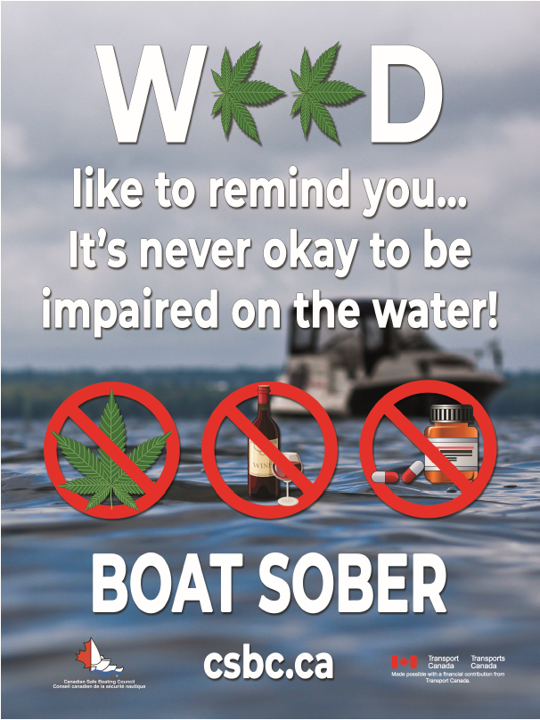
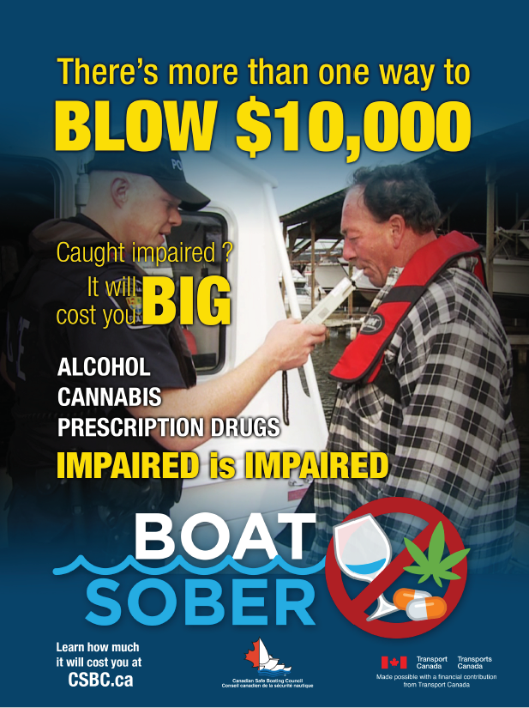
Two new draft ‘Boat Sober’ poster ad concepts were shown to boaters to elicit their reactions, as input to 2019 CSBC Safe Boating campaign development. Each ad was shown separately to one-half of English Canada boaters.

Slide 79
Both of the two new ‘Boat Sober’ poster ad concepts communicate effectively. The “Weed” ad elicits a stronger positive emotional reaction from boaters (more likable, believable, relevant and important message).
The “Blow 10,000” ad more strongly provides new information.
Both ads perform well on key ad effectiveness criteria – intrusiveness; emotional reaction; message relevance, believability and clarity; and persuasion.
Reaction to two new ‘Boat Sober’ poster ad concepts
% of English Canada Boaters (n = 184/186)
I like this ad
Messages in this ad are relevant to me
What this ad is saying is important
Ad tells me something new
Ad would grab my attention
Messages in ad are believable
Ad is confusing
Ad is irritating
After seeing ad, I am less likely to use cannabis before or while boating
46
68






~











34
64
31
53
24
47
63
89
56
84
17
34
26
56
47
73
45
75
3
58
85
45
84
6
12
1
13
7
17
5
18
35
50
32
52
Weed Ad – Strongly Agree
Blow 10,000 Ad – Strongly Agree
Weed Ad – Somewhat Agree
Blow 10,000 Ad – Somewhat Agree
14. Below is an idea for a poster ad. Please take a look at this ad now. How strongly do you agree or disagree that each of the following statements applies to the poster ad you just saw?

Slide 80
The ‘Weed’ ad was liked for its clear, simple message; the ‘Weed’ pun; and its attractive, eye-catching visuals.
The ‘Blow 10,000’ ad was liked for its clear message; and the (new) information provided re: the potential to be fined / arrested.
Likes - % of English Canada Boaters
 | ‘Weed’ Ad (n=184) | ‘Blow 10,000’ Ad (n=186)
Message (Net) | 34 | 27
- Clear / simple/straight forward message | 23 | 15
- Do not drive boat impaired / stay safe | 7 | 7
- Good / important message | 6 | 5
Like the pun / play on words | 18 | 1
Informative / can be fined/arrested | 3 | 16
Like the pictures / images/graphics | 13 | 4
Eye catching / attention drawing | 12 | 6
Examples of substances you can’t use while boating | 8 | 6
Colourful/like the colours | 1 | 4
Catchy / clever title / headline | 3 | 3
Like the logo | <1 | 3
Good / great / like it / love it | 1 | 2
Other | 1 | 8
Nothing | 14 | 14
Don’t Know | 6 | 9
15a. What, if anything, did you particularly like about this poster ad? Please be as specific as possible.

Slide 81
Similarly low levels of Dislikes for both ads.
Dislikes - % of English Canada Boaters
 | ‘Weed’ Ad (n=184) | ‘Blow 10,000’ Ad (n=186)
Dislike pictures /images | 6 | 5
Too busy / confusing | 5 | 5
Message is not clear | 5 | 4
Cheesy / cartoonish / amateur | 5 | 1
Dislike weed leaves / hard to read word “weed” | 4 | -
Should not include prescription drugs / not all prescription drugs are impairing | 3 | 4
Difficult to test for levels of cannabis | - | 4
Would like to see more diversity | 1 | 3
Unattractive / not esthetically pleasing | 2 | 1
Looks made by the government | 1 | 1
Other | 9 | 12
Nothing | 59 | 55
Don’t Know | 9 | 10
15b. What, if anything, did you particularly dislike about this poster ad? Please be as specific as possible.

Slide 82
Appendix

Slide 83
Demographic Profile:
Of note, Boater profile shifts younger in Fall 2018 – more 35-54 yrs and less 55+ yrs. Also average income is up 9% from Fall 2017.
 | TOTAL INTERVIEWS |  |  |  |  |  |  |  | BOATERS
 | 2014 | May 2015 | Aug 2015 | May 2016 | Aug 2017 | May 2018 | Aug 2018 |  | 2014 | May 2015 | Aug 2015 | May 2016 | Aug 2017 | May 2018 | Aug 2018
 | (1005) | (1004) | (1502) | (1000) | (1000) | (1002) | (1000) |  | (395) | (459) | (677) | (417) | (469) | (509) | (445)
Language
English | 79% | 81% | 80% | 79% | 80% | 80% | 80% |  | 79% | 84% | 84% | 81% | 84% | 84% | 83%
French | 21% | 19% | 20% | 21% | 20% | 20% | 20% |  | 21% | 16% | 16% | 19% | 16% | 16% | 17%
Gender
Male | 48% | 49% | 49% | 49% | 49% | 49% | 48% |  | 48% | 56% | 51% | 53% | 55% | 58% | 55%
Female | 52% | 51% | 51% | 51% | 51% | 51% | 52% |  | 52% | 44% | 49% | 47% | 45% | 42% | 45%
Age
18-34 | 28% | 28% | 28% | 28% | 28% | 28% | 28% |  | 33% | 35% | 39% | 37% | 32% | 36% | 38%
35-54 | 37% | 37% | 37% | 37% | 37% | 37% | 37% |  | 39% | 36% | 39% | 35% | 36% | 36% | 41%
55+ | 35% | 35% | 35% | 35% | 35% | 35% | 35% |  | 29% | 29% | 23% | 28% | 32% | 28% | 22%
Region
Atlantic | 7% | 7% | 7% | 7% | 7% | 7% | 7% |  | 7% | 8% | 7% | 7% | 7% | 8% | 8%
Quebec | 24% | 24% | 24% | 24% | 24% | 24% | 24% |  | 23% | 20% | 24% | 22% | 20% | 20% | 20%
Ontario | 38% | 38% | 38% | 38% | 38% | 38% | 38% |  | 39% | 36% | 38% | 38% | 42% | 39% | 42%
Prairies | 17% | 18% | 17% | 18% | 18% | 18% | 17% |  | 17% | 21% | 18% | 18% | 16% | 18% | 16%
BC | 13% | 13% | 13% | 13% | 13% | 13% | 13% |  | 14% | 16% | 13% | 16% | 15% | 14% | 13%
Income - Mean | $64.7M | $61.0M | $55.5M | $64.4M | $59.9M | $61.5M | $64.5M |  | $70.4M | $64.9M | $63.6M | $66.8M | $66.7M | $67.2M | $72.5M
Born in Canada | n/a | n/a | n/a | n/a | 87% | 88% | 88% |  | n/a | n/a | n/a | n/a | 89% | 90% | 91%
Not Born in Canada | n/a | n/a | n/a | n/a | 13% | 12% | 12% |  | n/a | n/a | n/a | n/a | 11% | 10% | 9%
& = significantly different from previous wave at 95% confidence level

Slide 84
Demographic Profile: Boaters continue to skew male, younger (even moreso in 2018) and towards higher income. New Boaters skew even younger and even more male. Compared to New Boaters, Interested Non-Boaters are more female, older, and may be held back by lower disposable income.
 | AUG 2018
 | Total Interviews | Interested Non-boaters | Boaters | New Boaters
 | (1000) | (262) | (445) | (129)
Language
English | 80% | 76% | 83% | 79%
French | 20% | 24% | 17% | 21%
Gender
Male | 48% | 45% | 55% | 65%
Female | 52% | 55% | 45% | 35%
Age
18-34 | 28% | 30% | 38% | 59%
35-54 | 37% | 43% | 41% | 33%
55+ | 35% | 28% | 22% | 8%
Region
Atlantic | 7% | 8% | 8% | 8%
Quebec | 24% | 30% | 20% | 28%
Ontario | 38% | 32% | 42% | 36%
Prairies | 17% | 19% | 16% | 16%
BC | 13% | 12% | 14% | 13%
Income - Mean | $64.5M | $56.4M | $72.5M | $70.2M
Born in Canada | 88% | 84% | 91% | 86%
Not Born in Canada | 12% | 16% | 9% | 14%
& = significantly different from Total

Slide 85
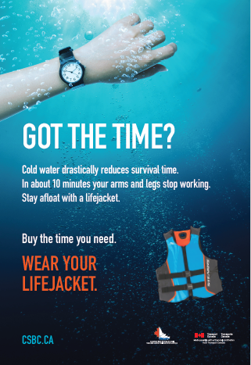
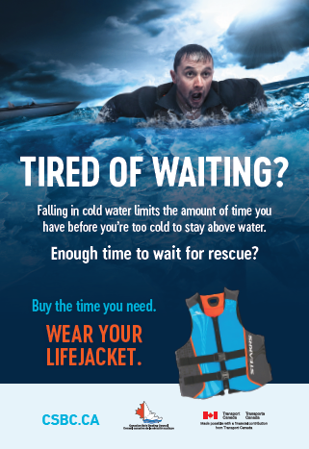
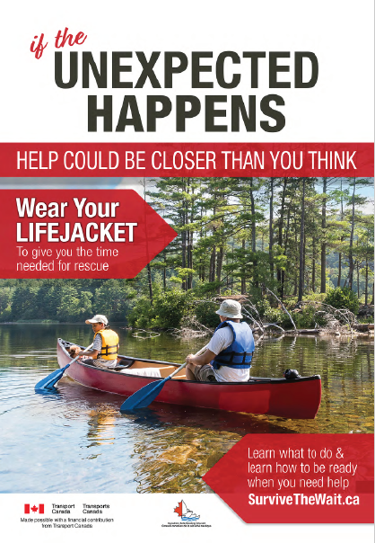
Q9: CSBC “Got the Time”, “Tired of Waiting” and “Unexpected Happens” English ads / posters

Slide 86
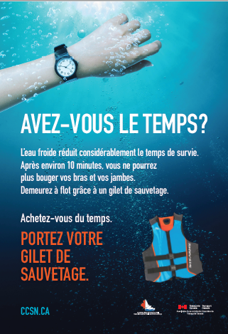


Q9: CSBC “Avez-vous le temps”, “Fatigué d’attendre” and “d’imprévu” French ads / posters

Slide 87
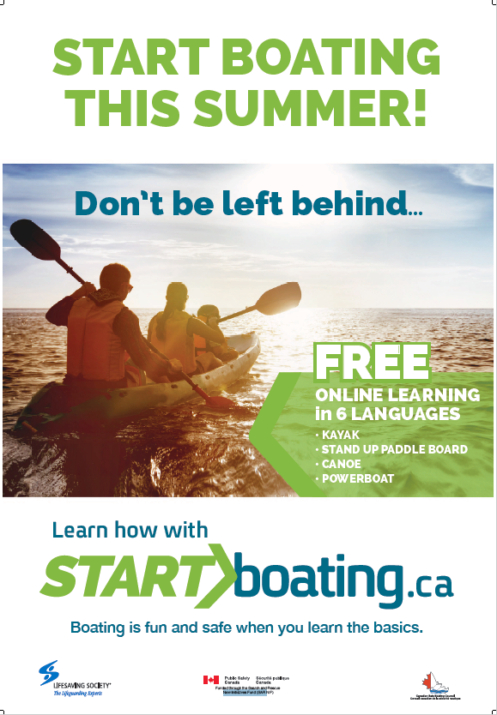
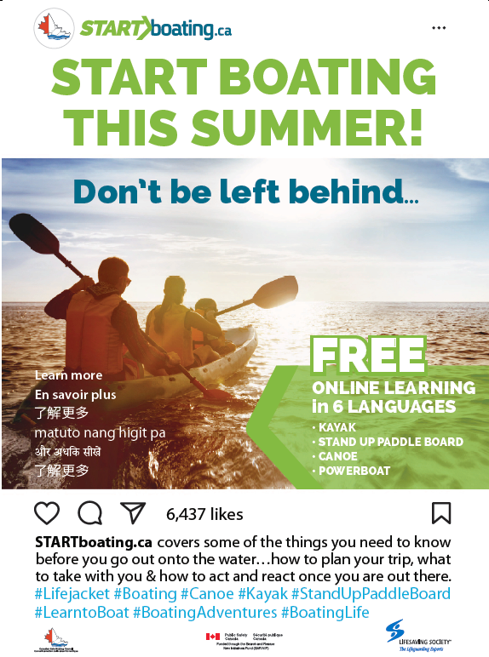
Q11a&b: CSBC “Start Boating This Summer”
English ads / posters

Slide 88


Q11a&b: CSBC “Partez en bateau cet été”
French ads / posters

Slide 89
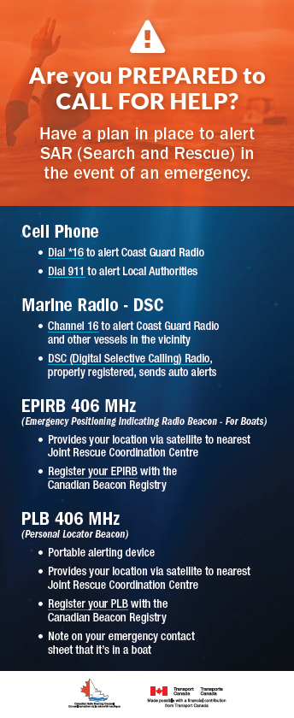
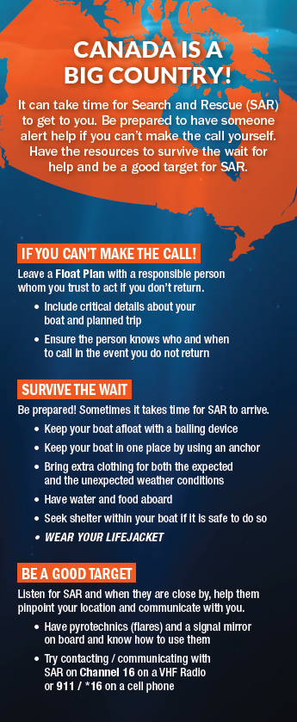
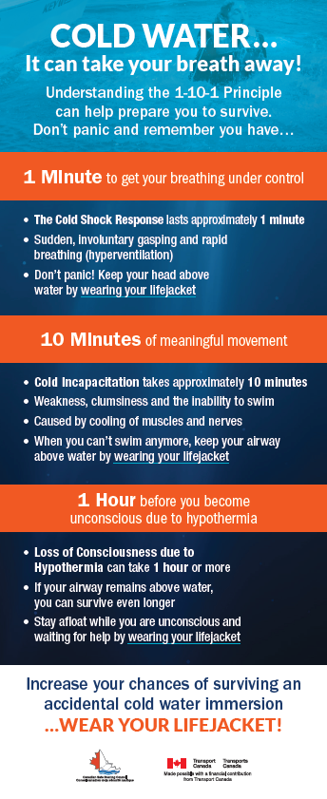
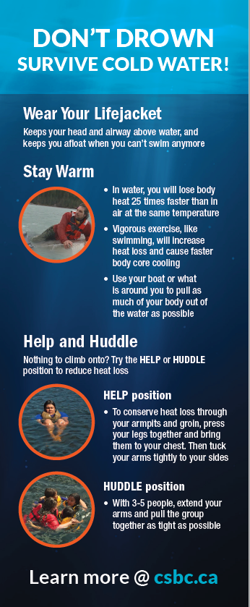
Q12a&b: CSBC English boating safety cards (4)

Slide 90
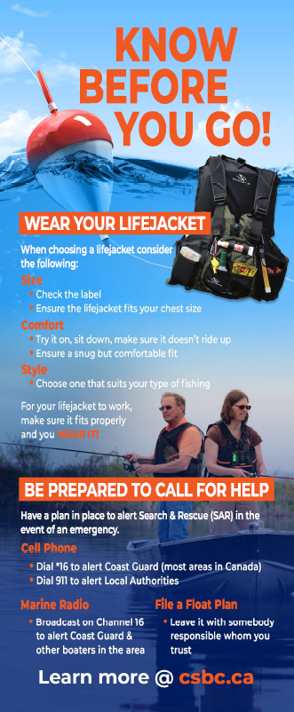
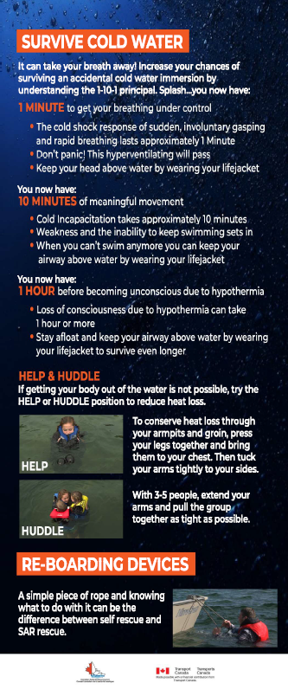
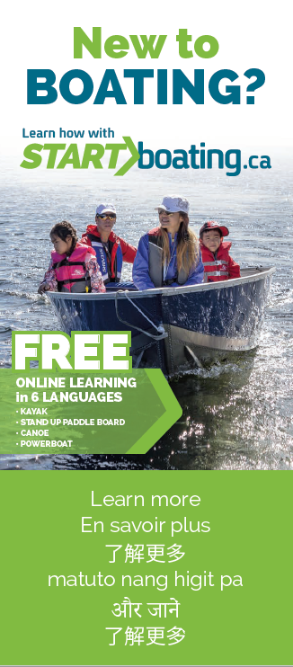
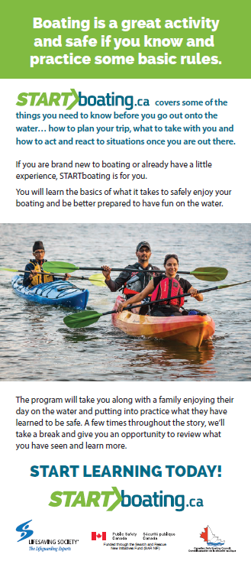
Q12a&b: CSBC English boating safety cards (4) (cont’d)

Slide 91
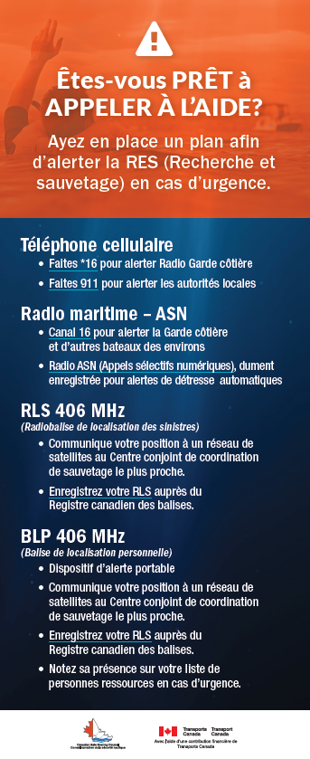
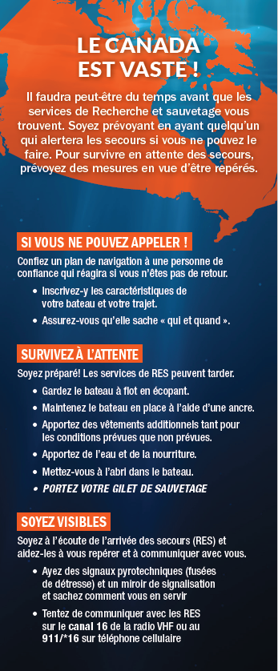
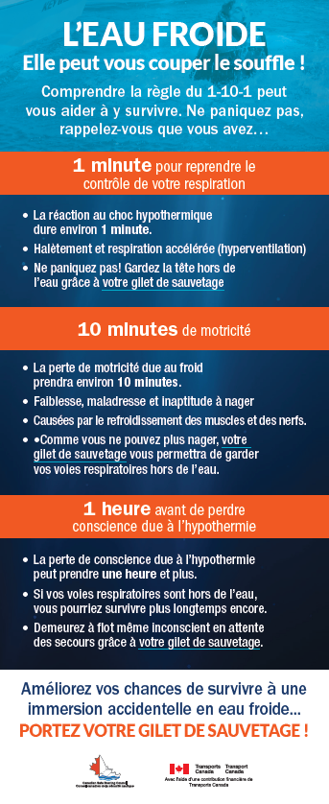
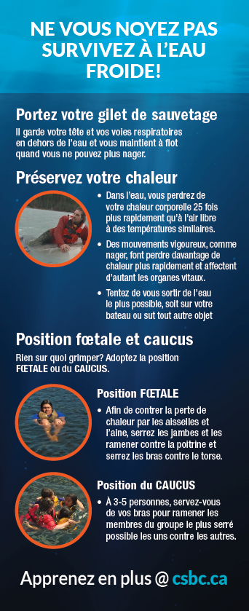
Q12a&b: CSBC French boating safety cards (4)

Slide 92

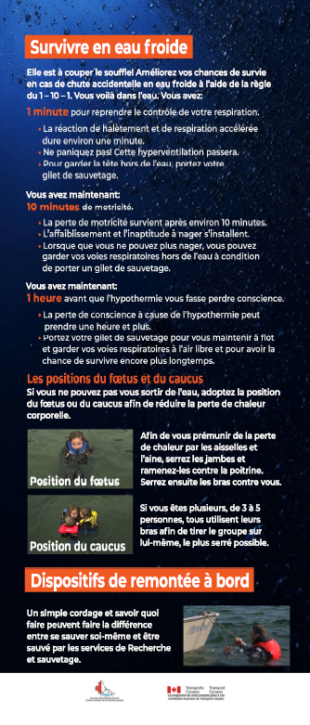

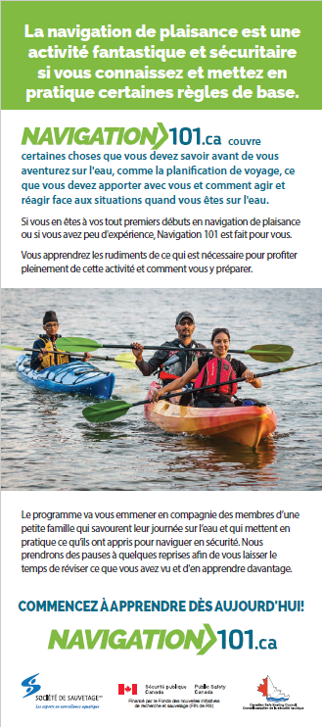
Q12a&b: CSBC French boating safety cards (4) (cont’d)

Slide 93
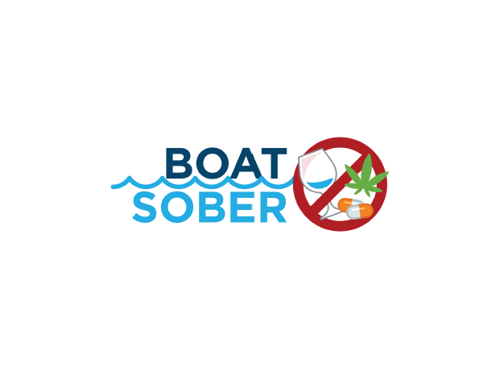

Q13b,c&d: CSBC ‘Boat Sober’ Slogan & logo
– English and French

Slide 94
Q14 & 15a,b: CSBC ‘Boat Sober’ Ad Concepts – English only

Slide 95
No changes to CSBC messages tracked – same in Fall 2018 as for Spring 2018 and Fall 2017.
Aug 2018, May 2018, Aug 2017: | May 2016 & Aug 2015: | May 2015: | 2014: | 2013 & earlier:
Don’t drink alcoholic beverages if you are operating a boat. Call 911 to report and help catch impaired boaters [EN] / One drink can change everything. Boat responsibly [FR] Impaired boating is impaired driving. The laws for impaired driving of an automobile also apply to impaired operation of a boat. | Don’t drink alcoholic beverages if you are operating a boat. Call 911 to report and help catch impaired boaters [EN] / One drink can change everything. Boat responsibly [FR] Impaired boating is impaired driving. The laws for impaired driving of an automobile also apply to impaired operation of a boat. | Don’t drink alcoholic beverages if you are operating a boat. More people are calling 911 to report and help catch impaired boaters. -- | Don’t drink alcoholic beverages if you are operating a boat. Call 911 to report and help catch impaired boaters. Leave the beer on the pier. | Don’t drink alcoholic beverages while boating… it’s that simple. If you drink, don’t drive.
Wear your lifejacket. Don’t just carry it on your boat. | Wear your lifejacket. Don’t just carry it on your boat. | Wear your lifejacket. Don’t just carry it on your boat. | Wear your lifejacket. Don’t just carry it on your boat. | Make the smart choice. Don’t just carry your lifejacket aboard your boat. Wear it.
Everyone operating a motorized boat needs to get their “boating license” (i.e. “Pleasure Craft Operator Card”). | Everyone operating a motorized boat needs to get their “boating license” (i.e. “Pleasure Craft Operator Card”). | Everyone operating a motorized boat needs to get their “boating license” (i.e. “Pleasure Craft Operator Card”). | Everyone operating a motorized boat needs to get their “boating license” (i.e. “Pleasure Craft Operator Card”). | Everyone operating a motorized boat or water craft should get their Pleasure Craft Operator Card.
Check the weather before you go and while out boating. Anticipate changing or unsuitable weather and wave conditions. | Check the weather before you go and while out boating. Anticipate changing or unsuitable weather and wave conditions. | Check the weather before you go and while out boating. Anticipate changing or unsuitable weather and wave conditions. | Check the weather before you go and while out boating. Anticipate changing or unsuitable weather and wave conditions. | Watch the weather while out boating… keep a weather eye out.
Have the right safety equipment on board your boat to be prepared. | Have the right safety equipment on board your boat to be prepared. | Have the right safety equipment on board your boat to be prepared. | Have the right safety equipment on board your boat to be prepared. -- | Have the right safety equipment on board your boat… have a flare for rescue. Review your checklist before you go out on the water. Be prepared.
If you fall into cold water and are already wearing your lifejacket, you’ll have a better chance to survive. Your first reaction when you fall unexpectedly into cold water is a deep gasp. Wearing a lifejacket keeps your head above water to avoid inhaling water and drowning. | If you fall into cold water and are already wearing your lifejacket, you’ll have a better chance to survive. Your first reaction when you fall unexpectedly into cold water is a deep gasp. Wearing a lifejacket keeps your head above water to avoid inhaling water and drowning. | If you fall into cold water and are already wearing your lifejacket, you’ll have a better chance to survive. Your first reaction when you fall unexpectedly into cold water is a deep gasp. Wearing a lifejacket keeps your head above water to avoid inhaling water and drowning. | If you fall into cold water and are already wearing your lifejacket, you’ll have a better chance to survive. -- | If you wear your lifejacket before falling into cold water you’ll float and have a chance to survive. Be prepared for the possibility of falling into cold water by wearing your lifejacket.
Take a boating course to become a more knowledgeable boater. | Take a boating course to become a more knowledgeable boater. | Take a boating course to become a more knowledgeable boater. | Take a boating course to become a more knowledgeable boater. | The more knowledge you have, the more enjoyable boating becomes.
If you’re hooked on fishing, maybe its time to get your kids hooked on wearing lifejackets too! - - | If you’re hooked on fishing, maybe it’s time to get hooked on wearing your lifejacket too. If you fish, it is great to get your kids hooked on fishing. Get them wearing their lifejackets so they’re hooked on lifejackets too.
4. Which of the following boating safety messages have you seen or heard during the last few months? (eg. on TV, radio, in newspapers, magazines, on-line, etc.)

Slide 96
No changes to safe boating attitudes / behaviours – same in Fall 2018 as for May 2018, Aug 2017 & May 2016.
Aug 2018, May 2018, Aug 2017, May 2016: | Aug 2015: | May 2015: | 2014: | 2013 & earlier:
Drinking & boating: I am not going to drink any alcoholic beverages while operating a boat. I am not going to operate a boat after I have consumed alcoholic beverages. I am going to call 9-1-1 to report an impaired boater if I see one. | Drinking & boating: I am not going to drink any alcoholic beverages while operating a boat this season. I am not going to operate a boat after I have consumed alcoholic beverages this season. I am going to call 9-1-1 to report an impaired boater if I see one. | Drinking & boating: I am not going to drink any alcoholic beverages while operating a boat this season. I am not going to operate a boat after I have consumed alcoholic beverages this season. I am going to call 9-1-1 to report an impaired boater if I see one. | Drinking & boating: Same I think there should be more law enforcement spot checks out on the water to check for “drinking & driving” boaters. | I am not going to drink any alcoholic beverages while out on the water in a boat this season. Same
Wearing your Lifejacket: I will wear my lifejacket all the time when I’m out on the water in a boat. I am going to strongly encourage everyone else who is out in a boat with me to wear their lifejacket. - - | Wearing your Lifejacket: I will wear my lifejacket all the time when I’m out on the water in a boat this season. I am going to strongly encourage everyone else who is out in a boat with me this season to wear their lifejacket. I’m going to wear an inflatable lifejacket when I’m out on the water in a boat this season. | Wearing your Lifejacket: I will wear my lifejacket all the time when I’m out on the water in a boat this season. I am going to strongly encourage everyone else who is out in a boat with me this season to wear their lifejacket. I’m going to wear an inflatable lifejacket when I’m out on the water in a boat this season. | Wearing your Lifejacket: Same. Same. Same. | Same Same Same
Preparedness: I will always check my boat over every time before I go out on the water; including making sure I have enough lifejackets on board I’m going to mentally run through a pre-departure checklist, every time I go out on the water. | Preparedness: I will always check my boat over every time before I go out on the water this season; including making sure I have enough lifejackets on board I’m going to mentally run through a pre-departure checklist, every time I go out on the water this season. | Preparedness: I will always check my boat over every time before I go out on the water this season; including making sure I have enough lifejackets on board I’m going to mentally run through a pre-departure checklist, every time I go out on the water this season. | Preparedness: Same. Same. | Same I’m going to review my pre-departure checklist, every time I go out on the water this season.
Cold water: I’m going to make a point of being better prepared for the possibility of falling into cold water, by wearing my lifejacket | Cold water: I’m going to make a point of being better prepared for the possibility of falling into cold water this season, by wearing my lifejacket | Cold water: I’m going to make a point of being better prepared for the possibility of falling into cold water this season, by wearing my lifejacket -- | Cold water: Same I don’t worry about the temperature of the water, as I don’t boat during what I consider to be the cold water season. | Same Same
Boating education: I already have my “boating license” (ie. Pleasure Craft Operator Card). I don’t have my “boating license” (Pleasure Craft Operator Card) yet, but I’m going to get it. I have already taken a boating course or training beyond the “boating license” (PCOC) level. I’m going to make a point of getting more information, or taking a boating course to become a more knowledgeable boater. | Boating education: I already have my “boating license” (ie. Pleasure Craft Operator Card). I don’t have my “boating license” (Pleasure Craft Operator Card) yet, but I’m going to get it this year. I have already taken a boating course or training beyond the “boating license” (PCOC) level. I’m going to make a point of getting more information, or taking a boating course to become a more knowledgeable boater. | Boating education: I already have my “boating license” (ie. Pleasure Craft Operator Card). I don’t have my “boating license” (Pleasure Craft Operator Card) yet, but I’m going to get it this year. I have already taken a boating course or training beyond the “boating license” (PCOC) level. I’m going to make a point of getting more information, or taking a boating course to become a more knowledgeable boater. | Boating education: Same. Same. Same. Same. | I already have my Pleasure Craft Operator Card. I don’t have my Pleasure Craft Operator Card yet, but I’m going to get it this year. I have already taken boating safety education or training beyond the Pleasure Craft Operator Card level I’m going to make a point of getting more information, or taking a course, to learn more about how to boat safely.
7. Please indicate how much you agree or disagree that each of these statements applies to you, ie. describes things you are doing or intend to do this year (on a scale from 1[Strongly disagree] to 10[Strongly agree])

