Slide 1
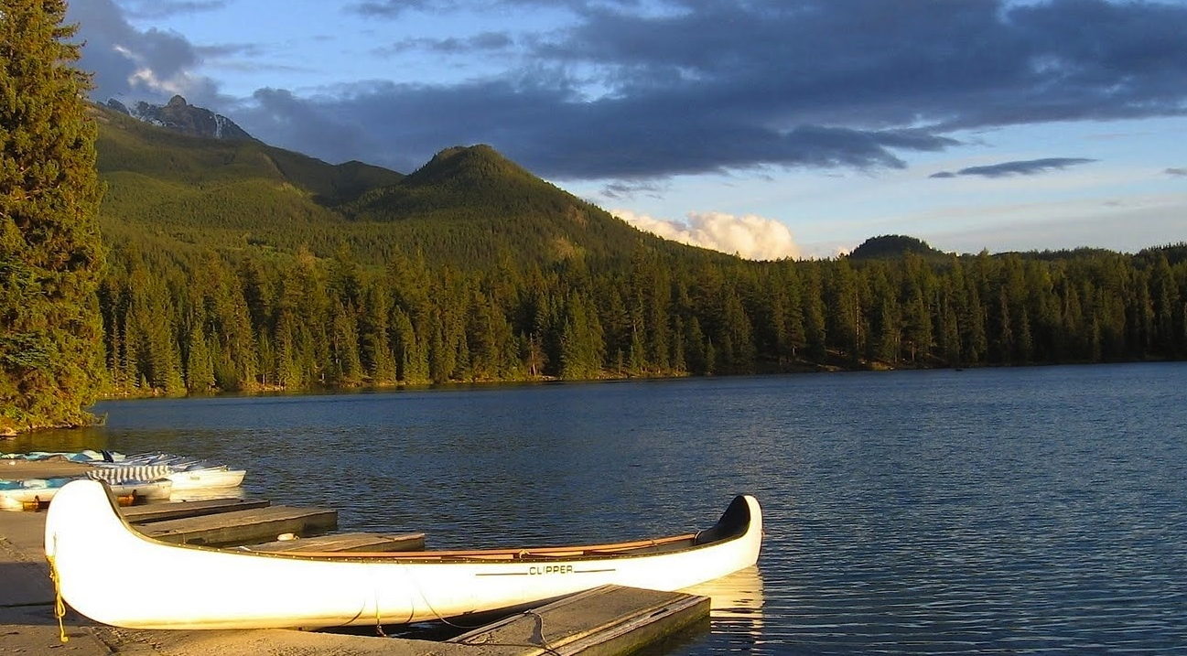


Canadian Safe Boating Council
Boating Safety Outreach
Qualitative Research Report
May 29, 2014
Prepared by
Prepared for

Slide 2

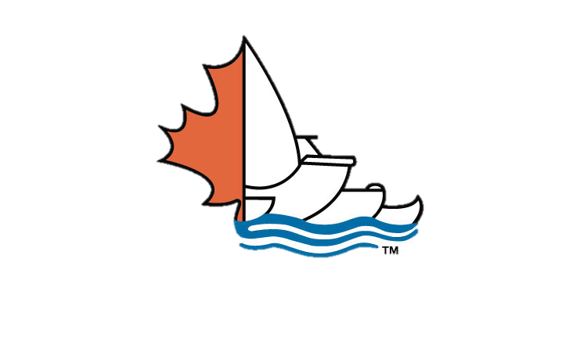
Table of Contents
Page
Research Objectives | 3
Methodology | 4
Executive Summary Detailed Learning Answers to our Burning Questions | 5 10
What are the driving insights about men and boating safety barriers? What are the more motivating messages to change behaviour? What lessons can be derived from men’s reactions to existing safety ads? | 11 26 39
Communications Opportunities Moving Forward | 47

Slide 3
Objectives
Core Research Objective
To investigate and better understand barriers, motivators and high potential opportunities to substantively improve safe boating behaviours among Canadian boaters.
Qualitative Area of Focus
Qualitative research focuses on:
  Finding new, more impactful ways to encourage boaters:
    to wear lifejackets
    NOT to drink and operate a boat
  Finding fresh, new, motivating triggers and touch points for messaging
  Identifying the highest potential communications/behavioural change initiatives.
Action Plan
Stakeholder consultation sessions will be held by CSBC / McCullough Associates to share highlights from the Qualitative Consumer Research and to solicit further input on barriers, motivators and new ways to change boater behaviours. (June 2014)
Insights from the qualitative phase will be tested and validated in the quantitative research phase. (August – September 2014)
  Note: Observations are based on qualitative research with a small number of respondents. Therefore, these findings should be viewed as directional, rather than conclusive.

Slide 4
Methodology
Research Methodology
  Two-hour Focus Groups, with 6 consumers in each.
  Seven focus groups were conducted across Canada as follows:
    Ontario (Toronto/GTA ) – 3 groups
      2 groups of recreational boaters (General Consumer Profile, below)
      1 group who are recreational boaters but who believe there are circumstances when drinking & driving a car and boat are acceptable (termed Risk Takers). Four of six participants did not have children.
    West (Greater Vancouver) - 2 groups of Recreational Boaters
    Quebec (Greater Montreal French) – 2 groups of Recreational Boaters
  General Consumer Profile of Recreational Boaters:
Verbatim codes:
Toronto = T
Montreal = M
Vancouver = V
Risk Takers = RT
Kids = K
No Kids = NK
Males, 25-45 years: one group of Dads with children between 3 and 15 yrs. living at home with them, and one group of men without children living at home with them, in each city.
They participate in recreational boating activities: small craft pleasure power boaters, recreational fishermen, casual canoeists. Included in the mix will be some who participate in sports–oriented boating e.g. with personal watercraft, waterskiing.
Have a variety of attitudes toward drinking and boating, with at least half in each group saying they have done it personally or have been in a boat driven by someone who had been drinking
Have a variety of PFD-wearing habits: never wear, sometimes wear but excluding those who always wear
At least some in each group also participate in other activities where safety behaviour/equipment is relevant i.e. alpine skiing, snowboarding, biking.

Slide 5
Executive Summary:
Drivers of Boating Behaviors
& Opportunities

Slide 6
Driver: Control
Barrier Insight:
Behavioural Evidence:
Implications to Safety:
Appealing Messages:
Motivators:
Communication Opportunity:
I am in control
I am a
good driver
I am a good
swimmer
I don’t drink too much to be able to drive a boat safely
There’s nothing
to hit
I am not at risk
Life Jacket
Drinking
“I can see the shore. I could swim to it if I needed to.” – VK
“Beer and wine won’t knock you out – not like hard liquor. You know your limits with beer.” – MK
L3. The “shock effect” is worse in cold water
  D3. You could kill yourself or someone you care about if you operate a boat after drinking, because… Your balance, reaction time, ability to navigate the boat, make decisions and exercise judgment are compromised with the effects of alcohol. This is exacerbated by the effects of sun, wind, waves…
L9. Being a good swimmer will not save you from the effects of cold water
Being safe is not being weak.
Drinking on the water is different than drinking on land. There are different risks on the water, that you can’t control.
You’re in control until you’re not: Water Wins.

Slide 7
Driver: Freedom
Barrier Insight:
Behavioural Evidence:
Implications to Safety:
Appealing Messages:
Motivators:
Communication Opportunity:
I define free time as freedom from rules
I DO play safe when kids are around…
I do get ‘away with’ a lot more while on vacation
I drink while driving a boat even though I don’t when driving a car
Rules bring me down
Drinking
“I won't get caught. The OPP doesn't patrol smaller lakes.” – TNK
“I know you are not suppose to, but I have never been stopped.” - VNK
D8. The legal consequences of drinking and driving your boat will also be applied to driving your car
D12. Enforcement & the risk of getting caught is increasing
D7. Impaired boating IS impaired driving.
There are actually boating and drinking rules that can affect you personally.
It’s drinking and driving that’s the issue, whatever you are driving. That is the law.

Slide 8
Driver: Guy Bonding
Barrier Insight:
Behavioural Evidence:
Implications to Safety:
Appealing Messages:
Motivators:
Communication Opportunity:
I don’t want to be the odd man out
We would razz a friend for wearing a dorky life jacket
We’re all less responsible when we’re together – that’s just what we do!
We think it’s hilarious when someone falls in the water
Being safe will not make you popular
Life Jacket
Drinking
“You don't want to seem like a 'wuss' with your friends.” – TNK
“Boating is a social activity, drinking is a social activity. They go hand in hand. It’s just the way it is.” – VK
“It conflicts with my manhood.” – TK
  D4. If you do kill someone, you will have to live with the pain/guilt of knowing you killed someone you love
  D1. You greatly increase the chances of killing someone you care about, if you operate a boat after drinking
If one guy goes missing, the group will never be the same.
Good buddies look after each other – so the fun can go on.

Slide 9
Driver: Relaxation
Barrier Insight:
Behavioural Evidence:
Implications to Safety:
Appealing Messages:
Motivators:
Communication Opportunity:
I have the right to relax
I don’t wear a lifejacket because it’s too hot and restrictive
I don’t want
tan lines
I use my life- jacket as a seat cushion
I like a cold beer on a sunny day
My comfort on any day trumps an accident that will never happen
Life Jacket
Drinking
“They are uncomfortable. You perspire. They are bulky. It’s a bother.” - TK
“Fishing is boring without beer.” – VK
  L13. An inflatable lifejacket is light and comfortable – an easy way to get the protection of a lifejacket without the bulkiness/lack of comfort of traditional lifejackets, that does not interfere at all with your on-the-water activities.
  L14. Modern “kayaking style” lifejackets, designed for ease of paddling while wearing them, are as comfortable to wear as a vest .
Being safe can make you feel more relaxed.
You can be comfortable and safer at the same time.
Lifejackets aren’t what they used to be.

Slide 10
Detailed Learning

Slide 11
  What are the driving insights about men and water safety barriers?

Slide 12
Driving insights about Men & Boating Safety Barriers
1.
I am in Control
I grew up fishing with my Dad/family.
I’ve been driving a boat since I was a kid.
The lake is calm.
It’s a beautiful day.
I am in the open water – there’s nothing to hit and lots of time to react.
Experience
Perceived Risk
I limit myself to a couple of drinks. I don’t drive the boat when I’m wasted.
I have life jackets on board if we need them.
Dimensions of Control
Responsibility
Consequence
Worst case scenario – someone gets wet.
I am a strong swimmer.
I am a good driver.
Skill

Slide 13
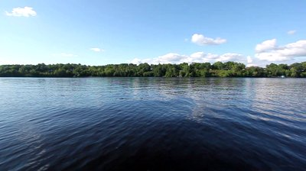
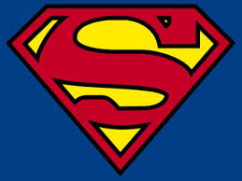
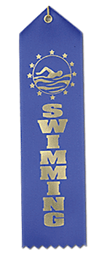
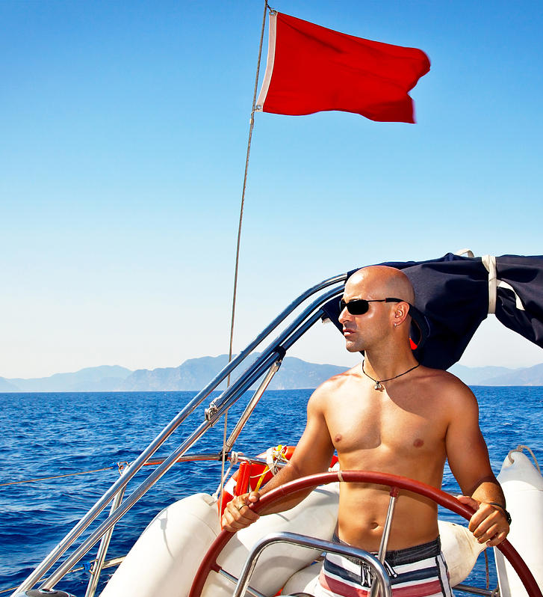
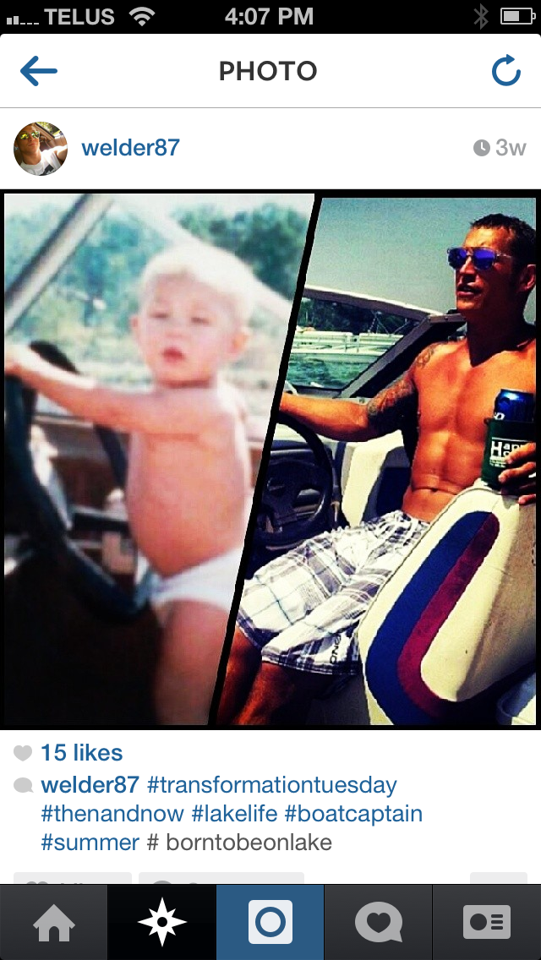
Driving insights about Men & Boating Safety Barriers
1.
I am in Control
“Superman syndrome -- You feel like you are indestructible. I felt like that a lot in my life: drinking and boating, drinking and driving, fighting when you are younger…it might even increase as you get older. You are getting weaker and in your head it increases a bit more, to counter that.” – TRT
“Less vigilance required with a quiet ride around the lake.” – MK
“It’s okay if the driver doesn't drink too much. In moderation it is low risk. Nothing will go wrong.” – VK
0
“It is highly unlikely that you get into trouble in a boat. No one is going to smack into you. You can see them coming.” – VNK

Slide 14
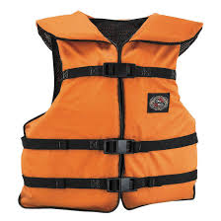
I am in Control
Implications on Safety
They have an inflated sense of security.
They can’t picture anything bad happening within such a serene environment.
They feel safe simply having the lifejacket in the boat.
They feel comfortable in their boat and on the water.
“There’s a low probability of needing it.” – VNK
They believe they are better off without a life jacket.
In their eyes, life jackets are for floating, not swimming. They plan to swim back to shore should they run into trouble – a lifejacket would just get in the way.
“I can swim better without the lifejacket than with the life jacket. If I fall into the water I am going to swim to the shore.” – TRT
They think life jackets are for children and people that don’t know how to swim.
“If you can’t swim, wear a life jacket. It is the smart thing to do.” – TRT
They’re more concerned about safety when doing ‘extreme’ sports.
They see the need to wear a lifejacket behind a boat, not in it, e.g. wakeboarding, waterskiing. Then the likelihood of a hard fall and/or hitting their head is high.
Only some wear a helmet on the ski hill, to defend against other (erratic) people hitting them.
“The lake is calm, it’s like glass. It is overkill -- like wearing a helmet when watching a hockey game.” – VK

Slide 15
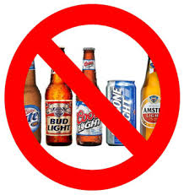
I am in Control
Implications on Safety
There’s nothing in the middle of their lake that shakes
their confidence and control.
There’s nothing to bump into.
They have a long reaction time and therefore a wide margin of error.
They’re going slowly or can modify their speed (or drive more slowly if really drunk).
They are in a sturdy boat.
“I justify it as, when you are in civilization the blood/alcohol level applies, but when you are in the middle of nowhere, that is okay.” – VK
“There’s less risk in the boat than in the car. It’s not a big deal if you drive crooked.” – MNK
They believe they have the required focus to operate a boat even when they’ve had a few beers.
They believe a boat requires less attention than driving a car:
There’s no traffic to contend with.
They don’t have to watch out for pedestrians.
They don’t have to drive in a straight line (they’re not restricted to a lane).
“One false move in a car and – boom! On the water there is not much to hit. Boating seems less dangerous – water seems less dangerous than cement.”– TRT

Slide 16
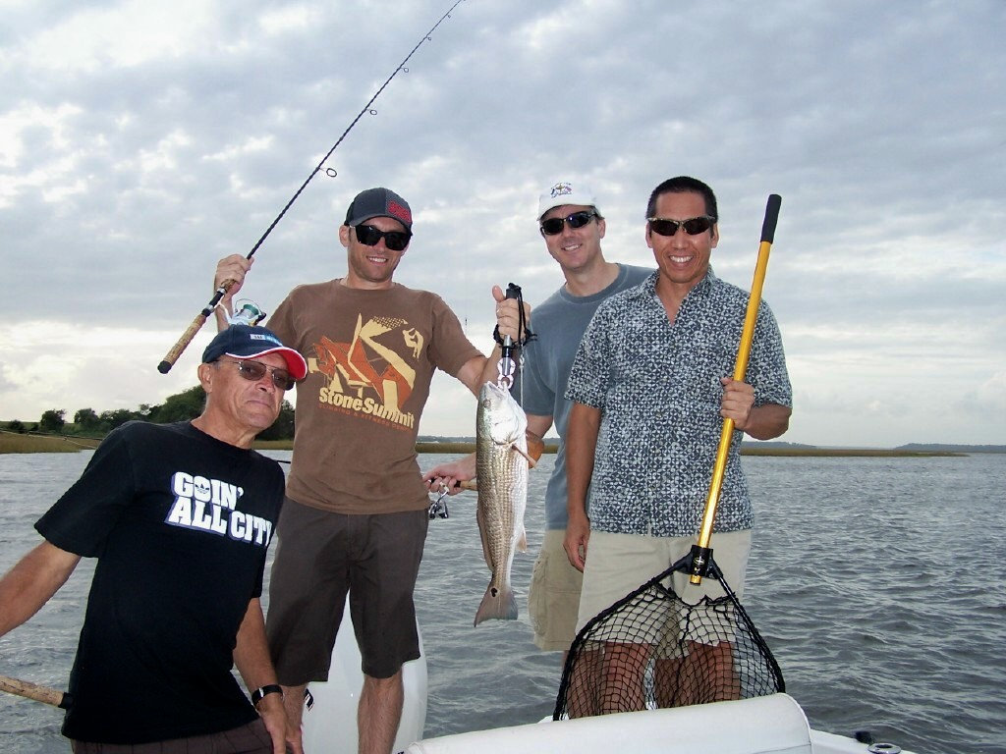
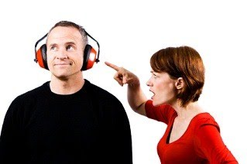
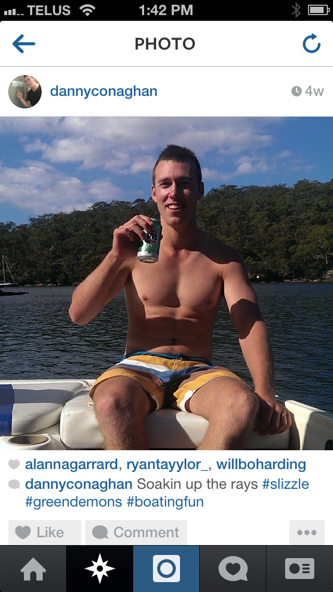
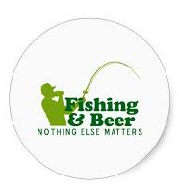
Driving insights about Men & Boating Safety Barriers, cont’d
2.
I define free time as freedom from rules
“If they want compliance, be reasonable. If not, people will put their heads in the sand.” – TNK
“Cars are stressful. Driving is stressful. It’s pressure and stress all the time. Boating is fun.” – TRT
“It pisses my wife off (that I don't wear it). It makes her mad sometimes. I like to be rebellious sometimes. You are going to be bitched at anyway. Pay the price, might as well commit the crime.” – VK
“When they (kids) aren’t around you do what you want, when they are around you have people to answer to that will bust your balls (aunts, uncles, grandparents, guardians, etc.).” – TRT

Slide 17
I define free time as freedom from rules
Implications on Safety
They push back on rules they don’t feel are necessary.
They don’t want to bother with a lifejacket when it’s highly unlikely they’ll need it.
They don’t want to wear a lifejacket when they know how to swim.
“It ties in with my personal belief that when driving and talking on the phone, holding the phone, I don't feel I am distracted. I don't text, but I feel I am okay with talking.” – VK
They don’t feel compelled to set a good example when the kids aren’t around.
Adults can fend for themselves.
Hanging with the guys allows them to tap into their ‘less responsible’ side.
“If all adults, we make the decision to do it. We’re living within our own standards and rules.” – VK

Slide 18
I define free time as freedom from rules
Implications on Safety
It doesn’t feel wrong to drink and operate a boat.
Everyone is doing it.
They’ve never been caught - it’s not highly monitored by the police.
They believe the police would only really care if you’re totally inebriated.
“Providing you are keeping a low profile and keeping to yourself, I think the Law Enforcement would just give you a warning.” – VK
They think it’s okay to drink because they’re just floating around.
They don’t consider it drinking & driving if they spend a few hours stationary (as they fish). It’s akin to drinking on the dock.
“You are not moving in a boat when fishing. The boat is not moving.” – VK
They strategize on how to have booze on board without getting in trouble.
They come up with tips and tricks to avoid getting caught.
They buy bottles so they can drop them overboard (if need be).
They fill empty bottles with water to give the appearance that they haven’t been touched.
“You can drop bottles in the lake. And you’re always moving, so it’s hard for others to notice you are not driving straight.” – MNK

Slide 19
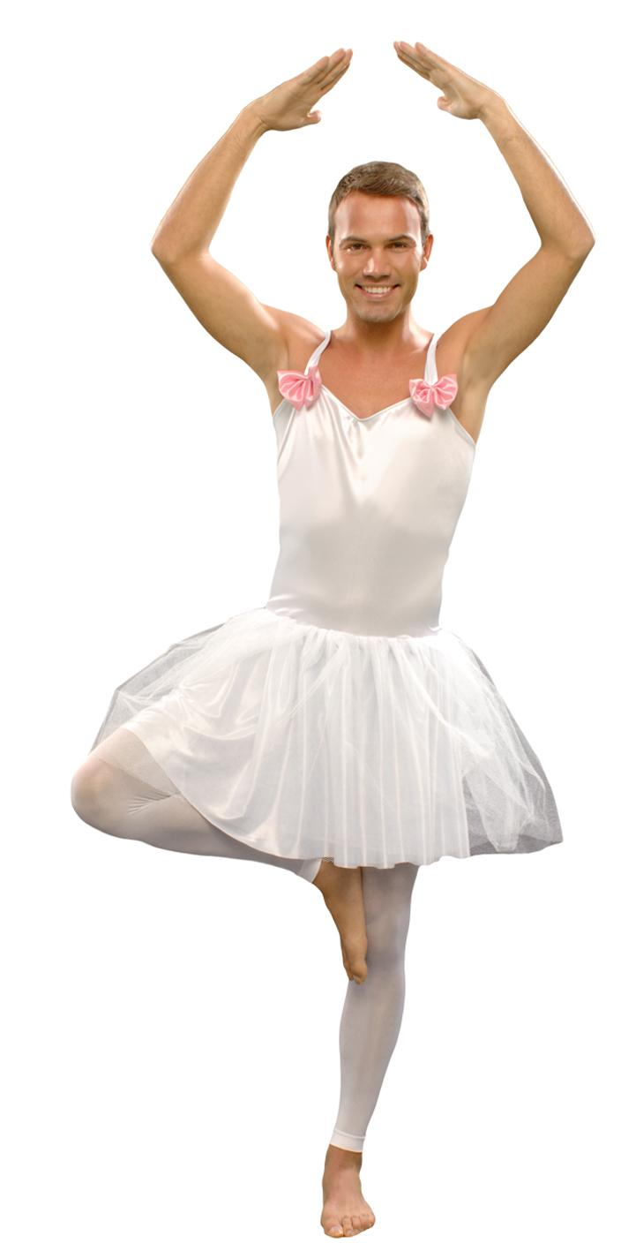
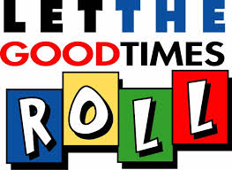
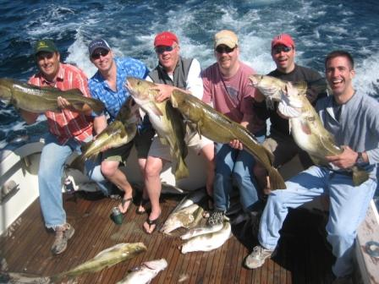

Driving insights about Men & Boating Safety Barriers, cont’d
3.
I don’t want to be the odd man out
“You don't want to be seen as the weird one (wearing a lifejacket).” – TNK
“You don’t want to look like an amateur. You want to look tough…like a guy who knows what he’s doing.” – MK
“No one wants to be the person that doesn’t drink. “ – TRT
“I have a list of stories that could have gone wrong, but I still do it. I know why it is wrong, but we do it anyway, why is that?” – VK

Slide 20
I don’t want to be the odd man out
Implications on Safety
They don’t want to be the only guy wearing a life jacket.
Their friends aren’t going to wear one.
They will get laughed at.
“It’s not the social norm, you would be the only one.
You’d be standing out in a bad way.” – VK
Wearing a lifejacket is a sign of weakness.
It implies you can’t swim.
It implies you’re worried about falling in the water.
It suggests you’re not comfortable on a boat.
“They’re going to think you`re the guy who is going to be scared to get wet.” – MNK
“It says 'I don't know how to swim‘ (and I do!). – VNK
Wearing a lifejacket erodes their self-confidence.
They feel like a child wearing a safety floating device.
The bright colours draw (unwanted) attention.
They feel ridiculous squeezing into a lifejacket – it’s never the right fit.
It’s not cool.

Slide 21
I don’t want to be the odd man out
Implications on Safety
They let their guard down when they’re hanging out with friends.
They are eager to forget about the stress and pressure of work, bills, deadlines, etc.
They tap into their less responsible selves.
They don’t have their wife/girlfriend nagging at them to obey the rules.
They get to step away from their ‘Daddy’ responsibilities.
“You drink with your spouse, girlfriend, buddy NOT with your kids. You need to take care of them. I may not notice one has fallen off the back.” – MK
They flex their boundaries and limitations for the sake of having a good time.
They do things they know are dangerous (overcrowded boat, driving drunk, etc.).
The thrive on the feeling of invincibility.
“Ever since I`ve been young, I`ve associated beer with boating, it`s a part of it.” – MNK
“When you are in a boat, you are swept-up in the situation.” – VK

Slide 22
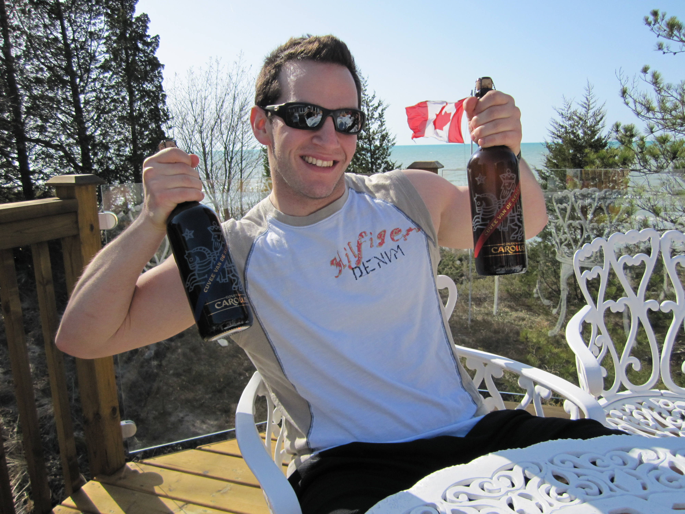
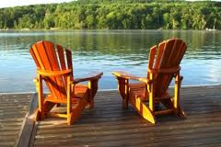
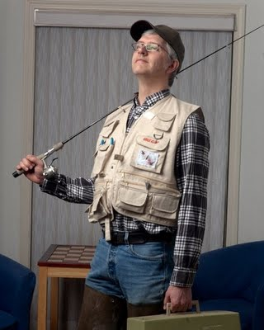
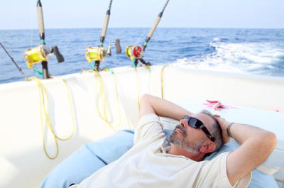
Driving insights about Men & Boating Safety Barriers, cont’d
4.
I have the right to relax
“That is what cottage life is all about.” – TNK
“Starting the weekend, that first beer, god damn, is so good.” – MNK
“If I am at the beach, and we decide to go out in the boat, I don't want to go up to the cottage and get a
lifejacket. That takes a plan.” – TNK

Slide 23
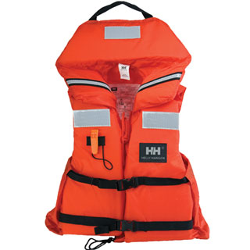
I have the right to relax
Implications on Safety
They resist wearing a lifejacket because it makes them uncomfortable.
They get too hot – it’s like wearing a winter vest on a summer day.
They smell bad.
They don’t fit properly (wrong size).
Traditional life jackets were: uncomfortable
bulky
cumbersome
awkward
Heavy
irritating
too damn hot
wet
mouldy
sticky
smelly
“They are wet and soggy when you arrive at the boat.” – TNK
“You want to feel the sun on your skin.” – MNK
They forgo a lifejacket if it requires too much effort.
They don’t want to hunt for a lifejacket or go too far to get one if it’s not already in the boat.
Sometimes they just want to jump in the boat and go (spontaneity).
They have it onboard, but use it as a pillow or seat cushion.
They’re looking to maximize comfort while obeying the law.

Slide 24
I have the right to relax
Implications on Safety
Drinking is intrinsically tied to relaxation, and boating.
The cottage is all about ‘good times’.
They enjoy a cold beer on a hot summer day, wherever they are.
The boat feels like the perfect spot to enjoy a drink or two with friends – it’s what we do.
“If my lifejacket had a place for a beer, I might wear one!” - TNK
“You take the cooler with you in the boat. It is hot, you are on vacation, you’re looking to kick back – and this mostly includes drinking.” - VK

Slide 25
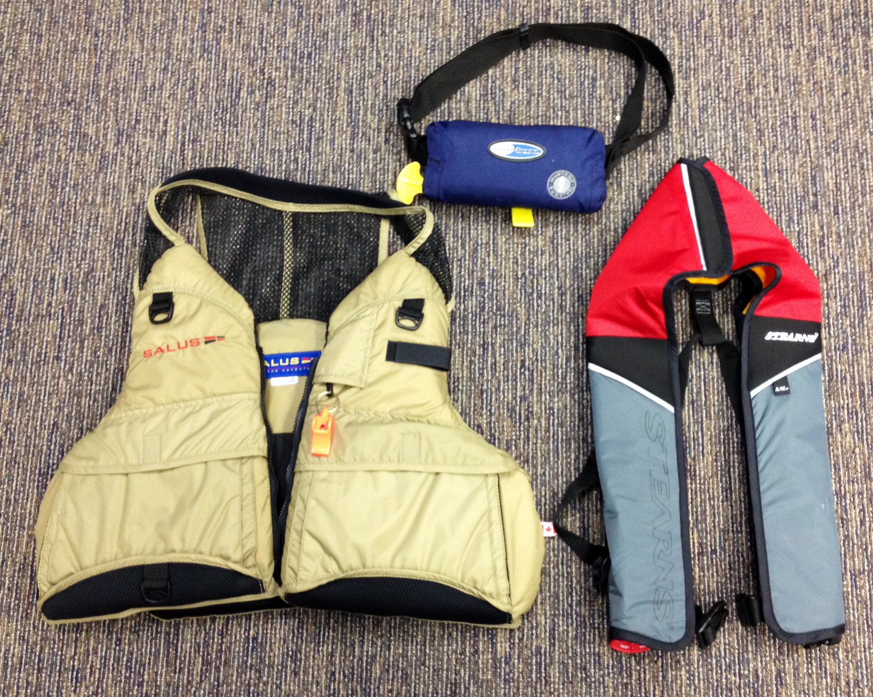
Reactions to the new PFDs*
Very few men had seen the new PFDs: they’re not being advertised, nor seen to be worn by leaders of watersports, while in their boats.
Reactions were very positive on styles:
Kayaking-style fishing vest
  They like pockets – it becomes part of their fishing attire. Useful instead of limiting.
  Not too restrictive in design
Suspender-style inflatable PFD
  Thin = light/cool
  Will fit well
  Sophisticated colours
“Your friends would not mock you in these.” – TK
“They are cool!” – VNK
Those aware of them felt they were too
expensive (estimated at $200-$300).
*PFDs shown to participants

Slide 26
  What are the more motivating messages to change behaviour?
Participants were asked to rank alternative messages in terms of their ability to motivate them to change their behavior. Their selections have been organized on the following pages to reflect their relative (qualitative) influence, accompanied by reasons why.
Colour Legend:
More Motivating
Moderately Motivating
Least Motivating

Slide 27
Consequences and Motivators
Encourages me to wear a lifejacket more often
More Motivating
  L12. As a parent, by not wearing your lifejacket, you are showing your children it is OK for them to go without a lifejacket / take the same risks, when they are older. Even if you don’t have a boating mishap where you need a lifejacket to survive, they might.
  L13. An inflatable lifejacket is light and comfortable – an easy way to get the protection of a lifejacket without the bulkiness/lack of comfort of traditional lifejackets, that does not interfere at all with your on-the-water activities.
  L3. The “shock effect” is worse in cold water. Canadian waters are cold most of the time. The shock / surprise of entering cold water unexpectedly can intensify the gasping reflex, you may inhale water and if you are not wearing a lifejacket, drown within 1 minute.
L9. Being a good swimmer will not save you from the effects of cold water. And currents, undertows and rough water can make it very difficult for even strong swimmers to survive and swim for very long without a lifejacket.

Slide 28
Consequences and Motivators
Moderately Motivating
  L14. Modern “kayaking style” lifejackets, designed for ease of paddling while wearing them, are as comfortable to wear as a vest . They do not interfere with your on-the-water fishing or boating activities, while giving you the flotation protection of a traditional lifejacket. A comfortable choice for any on-the-water boating activities.
  L6. A lifejacket buys you time to be rescued from cold water. Even in really cold water, hypothermia (cooling of your core body temperature) does not cause you to become unconscious for 1 hour or so. You won’t be able to swim or move much, but if you are wearing a lifejacket you can survive that long, to be rescued. Even longer in cool but not freezing cold water.
  L7. A lifejacket buys you time to be rescued. It is very tiring to hold onto a boat. And getting back into the boat may be impossible, if the boat has swamped or capsized. Wearing a lifejacket allows you to keep your head above water and conserve your energy, until you are rescued.
  L2. The shock of falling into deep water is completely different than choosing to jump or dive into water…it is unexpected and this unexpected entry causes a gasping reflex; you may involuntarily inhale water and if you are not wearing a lifejacket, drown within 1 minute. This can happen in any temperature of water. This means that if you unexpectedly end up in deep water, while out in a powerboat or canoe, there is a good chance you may drown if you’re not wearing a lifejacket.
  L5. If you survive the shock of your initial immersion into cold water, your muscles and body will begin to lose the capability of meaningful movement in 10 minutes. And then you will gradually lose your ability to swim. If you are not wearing a lifejacket, your head will begin slipping under the water, and you will drown.

Slide 29
Consequences and Motivators
Least Motivating
  L10. Wearing a lifejacket prepares and protects you for the unexpected. You may be a very conscientious boater. However many situations can arise, that result in ending up in the water unexpectedly, due to your boat (powerboat or canoe) swamping or capsizing, or falling overboard:
Rough water due to changes in weather. (Note: they might put one on if the water is hazardous.)
Unexpected effects of waves from other boats.
Unknown or unexpected rocks, logs, tree stumps or other obstacles in the water.
Mechanical difficulties with your boat.
Passenger thrown overboard when boat driver unexpectedly swerves / changes direction to avoid something (a log, etc.) floating in the water.
Reaching over side of boat (e.g.. to net fish, raise or lower anchor, etc.) and falling in. Loss of balance may be exacerbated by consumption of alcohol or wave motion.
Man urinating over side of boat, losing balance and falling in.
…You may end up in the water when you least expect it, even when you are being a responsible boat operator.
…Canadian boaters have drowned in all of the situations above.
  L11. Wearing a lifejacket means you are prepared if you need it.
If you unexpectedly fall in, you will not have the time to locate your lifejacket, reach for it and put it on. Falling into the water is sudden and quick.
It will be very difficult or impossible for you to put a lifejacket on after you are already in the water. It may still be in the boat; and/or you may be disoriented; and even if you aren’t, trying to put on a floating lifejacket while you are in the water is very difficult.

Slide 30
Consequences and Motivators
Least Motivating (cont’d)
  L4. You may well suffer the “shock effect” even on a warm or hot summer day, if you unexpectedly end up in deep water. The water does not have to be “ice cold” to cause you to gasp. On a warm or hot summer day, the water temperature (usually 10-15 degrees Celsius [50-60 degrees Fahrenheit]) will be much lower than your skin temperature, causing a sudden “surprise”. So if you unexpectedly end up in deep water, while out in a powerboat or canoe, there is a good chance you may drown if you’re not wearing a lifejacket.
  L8. If you fall out of a powerboat while the motor is still running, you could be run over by your boat, or severely injured by the propeller, such that you are unable to stay afloat if not wearing a lifejacket.
L1. If you unexpectedly end up in deep water, while out in a powerboat or canoe, there is a good chance you may drown if you’re not wearing a lifejacket.

Slide 31
Consequences and Motivators
What makes a message MOTIVATING?
It pulls at their heart strings. There’s nothing they wouldn’t do for their children. Most Dads said they already wear a lifejacket around their children to set a good example. Even the men without kids have children in their lives that they care about – nieces, nephews, cousins, etc.
It’s a promise that they can still enjoy their activity free from annoying restrictions.
It shares news about risks that seems plausible. Few had ever factored-in the effects of cold water on their ability to help themselves. And the information that they might ‘die within a minute’ jolted some into recalibrating the size of the risk.
It points to external factors being the issue, not their skill. They are confident in their swimming abilities, but they don’t know what to anticipate in a panic situation, or how cold water could strip them of their abilities. It gave them a valid reason to take precautions regardless of their swimming capability or sense of personal control.
It resonates with their personal experiences. Those in Vancouver and Montreal in particular could identify with the consistently cold temperature of their favourite water destinations; fishermen in Ontario connected cold water to the shoulder seasons of early May and the Fall.
The lifejacket is linked to a personal benefit. A lifejacket that buys you time (if you understand that time will be short) allows them to do what they and others need to do.
“Shock effect. I wasn’t aware that you could drown within a minute. I have heard of it but haven’t given it much thought. It buys you time.” – TRT
“I swim in cold water May 24 weekend, I know cold water makes your muscles cramp up, I can see how a lifejacket will help you.” – TNK

Slide 32
Consequences and Motivators
What FALLS SHORT on motivation?
Low probability of an accident. They weigh the severity of the consequence with
the probability of it actually happening. (Even if a new style of lifejacket is comfortable, why wear one at all if there is no need?)
  They may die within a minute, but think it would be rare and/or any increase in risk would be evident e.g., during a storm.
  They do not hear of boating accidents nearly as often as car accidents.
  They lack facts or statistics on risks to make them rethink the probability of something happening to them, to decrease their comfort zone and therefore increase their need to anticipate a problem occurring. Communicating the “threat” of a risk, in the absence of credible information backing it up, seems unrealistic and even a deterrent from accepting the message.
Conflicts with their personal beliefs: I am in control, I should be able to be free from rules. They need convincing evidence to make them redefine their needs, instead of the status quo of thinking that they could swim to shore (and even more easily without a lifejacket on), or would have a buddy to rescue them if they fall out of the boat, et al.
“I don't get on my boat thinking I am going to crash it.” - VNK
“I won’t get into a boat where I feel I need a life jacket to be safe in.” - TRT

Slide 33
Consequences and Motivators
Encourages me to not drink and operate a boat
More Motivating
  D8. The legal consequences of being caught drinking and operating your BOAT could also be applied to driving your CAR, i.e.. if caught drinking and boating you would also face road driving license suspensions, demerit points, criminal record if you travel outside Canada, and dramatic increase in the cost of your auto insurance (e.g.. up to about $10,000 per year if convicted of impaired driving). The same penalties as if you got caught drinking and driving your car.
  D4. If you do kill someone, you will have to live with the pain/guilt of knowing you killed someone you love.
  D1. You greatly increase the chances of killing someone you care about, if you operate a boat after drinking. E.g. if you have a collision, or make bad decisions that result in a passenger being injured or immersed in the water without a lifejacket and not rescued in time.
  D12. Enforcement & the risk of getting caught is increasing. For example:
  More police spot-checks* on the water;
  Police do (more) unmarked/ undercover patrols on lakes/rivers checking for boating and drinking, as well as other safety violations, so you won’t know who they are, until it is too late/ they catch you “red-handed”.
  People are watching what you are doing in your boat, even when you don’t know it. The “Call 9-1-1” campaign supported by MADD Canada, Transport Canada, local police forces and marinas has been a big success. More & more boaters, cottagers, marinas, etc. are calling 9-1-1, to report suspected drinking boaters, as well as automobile drinking drivers on the roads.
  Less predictable timing/location of on-the-water police spot-checks.
*Written as RIDE spot-checks when tested in Toronto

Slide 34
Consequences and Motivators
Moderately Motivating
  D3. You could kill yourself or someone you care about if you operate a boat after drinking, because… Your balance, reaction time, ability to navigate the boat, make decisions and exercise judgment are compromised with the effects of alcohol. This is exacerbated by the effects of sun, wind, waves, motion, darkness and weather – which can make the effects of alcohol much greater in a boat than on land***. You risk endangering your family and friends when you have the responsibility for operating the boat.
  D5. As a parent, by drinking and operating a boat, you are setting a bad example, showing your children & other young adults you boat with, that it is OK to drink and operate a boat. Even if you don’t have a boating mishap while drinking and boating, they might.
  D7. Impaired boating IS impaired driving. If you get caught drinking and operating a boat, it can result in heavy fines, criminal charges, a criminal record, jail time and seizing of your boat.
D9. In British Columbia* it is illegal for the boat operator or passengers to consume alcohol on any recreational boat, while the boat is underway. If you do, you can face legal charges and penalties, even if your blood alcohol level is under the legal limit (0.08).
*In Ontario, statements 9 and 10 were positioned as “In Ontario…”
**In Quebec, statements 9, 10 and 11 were positioned as “Quebec could change its boating laws to be like other Canadian provinces…”
*** The thought that a summer/boating environment actually increased the effect of alcohol and more greatly impacted their abilities was a new consideration for some.

Slide 35
Consequences and Motivators
Least Motivating
  D6. Beyond collisions, there are other risks if you drink and operate a boat, that are worse than when you are operating a car on the road. If you unexpectedly end up in the water, you increase the likelihood you could drown if you’ve been drinking – motor skills impairment makes it harder to swim and reduces how long you can swim; even more likely the “shock effect” of unexpectedly ending up in the water will cause you to gasp and your head may go under the water, and you inhale water; more rapid onset of the effects of cold water and hypothermia if you have been drinking.
  D2. You greatly increase the chances of you yourself being killed in a boating accident, if you operate a boat after drinking.
  D10. In British Columbia* it is only legal to consume alcohol on a boat if it is a large boat equipped with cooking, sleeping and toilet facilities AND the boat is at anchor, tied up at the dock/marina or grounded.
  D11.* Only on a large boat equipped with cooking, sleeping and toilet facilities is it even allowed to CARRY alcohol on a boat.
*In Quebec: statements 9, 10 and 11 were positioned as “Quebec could change its boating laws to be like other Canadian provinces…”; In Ontario, statements 9 and 10 were positioned as “In Ontario…”

Slide 36
Consequences and Motivators
What makes a message MOTIVATING?
Death. Taking someone’s life (even more than their own) really hits home to some, especially Dads.
They cringe at the thought of causing pain or harm to someone else and living with the guilt.
Conveys new information. Most did not know or understand the rules and regulations. (Those who thought they knew more were using the information to help secure their drinking rights and desires.)
Plausible consequence. For some, the thought of death was too big (not realistic within the context of their experiences in how and where they boat). However, the consequences of losing their driver’s license – for their car -- was something they could imagine. The impact of a boating incident affecting their daily lives in the city was not something to trifle with. (It seemed the possible impact of this might even provide reasonable justification to ‘the guys’ as to why they were behaving differently.)
Increased probability of getting caught. The consequence is meaningless if they don’t believe anything will happen to them. An increased chance of getting caught (increased spot-checks, police presence, or a 911 call (if they were out of control, which was doubtful)) would make them think twice about drinking and operating a boat.
“When you think of killing yourself, that chapter is done, closed. But I could not live with the thought of killing someone else.” – TK
“If we are looking at what would get me to change, I look at how drinking and driving a car has changed over the years -- it came down to people's perception of their chances of getting caught. It doesn't matter what the consequences are if I don't think I will ever get caught.”
– VK
“I didn't know it tied back to your car.
Having 4 cars, I have a lot of insurance.
It would get expensive really quick!” – VK

Slide 37
Consequences and Motivators
What FALLS SHORT on MOTIVATION?
Low probability. They weigh the severity of the consequence with the probability of it actually happening. While death rose to the top for its severity, some doubted that would ever happen to them. Again, outside of their personal experiences (and little mention of fatal incidents in the news) it is not relevant to them. They would rather not think about it.
Unrealistic comparisons to cars. They fully believe that car accidents are more likely to happen, and are more severe, than just about anything that could happen to them in their boat. Driving a car they equate with being in close proximity to other cars, higher speeds, and being threatened by ‘out of control’ drivers. There is the need to inform them, and convince them, of boating-related risks and the negative consequences of drinking and boating. Given their experiences do not align, this will be a challenge.
“The only way I see killing someone is flying down a lake at night, which I would never do.” – TNK

Slide 38
Consequences and Motivators
What differences among segments emerged?
  Threats imposed by cold water temperatures held a longer season of relevance among those in Vancouver and Montreal compared to those in Ontario; the latter associated cold water more with shoulder seasons only. Consistent with this enjoyment of the Pacific ocean, Vancouverites also place more emphasis on the dangers of deep water.
  Men Without Children were found to be EVEN more engaged than Dads on messages that challenged their assumptions about personal control: physical reactions to the water as opposed to personal competency e.g., shock effect, lack of muscle control in cold water (L2, L5, L6, L7, L9). (Note: Dads also found this area strongly relevant.) Men Without Children and Risk Takers were also particularly motivated by statements that outlined the legal consequences of drinking and operating a boat (D8 with D7 & D9).
  Dads were EVEN more engaged by statements that directly spoke to their need to safeguard their children and set a good example. This encompassed being a good role model by wearing a lifejacket themselves, L12. (Note: Men Without Children also found this area strongly relevant given they had children in their lives, just not their own). However, Dads were more struck by the idea that they might cause the death of someone they love (D1), since harming their child would be unbearable.
“You want kids to be safe.” - TNK

Slide 39
  What lessons can be derived from men’s reactions to existing safety ads?
The approaches are loosely ordered from highest to lowest appeal on the following pages.

Slide 40
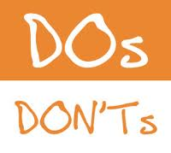
Lessons from Existing Safety Ads
Men appreciate humour - when it is smart or witty. (Anything
too farcical detracts from the seriousness of the message.)
They welcome the unexpected. A twist or shock at the end helps drive the message home.
They prefer to have dreadful scenarios left open to their imagination, particularly when it comes to death. They can mentally finish the scenario themselves – it feels more personal, and respectful, and may be less likely to be seen as “overkill”.
They need new information that challenges their beliefs in believable ways, in order to prompt them to re-examine their point of view on risks and consequences.
They need an intense message to make a point and lead to a solution.
While they will accept ads being persuasive about safety measures, they don’t want them to resort to “dramatics” or hollow scare tactics. Too much drama in the absence of a credible story or information falls on deaf ears or creates even more resistance.
Anything too cute (e.g. cartoons) is discounted as being seen to target children and runs the risk of insulting their intelligence and/or undermining the relevance of the message. And given their self-proclaimed balanced behavior when drinking and operating a boat, showing immature behavior (e.g. rash boating that teens or young adults would do) also makes them conclude ‘that’s not relevant to me’.
Analogies are difficult; we saw that men need to be educated on boating risks, consequences and solutions.
“They respected me enough to do it that way – they treated me like I was intelligent and could get it. I didn’t have to be tricked or frightened.” – TRT

Slide 41
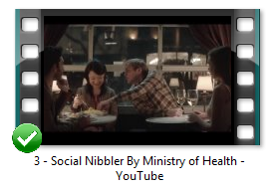
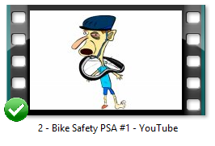
Feedback on Messaging Approaches
Well received
Tongue in cheek
Unique approach
Use of real people
Gets the point across without being pushy
Gets people to evaluate their actions
X Too subtle/light – some missed the point
X An approach can be too amusing and entertaining to cause a rethink on boating safety.
Humorous
Edgy
Clever execution (using bike names)
Strong message comprehension
Unique
X Might be too light in tone to get boating message across
X High risk to offend people (vulgar)
X Too controversial for Canadians
X Childish – seems to be targeted too young
“The message was clear because of the soft sell – your brain turns off if too serious. We don't need another mom telling us what to do.” – TNK
“I like that metaphor. I like how it creates
discrepancies in people's thinking, so many people accept rationale that they are a social smoker.”
– VNK

Slide 42
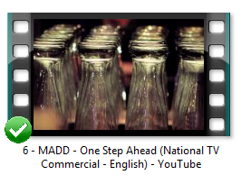
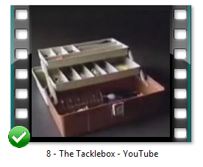
Feedback on Messaging Approaches, cont’d
Presented in English and French
Clear message: plan ahead
Appealing ‘first person’ viewpoint
Offers a solution; feels less gloomy
High impact using the kids crossing
Visually conveys the effect on reflexes
X Drinking and driving a boat is not as big an issue as when driving a car
Liked the approach of an fishing analogy
Gets a fisherman’s attention
X Too literal – lacked some of the cleverness of other ads
X Targets fishermen only
X Not enough of a call to action or solution
“You have to shock people and this will shock the hell out of them.” – VK
“It might work best. It’s not shoving anything down your throat, but it makes you think ahead a bit.” – TNK
“Who actually kills someone when they are drinking, when there are only 2 people on the lake?! It`s possible but SO RARE, the risk is so low.” – MK

Slide 43
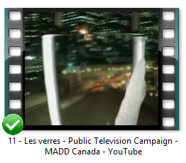
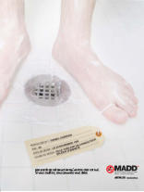
Feedback on Messaging Approaches, cont’d
Presented in English and French
Includes feedback on 12. In Reverse
Presented in French (print ad)
Clearly conveys that your abilities are impacted
Some felt the idea was transferrable to boats when sporting (water skiing, wake boarding)
X Some felt is wasn’t as applicable to boating safety – perceived as much more dangerous in a car (you’re alone on the lake vs. a busy road)
Shock effect
Emotionally relevant – guilt was considered effective
X Confusion around Father’s death – the meaning behind the dates
X Intent not obvious
X More effective if first-person
“Someone else’s suffering is much worse than you dying.” - MK

Slide 44
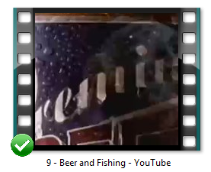
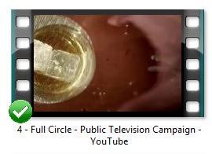
Feedback on Messaging Approaches, cont’d
Funny
Relatable
Memorable
X Related more to the beer than the safety message
X Doesn’t convey the magnitude of the consequence of drinking & boating
X Too light – particularly given seriousness of the topic
Cleverly engineered in ‘design’
X Low appeal
X Not personal enough
X Less impact with the focus on their own death rather than killing someone else
X Some didn’t get the ‘Come Full Circle’ focus
“It’s a great ad for a beer company! It made me thirsty.” – TNK

Slide 45
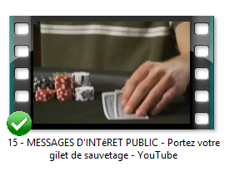
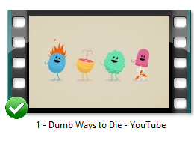
Feedback on Messaging Approaches, cont’d
Presented in English and French
Funny
Poker grabs your attention
X The fall into the lake detracts from credibility of the message
X They are more likely to be with a buddy who would ‘fish them out’ of the water
X Disconnect between topics: successful poker is contingent on taking risks
Cute, could be good for children
Song is catchy
X Approach is too childish for them since they need to be convinced of the seriousness of boating safety
“I appreciate there is no doom and gloom and that it is kid-friendly. They didn’t show me my buddy in a body bag.” – TRT

Slide 46
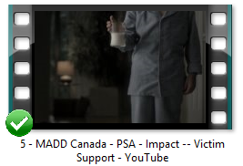
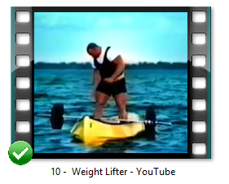
Feedback on Messaging Approaches, cont’d
Shock value
Emotional impact hits home, especially among Dads
Raises awareness
X Less relevant to boating
X Works best for cars
X High potential for viewing fatigue
Funny / entertaining
X Too far fetched
X Doesn’t tell you to wear your life jacket
X Disconnect between the analogy and a course of action or solution
X Doesn’t show the danger
“I don't know anyone who has died from boating and drinking.” – TK
“It’s a laugh to the point of stupidity.” – TNK

Slide 47
Communication Opportunities
Moving Forward

Slide 48
Communication Opportunity: Control
1.
I am in control
“Control” Opportunities
“Control” Watch-outs
Create reasonable doubt!
Illustrate that serious boating incidents happen to strong and able men (share stats and show guys they would admire/aspire to) and can be avoided. For example:
That normal control is trumped when your body’s involuntary system creates a deadly “shock effect”.
That the toughest of men will feel the pain of losing the buddy they love e.g. imagine letting your best friend’s wife know that something went horribly wrong (without showing too many details).
That the effects of alcohol ‘on the water’ strips men of their capabilities, without them knowing (at least until they get back onto the dock).
That one safety incident on the water can limit their daily life on land in a car.
Don’t allow a scenario to be interpreted as everyday or funny i.e. guy falling over the boat’s edge would be the centre of a joke, not a catastrophe.
Avoid women! They are already a source of aggravation on the issue of control.

Slide 49
Communication Opportunity: Freedom
2.
I define free time as freedom from rules
“Freedom” Opportunities
“Freedom” Watch-outs
Draw legal parallels between driving a boat and driving a car under the influence (depending on the province).
For example:
This is not negotiable, it’s the law.
Even without patrols in eyesight, they’re at risk of being reported.
Share the law since most don’t know it.
Why not have a designated driver when boating so the party really doesn’t stop?
Take stock of a driver’s condition, before he gets behind the wheel – just like you would with a car.
Don’t let short-term fun on a boat, ruin your fun for months.
Avoid women.
Avoid over-suggesting the chances of being caught: present as common sense, not a threat.

Slide 50
Communication Opportunity: Guy Bonding
3.
I don’t want to be the odd man out
“Odd Man” Opportunities
“Odd Man Out” Watch-outs
Tap into “all for one and one for all”.
For example:
Guys recalling one of their own who was saved e.g. by the “designated driver” or by the lifejacket he activated when he hit the water. It’s a “ha, ha!” with a serious “love ya bro” signature thought.
Create hero status for guy who chose to be the designated driver.
Turn the tables by guys ridiculing the one who isn’t wearing his (cool, light, new) PFD and all his petty ‘reasons’ – my tan line et al. Make him the odd man out.
Don’t show “one guy” as being the safe guy – leverage the group mentality.

Slide 51
Communication Opportunity: Relaxation
4.
I have the right to relax
“Relaxation” Opportunities
“Relaxation” Watch-outs
Redefine the image of ‘lifejackets’ (now designed to be worn) and create an emotional desire to buy and wear.
For example:
Nothing else is antiquated in your life, why should your lifejackets be?
You can be safe and comfortable with the new-style PFDs.
Why is it a ‘splurge’ to buy a lifejacket designed to be worn, when you’re saving lives?
Get more professionals to wear them while they’re in the boat: set a higher bar of behavior.
Many may still need a rational reason to wear a lifejacket, regardless of how comfortable they are.

Slide 52
Comments or questions? Please contact us:
Lisa Elder: heads up Inspiration from Information Inc. 416.482.3693 lisa.elder@headsupgroup.com headsupgroup.com
Tom McCullough: McCullough Associates 705.739.7149 tom.mccullough@rogers.com

