Slide 1
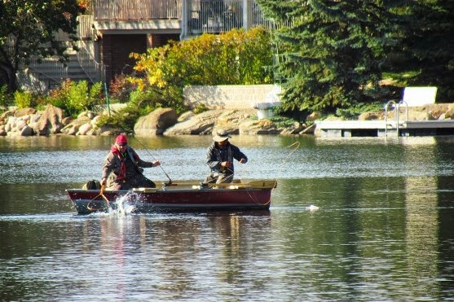

“Motivating Change in Canadian Boaters Safety Behaviours”
Fishing Workshop
2014 Research Highlights: Fishers
        Prepared for: Canadian Safe Boating Council
        Workshop Presentation Prepared by: McCullough Associates
        Research study conducted by: Ipsos Reid
        Date: January 2015
1

Slide 2
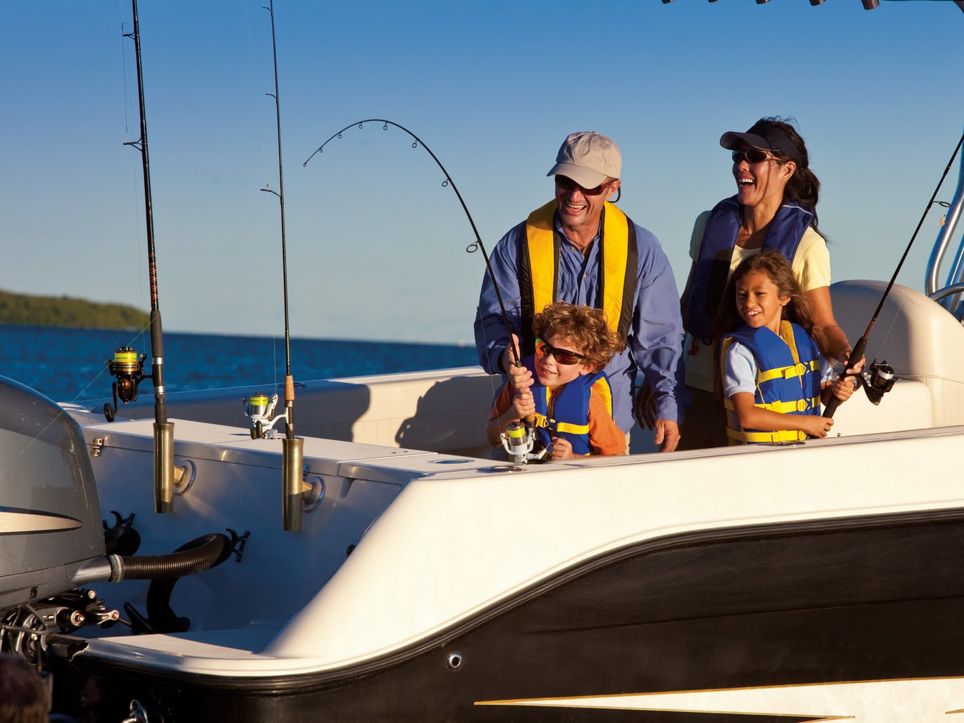
The Challenge
To improve boating safety practices in Canada.

Slide 3
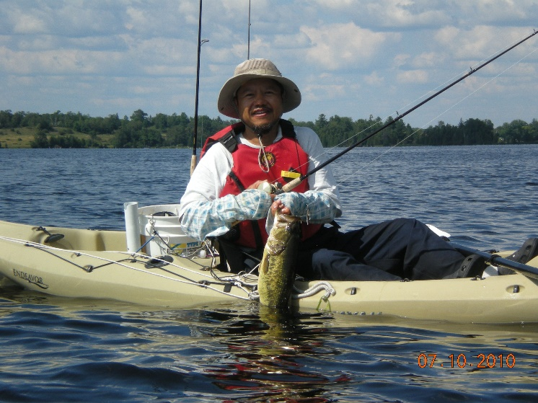
Research Program Background
  Overall Research Objective:
  To investigate and better understand barriers, motivators and high potential opportunities to improve safe boating behaviours among Canadian boaters, including Fishers, Pleasure Powerboaters and Paddlers.
  2014 Research Program:
  Preliminary Stakeholder Session (February)
  Qualitative Consumer Focus Groups Research (May)
  Stakeholder Consultation Sessions (June)
  Quantitative National Consumer Survey (August)
  Overall Learning presented at CSBC Symposium (September)
3
Notes:
Identified in Step 1 Preliminary Stakeholder Session, and re-confirmed in Step 3 Stakeholder Consultation Sessions, that the top 2 boating safety “problem areas” to focus on, that if addressed, could make the biggest difference to improving boating safety, are: “not wearing lifejackets” and “drinking and operating a boat/watercraft”. So, focused the Research Steps on more deeply understanding the barriers and motivators related to these 2 areas, in search of new ways to motivate changes in boaters’ ingrained behaviours in these areas.

Slide 4
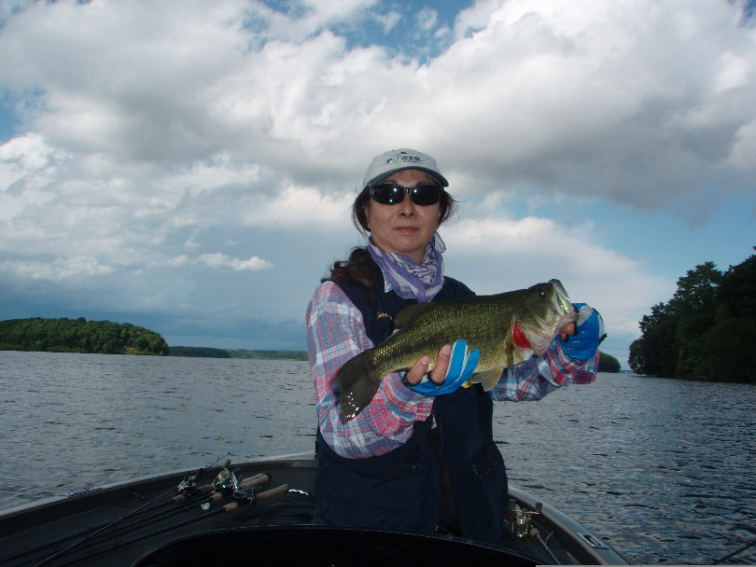
Workshop Flow
Research Learning
  Who are Canadian boaters? What are they thinking & doing? …Fishers in particular?
  What’s stopping them from being safer? What are the barriers to…
  …wearing Lifejackets?
  …Not drinking & operating boats?
  What could motivate them to change/improve these behaviours?
  What communications / messaging directions could have the most impact?
  Would increased focus on safety affect participation in boating / fishing?
  Summary
Workshop discussion
  What should we do, with Fishers?
4
Notes:
Purpose of today’s workshop is to share the learning with you from our 2014 in-depth Boating Safety research, and together, identify what we could do, to improve Paddler safety.
Brief introduction to the research. Then present highlights of paddling-related learning from the research…
Who: profile – demographics; attitudes related to safety
What are they doing: activities while boating; safety behaviours – wearing of lifejackets, drinking while boating
Etc.
Re: Workshop discussion – more details later.

Slide 5
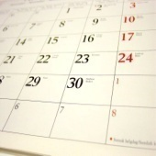
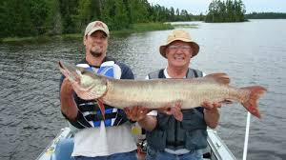

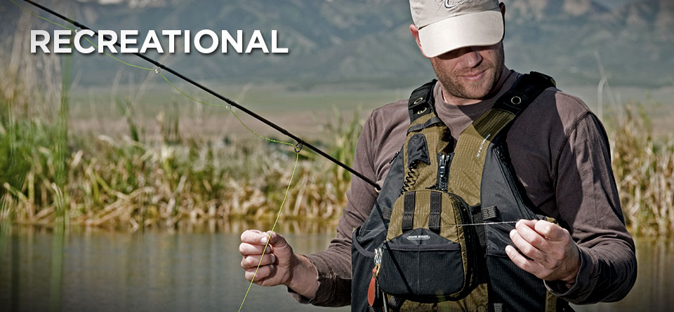
Quantitative Research Approach
  A quantitative online survey,
  conducted via Ipsos Reid’s online panel.
    Fieldwork: August 21-29, 2014
    Sample: 1204 completed interviews, nationally, in English and in French
  Representative of Canada. After screening for boaters, final respondents are:
  Recreational participants in all types of boating activities.
  Aged 18-69 yrs.
  60% males, 40% females.
  Regional quotas to provide solid representation in each major region of Canada.
    B.C., Prairies, Ontario, Quebec, Atlantic, Northern.
Fieldwork
Sample

Slide 6
Canadian Boaters
… focus on Fishers

Slide 7
Overall, almost half (45%) of Canadians are boaters, at least occasionally.
One-quarter (25%) of Canadians participate in Fishing.
Canadian Boating Participation - Incidence*
% of population 18-69 years
34%
30%
Powerboating
Non-Powerboating
Fishing (net)
*NOTE: This slide shows full response data for the question, including those who may have left/not qualified for the survey after this question.
S4. Which of the following activities do you participate in, at least occasionally? (Select all)
Total screened who answered S4 (n=9075)

Slide 8

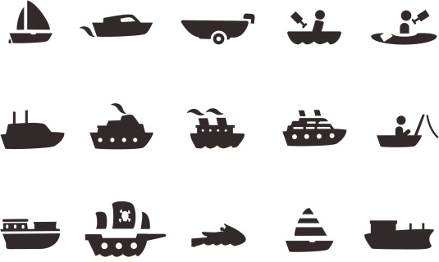



Within this research, the following icons represent each of the boating participant groups below:
At least occasionally…
 | Paddlers (n=746) | Participated in canoeing, kayaking or stand up paddleboarding
 | Fishers (n=704) | Participated in fishing from a boat, canoe or other type of craft as either the driver or as a passenger
 | Pleasure Powerboaters (n=574) | Participated in pleasure boating in a powerboat, including cruising, waterskiing, wakeboarding or PWC, as either the driver or as a passenger
 | Sailors (n=173) | Participated in sailing or sailboarding (windsurfing)
 | Personal Watercraft Riders (n=137) | Rode a personal watercraft (PWC)
 | Small Craft (n=944) | Participated in canoeing, kayaking, boating in another type of non-powered craft (such as a rowboat, inflatable craft), a powerboat under 6 meters in length, or sailboat under 6 meters in length
62%
58%
48%
14%
11%
78%
S4. Which of the following activities do you participate in, at least occasionally? (Select all)

Slide 9
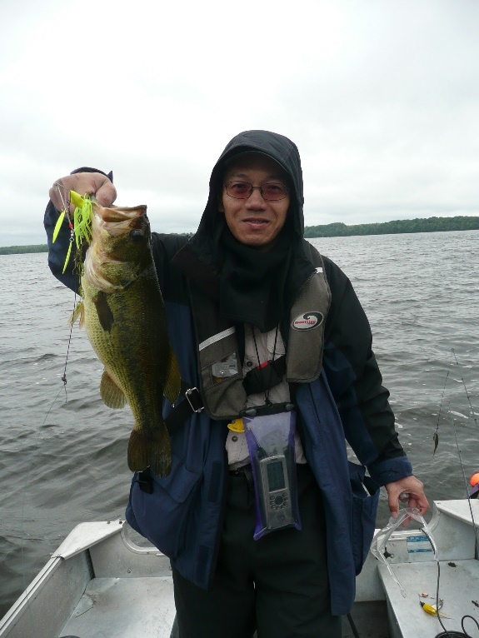
The majority of recreational boaters (59%) participate in Fishing.
The majority of Fishers (57%) drive the boat at least some of the time while fishing; less than half (41%) are fishing passengers who never drive the boat.
About one-quarter fish frequently (6+ times/yr) and about half fish very infrequently (1-2 times/yr).
Most (73%) fish from a powerboat less than 6 meters in length; one-quarter fish at least occasionally from a larger powerboat over 6 meters in length; and one-third (34%) fish at least occasionally from a canoe or kayak.
Fishing Participation among Recreational Boaters - % of total Boaters
Boating Activity | % of Total Boaters | % of Total Fishers
Base | 1204 | 746
Fishing (net) | 59% | 100%
…as a passenger (total) | 46% | 78%
…as a passenger (not driver) | 25% | 41%
…as the driver | 33% | 57%
Fishing from a powerboat <6m | 43% | 73%
Fishing from a powerboat 6m+ | 15% | 25%
Fishing from a canoe or kayak | 20% | 34%
Frequent Fishers (6+ times/year) | 15% | 23%
Moderate Fishers (3-5 times/yr) | 17% | 26%
Infrequent Fishers (1-2 times/yr) | 24% | 48%
Note: Sourced from survey questions S4, S6, S7, S8, 102.

Slide 10
Among participants, higher frequency of boat driving than as passengers. Many Fishers also moderate to frequent participants in other boating activities, especially pleasure powerboating as drivers and passengers.
Frequency of Participation in Boating Activities among all Fishers
% Fisher Participation in Boating Activities |  | Base
78% | Fishing from a boat (passenger total) | 551
57% | Fishing from a boat (driver) | 401
40% | Canoeing | 284
26% | Kayaking | 182
38% | Pleasure powerboating as a passenger | 269
24% | Pleasure powerboating as a driver | 171
14% | Personal watercraft (PWC) | 102
15% | Sailing | 103
7% | Sailboarding | 47
29% | Boating in another non-powered craft | 206
8% | Hunting from any watercraft | 58
Total Fishers (n=704)
101. How many times, in the past year, would you say that you participate in each of the following activities? (Select one per row)

Slide 11
Regionally… Fishing participation rate amongst boaters highest in the North and lowest in B.C.
Higher participation in North reflects higher proportions of powerboat drivers, frequent fishers and fishing from large powerboats 6m+.
In BC, lower proportion of powerboat drivers and fishing from small powerboats <6m.
Fishing Participation among Recreational Boaters by Region - % of total Boaters
Boating Activity | Total | BC | Prairies | Ontario | Quebec | Atlantic | North
Base | 1204 | 260 | 164 | 329 | 298 | 150 | 102
Fishing (net) | 59% | 52% | 65% | 57% | 61% | 63% | 74%
…as a passenger (total) | 46% | 42% | 55% | 44% | 46% | 44% | 57%
…as a passenger (not driver) | 25% | 26% | 33% | 21% | 23% | 27% | 27%
…as the driver | 33% | 25% | 32% | 36% | 38% | 35% | 46%
Fishing from a powerboat <6m | 43% | 33% | 28% | 41% | 51% | 43% | 51%
Fishing from a powerboat 6m+ | 15% | 17% | 20% | 16% | 7% | 15% | 22%
Fishing from a canoe or kayak | 20% | 17% | 17% | 20% | 20% | 27% | 23%
Frequent Fishers | 15% | 12% | 21% | 15% | 13% | 19% | 26%
Moderate Fishers | 17% | 15% | 16% | 17% | 20% | 17% | 17%
Infrequent Fishers | 24% | 23% | 26% | 22% | 26% | 25% | 25%
Over 120/Under 80 index compared to total boating population
Note: Sourced from survey questions S4, S6, S7, S8, 102. The data shown indicate the penetration of each
boating activity listed, among total boaters in each region.

Slide 12
Fishing participation rate higher amongst men than women; and increases with age.
Men much more likely to be powerboat drivers while fishing than women; women more likely to be passengers who do not drive. Women also much less likely to be fishing in small powerboats less than 6m in length.
Older boaters 55 – 69 yrs of age are less likely to be fishing from large powerboats over 6m or canoes/kayaks.
Fishing Participation among Recreational Boaters by Demographic - % of Boaters
Boating Activity | Total Boaters | 18-34 | 35-54 | 55-69 | Male | Female | Parents | New Cdns
Base | 1204 | 338 | 540 | 326 | 716 | 488 | 419 | 50
Fishing (net) | 59% | 54% | 59% | 64% | 64% | 50% | 63% | 60%
…as a passenger (total) | 46% | 44% | 47% | 47% | 47% | 44% | 48% | 42%
…as a passenger (not driver) | 25% | 23% | 25% | 28% | 22% | 30% | 25% | 26%
…as the driver | 33% | 30% | 34% | 36% | 42% | 20% | 39% | 34%
Fishing from a powerboat <6m | 43% | 38% | 42% | 48% | 49% | 34% | 47% | 40%
Fishing from a powerboat 6m+ | 15% | 17% | 15% | 11% | 16% | 13% | 16% | 22%
Fishing from a canoe or kayak | 20% | 22% | 21% | 15% | 21% | 17% | 24% | 28%
Frequent Fishers | 15% | 16% | 14% | 18% | 17% | 13% | 18% | 18%
Moderate Fishers | 17% | 15% | 18% | 19% | 20% | 14% | 19% | 16%
Infrequent Fishers | 24% | 20% | 26% | 25% | 26% | 22% | 25% | 24%
Over 120/Under 80 index compared to total boating population
Note: Sourced from survey questions S4, S6, S7, S8, 102. The data shown indicate the penetration of each
boating activity listed, among the total sub-group in each column header.

Slide 13
In general, boaters most commonly participate in relaxation activities such as observing, eating/drinking and swimming/sunning. Fishing is the most popular individual activity while boating.
Overall Participation in Recreational Boating Activities – Total Boaters
74% Observing
60% Drinking/Eating
57% Swimming/Sun
56% Fishing/Hunting
55% Paddling
41% Canoeing
29% Kayaking
37% Overnighting
Camping
Overnight trips
Sleep Aboard
35% Entertaining
17% Water Sports
14% Underwater
12% Sailing
Sailing
Sailboarding/ windsurfing
23% Reading
16% Rowing
6% Wave Running
5% White Water Rafting
102. When you go out in a boat recreationally, which of the following activities, if any, do you participate in? (Select all)
Top 3 activities

Slide 14
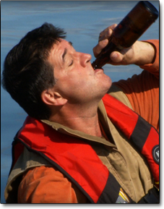
Drinking alcoholic beverages is one of the top fifteen activities while boating.
Top Fifteen Activities:
Overall Participation in Recreational Boating Activities – Total Boaters
102. When you go out in a boat recreationally, which of the following activities, if any, do you participate in? (Select all)

Slide 15
Those who fish from large powerboats >6m, and from canoes/kayaks, much more likely than small powerboat fishers to engage in sightseeing, cruising, swimming & sunbathing, as well as fishing; and much more likely to be drinking/ eating as well.
Overall, Fishers more likely than boaters in general to be drinking/eating while out boating.
Those who fish from large powerboats >6m more likely than boaters in general and Fishers in general to drink alcoholic beverages, as well as eat snacks/meals.
Top Boating Activities By Fisher Sub-groups
 |  |  | Fish from a… |  |  | Fishing…
 | Total Boaters | Total Fishers | Pwrbt <6m | Pwrbt >6m | Canoe/ Kayak | Drivers | Passgrs only
Base | (n=1204) | (n=704) | (n=513) | (n=175) | (n=238) | (n=401) | (n=303)
Observing (Net) | 74% | 74% | 72% | 73% | 85% | 74% | 73%
Nature observation | 53% | 56% | 54% | 58% | 76% | 59% | 53%
Sightseeing | 45% | 46% | 43% | 56% | 61% | 48% | 43%
Cruising | 39% | 42% | 45% | 50% | 49% | 45% | 39%
Drinking/Eating (Net) | 60% | 66% | 66% | 74% | 72% | 68% | 64%
Drinking (Subnet) | 50% | 56% | 56% | 66% | 62% | 57% | 55%
Drinking non-alcoholic beverages | 39% | 43% | 44% | 51% | 50% | 45% | 40%
Drinking beer, wine, other alcoholic beverages | 30% | 34% | 34% | 45% | 40% | 37% | 30%
Eating snacks or meals | 50% | 56% | 55% | 66% | 61% | 59% | 52%
Swimming/Sunning (Net) | 57% | 61% | 59% | 69% | 73% | 62% | 59%
Swimming | 48% | 51% | 49% | 62% | 64% | 55% | 47%
Sunbathing | 39% | 42% | 41% | 48% | 48% | 41% | 42%
Over 120/Under 80 index compared to total boating population
102. When you go out in a boat recreationally, which of the following activities, if any, do you participate in? (Select all)

Slide 16
Canadian boaters generally feel knowledgeable and confident about boating. Less than half are interested in taking additional training/education and only 1 in 10 feel nervous about being in a boat on the water.
Broad Attitudes toward Boating & Boating Safety
72%
9%
69%
14%
43%
24%
13%
74%
Total respondents (n=1204)
201. Please indicate your level of agreement with the following statements.

Slide 17

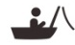
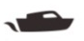



Sailors and PWC riders feel the most knowledgeable and confident.
Sailors are most likely to want additional training; also 20% of Sailors who feel “nervous”.
Fishers similar to overall total boaters.
I am very knowledgeable about boating safety
I am very confident in my ability to operate a boat
(n=746)
(n=746)
(n=704)
(n=704)
(n=574)
(n=574)
(n=173)
(n=173)
(n=137)
(n=137)
(n=944)
(n=944)
I would like to take additional boating training/education in the future
I am nervous being in a boat on the water
(n=746)
(n=746)
(n=704)
(n=704)
(n=574)
(n=574)
(n=173)
(n=173)
(n=137)
(n=137)
(n=944)
(n=944)
Over 120/Under 80 index compared to total boating population
201. Please indicate your level of agreement with the following statements.
Strongly Agree / Somewhat Agree top-2-box %’s shown.

Slide 18
Fishing powerboat drivers feel most knowledgeable and confident; frequent Fishers also quite confident.
Large powerboat and canoe/kayak fishers more interested in additional training / education that small powerboat fishers.
Demographically, fishers most interested in training/education are women (50%), parents (50%) and those living in BC (57%).
Fishing Sub-groups: Top-2-Box Attitudes toward Boating & Boating Safety
T2B | I am very knowledgeable about boating safety |  | I am very confident in my ability to operate a boat |  | I would like to take additional boating training/education in the future |  | I am nervous being in a boat on the water
Total Boaters | 72% |  | 69% |  | 43% |  | 13%
Total Fishing | 77% |  | 75% |  | 43% |  | 13%
Fishing Drivers | 87% |  | 89% |  | 41% |  | 13%
Fishing Passengers only | 65% |  | 57% |  | 48% |  | 14%
Fish from Powerboat <6m | 77% |  | 74% |  | 43% |  | 14%
Fish from Powerboat >6m | 82% |  | 79% |  | 51% |  | 15%
Fish from canoe/kayak | 82% |  | 83% |  | 49% |  | 12%
Frequent Fishers | 85% |  | 85% |  | 41% |  | 12%
Moderate Fishers | 79% |  | 82% |  | 48% |  | 12%
Infrequent Fishers | 72% |  | 65% |  | 42% |  | 13%
Over 120 /Under 80 index compared to total boating population
201. Please indicate your level of agreement with the following statements.

Slide 19
Focus on:
Lifejacket use while Boating

Slide 20
Half of Canadians claim to ‘always’ wear a lifejacket when in a boat.
Those unable to swim (77% ‘Always) and Atlantic Canada (62%) are more likely to ‘Always’ wear a lifejacket.
Ages 18-34 (46%), Ontario (45%), New Canadians (44%) and strong swimmers (44%) are less frequent wearers of PFDs.
Overall Frequency of Wearing Lifejacket – Total Boaters
Frequent Wearers
Top 2 Box: 76%
Infrequent Wearers
Bottom 2 Box: 13%
Total respondents (n=1204)
103a. Overall, how often do you wear a lifejacket when in a boat? (Select one)

Slide 21

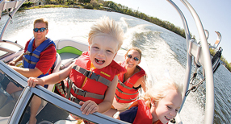


Pleasure powerboaters are the group least likely to wear lifejackets.
Fishers are similar to overall boaters. Half of both powerboat drivers and passengers claim to wear a PFD ‘always’ (48%)… on par with the overall results.
Overall Frequency of Wearing Lifejacket
Frequent Wearing of Lifejackets by Boating Sub-groups - % ‘Always’ Wear
(n=746)
(n=704)
(n=574)
(n=173)
(n=137)
(n=944)
Over 120/Under 80 index compared to total boating population
103a. Overall, how often do you wear a lifejacket when in a boat? (Select one)

Slide 22
Fishing drivers and passengers equally likely to wear/not wear lifejackets.
Overall Frequency of Wearing Lifejacket
Frequent/Infrequent Wearers of Lifejackets among Fishers
Total Fishing (n=704)
Fishing Drivers (n=401)
Fishing Passengers only (n=303)
From a Pwrbt <6m (n=513)
From a Pwrbt >6m (n=175)
From canoe or kayak (n=238)
Over 120/Under 80 index compared to total boating population
103a. Overall, how often do you wear a lifejacket when in a boat? (Select one)

Slide 23
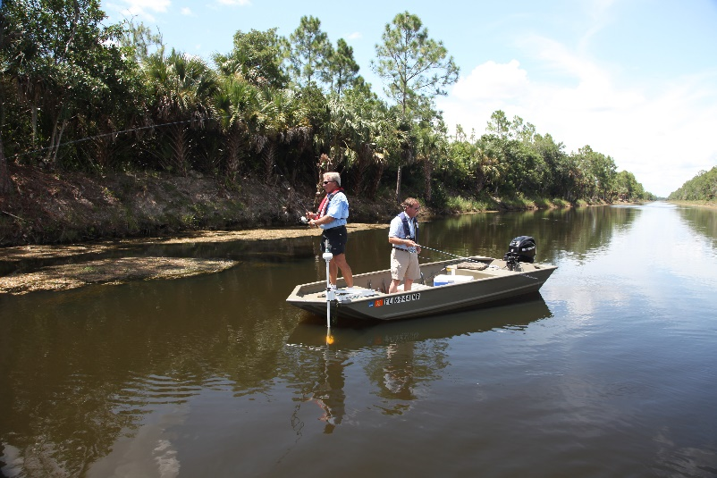
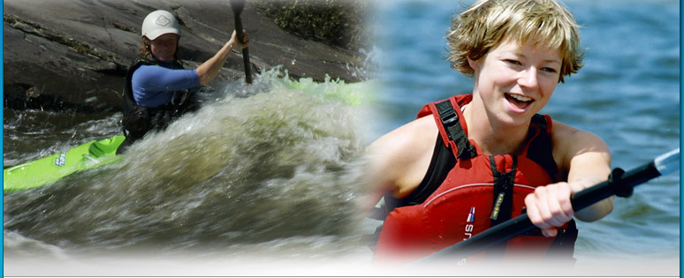
When asked directly about lifejacket habits for specific boating activities, boaters were most likely to indicate that they ‘Always’ wear a lifejacket when paddling. Equally less likely when fishing and when pleasure powerboating.
Frequency of Wearing Lifejacket while…
Base | (n=602) |  | (n=371) | (n=306) | (n=265)
Always |  |  | 75% | 50% | 48%
Overall (Q103a)
<6m
103a. Overall, how often do you wear a lifejacket when in a boat? (Select one)
104a. How often do you wear a lifejacket when you are in a canoe or kayak? (Select one)
105a. How often do you wear a lifejacket when you are fishing from a boat? (Select one)
106a. How often do you wear a lifejacket when you are pleasure boating in a powerboat under 6 metres in length for reasons other than fishing? (Select one)
Over 120 /Under 80 index compared to total boating population
Lifejackets: Group A only (n=602)

Slide 24
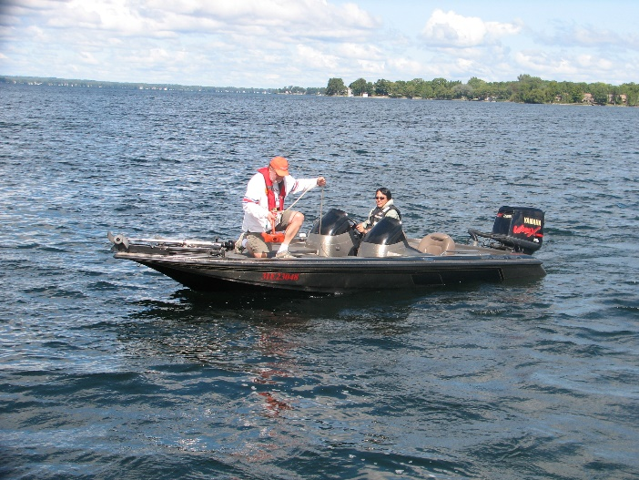
Fishing sub-groups equally unlikely to wear lifejackets when fishing, except even less so for those who fish from a canoe or kayak.
Frequency of Wearing a Lifejacket when fishing from a boat (Q105a)
Group A Fishers | % Always
Total Fishing (n=306) | 50%
Fishing Drivers (n=173) | 47%
Fishing Passengers only (n=241) | 50%
Fish from Powerboat <6m (n=244) | 51%
Fish from Powerboat >6m (n=98) | 46%
Fish from Canoe/Kayak (n=82) | 42%
Frequent Fishers (n=92) | 49%
Moderate Fishers (n=80) | 48%
Infrequent Fishers (n=127) | 53%
Overall Frequency of Wearing Lifejacket (Group A at Q103a)
Base | (n=602)
Always
Over 120 /Under 80 index compared to total Group A
Lifejackets: Group A only (n=602)
103a. Overall, how often do you wear a lifejacket when in a boat? (Select one)
105a. How often do you wear a lifejacket when you are fishing from a boat? (Select one)

Slide 25
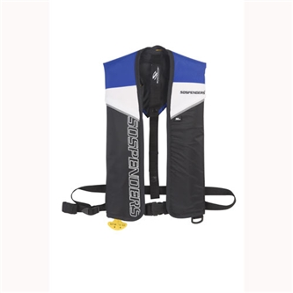
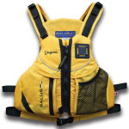
Awareness for inflatable and paddling-style lifejackets is high, but Familiarity and Usage is low. Almost half know little or nothing about inflatables (44%) and paddling-style (41%) lifejackets.
Awareness of Lifejacket Types - % of Total Boaters
Aware: 82%
Inflatable lifejacket
Know little to nothing: 44%
“Inflatable lifejacket that you wear as a collar/ vest. Comes in models that inflate manually by pulling a cord/toggle to activate it, or auto models that inflate automatically when you become immersed in the water”
Aware: 83%
Paddling-style lifejacket
Know little to nothing: 41%
“Paddling-style lifejacket designed for ease of paddling and movement, with 6-way adjustments to body size and shape”
Total respondents (n=1204)
202. Which of these phrases best describes your awareness of each of the different kinds of lifejackets shown below? (Select one per row)

Slide 26
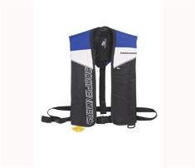
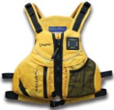
With Fishers, awareness of inflatable and paddling-style lifejackets is high, but Familiarity and Usage is low – similar to boaters overall.
However, still 40%+ of Paddlers not familiar with Paddling-style lifejackets and inflatables; and 2/3 (Paddling-style) to 3/4 (Inflatables) who have never tried them.
Only slightly higher trial of Inflatables with Fishing drivers, Frequent Fishers and those who fish from large Powerboats >6m.
Trial of Paddling-style jackets peaks at 39% with Frequent Fishers and those fishing from canoes/kayaks.
Inflatable lifejacket
Paddling-style lifejacket
 | Base | % Used | % Familiar | % Aware | % Used | % Familiar | % Aware
Total Boaters | 1204 | 23% | 57% | 83% | 32% | 59% | 83%
Total Fishing | 704 | 26% | 61% | 86% | 32% | 61% | 86%
Fishing Drivers | 401 | 28% | 64% | 87% | 35% | 65% | 90%
Fishing Passengers only | 303 | 23% | 57% | 85% | 29% | 55% | 81%
Fish from Powerboat <6m | 513 | 25% | 61% | 85% | 31% | 60% | 86%
Fish from Powerboat >6m | 175 | 34% | 66% | 89% | 38% | 69% | 88%
Fish from Canoe/Kayak | 238 | 27% | 61% | 88% | 39% | 66% | 89%
Frequent Fishers | 185 | 31% | 68% | 87% | 39% | 68% | 91%
Moderate Fishers | 207 | 22% | 59% | 87% | 30% | 60% | 86%
Infrequent Fishers | 288 | 26% | 58% | 85% | 31% | 58% | 84%
Over 120 /Under 80 index compared to total boating population
202. Which of these phrases best describes your awareness of each of the different kinds of lifejackets shown below? (Select one per row)

Slide 27
As a key part of this research, we explore what the most important “barriers” are, and what the most important “motivators” are, for boaters.
Background
Based on earlier research and stakeholders’ input to the CSBC team, we know there are many attitudes and behaviours “stopping” boaters from “doing what we want them to” (barriers), and a lot of different reasons why they might “do what we want them to” (motivators).
In the qualitative focus groups research stage that preceded this quantitative survey, we learned more about barriers and motivators, and that there were a number of communications messaging directions that seemed like they had potential to convince boaters to “do what we want them to”, regarding wearing lifejackets, and not drinking while operating a boat.
Thirdly, in our annual CSBC tracking research in spring 2014, we did a preliminary pre-test of 6 messaging statements regarding reasons to wear your lifejacket and another 6 reasons to not drink alcoholic beverages when operating a boat; and found high potential for most of these message directions.
Compiling this past and current knowledge, we identified a long list of items to test within this research:
  For “wearing your lifejacket”: 17 potential motivators, 31 potential barriers,
  10 communications statements and 9 supporting facts.
  For “not drinking alcoholic beverages while operating a boat”: 14 potential motivators, 19 potential barriers,
  7 communications statements and 7 supporting facts.

Slide 28
To move beyond the ‘easy’ answers, and better discriminate between these many options…
…Barriers, Motivators & Communications statements were tested using a “MaxDiff” research method
What is MaxDiff?
Maximum Difference Analysis (or MaxDiff) is an advanced research technique used to understand the relative influence of various factors – in this case, among motivations, barriers and communications messages with boaters.
MaxDiff is an easy way for respondents to select the most influential factor without having to choose from a long list of items and it results in stronger discrimination among the items.
This analysis provides stronger reliability and clearer insights than more simplistic rating or ranking procedures.
In the MaxDiff exercises, respondents were shown a random subset of 3-4 items for each of the motivations, barriers and communications sections. They were asked to choose, among the selection of 3-4 items being shown, which one they considered to be the most convincing statement, and which one they considered to be the least convincing. Each respondent performed this “choice task” a number of times, each time with a different subset of 3-4 statements/messages.
An additional question established ‘absolute’ values for each, asking whether both, one or neither of the statements selected was convincing.
Here’s what we learned…

Slide 29
The “top 9” (of 31) Barriers to Wearing Lifejackets resonate most with boaters.
Based on MaxDiff Scores / 10
Barriers to wearing a lifejacket
# 1 is most discriminating
4.4 | I feel that I am prepared in the event of cold water immersion
3.3 | A lifejacket is uncomfortable to wear
3.2 | I don’t know anyone who has ever drowned or almost drowned
3.2 | I don’t worry about the temperature of the water, as I don’t boat during what I consider to be the cold water season
3.0 | The lifejackets that I would like are too expensive
2.9 | I only need to wear a lifejacket in riskier conditions (tippy boat, rough water, at high speeds)
2.7 | A lifejacket is too hot to wear
2.7 | Wearing a lifejacket interferes with my activity while boating
2.6 | I only need to wear a lifejacket when involved in sports (e.g. waterskiing, wakeboarding)
2.3 | I tend to go along with what others on the boat are doing – if they wear one, I will too
2.2 | I want to feel the sun on my skin / sun tan and I can’t with a lifejacket
2.1 | If something happens where I need a lifejacket, I can always put one on
2.0 | I prefer to use a lifejacket as a cushion / to sit on / as a pillow
2.0 | Lifejackets smell bad
2.0 | Wearing a lifejacket puts a damper on things
1.8 | It’s not cool to wear a lifejacket
1.8 | I don’t need to set an example for others by wearing a lifejacket, particularly if there are no children around
1.7 | I don’t want to be the odd one by wearing a lifejacket
1.7 | I’ve got good boating skills so I don’t need to wear a lifejacket
1.6 | I don’t think there is anything people can do to improve their chances of surviving immersion in cold water
1.6 | I don’t think a PFD or lifejacket will help if someone falls into cold water
1.5 | I don’t need to worry about cold water immersion, as it is unlikely to happen to me
1.5 | Family and friends are looking out for me, so I don’t really need to wear a lifejacket
1.5 | It is very unlikely that something serious is going to happen, so there’s really no need to wear a lifejacket
1.5 | I don’t want others to think I’m scared of water when I wear a lifejacket
1.4 | I’m better off without a lifejacket / I can swim better without one
1.4 | I’m a strong swimmer, so I don’t need to wear a lifejacket
1.4 | I don’t want others to think I can’t swim
1.3 | Wearing a lifejacket does not fit with the image I want to project
1.1 | My family /friends don’t need to wear lifejackets because I can look out for them
0.9 | There’s no real risk when you fall into the water, so wearing a lifejacket isn’t really needed
Lifejackets: Group A only (n=602)
Q301. Here are some statements that describe how people feel about wearing lifejackets while boating. Which one do you agree with the most and which one do you agree with the least? (Select one )

Slide 30
The “top 9” Barriers to Wearing Lifejackets are the same for Fishers as for Pleasure Powerboaters and Paddlers.
Based on MaxDiff Scores / 10
Barriers to wearing a lifejacket
Total Boaters
4.4 | I feel that I am prepared in the event of cold water immersion | 4.5 | 4.5 | 4.5
3.3 | A lifejacket is uncomfortable to wear | 3.3 | 3.4 | 3.3
3.2 | I don’t know anyone who has ever drowned or almost drowned | 3.3 | 3.3 | 3.3
3.2 | I don’t worry about the temperature of the water, as I don’t boat during what I consider to be the cold water season | 3.2 | 3.3 | 3.2
3.0 | The lifejackets that I would like are too expensive | 3.1 | 3.1 | 3.1
2.9 | I only need to wear a lifejacket in riskier conditions (tippy boat, rough water, at high speeds) | 3.0 | 3.3 | 3.0
2.7 | A lifejacket is too hot to wear | 2.8 | 2.9 | 2.8
2.7 | Wearing a lifejacket interferes with my activity while boating | 2.8 | 3.0 | 2.8
2.6 | I only need to wear a lifejacket when involved in sports (e.g. waterskiing, wakeboarding) | 2.7 | 3.0 | 2.7
2.3 | I tend to go along with what others on the boat are doing – if they wear one, I will too | 2.4 | 2.6 | 2.4
2.2 | I want to feel the sun on my skin / sun tan and I can’t with a lifejacket | 2.2 | 2.5 | 2.2
2.1 | If something happens where I need a lifejacket, I can always put one on | 2.3 | 2.4 | 2.3
2.0 | I prefer to use a lifejacket as a cushion / to sit on / as a pillow | 2.2 | 2.2 | 2.2
2.0 | Lifejackets smell bad | 2.0 | 2.1 | 2.0
2.0 | Wearing a lifejacket puts a damper on things | 2.1 | 2.2 | 2.1
1.8 | It’s not cool to wear a lifejacket | 1.9 | 1.8 | 1.9
1.8 | I don’t need to set an example for others by wearing a lifejacket, particularly if there are no children around | 1.9 | 2.0 | 1.9
1.7 | I don’t want to be the odd one by wearing a lifejacket | 1.8 | 1.9 | 1.8
1.7 | I’ve got good boating skills so I don’t need to wear a lifejacket | 1.8 | 2.0 | 1.8
1.6 | I don’t think there is anything people can do to improve their chances of surviving immersion in cold water | 1.7 | 1.6 | 1.7
1.6 | I don’t think a PFD or lifejacket will help if someone falls into cold water | 1.7 | 1.5 | 1.7
1.5 | I don’t need to worry about cold water immersion, as it is unlikely to happen to me | 1.6 | 1.6 | 1.6
1.5 | Family and friends are looking out for me, so I don’t really need to wear a lifejacket | 1.6 | 1.8 | 1.6
1.5 | It is very unlikely that something serious is going to happen, so there’s really no need to wear a lifejacket | 1.6 | 1.7 | 1.6
1.5 | I don’t want others to think I’m scared of water when I wear a lifejacket | 1.6 | 1.5 | 1.6
1.4 | I’m better off without a lifejacket / I can swim better without one | 1.5 | 1.7 | 1.5
1.4 | I’m a strong swimmer, so I don’t need to wear a lifejacket | 1.5 | 1.7 | 1.5
1.4 | I don’t want others to think I can’t swim | 1.5 | 1.5 | 1.5
1.3 | Wearing a lifejacket does not fit with the image I want to project | 1.4 | 1.3 | 1.4
1.1 | My family /friends don’t need to wear lifejackets because I can look out for them | 1.2 | 1.3 | 1.2
0.9 | There’s no real risk when you fall into the water, so wearing a lifejacket isn’t really needed | 1.0 | 1.0 | 1.0
Q301. Here are some statements that describe how people feel about wearing lifejackets while boating. Which one do you agree with the most and which one do you agree with the least? (Select one )
Lifejackets: Group A only (n=602)
Notes:
Could use Max Diff Excel Tool, if/as needed to show that “the top 9 are the top 9” with demographic and activity sub-groups. Note: It does not drill down any further within Paddlers. No meaningful differences by age, gender.
Biggest difference among Boating sub-groups is that Quebec boaters are more concerned about LJ comfort barriers (#2 above, “A LJ is uncomfortable to wear” is #1 in Quebec), LJ cost/expense (#5 above, “The LJs that I would like are too expensive” is #2 in Quebec) and personal image/peer influence barriers.
Parents with children under 13 yrs are less concerned with LJ comfort factors than Boaters without children. Also less concerned about personalimage/peer influence barriers. However, “the top 9 are the top 9” with both Parents and Boaters without children.

Slide 31
There are several “reasons why not” themes evident in the top 9 barriers.
Based on MaxDiff Scores / 10
Barriers to wearing a lifejacket
Top 9 barriers that resonate most with boaters
4.4 | I feel that I am prepared in the event of cold water immersion
3.3 | A lifejacket is uncomfortable to wear
3.2 | I don’t know anyone who has ever drowned or almost drowned
3.2 | I don’t worry about the temperature of the water, as I don’t boat during what I consider to be the cold water season
3.0 | The lifejackets that I would like are too expensive
2.9 | I only need to wear a lifejacket in riskier conditions (tippy boat, rough water, at high speeds)
2.7 | A lifejacket is too hot to wear
2.7 | Wearing a lifejacket interferes with my activity while boating
2.6 | I only need to wear a lifejacket when involved in sports (e.g. waterskiing, etc.)
‘Reason why not’ themes
Risk is low/unlikely to need it
Uncomfortable/Reduces Enjoyment
Too expensive
Not concerned about Cold Water
Lifejackets: Group A only (n=602)
Q301. Here are some statements that describe how people feel about wearing lifejackets while boating. Which one do you agree with the most and which one do you agree with the least? (Select one )
Notes:
Same note as for sl 31:
Could use Max Diff Excel Tool, if/as needed to show that “the top 9 are the top 9” with demographic and activity sub-groups. Note: It does not drill down any further within Paddlers. No meaningful differences by age, gender.
Biggest difference among Boating sub-groups is that Quebec boaters are more concerned about LJ comfort barriers (#2 above, “A LJ is uncomfortable to wear” is #1 in Quebec), LJ cost/expense (#5 above, “The LJs that I would like are too expensive” is #2 in Quebec) and personal image/peer influence barriers.
Parents with children under 13 yrs are less concerned with LJ comfort factors than Boaters without children. Also less concerned about personalimage/peer influence barriers. However, “the top 9 are the top 9” with both Parents and Boaters without children.

Slide 32
“Top 10” Motivators are highly motivating “reasons why” to wear a Lifejacket; and especially the “top 3”.
Based on MaxDiff Scores / 10
Motivations for wearing a lifejacket
9.3 | I know that wearing a lifejacket is the smart thing to do
9.1 | I wear a lifejacket to be safe
9.1 | If you pick the right lifejacket, you can be comfortable and safer at the same time
8.2 | I wear a lifejacket to ensure I will be there for my family when they need me
7.8 | I want to set a good example for others by wearing a lifejacket
7.7 | I make a point of being prepared for the possibility of falling into cold water, by wearing a lifejacket
7.6 | Wearing a lifejacket shows I’m strong enough to do the right thing
7.1 | Wearing a lifejacket lets me focus on having good times with others
7.1 | If I wear a lifejacket, I can be more confident that nothing will go wrong
7.1 | If someone close to me drowned because he/she was not wearing a lifejacket, boating would never be the same for me
6.8 | Wearing a lifejacket lets me relax
6.3 | A lifejacket gives me better control
6.3 | I feel that those who are close to me want me to wear a lifejacket
4.9 | Others will look up to me for wearing a lifejacket
3.7 | When I wear a lifejacket, I don’t need to worry about anything
3.0 | Wearing a lifejacket lets me push my limits
2.8 | I feel I can take more chances when I wear a lifejacket
Top 10 compete within 2.2 pts
Motivation
Cold Water Motivation
Q301. Here are some statements that describe how people feel about wearing lifejackets while boating. Which one do you agree with the most and which one do you agree with the least? (Select one )
Lifejackets: Group A only (n=602)

Slide 33
“Top 3” and “Top 10” Motivators are the same for Fishers as for Pleasure Powerboaters and Paddlers.
Based on MaxDiff Scores / 10
Motivations for wearing a lifejacket
Total Boaters
9.3 | I know that wearing a lifejacket is the smart thing to do | 9.3 | 9.2 | 9.3
9.1 | I wear a lifejacket to be safe | 9.0 | 8.9 | 9.0
9.1 | If you pick the right lifejacket, you can be comfortable and safer at the same time | 9.0 | 8.9 | 9.0
8.2 | I wear a lifejacket to ensure I will be there for my family when they need me | 8.3 | 7.9 | 8.3
7.8 | I want to set a good example for others by wearing a lifejacket | 7.8 | 7.6 | 7.8
7.7 | I make a point of being prepared for the possibility of falling into cold water, by wearing a lifejacket | 7.7 | 7.4 | 7.7
7.6 | Wearing a lifejacket shows I’m strong enough to do the right thing | 7.6 | 7.5 | 7.6
7.1 | Wearing a lifejacket lets me focus on having good times with others | 7.1 | 6.8 | 7.1
7.1 | If I wear a lifejacket, I can be more confident that nothing will go wrong | 7.1 | 7.0 | 7.1
7.1 | If someone close to me drowned because he/she was not wearing a lifejacket, boating would never be the same for me | 7.2 | 7.3 | 7.2
6.8 | Wearing a lifejacket lets me relax | 6.9 | 6.5 | 6.9
6.3 | A lifejacket gives me better control | 6.4 | 6.2 | 6.4
6.3 | I feel that those who are close to me want me to wear a lifejacket | 6.3 | 6.0 | 6.3
4.9 | Others will look up to me for wearing a lifejacket | 5.1 | 4.9 | 5.1
3.7 | When I wear a lifejacket, I don’t need to worry about anything | 3.6 | 3.8 | 3.6
3.0 | Wearing a lifejacket lets me push my limits | 3.1 | 3.0 | 3.1
2.8 | I feel I can take more chances when I wear a lifejacket | 2.8 | 2.9 | 2.8
Motivation
Cold Water Motivation
Lifejackets: Group A only (n=602)
Q301. Here are some statements that describe how people feel about wearing lifejackets while boating. Which one do you agree with the most and which one do you agree with the least? (Select one )
Notes:
Could use Max Diff Excel Tool, if/as needed to show that “the top 10 are the top 10” and “top 3 are top 3” with demographic and activity sub-groups. Note: It does not drill down any further within Paddlers. No meaningful differences by age, gender.
No meaningful differences regionally. Same “top 3” and “top 10” in Quebec as in other regions. Just generally higher scores on each motivator in Quebec..
No meaningful differences for “top 3” and “top 10” for Parents with children under 13 yrs vs Boaters without children.

Slide 34
There are several ‘reasons why to wear a lifejacket’ themes evident in the top 10 motivators.
Based on MaxDiff Scores / 10
Motivations for wearing a lifejacket
“Top 10” motivators that resonate most with boaters
9.3 | I know that wearing a lifejacket is the smart thing to do
9.1 | I wear a lifejacket to be safe
9.1 | If you pick the right lifejacket, you can be comfortable and safer at the same time
8.2 | I wear a lifejacket to ensure I will be there for my family when they need me
7.8 | I want to set a good example for others by wearing a lifejacket
7.7 | I make a point of being prepared for the possibility of falling into cold water, by wearing a lifejacket
7.6 | Wearing a lifejacket shows I’m strong enough to do the right thing
7.1 | Wearing a lifejacket lets me focus on having good times with others
7.1 | If I wear a lifejacket, I can be more confident that nothing will go wrong
7.1 | If someone close to me drowned because he/she was not wearing a lifejacket, boating would never be the same for me
‘Motivating reasons’ themes
Right thing to do
Safety net/security
Avoid emotional pain
Cold Water motivation
Lifejackets: Group A only (n=602)
Q301. Here are some statements that describe how people feel about wearing lifejackets while boating. Which one do you agree with the most and which one do you agree with the least? (Select one )
Notes:
Same note as on slide 34:
Could use Max Diff Excel Tool, if/as needed to show that “the top 10 are the top 10” and “top 3 are top 3” with demographic and activity sub-groups. Note: It does not drill down any further within Paddlers. No meaningful differences by age, gender.
No meaningful differences regionally. Same “top 3” and “top 10” in Quebec as in other regions. Just generally higher scores on each motivator in Quebec..
No meaningful differences for “top 3” and “top 10” for Parents with children under 13 yrs vs Boaters without children.

Slide 35
The most convincing Communications Message speaks to a lifejacket buying you time if you fall out of your boat.
3 of 5 second-tier messages are about the benefits of lifejackets in cold water.
All demographic breaks and boating sub-groups, including Fishers, select the same top-ranked statement, and have similar ratings for the 5 2nd tier statements.
Messages about wearing a lifejacket
Top Communications Messages (6 of 10) for wearing lifejackets
Rank | Communications Messages | MD Score
1 | A lifejacket buys you time to be rescued if you fall out of your boat. It may be impossible to get back into your boat if it has swamped or capsized, and it may be too far to successfully swim to shore. Wearing a lifejacket will keep your head above water to survive until you are rescued. | 8.8
2 | Being a good swimmer will not save you from the effects of cold water. Your muscles will begin to lose the capability for meaningful movement in approximately 10 minutes. Then you will gradually lose your ability to swim, your head will begin to slip under the water, and if you are not wearing a lifejacket you will drown | 8.1
3 | You can’t control the “shock effect” of falling unexpectedly into cold water. It causes a gasping reflex you can’t control. You may inhale water and drown within 1 minute if you are not wearing a lifejacket. | 7.9
4 | It is a lot harder and more dangerous to try to swim to shore without a lifejacket than you think, if you fall out of a boat or it capsizes/swamps,. The distance is often further than you think; it is hard to swim with clothes on or in rough water; and as fatigue sets in your swimming effectiveness is reduced. | 7.9
5 | Even in really cold water, you will remain conscious for 1 hour or so, even if you can no longer move your muscles to swim. Wearing a lifejacket will keep your head above water so you can survive without swimming until you are rescued. | 7.8
6 | You may not be able to control the “shock effect” of unexpectedly falling into deep water, even on a warm or hot summer day. The surprise may cause you to gasp, inhale water and drown within 1 minute if you are not wearing a lifejacket. | 7.7
Little separation between the 5 2nd tier messages –
all are highly convincing to boaters
Q302. Here are some statements about wearing lifejackets while boating. Which one do you feel convinces you the most to wear a lifejacket more often and which one applies the least? (Select one)
Lifejackets: Group A only (n=602)
Notes:
In Max Diff Excel tool, can see that:
#1 is #1 and similar ratings for both men and women. For #2 to #6, rankings are the same for men and women, but ratings are even higher amongst women than men - for “cold water” risk/danger and “shock effect” messages.
Similar picture by age. #1 is #1 with both younger and older boaters. Higher ratings for older boaters, especially #1 and #7.
No meaningful differences between Paddlers, Fishers and Pleasure Powerboaters.
No meaningful differences by region.

Slide 36
The #1 message addresses ‘Safety Net/Security’ top motivators. And confronts ‘Risk is low’ perception barriers.
Messages about wearing a lifejacket
Top Communications Messages for wearing lifejackets
Theme Connections
Rank | Communications Messages | MD Score
1 | A lifejacket buys you time to be rescued if you fall out of your boat. It may be impossible to get back into your boat if it has swamped or capsized, and it may be too far to successfully swim to shore. Wearing a lifejacket will keep your head above water to survive until you are rescued. | 8.8
2 | Being a good swimmer will not save you from the effects of cold water. Your muscles will begin to lose the capability for meaningful movement in approximately 10 minutes. Then you will gradually lose your ability to swim, your head will begin to slip under the water, and if you are not wearing a lifejacket you will drown | 8.1
3 | You can’t control the “shock effect” of falling unexpectedly into cold water. It causes a gasping reflex you can’t control. You may inhale water and drown within 1 minute if you are not wearing a lifejacket. | 7.9
4 | It is a lot harder and more dangerous to try to swim to shore without a lifejacket than you think, if you fall out of a boat or it capsizes/swamps,. The distance is often further than you think; it is hard to swim with clothes on or in rough water; and as fatigue sets in your swimming effectiveness is reduced. | 7.9
5 | Even in really cold water, you will remain conscious for 1 hour or so, even if you can no longer move your muscles to swim. Wearing a lifejacket will keep your head above water so you can survive without swimming until you are rescued. | 7.8
6 | You may not be able to control the “shock effect” of unexpectedly falling into deep water, even on a warm or hot summer day. The surprise may cause you to gasp, inhale water and drown within 1 minute if you are not wearing a lifejacket. | 7.7
Barriers
Motivators
Risk is low
Safety net
No cold water concern (+low risk)
Cold
water motivation
No cold water concern
Cold
water motivation
Risk is low
Safety net
No cold water concern
Cold
water motivation
Risk is low
Safety net
Q302. Here are some statements about wearing lifejackets while boating. Which one do you feel convinces you the most to wear a lifejacket more often and which one applies the least? (Select one)
Lifejackets: Group A only (n=602)
Notes:
In Max Diff Excel tool, can see that:
#1 is #1 and similar ratings for both men and women. For #2 to #6, rankings are the same for men and women, but ratings are even higher amongst women than men - for “cold water” risk/danger and “shock effect” messages.
Similar picture by age. #1 is #1 with both younger and older boaters. Higher ratings for older boaters, especially #1 and #7.
No meaningful differences between Paddlers, Fishers and Pleasure Powerboaters.
No meaningful differences by region.

Slide 37
The most effective Fact informs boaters via past drowning statistics about the possibly fatal consequences of not wearing a lifejacket.
All demographic breaks and boater subgroups, including Fishers, choose the same fact as the most effective communications statement; and there is little difference in ratings of the other Facts across subgroups.
Facts about wearing a lifejacket
Top Supporting Facts (6 of 9) for wearing lifejackets
Rank | Supporting Facts | MD Score
1 | 80% of people who drown while boating were not wearing a lifejacket and they could have survived if they were. | 8.8
2 | 70% of boating fatality victims were with other people (ie. not alone), who were NOT able to rescue them. | 8.1
3 | In a controlled “test” of fishermen who fell out of their small powerboat, 1000 metres from shore, fully clothed, not wearing a lifejacket, and tried to swim to shore, 7 out of 10 did not make it. | 7.9
You may unexpectedly and suddenly, end up in the water due to swamping, capsizing or falling overboard, because of external factors beyond your control such as…
4 | … Careless / inattentive / distracted driving of a boat by “the other guy”; e.g. your boat has to suddenly swerve, or another powerboat or personal watercraft runs over/collides with your canoe/kayak, pedal boat or powerboat. | 7.8
5 | … Unknown or unexpected rocks, submerged/partially floating logs, tree stumps or other obstacles in the water that you do not see. | 7.8
6 | …Rough water, due to rapid changes in weather or unexpected effects of waves from other boats. | 7.8
Little separation between the 5 2nd tier facts –
all are highly convincing to boaters
Lifejackets: Group A only (n=602)
Q303. Here are some facts about wearing lifejackets while boating. Which one do you feel convinces you the most to wear a lifejacket more often and which one convinces you the least? (Select one)
Notes:
In Max Diff Excel tool, can see that:
No differences in rankings of Facts by gender, age, region or boater sub-groups (Paddlers vs Fishers vs Pleasure Powerboaters).

Slide 38
Significantly more boaters say they would Always wear a lifejacket after having seen the motivations, barriers, and communications statements.
Current Behaviour & Future Intent to Wear a Lifejacket
 | Current Behaviour (Q103a) | Future Intent (Q304)
Base | (n=602) | (n=602)
Always
Most of the time
Sometimes
Rarely
Never
Difference
∆ pts
Lifejackets: Group A only (n=602)
103a. Overall, how often do you wear a lifejacket when in a boat? (Select one )
304. How often do you think you will wear a lifejacket when in a boat in the future? (Select one)

Slide 39
There is broad-based positive impact for exposure to lifejacket motivations, barriers and communications statements across ALL boater groups, including Fishers.
And also broad positive impact across all Regions, with biggest regional intent to improve lifejacket wearing in BC, Ontario & Quebec.
Boating Subgroups: Current Behaviour & Future Intent to Wear a Lifejacket
 | Current Behaviour: “Always” wear a lifejacket |  | Future Intended Behaviour to “Always” wear a lifejacket |  | Difference ∆ pts
Total Group A | 54% |  | 66% |  | +12
 | 59% |  | 69% |  | +10
 | 52% |  | 66% |  | +14
 | 42% |  | 58% |  | +16
 | 47% |  | 62% |  | +15
 | 52% |  | 70% |  | +17
 | 56% |  | 67% |  | +11
(n=371)
(n=347)
(n=280)
(n=89)
(n=69)
(n=472)
Statistically significant change
Over 120/Under 80 index compared to total Group A
103a. Overall, how often do you wear a lifejacket when in a boat? (Select one )
304. How often do you think you will wear a lifejacket when in a boat in the future? (Select one)

Slide 40
There is broad-based positive impact for exposure to lifejacket motivations, barriers and communications statements across ALL Fishing sub-groups.
Fishing: Current Behaviour & Future Intent to Wear a Lifejacket
 | Current Behaviour: “Always” wear a lifejacket (Total) |  | Future Intended Behaviour to “Always” wear a lifejacket (Group A) |  | Difference ∆ pts
Total Boaters | 54% |  | 66% |  | +12
Total Fishing | 53% |  | 66% |  | +13
Fishing Drivers | 52% |  | 65% |  | +13
Fishing Passengers only | 54% |  | 68% |  | +14
Fish from Powerboat <6m | 52% |  | 66% |  | +14
Fish from Powerboat >6m | 49% |  | 62% |  | +13
Fish from canoe/kayak | 57% |  | 62% |  | +5
Note: Current behaviour is based on all respondents (n=1204); Future intended behaviour is reported on Group A respondents (n=602)
Statistically significant change
Over 120/Under 80 index compared to total boaters
103a. Overall, how often do you wear a lifejacket when in a boat? (Select one )
304. How often do you think you will wear a lifejacket when in a boat in the future? (Select one)

Slide 41
Exploring interest in lifejacket legislation

Slide 42
Respondents were shown the following text and asked to indicate their level of agreement with proposed legislation:
Every year, on average, over 100 Canadians drown while participating in boating, and about 80% of these drowning victims are not wearing a lifejacket or personal flotation device.
One possible solution that may help to prevent drowning deaths is the government could create legislation that would make it mandatory for all boaters to wear a lifejacket or personal flotation device at all times while underway on the water in a small boat, or at least for certain people or types of boats.
502. … Here is a list of different types of small boats under six metres (20 feet) in length that legislation could apply to as well as different groups the legislation could apply to.
Please indicate which of these you would favour, if any. (Select one per row)

Slide 43
A strong majority of boaters support legislation for all of the identified boat-types; with at least 2/3 supporting legislation for all people on-board.
Less than 10% of boaters are opposed to legislation.
There is strong support for legislation among all boating activity groups, as well as parents.
Overall Agreement with Legislation
Total In favour of some legislation | All People On-Board | Just Minors (<18 years) | Just Children (<13 years) | At Least One Person On-Board |  | Not in Favour |  | Undecided
✓
✗
?
Powerboats under 6m | 86% | 65% | 10% | 8% | 3% |  | 8% |  | 7%
Sailboat under 6m | 85% | 67% | 9% | 7% | 3% |  | 8% |  | 6%
Canoe or Kayak | 85% | 68% | 9% | 5% | 3% |  | 9% |  | 6%
Rowboat/dinghy | 85% | 64% | 10% | 8% | 3% |  | 10% |  | 6%
Personal Watercraft | 89% | 77% | 5% | 3% | 4% |  | 7% |  | 5%
502. … Here is a list of different types of small boats under six metres (20 feet) in length that legislation could apply to as well as different groups the legislation could apply to.
Please indicate which of these you would favour, if any. (Select one per row)
Total respondents (n=1204)

Slide 44

There is strong support for legislation among all boating activity groups, including Fishers, as well as parents (of children under 18).
Agreement with Legislation among Subgroups
✓
Total in favour of some legislation
Not in favour of any legislation
✗
Parents
Powerboats under 6m | 87% | 7% | 87% | 7% | 82% | 10% | 84% | 9% | 85% | 7% | 86% | 8% | 87% | 6%
Sailboat under 6m | 87% | 8% | 86% | 7% | 82% | 10% | 83% | 10% | 85% | 7% | 86% | 8% | 85% | 7%
Canoe or Kayak | 87% | 8% | 85% | 8% | 82% | 10% | 80% | 11% | 83% | 10% | 85% | 9% | 84% | 9%
Rowboat/ dinghy | 86% | 9% | 85% | 9% | 82% | 11% | 80% | 11% | 82% | 9% | 85% | 9% | 85% | 9%
Personal Watercraft | 90% | 5% | 88% | 6% | 87% | 8% | 82% | 9% | 87% | 6% | 89% | 6% | 88% | 6%
 | (n=746) |  | (n=704) |  | (n=574) |  | (n=173) |  | (n=137) |  | (n=944) |  | (n=419)
✓
✗
✓
✗
✓
✗
✓
✗
✓
✗
✓
✗
✓
✗
502. … Here is a list of different types of small boats under six metres (20 feet) in length that legislation could apply to as well as different groups the legislation could apply to. Please indicate which of these you would favour, if any. (Select one per row)
Over 120 /Under 80 index compared to total boating population

Slide 45
Just as many small craft boaters are in favour of legislation now as in 2003 “Will It Float” poll. There are more ‘undecided’ and slightly fewer opposed in 2014 than in 2003.
Comparison of Agreement with Legislation among Small Craft boaters
✓
Total in favour of some legislation
Not in favour of any legislation
Undecided
✗
?
2003
2014
Difference
∆ pts
Powerboats under 6m | 87% | 11% | 3% |  | 87% | 7% | 7%
Sailboat under 6m | 88% | 10% | 2% |  | 86% | 7% | 7%
Canoe or Kayak | 89% | 10% | 1% |  | 85% | 8% | 6%
Rowboat/ dinghy | 86% | 12% | 2% |  | 85% | 9% | 6%
Personal Watercraft | 89% | 9% | 2% |  | 88% | 6% | 5%
 | (n=390) |  |  |  | (n=944)
✓
✗
?
✓
✗
?
✓
✗
?
- | -4 | +4
-2 | -3 | +5
-4 | -2 | +5
-1 | -3 | +4
-1 | -3 | +3
502. … Here is a list of different types of small boats under six metres (20 feet) in length that legislation could apply to as well as different groups the legislation could apply to. Please indicate which of these you would favour, if any. (Select one per row)

Slide 46
Focus on:
Drinking Alcoholic Beverages while Boating

Slide 47
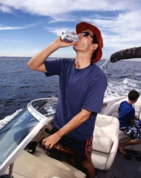
Half (51%) claim to ‘never’ drink alcoholic beverages while boating.
One-quarter (23%) admit to drinking at least ‘sometimes’.
Powerboat drivers (28% at least sometimes) & younger boaters 18-34 yrs (36%) admit to drinking alcohol more often while boating.
More alcohol consumption in Quebec (28% ‘at least sometimes’; only 41% ‘Never’), where drinking & boating laws are less restrictive.
Overall Frequency of Drinking Alcohol while Boating - % of Total Boaters
At Least Sometimes: 23%
I drink alcoholic beverages all the time while boating | I drink alcoholic beverages often while boating | I drink alcoholic beverages sometimes while boating | I drink alcoholic beverages the odd time while boating | I drink alcoholic beverages shortly before but never while boating | I never drink alcoholic beverages before or while
Total respondents (n=1204)
103b. Overall, which of the following applies to you personally when you are in a boat? (Select one)

Slide 48
Sailors, PWC riders and Pleasure Powerboaters consume alcohol while boating more than Fishers or Paddlers do. However, even among Fishers, more than one-quarter (27%) drink alcoholic beverages at least sometimes.
Overall Frequency of Drinking Alcohol while Boating
Frequency of Drinking Alcohol while Boating among Sub-groups
(n=746)
(n=704)
(n=574)
(n=173)
(n=137)
(n=944)
Over 120/Under 80 index compared to total boating population
103b. Overall, which of the following applies to you personally when you are in a boat? (Select one)

Slide 49
Within Fishers, those who fish from a large powerboat >6m and those who fish from a canoe or kayak drink alcohol more frequently while boating.
Overall Frequency of Drinking Alcohol while Boating
Frequency of Drinking Alcohol while Boating among Fishers
Total Fishers (n=704)
Fishing Drivers (n=401)
Fishing Passengers only (n=303)
From a Pwrbt <6m (n=513)
From a Pwrbt >6m (n=175)
From canoe or kayak (n=238)
Over 120/Under 80 index compared to total boating population
103b. Overall, which of the following applies to you personally when you are in a boat? (Select one)

Slide 50
1/4 of Fishers say they drink alcoholic beverages at least ‘sometimes’ while fishing.
Demographically, much higher amongst younger Fishers 18-34 yrs (42% ‘at least sometimes’).
Frequency of Drinking Alcohol while…
 | Overall (Q103b)
Base | (n=602) |  | (n=375) | (n=311) | (n=277)
I drink alcoholic beverages all the time while boating |  |  | 1% | 2% | 3%
I drink alcoholic beverages often while boating |  |  | 4% | 10% | 9%
I drink alcoholic beverages sometimes while boating |  |  | 5% | 13% | 15%
I drink alcoholic beverages the odd time while boating |  |  | 12% | 19% | 18%
I drink alcoholic beverages shortly before but never while boating |  |  | 9% | 5% | 9%
I never drink alcoholic beverages before or while boating |  |  | 69% | 51% | 46%
<6m
24%
10%
25%
27%
Over 120/Under 80 index compared to total Group B
103b. Overall, which of the following applies to you personally when you are in a boat? (Select one)
104b. Which of the following applies to you personally when you are canoeing or kayaking? (Select one)
105b. Which of the following applies to you personally when you are fishing from a boat? (Select one)
106b. Which of the following applies to you personally when you are pleasure boating in a powerboat
under 6 meters in length for reasons other than fishing? (Select one)
Alcohol: Group B only (n=602)

Slide 51
While Fishing, those who fish from large powerboats 6m+ are the most frequent drinkers.
Frequency of Drinking Alcohol while
Fishing from a boat among…
Fishing Drivers | Fishing Passgrs only | From pwrbt <6m | From pwbt 6m+ | From canoe/kayak | Frequent Fishers | Moderate Fishers | Infrequent Fishers
However, about one-quarter or more of all fishing sub-groups, including fishing powerboat drivers drink alcoholic beverages at least sometimes, while fishing.
 | Overall (Q103b) |  | Total Fishing
Base | (n=602) |  | 311 | 180 | 131 | 269 | 77 | 88 | 78 | 103 | 120
I drink alcoholic beverages all the time while boating |  |  | 2% | 3% | 2% | 3% | - | 1% | - | 4% | 2%
I drink alcoholic beverages often while boating |  |  | 10% | 10% | 10% | 10% | 17% | 14% | 15% | 8% | 9%
I drink alcoholic beverages sometimes while boating |  |  | 13% | 14% | 12% | 13% | 17% | 13% | 12% | 17% | 11%
I drink alcoholic beverages the odd time while boating |  |  | 19% | 21% | 17% | 19% | 16% | 21% | 18% | 18% | 23%
I drink alcoholic beverages shortly before but never while boating |  |  | 5% | 4% | 5% | 5% | 5% | 5% | 5% | 4% | 5%
I never drink alcoholic beverages before or while boating |  |  | 51% | 48% | 55% | 51% | 46% | 48% | 50% | 51% | 51%
24%
25%
27%
24%
26%
34%
28%
27%
29%
22%
Over 120/Under 80 index compared to total Group B at Q103b
Alcohol: Group B only (n=602)
103b. Overall, which of the following applies to you personally when you are in a boat? (Select one)
105b. Which of the following applies to you personally when you are fishing from a boat? (Select one)

Slide 52
There is plenty of room for improvement in educating boaters about the laws surrounding alcohol consumption while boating.
Awareness of Laws regarding Drinking Alcohol while Boating
It is illegal to operate a powerboat under 6m (20 feet) in length with a blood alcohol level of .08 or higher
It is illegal to operate any kind of boat, including a canoe or kayak , with a blood alcohol level of .08 or higher
It is illegal to drink alcoholic beverages when the boat is moving / underway
It is illegal to carry any open containers of alcoholic beverages in a boat under 6m that is underway/moving
It is illegal to drink alcoholic beverages in a boat under 6m while it is docked or anchored
It is illegal to be in any kind of boat as a passenger with a blood alcohol level of .08 or higher
It is OK to drink alcoholic beverages in a boat under 6m as long as the operator does not have a blood alcohol level of .08 or higher
None of these
Don't know
Only 8% choose all of these statements (and none of the others)
28% selected at least 3 of these statements (and none of the others)
Total respondents (n=1204)
203. Here are some statements about the laws regarding drinking alcoholic beverages while boating. Which ones do you think are correct? (Select all)

Slide 53
Fishers’ knowledge of drinking and boating laws is similar to boaters overall.
Only two-thirds (68%) of Fishers know it is illegal to operate any kind of boat with a blood alcohol level of .08 or higher;
and only one-third (34%) know it is illegal (ex Quebec) to drink alcoholic beverages in a boat <6m when anchored or docked.
Similar for all Fisher sub-groups, including Fishing powerboat drivers, who are no more knowledgeable than Fishing passengers or Fishers overall.
Boating Subgroups: Awareness of Laws regarding Drinking Alcohol while Boating
 | Total Boaters
Base | (n=1204) | (n=746) | (n=704) | (n=574) | (n=137)
It is illegal to operate a powerboat under 6m (20 feet) in length with a blood alcohol level of .08 or higher | 74% | 72% | 75% | 78% | 75%
It is illegal to operate any kind of boat, including a canoe or kayak, with a blood alcohol level of .08 or higher | 66% | 64% | 68% | 67% | 66%
It is illegal to drink alcoholic beverages when the boat is moving / underway | 57% | 53% | 58% | 56% | 50%
It is illegal to carry any open containers of alcoholic beverages in a boat under 6m that is underway/moving | 53% | 51% | 53% | 54% | 50%
It is illegal to drink alcoholic beverages in a boat under 6m while it is docked or anchored | 32% | 30% | 34% | 31% | 35%
It is illegal to be in any kind of boat as a passenger with a blood alcohol level of .08 or higher | 26% | 26% | 29% | 25% | 27%
It is OK to drink alcoholic beverages in a boat under 6m as long as the operator does not have a blood alcohol level of .08 or higher | 24% | 23% | 27% | 27% | 38%
None of these | 2% | 2% | 2% | 1% | 2%
Don't know | 8% | 10% | 7% | 6% | 5%
Over 120/Under 80 index compared to total boating population
203. Here are some statements about the laws regarding drinking alcoholic beverages while boating. Which ones do you think are correct? (Select all)
Notes:
In Paddling presentation, need to emphasize that drinking and operating boat laws apply to “human powered” paddlecraft, as well as to motorized boats.

Slide 54
#1 Barrier re: Drinking Alcohol while boating is lack of personal experience with the impact
Based on MaxDiff Scores / 10
Barriers to prevent drinking and operating a boat
# 1 is most discriminating
4.7 | I don’t know anyone who has died or had a close call due to drinking and boating
2.6 | It is perfectly fine to drink in a boat as long as the operator doesn’t have too much to drink
2.4 | Having a drink while boating is part of having a good time
2.3 | It’s legal to drink while operating a boat
2.3 | It is easy to get away with drinking alcoholic beverages and operating a boat because erratic driving isn’t as obvious as on the road
2.1 | It is not dangerous to drink in a boat when you are just drifting or floating around without the motor on.
2.1 | The risk of a collision in a boat is very low, even if you have been drinking
2.0 | You can see what’s coming when you are in a boat and can avoid problems, even if you’ve been drinking alcoholic beverages
2.0 | I don’t want to worry about the rules when I’m out in a boat having a good time
1.9 | I don’t worry about drinking and operating a boat because the risk of getting caught is very low
1.9 | Drinking while boating is part of how I connect with friends
1.9 | Just a few drinks will have no impact on my ability to operate a boat
1.9 | Serving alcoholic beverages while boating is how I show others a good time
1.9 | It’s normal / acceptable to drink while boating
1.8 | Operating a boat doesn’t require as much attention as driving a car
1.7 | The worst that will happen if you are stopped for drinking and operating a boat is that you will get a warning
1.7 | It is more exciting to drive or ride in a boat after a drink or two
1.7 | Providing alcohol to others while boating is part of how I show I care for them
1.5 | It’s my boat and I’ll drink alcoholic beverages if I want to
Alcohol: Group B only (n=602)
Q401. Here are some statements that describe how people feel about drinking alcoholic beverages while operating a boat. Which one do you agree with the most and which one do you agree with the least? (Select one)

Slide 55
The top Barriers re: Drinking Alcohol are the same for Fishers as for Pleasure Powerboaters and Paddlers.
Based on MaxDiff Scores / 10
Barriers to prevent drinking and operating a boat
Total Boaters
4.7 | I don’t know anyone who has died or had a close call due to drinking and boating | 4.8 | 4.6 | 4.8
2.6 | It is perfectly fine to drink in a boat as long as the operator doesn’t have too much to drink | 2.9 | 2.9 | 2.9
2.4 | Having a drink while boating is part of having a good time | 2.6 | 2.6 | 2.6
2.3 | It’s legal to drink while operating a boat | 2.5 | 2.5 | 2.5
2.3 | It is easy to get away with drinking alcoholic beverages and operating a boat because erratic driving isn’t as obvious as on the road | 2.6 | 2.4 | 2.6
2.1 | It is not dangerous to drink in a boat when you are just drifting or floating around without the motor on | 2.4 | 2.2 | 2.4
2.1 | The risk of a collision in a boat is very low, even if you have been drinking | 2.4 | 2.2 | 2.4
2.0 | You can see what’s coming when you are in a boat and can avoid problems, even if you’ve been drinking alcoholic beverages | 2.3 | 2.1 | 2.3
2.0 | I don’t want to worry about the rules when I’m out in a boat having a good time | 2.1 | 2.0 | 2.1
1.9 | I don’t worry about drinking and operating a boat because the risk of getting caught is very low | 2.2 | 2.1 | 2.2
1.9 | Drinking while boating is part of how I connect with friends | 2.2 | 2.1 | 2.2
1.9 | Just a few drinks will have no impact on my ability to operate a boat | 2.3 | 2.1 | 2.3
1.9 | Serving alcoholic beverages while boating is how I show others a good time | 2.1 | 2.0 | 2.1
1.9 | It’s normal / acceptable to drink while boating | 2.2 | 2.0 | 2.2
1.8 | Operating a boat doesn’t require as much attention as driving a car | 2.1 | 1.9 | 2.1
1.7 | The worst that will happen if you are stopped for drinking and operating a boat is that you will get a warning | 2.0 | 1.8 | 2.0
1.7 | It is more exciting to drive or ride in a boat after a drink or two | 1.9 | 1.8 | 1.9
1.7 | Providing alcohol to others while boating is part of how I show I care for them | 1.9 | 1.7 | 1.9
1.5 | It’s my boat and I’ll drink alcoholic beverages if I want to | 1.7 | 1.6 | 1.7
Q401. Here are some statements that describe how people feel about drinking alcoholic beverages while operating a boat. Which one do you agree with the most and which one do you agree with the least? (Select one)
Alcohol: Group B only (n=602)

Slide 56
The #1 top barrier, and several others, relate to the broader perception that ‘drinking and boating’ is not dangerous.
Based on MaxDiff Scores / 10
Barriers to prevent drinking and operating a boat
Top 7 Barriers
4.7 | I don’t know anyone who has died or had a close call due to drinking and boating
2.6 | It is perfectly fine to drink in a boat as long as the operator doesn’t have too much to drink
2.4 | Having a drink while boating is part of having a good time
2.3 | It’s legal to drink while operating a boat
2.3 | It is easy to get away with drinking alcoholic beverages and operating a boat because erratic driving isn’t as obvious as on the road
2.1 | It is not dangerous to drink in a boat when you are just drifting or floating around without the motor on.
2.1 | The risk of a collision in a boat is very low, even if you have been drinking
Reason ‘why not’ themes
It’s not dangerous
I think it’s legal
Not going to get caught
Part of a good time
Q401. Here are some statements that describe how people feel about drinking alcoholic beverages while operating a boat. Which one do you agree with the most and which one do you agree with the least? (Select one)
Alcohol: Group B only (n=602)

Slide 57
“Top 9” are highly motivating reasons to not Drinking Alcohol while boating; especially the “top 5”.
Based on MaxDiff Scores / 10
Motivations to not drink and operate a boat
8.5 | Drinking and operating a boat puts those I care about at risk
8.4 | I am more likely to avoid problems if I don’t drink and operate a boat
8.3 | Boating would never be the same for me if someone close to me died because I was drinking while operating a boat
8.2 | I don’t need to drink to have a good time; boating is a natural high
8.2 | I don’t want the pain I would feel if I knew I killed someone because I was drinking while operating a boat
7.8 | I want to set a good example for children by not drinking when operating a boat
7.6 | I want to set a good example for teenagers by not drinking when operating a boat
7.6 | I show others that I care about them by avoiding alcoholic beverages while boating
7.5 | Those who are ‘in the know’ always avoid alcoholic beverages while operating a boat
6.2 | I wouldn’t drink while operating a boat if I knew that I could lose my automobile driver’s license for impaired operation of a boat
6.2 | I always try to have a designated driver/‘skipper’ if we are drinking while boating
5.9 | Others will look up to me for avoiding alcoholic beverages while operating a boat
5.7 | I have more energy when I don’t drink while boating
3.6 | I wouldn’t drink while operating a boat if there was more enforcement of drinking & boating laws and a bigger chance of getting caught
Top 9 compete
Alcohol: Group B only (n=602)
Q401. Here are some statements that describe how people feel about drinking alcoholic beverages while operating a boat. Which one do you agree with the most and which one do you agree with the least? (Select one)

Slide 58
“Top 5” and “Top 9” Motivators are the same for Fishers as for Pleasure Powerboaters and Paddlers.
Based on MaxDiff Scores / 10
Motivations to not drink and operate a boat
Total Boaters
8.5 | Drinking and operating a boat puts those I care about at risk | 8.3 | 8.2 | 8.3
8.4 | I am more likely to avoid problems if I don’t drink and operate a boat | 8.3 | 8.2 | 8.3
8.3 | Boating would never be the same for me if someone close to me died because I was drinking while operating a boat | 8.2 | 8.2 | 8.2
8.2 | I don’t need to drink to have a good time; boating is a natural high | 8.1 | 8.0 | 8.1
8.2 | I don’t want the pain I would feel if I knew I killed someone because I was drinking while operating a boat | 8.1 | 8.1 | 8.1
7.8 | I want to set a good example for children by not drinking when operating a boat | 7.7 | 7.5 | 7.7
7.6 | I want to set a good example for teenagers by not drinking when operating a boat | 7.5 | 7.4 | 7.5
7.6 | I show others that I care about them by avoiding alcoholic beverages while boating | 7.4 | 7.3 | 7.4
7.5 | Those who are ‘in the know’ always avoid alcoholic beverages while operating a boat | 7.4 | 7.2 | 7.4
6.2 | I wouldn’t drink while operating a boat if I knew that I could lose my automobile driver’s license for impaired operation of a boat | 6.3 | 6.2 | 6.3
6.2 | I always try to have a designated driver/‘skipper’ if we are drinking while boating | 6.3 | 6.3 | 6.3
5.9 | Others will look up to me for avoiding alcoholic beverages while operating a boat | 5.8 | 5.7 | 5.8
5.7 | I have more energy when I don’t drink while boating | 5.7 | 5.5 | 5.7
3.6 | I wouldn’t drink while operating a boat if there was more enforcement of drinking & boating laws and a bigger chance of getting caught | 3.9 | 3.6 | 3.9
Q401. Here are some statements that describe how people feel about drinking alcoholic beverages while operating a boat. Which one do you agree with the most and which one do you agree with the least? (Select one)
Alcohol: Group B only (n=602)

Slide 59
Emotional pain / emotion connection with friends & family underpins several of the top motivations.
Based on MaxDiff Scores / 10
Motivations to not drink and operate a boat
Top 6 Motivators
8.5 | Drinking and operating a boat puts those I care about at risk
8.4 | I am more likely to avoid problems if I don’t drink and operate a boat
8.3 | Boating would never be the same for me if someone close to me died because I was drinking while operating a boat
8.2 | I don’t need to drink to have a good time; boating is a natural high
8.2 | I don’t want the pain I would feel if I knew I killed someone because I was drinking while operating a boat
7.8 | I want to set a good example for children by not drinking when operating a boat
Motivating Reasons
Avoid emotional pain
Safety net/Security/Control
Have good time without it
Alcohol: Group B only (n=602)
Q401. Here are some statements that describe how people feel about drinking alcoholic beverages while operating a boat. Which one do you agree with the most and which one do you agree with the least? (Select one)

Slide 60
Two of the three top-ranked communications statements highlight the connection between boating & automobile impaired driving. All demographic breaks and boating subgroups, including Fishers, rank the same top statement as the most convincing. While there are some differences between 2nd and 3rd rankings, all subgroups choose the same top three statements; and Fishers’ ratings for #2 &#3 are the same as total boaters’ ratings.
Messages about drinking while boating
Communications Messages for drinking while operating a boat
Rank | Communications Messages | MD Score
1 | Impaired boating is impaired driving, just like being impaired from drinking while driving a car. If you get caught impaired and operating a boat, it will result in heavy fines, criminal charges, a criminal record, jail time and seizing of your boat. | 9.0
2 | You will have to live with the pain and guilt of knowing you killed someone you love, if you kill someone while operating a boat after drinking. | 8.5
3 | The legal consequences of being caught drinking and operating your boat could also be applied to driving your car, i.e. your road driving license would be suspended. | 8.5
4 | Enforcement and the risk of getting caught drinking and operating your boat is increasing… more police spot checks, more unmarked patrol boats, more 9-1-1 calls reporting impaired boaters | 7.4
5 | The influence of alcohol can be much worse in a boat than on land due to the effects of sun, wind, waves, motion, darkness and weather. You greatly increase the chances of killing someone you care about, if you operate a boat after drinking. | 7.2
6 | By drinking and operating a boat, you are setting a bad example, by showing children and young adults you boat with that it is OK to drink and drive a boat. | 6.9
7 | By having a designated driver/skipper when out in a boat with friends/family, you can reduce the risk of having a drinking and boating accident or getting caught for impaired boating. | 6.7
top 3 messages are clearly the top tier for most convincing
Alcohol: Group B only (n=602)
Q402. Here are some statements about drinking alcoholic beverages while boating. Which one do you feel convinces you the most to not drink while operating a boat and which one convinces you the least? (Select one)

Slide 61
The #1 Message addresses the ‘I think it’s legal’ barrier, and fundamental lack of awareness/understanding of the drinking and boating laws.
Messages about drinking while boating
Top 3 Communications Messages for drinking while operating a boat
Rank | Communications Messages | MD Score
1 | Impaired boating is impaired driving, just like being impaired from drinking while driving a car. If you get caught impaired and operating a boat, it will result in heavy fines, criminal charges, a criminal record, jail time and seizing of your boat. | 9.0
2 | You will have to live with the pain and guilt of knowing you killed someone you love, if you kill someone while operating a boat after drinking. | 8.5
3 | The legal consequences of being caught drinking and operating your boat could also be applied to driving your car, i.e. your road driving license would be suspended. | 8.5
Theme Connections
Barriers
Motivators
I think its legal | Safety net/ Security
It’s not dangerous | Avoid emotional pain
I think it’s legal | Safety net/ Avoid pain
Alcohol: Group B only (n=602)
Q402. Here are some statements about drinking alcoholic beverages while boating. Which one do you feel convinces you the most to not drink while operating a boat and which one convinces you the least? (Select one)

Slide 62
The two top-ranked Facts confront the lack of awareness/ understanding of boating driving laws.
Facts about drinking while boating
With Fishers, as well as Pleasure Powerboaters and Paddlers, the same Facts are ranked #1 and #2, as for the overall boater ratings below.
Supporting Facts for drinking while operating a boat
Rank | Supporting Facts | MD Score
1 | Impaired driving laws in Canada apply to driving a boat as well as to driving a car on the road. | 8.5
2 | It is illegal to operate any boat while impaired (i.e., with a blood alcohol level over .08). | 8.4
3 | Alcohol is involved in more than 40% of boating fatalities. | 7.9
4 | It is illegal for boat operators or passengers to consume alcoholic beverages when the boat is moving / underway on any recreational boat. | 7.4
5 | In a controlled “test”, boaters were tested who had been drinking but were NOT impaired (blood alcohol levels between .030 and .049 BAC). ALL of them were able to operate a small outboard motorboat to navigate safely/correctly through an obstacle course before drinking. NONE of them were able to safely/correctly navigate through the same obstacle course after drinking. | 7.2
6 | It is illegal to consume alcoholic beverages on any boat that is anchored or docked unless the boat is equipped as a residence, with cooking, sleeping and sanitation facilities. | 6.1
7 | It is illegal to carry open alcoholic beverages on a boat unless the boat is equipped with cooking, sleeping and sanitation facilities. | 6.0
Top 3 facts are top tier most convincing
Alcohol: Group B only (n=602)
Q403. Here are some facts about drinking alcoholic beverages while boating. Which one do you feel convinces you the most to not drink while operating a boat and which one convinces you the least? (Select one)

Slide 63
Boaters were very positively influenced by exposure to the motivations, barriers, communications statements and facts – intent to ‘never’ drink alcohol before or during boating rose from 50% to 70%.
The biggest shift to ‘never’ comes from the occasional drinkers.
Current Behaviour & Future Intent to Drink Alcohol while Boating
 | Current Behaviours (Q103b) | Future Intent (Q404)
Base | (n=602) | (n=602)
I’m likely to drink alcoholic beverages all the time while boating
I’m likely to drink alcoholic beverages often while boating
I’m likely to drink alcoholic beverages sometimes while boating
I’m likely to drink alcoholic beverages the odd time while boating
I’m likely to drink alcoholic beverages shortly before but never during
I’m likely to never drink alcoholic beverages before or while boating
Difference
∆ pts
103b. Overall, which of the following applies to you personally when you are in a boat? (Select one)
404. Which of the following would best describe how you will behave when operating a boat
in the future? (Select one)
Alcohol: Group B only (n=602)

Slide 64
All boating sub-groups, including Fishers, show strong shift in intent to less drinking alcohol while boating, after exposure to motivations, barriers and communications.
Powerboat passengers show the greatest intent to ‘never’ drink while boating (from 48% to 76% ‘never’). Powerboat drivers improved from 46% to 63%. Similarly strong, significant increases for boaters in all regions.
Boating Subgroups: Current Behaviour & Future Intent to Drink Alcohol while Boating
 | Current Behaviour: “Never” drink alcohol while boating |  | Future Intended Behaviour to “Never” drink alcohol while boating |  | Difference ∆ pts
Total Group B | 50% |  | 70% |  | +20
 | 52% |  | 70% |  | +19
 | 49% |  | 70% |  | +21
 | 41% |  | 63% |  | +23
 | 37% |  | 56% |  | +19
 | 41% |  | 60% |  | +19
 | 51% |  | 70% |  | +19
(n=375)
(n=357)
(n=294)
(n=84)
(n=68)
(n=472)
Statistically significant change
103b. Overall, which of the following applies to you personally when you are in a boat? (Select one)
404. Which of the following would best describe how you will behave when operating a boat
in the future? (Select one)
Over 120/Under 80 index compared to total Group B

Slide 65
ALL Fishing sub-groups show strong shifts in intent to less drinking alcohol while boating, after exposure to motivations, barriers and communications.
Fishing: Current Behaviour & Future Intent to Drink Alcohol while Boating
 | Current Behaviour: “Never” drink alcohol while boating (Total) |  | Future Intended Behaviour to “Never” drink alcohol while boating (Group B) |  | Difference ∆ pts
Total Boaters | 50% |  | 70% |  | +20
Total Fishing | 47% |  | 70% |  | +23
Fishing Drivers | 45% |  | 61% |  | +16
Fishing Passengers only | 50% |  | 70% |  | +20
Fish from Powerboat <6m | 47% |  | 68% |  | +21
Fish from Powerboat >6m | 43% |  | 64% |  | +21
Fish from canoe/kayak | 45% |  | 70% |  | +25
Note: Current behaviour is based on all respondents (n=1204);
Future intended behaviour is reported on Group B respondents (n=602)
Statistically significant change
Over 120/Under 80 index compared to total boaters
103b. Overall, which of the following applies to you personally when you are in a boat? (Select one)
404. Which of the following would best describe how you will behave when operating a boat
in the future? (Select one)

Slide 66
Overall Attitudes

Slide 67
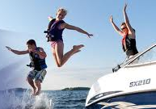
For most boaters (67%), an increased focus on boating safety would not change their current boating participation.
For one-quarter (27%), it would increase their participation, and very few (only 4%) would reduce their boating participation. This same pattern is evident in all regions.
Future Participation in Boating
if there was an increased focus on safety
Increased Participation
Top 2 Box: 27%
Decreased Participation
Bottom 2 Box: 4%
Net pts ∆ participation
+23
(Don't know / it depends: 2%)
501. If there were an increased focus on boating safety (e.g. encouraging more wearing of lifejackets, discouraging drinking while operating boats, etc.), what impact do you think it would have on your own personal participation in boating? (Select one)
Total respondents (n=1204)

Slide 68

There is a similarly positive influence on boating participation across
ALL boating activity subgroups, including Fishers.
Even more positive among Sailors and PWC riders.
Overall Future Participation in Boating if there was an increased focus on safety
Net ∆ pts Participation
Among Boater Sub-groups
+24
(n=746)
+28
(n=704)
+26
(n=574)
+36
(n=173)
+33
(n=137)
+23
(n=944)
Over 120 /Under 80 index compared to total boating population
501. If there were an increased focus on boating safety (e.g. encouraging more wearing of lifejackets, discouraging drinking while operating boats, etc.), what impact do you think it would have on your own personal participation in boating? (Select one)

Slide 69
There is a positive effect on participation amongst all the Fishing sub-groups. Even more positive for those fishing from large powerboats >6m and those fishing from canoes & kayaks.
Overall Future Participation in Boating if there was an increased focus on safety
Net ∆ pts Participation
Future Participation Intent among Fishers
Total Fishing (n=704)
+27
Fishing Drivers (n=401)
+29
Fishing Passengers only (n=303)
+25
From a Pwrbt <6m (n=513)
+24
From a Pwrbt >6m (n=175)
+38
From canoe or kayak (n=238)
+29
Over 120 /Under 80 index compared to total boating population
501. If there were an increased focus on boating safety (e.g. encouraging more wearing of lifejackets, discouraging drinking while operating boats, etc.), what impact do you think it would have on your own personal participation in boating? (Select one)

Slide 70
Summary Implications

Slide 71
Implications (for discussion)
Overall
“Green light” for stronger boating safety messaging & public education to contribute to healthy, growing Canadian recreational boating industry/participation!
  It’s part of the solution, not the problem.
Strong potential to “move the needle” to achieve more wearing of lifejackets and less drinking and operating boats, via strong communications and public education.
  Based on both the strong overall “pre” / “post” positive response from boaters; and the positive reaction to top messages tested.
  Motivators and potential messages look to have the power to overcome existing perceptions and barriers.
  Very strong consistency in these research results across boating sub-groups & regions… makes strong case for common communications focus with all boaters across the country.
New approaches, benefits, “angles” likely needed to stimulate increased participation in boating training/education programs.
  Boater perceptions of their knowledge and confidence broadly high, and existing latent interest in taking additional boating education/training is low.
  Among Fishers, women, parents, large powerboat >6m and canoe/
  kayak fishers express the most interest in boating education/ training.

Slide 72
Implications (for discussion)
Wearing Lifejackets
Confirmed there is significant lifejacket wearing upside we can target with Fishers, as well as with pleasure powerboaters and paddlers.
  Upside with all Fishing sub-groups (drivers and passengers; those who fish from small powerboats <6m, large powerboats and canoes/kayaks).
While not currently a focus for the CSBC and boating stakeholders, there is an appetite amongst boaters for stronger lifejackets/PFD legislation, that would require wearing of PFDs.
  Just as strong support among Fishers as among other boaters.
  Just as strong support now, as there was 11 years ago when the “Will it Float” study poll was conducted in 2003.
Significant opportunity to drive greater awareness and familiarity with inflatable and paddling-style lifejackets.
  Among Fishers, large upside for increased trial and usage with all Fishing sub-groups.
There is exciting potential for new public education communications messaging, to capitalize on the barriers, motivators, “themes” and convincing messages arising from this research.
  A lot of “arrows in our quiver”, but highest potential messaging well identified.
  For example …

Slide 73
Example of High Potential “Wear Your Lifejacket”
Communications focus
Barriers
to overcome
Motivators
Risk is low / unlikely to need it
Safety Net / Security
A lifejacket buys you time to be rescued if you fall out of your boat. It may be impossible to get back into your boat if it has swamped or capsized, and it may be too far to successfully swim to shore. Wearing a lifejacket will keep your head above water to survive until you are rescued.
Message Focus
Emotional Connection
Persuasive Supporting Facts
80% of people who drown while boating were not wearing a lifejacket, and they could have survived if they were.

Slide 74
Implications (for discussion)
Don’t drink and Operate a Boat
Upside with Fishers, as well as pleasure powerboaters and paddlers.
  Powerboat drivers and younger Fishers deserve special focus.
  Fishers in large powerboats >6m are the most frequent drinkers while fishing;
  but also one-quarter of fishers in small powerboats <6m and in canoes/ kayaks drinking at least sometimes, as well.
Significant opportunity to drive better awareness and understanding of the drinking and boating laws.
  Fishers equally unaware of drinking and boating laws, as pleasure powerboaters and paddlers.
  Only two-thirds of Fishers know it is illegal to operate any kind of a boat with a blood alcohol level of .08 or higher
  Only one-third of Fishers know it is illegal (ex Quebec) to drink in a boat <6m while anchored or docked.
Great potential for new public education communications messaging to reduce drinking when operating boats.
  For example …

Slide 75
Example of High Potential “Don’t Drink and Operate a Boat” Communications focus
Barriers
to overcome
Motivators
Safety net / Security
…The right thing to do…
…and avoid emotional pain (once they know)
I think it’s legal;
lack of awareness, knowledge
Impaired boating is impaired driving,
just like being impaired from drinking while driving a car. If you get caught impaired and operating a boat, it will result in heavy fines, criminal charges, a criminal record, jail time and seizing of your boat.
Message Focus
Emotional Connection
Impaired driving laws in Canada apply to driving a boat as well as to driving a car on the road.
Persuasive Supporting Facts
It is illegal to operate any boat while impaired
(i.e., with a blood alcohol level over .08).

Slide 76
Working Session agenda
Agenda
Insert agenda, as customized from separate Word doc, for the particular session

Slide 77
Appendix

Slide 78
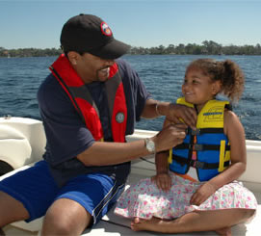
Background
Boating is a quintessential part of Canadian summer across this country. The canoe and kayak are cultural icons; fishing is one of the country’s most popular outdoor activities. Diehard aficionados sail, SUP, wakeboard, wind/kite surf and waterski.
Many Canadians have easy access to boats and water but not all are fully informed of the risks involved, and even fewer routinely follow safe boating practices.
The Canadian Safe Boating Council (CSBC) is leading a 3 year, multi-faceted initiative that is focused on raising knowledge and awareness of safe boating practices among Canadians, particularly boaters.
The ultimate goal is to increase the number of pleasure craft operators following safe boating practices; and to reduce the loss of life, injuries and property damage due to boating incidents.
Three principal target groups have been identified: pleasure power boaters, fishers and paddlers (canoe and kayak).
Of the five specific problem areas:
this research focuses on the first two.
    Not wearing lifejackets and PFDs
    Drinking and operating a boat
    Insufficient boating education and knowledge
    Lack of preparedness when a boating emergency occurs
    Lack of understanding and preparedness for cold water immersion

Slide 79
Sample Sizes by Key Demographics
Gender
Female | n=488 | 40%
Male | n=716 | 60%
Age
18-34 | n=338 | 28%
35-44 | n=249 | 21%
45-54 | n=291 | 24%
55-69 | n=326 | 27%
Region (Overlap in Northerners category)
British Columbia | n=260 | 22%
Prairies | n=164 | 14%
Ontario | n=329 | 27%
Quebec | n=298 | 25%
Atlantic | n=150 | 13%
Northerners | n=102 | 9%

Slide 80
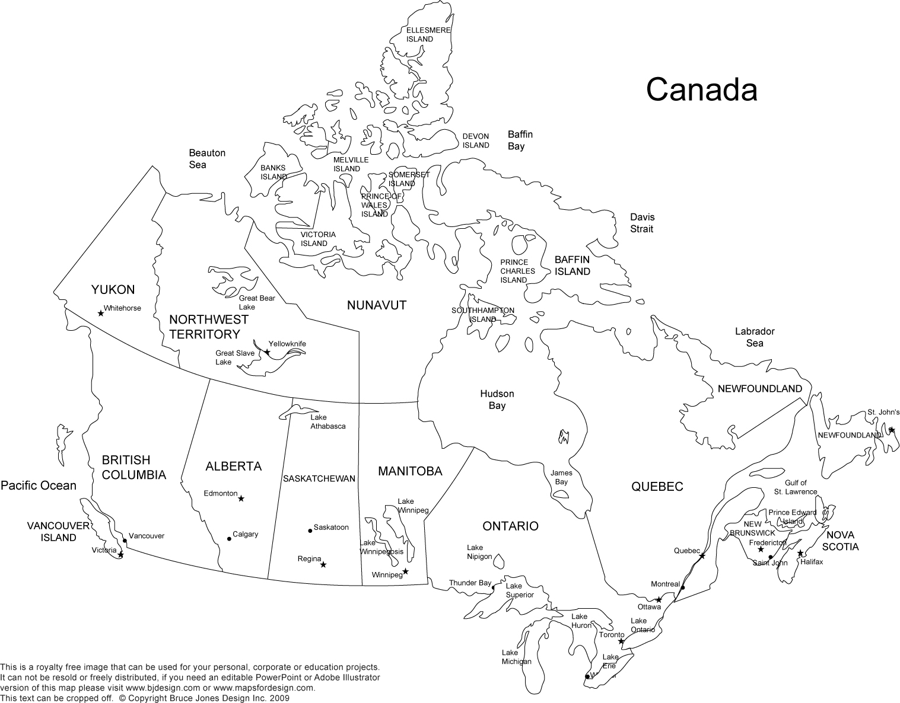
Northerners were defined as those ‘above the red line’

Slide 81
In an average year, over 8 in 10 boaters use a boat for recreational purposes.
Boating Purposes Incidence*
% of boaters
e.g. for leisure activities. Includes travel to and from water access leisure cottages/cabins. | e.g. part of daily living activities that are not recreational or occupational; excludes travel to and from water access leisure cottages/cabins | e.g. part of your job
*NOTE: This slide shows full response data for the question, including those who may have left/not qualified for the survey after this question.
S5. In an average year, do you use any boat or water craft (incl. powerboat, canoe, kayak, sailboat, etc.) for each of the following purposes? (Select all)
Total screened who answered S5 (n=4046)

Slide 82
Almost half of recreational boaters identify themselves as strong swimmers. Only a small percentage of these boaters are unable to swim, but 1 in 5 (19%) are weak swimmers.
Level of Swimming Ability
Strong Swimmers
45%
Weak Swimmers
19%
Total respondents (n=1204)
801. How would you describe your swimming ability? (Select one)

Slide 83
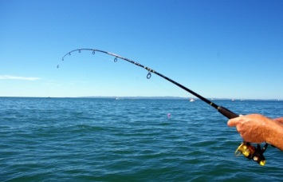
Fishing primarily occurs from a powerboat, especially those under 6 metres in length.
59% fish, at
least occasionally
However, one-third (34%) of Fishers fish from a canoe or kayak.
Types of Fishing Boats
Fishing from a Powerboat
88%
Those who fish at least occasionally (n=704)
S6. Which of the following types of boats do you fish from, at least occasionally? (Select all)

Slide 84
Men are much more likely than women to be powerboat drivers while fishing; men also more likely to be fishing from small powerboats under 6m.
Among older fishers 55-69 yrs, lower proportion of fishing from small powerboats <6m and from canoes/kayaks.
By region, lower proportion of fishing from small powerboats <6m and powerboat drivers in BC; and low proportion of fishing from
large powerboats >6m in Quebec.
 |  |  | Fish from a… |  |  | Fishing…
 | Total Boaters | Total Fishers | Pwrbt <6m | Pwrbt >6m | Canoe/ Kayak | Drivers | Passgrs only
Base | (n=1204) | (n=704) | (n=513) | (n=175) | (n=238) | (n=401) | (n=303)
BC | 22% | 19% | 17% | 26% | 19% | 16% | 22%
Prairies | 14% | 15% | 14% | 18% | 12% | 13% | 18%
Ontario | 27% | 26% | 27% | 31% | 27% | 29% | 23%
Quebec | 25% | 26% | 29% | 13% | 25% | 28% | 23%
Atlantic | 13% | 13% | 12% | 13% | 17% | 13% | 14%
North | 8% | 11% | 10% | 13% | 10% | 12% | 9%
Male | 60% | 65% | 68% | 65% | 64% | 76% | 52%
Female | 41% | 35% | 32% | 35% | 36% | 24% | 48%
Ages 18-34 | 28% | 26% | 25% | 34% | 32% | 25% | 26%
Ages 35-54 | 45% | 45% | 44% | 45% | 47% | 46% | 44%
Ages 55-69 | 27% | 29% | 31% | 21% | 21% | 29% | 30%
Parents | 35% | 38% | 38% | 38% | 42% | 40% | 34%
New Canadians | 4% | 4% | 4% | 6% | 6% | 4% | 4%
Strong Swimmers | 45% | 44% | 44% | 51% | 53% | 50% | 37%
Moderate Swimmers | 33% | 32% | 32% | 30% | 30% | 31% | 32%
Weak Swimmers | 19% | 19% | 19% | 14% | 14% | 15% | 24%
Unable to swim | 4% | 5% | 5% | 6% | 3% | 4% | 6%
Fishing Demographic Profile
Over 120/Under 80 index compared to total boating population

Slide 85
There is some variability in claimed wearing of lifejackets among key demographic subgroups.
Those unable to swim and Atlantic Canada are more likely to ‘always’ wear a lifejacket.
Ages 18-34, Ontario, New Canadians and strong swimmers are less frequent wearers of PFDs.
Overall Frequency of Wearing Lifejacket
Notable Differences in Frequent Wearing of Lifejackets - % ‘Always’ Wear
Age
Region
New Canadians
Swimming Level
Over 120 /Under 80 index compared to total boating population
103a. Overall, how often do you wear a lifejacket when in a boat? (Select one)

Slide 86
The most convincing Communications Message overall, is also most convincing with Fishers, Pleasure Powerboaters and Paddlers specifically
…a lifejacket buying you time if you fall out of your boat.
Messages about wearing a lifejacket
Top Communications Messages (6 of 10) for wearing lifejackets
 |  | MD Score
Rank | Communications Messages | Total Boaters
 |  | (n=602) | (n=287) | (n=251) | (n=350)
1 | A lifejacket buys you time to be rescued if you fall out of your boat. It may be impossible to get back into your boat if it has swamped or capsized, and it may be too far to successfully swim to shore. Wearing a lifejacket will keep your head above water to survive until you are rescued. | 8.8 | 8.7 | 8.8 | 8.9
2 | Being a good swimmer will not save you from the effects of cold water. Your muscles will begin to lose the capability for meaningful movement in approximately 10 minutes. Then you will gradually lose your ability to swim, your head will begin to slip under the water, and if you are not wearing a lifejacket you will drown | 8.1 | 7.9 | 8.2 | 8.2
3 | You can’t control the “shock effect” of falling unexpectedly into cold water. It causes a gasping reflex you can’t control. You may inhale water and drown within 1 minute if you are not wearing a lifejacket. | 7.9 | 7.6 | 8.0 | 8.1
4 | It is a lot harder and more dangerous to try to swim to shore without a lifejacket than you think, if you fall out of a boat or it capsizes/swamps,. The distance is often further than you think; it is hard to swim with clothes on or in rough water; and as fatigue sets in your swimming effectiveness is reduced. | 7.9 | 7.6 | 7.9 | 8.0
5 | Even in really cold water, you will remain conscious for 1 hour or so, even if you can no longer move your muscles to swim. Wearing a lifejacket will keep your head above water so you can survive without swimming until you are rescued. | 7.8 | 7.6 | 7.9 | 7.9
6 | You may not be able to control the “shock effect” of unexpectedly falling into deep water, even on a warm or hot summer day. The surprise may cause you to gasp, inhale water and drown within 1 minute if you are not wearing a lifejacket. | 7.7 | 7.3 | 7.7 | 7.9
Lifejackets: Group A only (n=602)
Q302. Here are some statements about wearing lifejackets while boating. Which one do you feel convinces you the most to wear a lifejacket more often and which one applies the least? (Select one)

Slide 87
The most effective Fact overall is also the most persuasive with Fishers, Pleasure Powerboaters and Paddlers specifically.
…informs boaters via past drowning statistics about the possibly fatal consequences of not wearing a lifejacket.
Facts about wearing a lifejacket
Top Supporting Facts (6 of 9) for wearing lifejackets
 |  | MD Score
Rank | Supporting Facts | Total Boaters
 |  | (n=602) | (n=290) | (n=250) | (n=349)
1 | 80% of people who drown while boating were not wearing a lifejacket and they could have survived if they were. | 8.8 | 8.6 | 8.8 | 8.9
2 | 70% of boating fatality victims were with other people (ie. not alone), who were NOT able to rescue them. | 8.1 | 7.8 | 8.2 | 8.2
3 | In a controlled “test” of fishermen who fell out of their small powerboat, 1000 metres from shore, fully clothed, not wearing a lifejacket, and tried to swim to shore, 7 out of 10 did not make it. | 7.9 | 7.7 | 7.8 | 8.0
You may unexpectedly and suddenly, end up in the water due to swamping, capsizing or falling overboard, because of external factors beyond your control such as…
4 | … Careless / inattentive / distracted driving of a boat by “the other guy”; e.g. your boat has to suddenly swerve, or another powerboat or personal watercraft runs over/collides with your canoe/kayak, pedal boat or powerboat. | 7.8 | 7.7 | 7.8 | 7.9
5 | … Unknown or unexpected rocks, submerged/partially floating logs, tree stumps or other obstacles in the water that you do not see. | 7.8 | 7.8 | 7.8 | 7.8
6 | …Rough water, due to rapid changes in weather or unexpected effects of waves from other boats. | 7.8 | 7.7 | 7.9 | 7.8
Q303. Here are some facts about wearing lifejackets while boating. Which one do you feel convinces you the most to wear a lifejacket more often and which one convinces you the least? (Select one)
Lifejackets: Group A only (n=602)

Slide 88
The strongest regional intent to improve lifejacket compliance is in BC, Ontario and Quebec. And there is broad-based positive impact on intent to ‘always’ wear lifejackets across almost all demographic sub-groups.
Regions: Current Behaviour & Future Intent to Wear a Lifejacket
 | Current Behaviour: “Always” wear a lifejacket |  | Future Intended Behaviour to “Always” wear a lifejacket |  | Difference ∆ pts
Total Group A | 54% |  | 66% |  | +12
BC (n=130) | 51% |  | 65% |  | +14
Prairies (n=82) | 61% |  | 68% |  | +7
Ontario (n=164) | 46% |  | 61% |  | +15
Quebec (n=149) | 58% |  | 70% |  | +11
Atlantic (n=76) | 59% |  | 67% |  | +8
North (n=55) | 47% |  | 58% |  | +11
Statistically significant change
Over 120/Under 80 index compared to total Group A
103a. Overall, how often do you wear a lifejacket when in a boat? (Select one )
304. How often do you think you will wear a lifejacket when in a boat in the future? (Select one)

Slide 89
There is a broad-based positive impact on intent to ‘always’ wear lifejackets across demographic subgroups. Boaters who are unable to swim are more apt to wear a lifejacket currently, and in the future.
Key Subgroups: Top Box Current Behaviour & Future Intent to Wear a Lifejacket
 | Current Behaviour: “Always” wear a lifejacket |  | Future Intended Behaviour to “Always” wear a lifejacket |  | Difference ∆ pts
Total Group A | 54% |  | 66% |  | +12
Males | 55% |  | 65% |  | +10
Females | 53% |  | 67% |  | +14
Ages 18-34 | 45% |  | 58% |  | +13
Ages 35-44 | 56% |  | 66% |  | +10
Ages 45-54 | 58% |  | 73% |  | +15
Ages 55-69 | 59% |  | 67% |  | +8
Total Swimmers | 53% |  | 65% |  | +12
Weak Swimmers | 59% |  | 72% |  | +13
Strong Swimmer | 46% |  | 56% |  | +11
Unable to swim | 74% |  | 87% |  | +13
Parents (of children <18) | 54% |  | 65% |  | +12
No Children | 53% |  | 65% |  | +13
Statistically significant change
103a. Overall, how often do you wear a lifejacket when in a boat? (Select one )
304. How often do you think you will wear a lifejacket when in a boat in the future? (Select one)
Over 120/Under 80 index compared to total Group A

Slide 90
Powerboat drivers and younger boaters admit to drinking alcohol more often while boating; those unable to swim appear cautious and are more likely to ‘never’ drink.
Overall Frequency of Drinking Alcohol while Boating
Notable Differences in Frequency of Drinking Alcohol while Boating
Powerboat Drivers/Passengers
Age
Region
Swimming Level
Over 120/Under 80 index compared to total boating population
103b. Overall, which of the following applies to you personally when you are in a boat?
(Select one)

Slide 91
More boaters in the Prairies and Ontario understand it is illegal to carry open alcohol in a boat under 6m, and illegal to drink in a boat under 6m while docked/anchored; responses of Quebec boaters reflect less restrictive Quebec laws.
Regional: Awareness of Laws regarding Drinking Alcohol while Boating
 | BC | Prairies | Ontario | Quebec | Atlantic | North
Base | 260 | 164 | 329 | 298 | 150 | 102
It is illegal to operate a powerboat under 6m (20 feet) in length with a blood alcohol level of .08 or higher | 71% | 80% | 77% | 73% | 69% | 84%
It is illegal to operate any kind of boat, including a canoe or kayak, with a blood alcohol level of .08 or higher | 61% | 72% | 69% | 65% | 65% | 66%
It is illegal to drink alcoholic beverages when the boat is moving / underway | 51% | 64% | 66% | 49% | 53% | 65%
It is illegal to carry any open containers of alcoholic beverages in a boat under 6m that is underway/moving | 25% | 42% | 38% | 24% | 31% | 32%
It is illegal to drink alcoholic beverages in a boat under 6m while it is docked or anchored | 49% | 66% | 66% | 36% | 50% | 60%
It is illegal to be in any kind of boat as a passenger with a blood alcohol level of .08 or higher | 25% | 30% | 24% | 24% | 31% | 30%
It is OK to drink alcoholic beverages in a boat under 6m as long as the operator does not have a blood alcohol level of .08 or higher | 22% | 18% | 23% | 32% | 24% | 28%
None of these | 2% | - | 2% | 2% | 3% | 2%
Don't know | 11% | 8% | 6% | 7% | 8% | 7%
Over 120/Under 80 index compared to total boating population
203. Here are some statements about the laws regarding drinking alcoholic beverages while boating. Which ones do you think are correct? (Select all)

Slide 92
The most convincing Communications Messages overall, are also most convincing with Fishers, Pleasure Powerboaters and Paddlers specifically.
Messages about drinking while boating
Communications Messages for drinking while operating a boat
 |  | MD Score
Rank | Communications Messages | Total Boaters
 |  | (n=602) | (n=297) | (n=268) | (n=360)
1 | Impaired boating is impaired driving, just like being impaired from drinking while driving a car. If you get caught impaired and operating a boat, it will result in heavy fines, criminal charges, a criminal record, jail time and seizing of your boat. | 9.0 | 8.8 | 8.9 | 9.0
2 | You will have to live with the pain and guilt of knowing you killed someone you love, if you kill someone while operating a boat after drinking. | 8.5 | 8.5 | 8.5 | 8.5
3 | The legal consequences of being caught drinking and operating your boat could also be applied to driving your car, i.e. your road driving license would be suspended. | 8.5 | 8.2 | 8.5 | 8.5
4 | Enforcement and the risk of getting caught drinking and operating your boat is increasing… more police spot checks, more unmarked patrol boats, more 9-1-1 calls reporting impaired boaters | 7.4 | 7.2 | 7.3 | 7.6
5 | The influence of alcohol can be much worse in a boat than on land due to the effects of sun, wind, waves, motion, darkness and weather. You greatly increase the chances of killing someone you care about, if you operate a boat after drinking. | 7.2 | 7.0 | 7.2 | 7.2
6 | By drinking and operating a boat, you are setting a bad example, by showing children and young adults you boat with that it is OK to drink and drive a boat. | 6.9 | 6.8 | 6.6 | 6.9
7 | By having a designated driver/skipper when out in a boat with friends/family, you can reduce the risk of having a drinking and boating accident or getting caught for impaired boating. | 6.7 | 6.6 | 6.6 | 6.9
Q402. Here are some statements about drinking alcoholic beverages while boating. Which one do you feel convinces you the most to not drink while operating a boat and which one convinces you the least? (Select one)
Alcohol: Group B only (n=602)

Slide 93
The most effective Facts overall are also the most persuasive with Fishers, Pleasure Powerboaters and Paddlers specifically.
Facts about drinking while boating
Supporting Facts for drinking while operating a boat
 |  | MD Score
Rank | Supporting Facts | Total Boaters
 |  | (n=602) | (n=297) | (n=263) | (n=361)
1 | Impaired driving laws in Canada apply to driving a boat as well as to driving a car on the road. | 8.5 | 8.3 | 8.5 | 8.6
2 | It is illegal to operate any boat while impaired (i.e., with a blood alcohol level over .08). | 8.4 | 8.2 | 8.3 | 8.4
3 | Alcohol is involved in more than 40% of boating fatalities. | 7.9 | 7.7 | 7.9 | 8.0
4 | It is illegal for boat operators or passengers to consume alcoholic beverages when the boat is moving / underway on any recreational boat. | 7.4 | 7.2 | 7.3 | 7.5
5 | In a controlled “test”, boaters were tested who had been drinking but were NOT impaired (blood alcohol levels between .030 and .049 BAC). ALL of them were able to operate a small outboard motorboat to navigate safely/correctly through an obstacle course before drinking. NONE of them were able to safely/correctly navigate through the same obstacle course after drinking. | 7.2 | 6.9 | 7.3 | 7.1
6 | It is illegal to consume alcoholic beverages on any boat that is anchored or docked unless the boat is equipped as a residence, with cooking, sleeping and sanitation facilities. | 6.1 | 5.8 | 5.9 | 6.2
7 | It is illegal to carry open alcoholic beverages on a boat unless the boat is equipped with cooking, sleeping and sanitation facilities. | 6.0 | 5.8 | 5.8 | 6.1
Q403. Here are some facts about drinking alcoholic beverages while boating. Which one do you feel convinces you the most to not drink while operating a boat and which one convinces you the least? (Select one)
Alcohol: Group B only (n=602)

Slide 94
All regions show a stronger level of intent to ‘never’ drink alcoholic beverages in the future during boating activities.
Regions: Current Behaviour & Future Intent to Drink Alcohol while Boating
 | Current Behaviour: “Never” drink alcohol while boating |  | Future Intended Behaviour to “Never” drink alcohol while boating |  | Difference ∆ pts
Total Group B | 50% |  | 70% |  | +20
BC (n=130) | 49% |  | 69% |  | +20
Prairies (n=82) | 60% |  | 78% |  | +18
Ontario (n=165) | 55% |  | 74% |  | +19
Quebec (n=149) | 38% |  | 60% |  | +22
Atlantic (n=74) | 54% |  | 70% |  | +16
North (n=47) | 47% |  | 64% |  | +17
Statistically significant change
103b. Overall, which of the following applies to you personally when you are in a boat? (Select one)
404. Which of the following would best describe how you will behave when operating a boat
in the future? (Select one)
Over 120/Under 80 index compared to total Group B

Slide 95
There is a broad-based increase in future intent to ‘never’ drink alcohol while boating, across demographic subgroups. Those unable to swim report a lower increase in willingness to ‘never’ drink while boating since this group is already highly likely to not drink while boating.
Key Subgroups: Bottom Box Current Behaviour & Future Intent to Drink Alcohol while Boating
 | Current Behaviour: “Never” drink alcohol while boating |  | Future Intended Behaviour to “Never” drink alcohol while boating |  | Difference ∆ pts
Total Group B | 50% |  | 70% |  | +20
Males | 51% |  | 67% |  | +17
Females | 49% |  | 73% |  | +24
Ages 18-34 | 37% |  | 55% |  | +18
Ages 35-44 | 50% |  | 73% |  | +23
Ages 45-54 | 54% |  | 72% |  | +18
Ages 55-69 | 59% |  | 79% |  | +20
Total Swimmers | 49% |  | 69% |  | +20
Strong Swimmer | 48% |  | 67% |  | +19
Unable to swim | 71% |  | 83% |  | +13
Parents (of children <18) | 45% |  | 69% |  | +24
No Children | 53% |  | 70% |  | +16
Statistically significant change
103b. Overall, which of the following applies to you personally when you are in a boat? (Select one)
404. Which of the following would best describe how you will behave when operating a boat
in the future? (Select one)
Over 120/Under 80 index compared to total Group B

Slide 96
A similarly positive influence across regions.
There is slightly less upside in Quebec and among Northerners, but still very positive.
Overall Future Participation in Boating if there was an increased focus on safety
Net ∆ pts Participation
Among Regions
+27
BC
Prairies
Ontario
Quebec
Atlantic
North
(n=260)
+21
(n=164)
+22
(n=329)
+19
(n=298)
+28
(n=150)
+17
(n=102)
Over 120 /Under 80 index compared to total boating population
501. If there were an increased focus on boating safety (e.g. encouraging more wearing of lifejackets, discouraging drinking while operating boats, etc.), what impact do you think it would have on your own personal participation in boating? (Select one)

