Slide 1
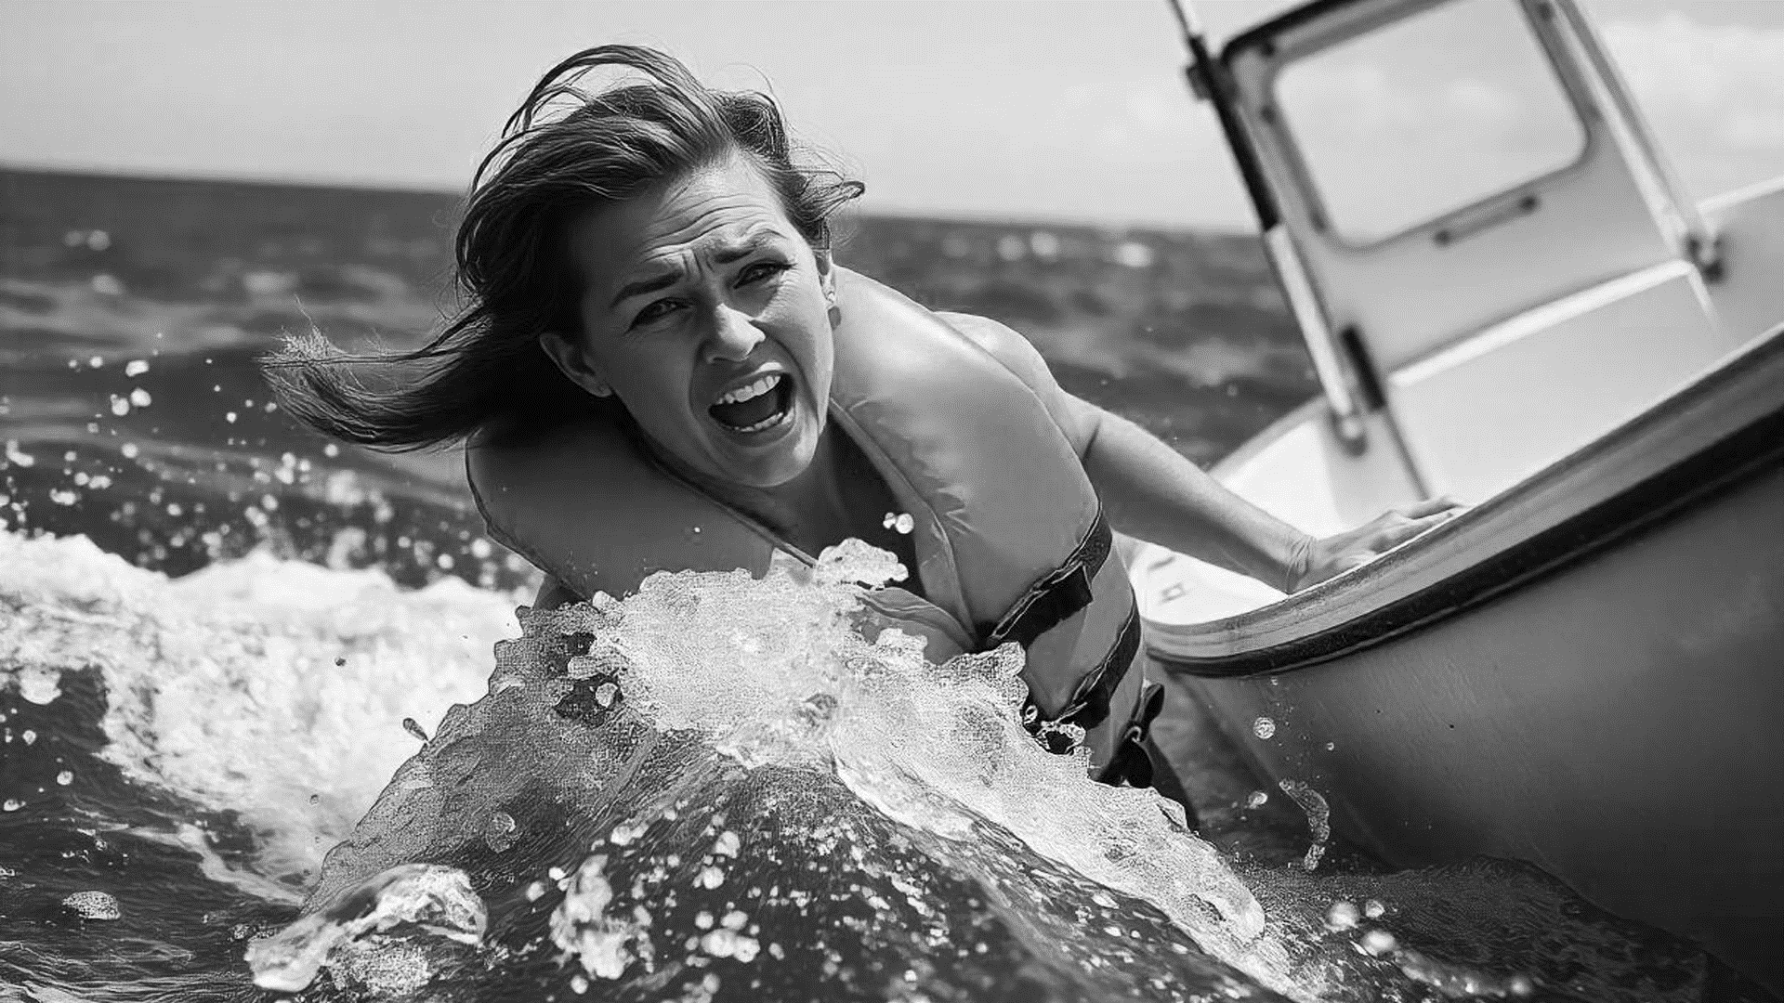


Human Reaction Research
Shock and Awe Project
Notes:
The Shock Factor is the working title for the official Shock and Awe SAR NIF project. This 3-year national drowning prevention program aimed to reduce incidents and enhance the effectiveness of SAR by demonstrating to Canadian boaters that they are more susceptible to drowning during accidental immersion than they might think, with the ultimate goal of increasing lifejacket wear.

Slide 2

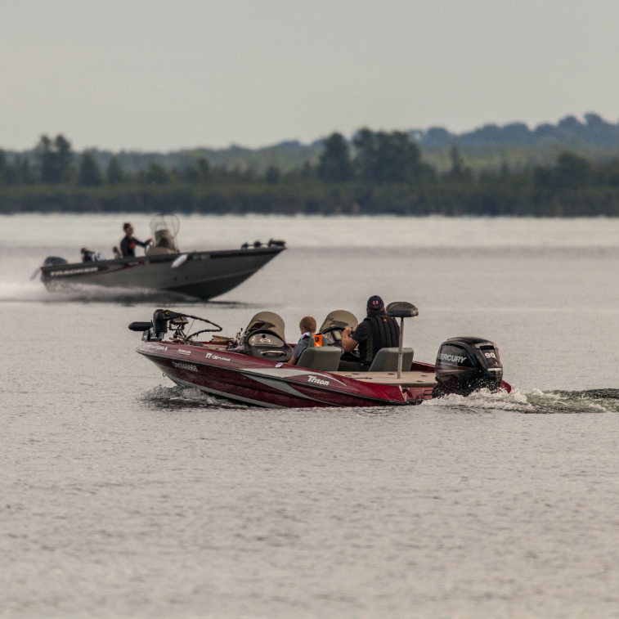
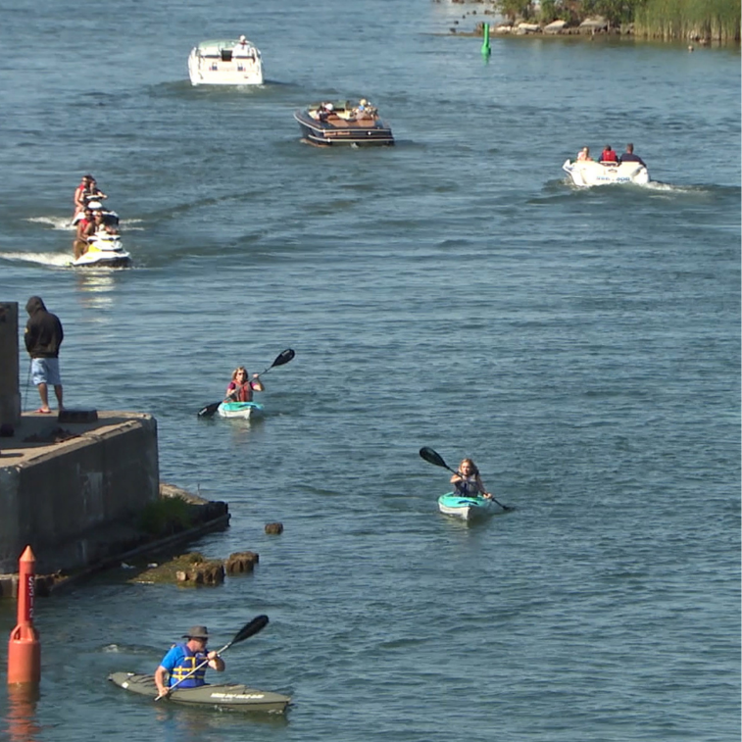
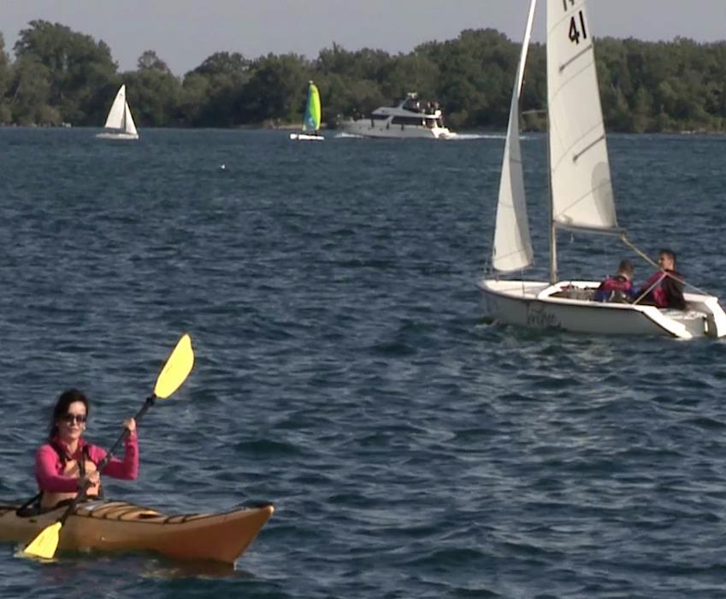
The Premise
Notes:
What was the premise behind The Shock Factor?
With The Shock Factor, we aimed to work with real boaters to debunk the myths and excuses many have for not wearing a lifejacket. Through a series of experiences, we demonstrated the real risks associated with the “shock factor” of an unexpected fall from a boat – risks that can lead to outcomes capable of ruining a boater’s day on the water.
Dr. Giesbrecht was once again part of the research team, contributing to the creation and design of the experiences, as well as analyzing the physiological data.
Our ultimate goal was to engage boaters and help them believe in and understand the importance of always wearing a lifejacket while boating, as anything can happen that might unexpectedly put them in the water.
What were the experiences conducted during The Shock Factor that helped us achieve this ultimate goal?

Slide 3
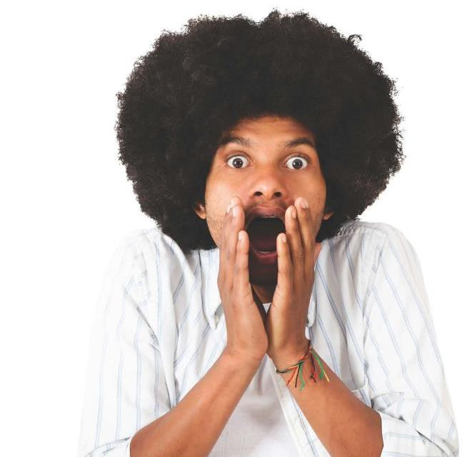
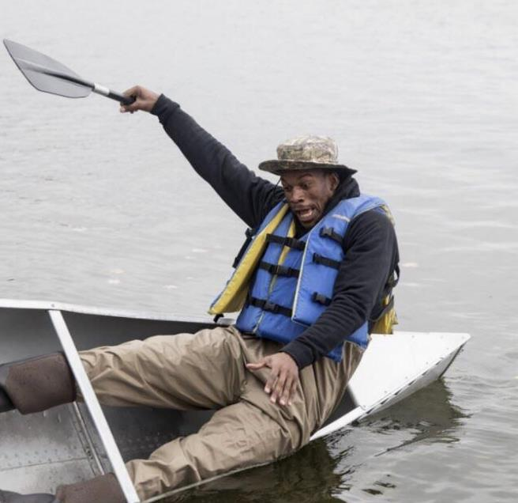
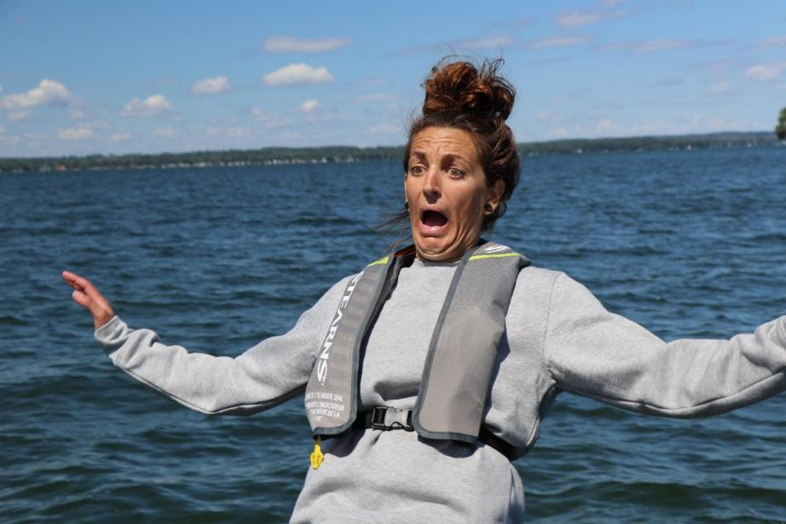
Human Reaction Research
Notes:
With the human reaction research experiences, we aimed to demonstrate that the shock or surprise of an unexpected fall overboard causes a “GASP” reaction, which can be “deadly” no matter the time of year or the water temperature.
Building on the knowledge gained during Cold Water Bootcamp and Beyond Cold Water Bootcamp, these experiences were designed to show that it doesn’t matter how experienced a boater you are, how well you can swim, what the water temperature is (warm or cold), or how close your lifejacket may be. When you are boating, there is always a risk of an unexpected fall into the water.

Slide 4
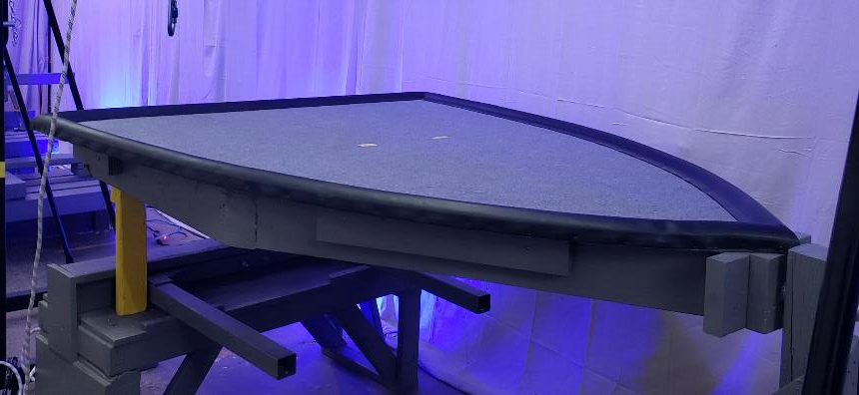
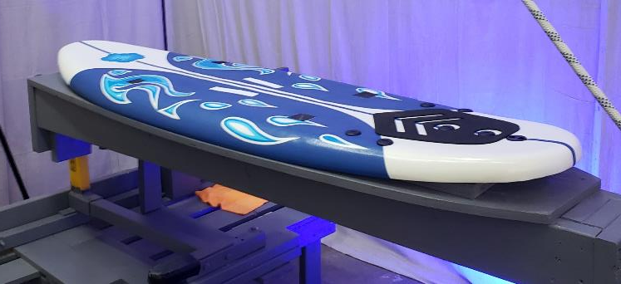
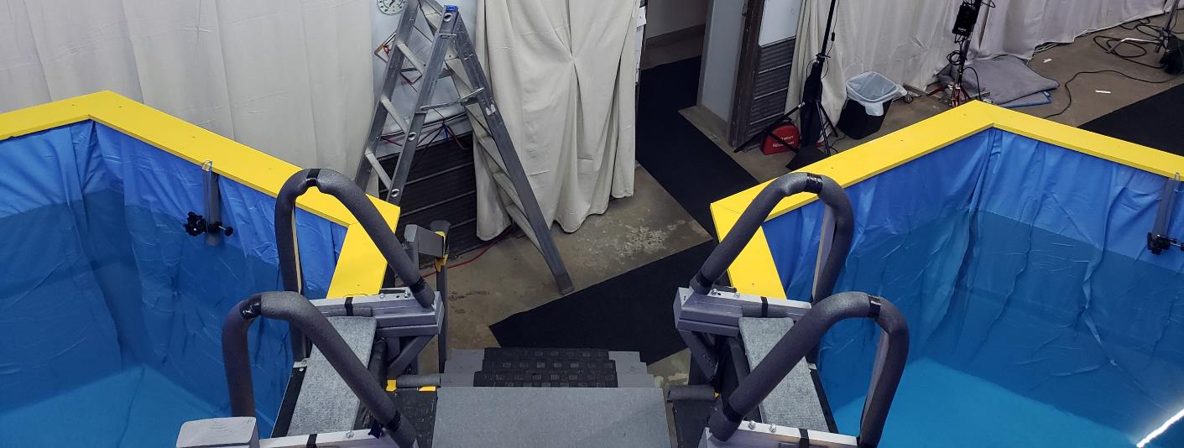
Human Reaction Research – The Experiences
Notes:
Four experiences were designed for Shock Factor. These experiences aimed to place participants in surprise situations to record their reactions, both physical and physiological.
These included two virtual reality experiences and two physical experiences. The virtual reality scenarios were:
VR SUP
VR Fishing on a Bass Boat
The physical experiences were:
3. Warm Water Dunk Tank
4. Cold Water Dunk Tank
These experiences were designed to represent the ‘surprise’ of an unexpected fall into the water.

Slide 5
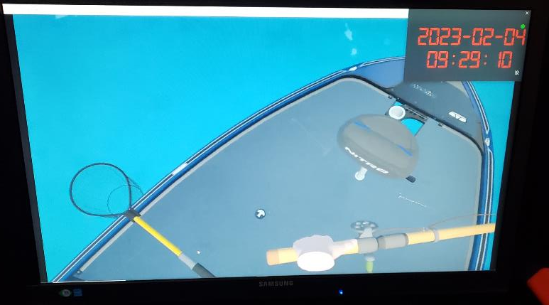
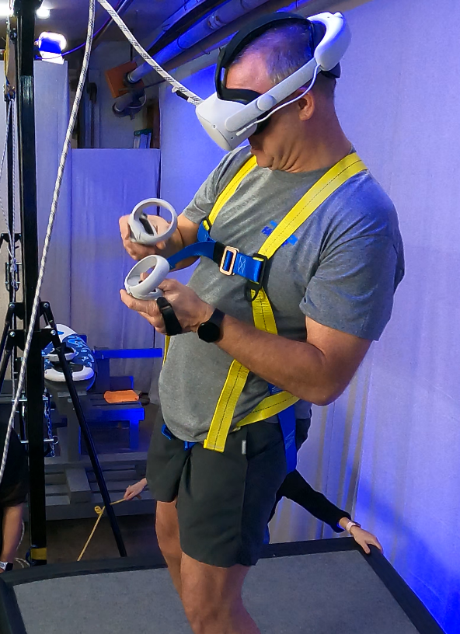
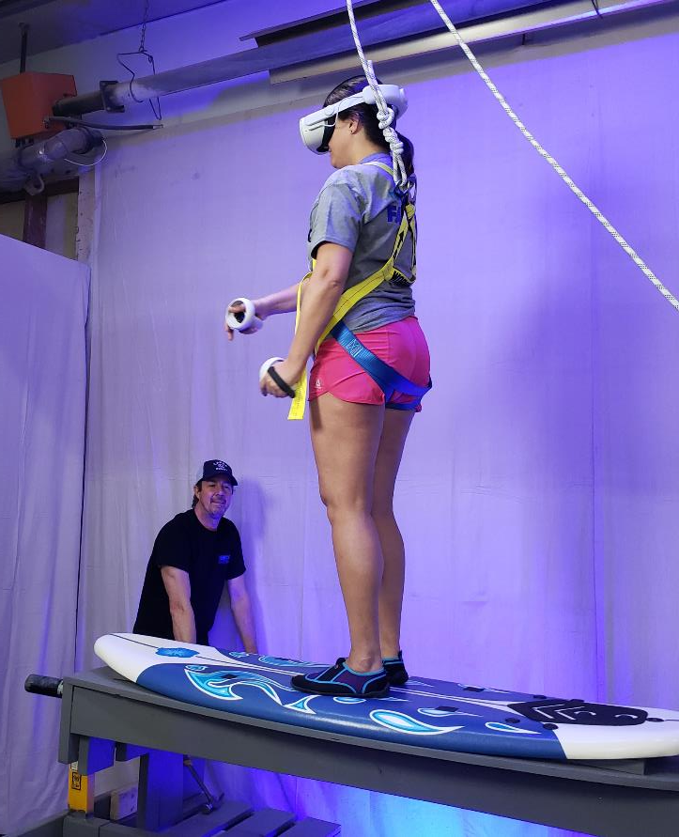
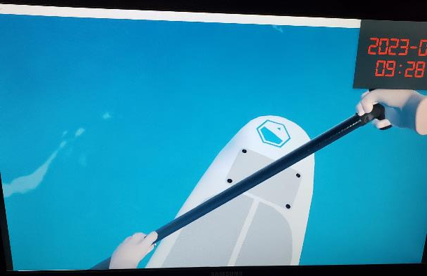
How the VR Worked
Notes:
The VR experiences were designed closely simulate real-life boating scenarios where the risk of unexpected immersion is higher.
For example, according to the 2024 LSS National Drowning Statistics, 12% of drowning incidents involved individuals who were fishing.
Several factors contribute to these accidents, such as the low profile of the front deck and the fact that most anglers stand while casting or reeling in a fish. Fisherpeople can easily become preoccupied, especially when trying to land a fish. This 'multi-tasking' or 'lack of attention to their surroundings' increases the risk of falling overboard due to instability, leaning too far while landing a fish, or other factors.
The goal of the Fishing VR scenario is to show the boating public, particularly fisherpeople, the dangers of not wearing a lifejacket. While the scenario focuses on fishing, the principles also apply to other boating activities, such as pulling up an anchor or assisting a tuber or skier from a swim platform. The risk is always higher when you are in an unstable' position.
The SUP was chosen because the risk of unexpectedly falling off is significant. Stand-up paddleboarding relies heavily on balance, and even a small wave can disrupt the balance of an experienced user.
Another reason for choosing the SUP is supported by research. According to the 2023 USCG lifejacket wear study, approximately 50% of SUP users wear a lifejacket. Additionally, the RTF 2021/2022 aerial study observed that 40% of SUP users were wearing a PFD.
The goal of this VR experience was to show the SUP community how risky it can be to use a SUP without wearing a lifejacket.

Slide 6
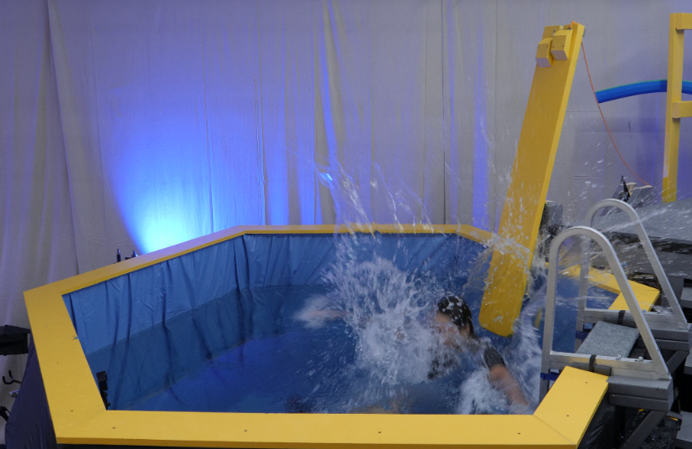
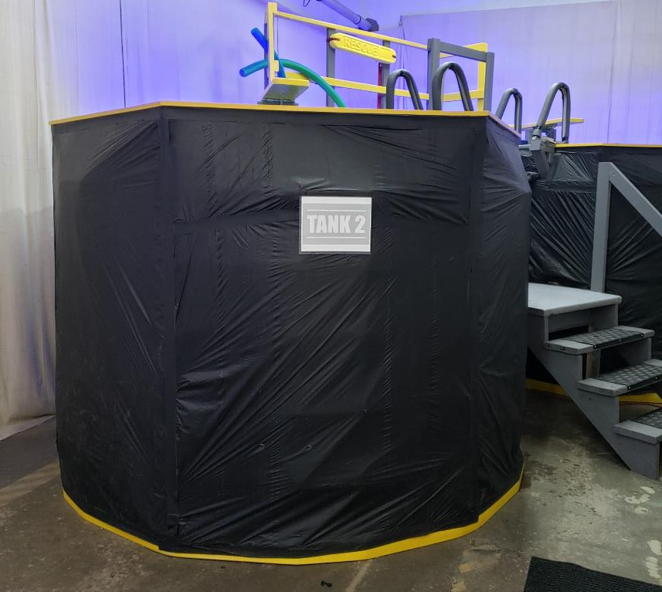
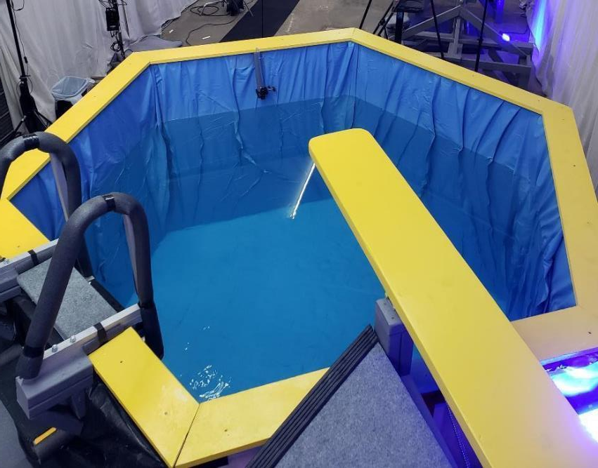
The Dunk Tanks
Notes:
Cold Water Bootcamp demonstrated the effects of cold water on the body, such as the gasp reflex and loss of mobility in the extremities.
For the Shock Factor, we “raised” the water temperature to determine if there was a difference in the body’s reaction to an unexpected immersion.
Two dunk tanks were constructed: one was heated to approximately 35°C (body temperature), and the other was kept at the facility’s room temperature of 16°C. This is equivalent to the water temperature of many Canadian inland lakes in June.
During the experiences, participants sat at the edge of the platform. The researcher’s job was to “distract” them by talking about the cool underwater images displayed on a TV screen in front of them.
While participants knew they would be “dunked”, they didn’t know exactly when. It was this element of surprise that allowed us to record their reactions.

Slide 7
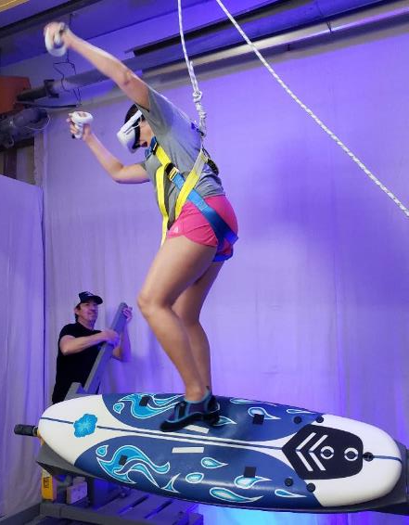
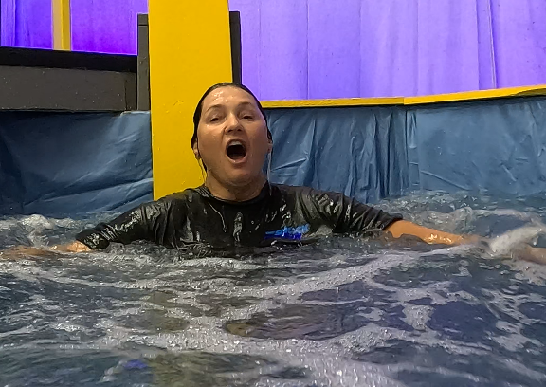
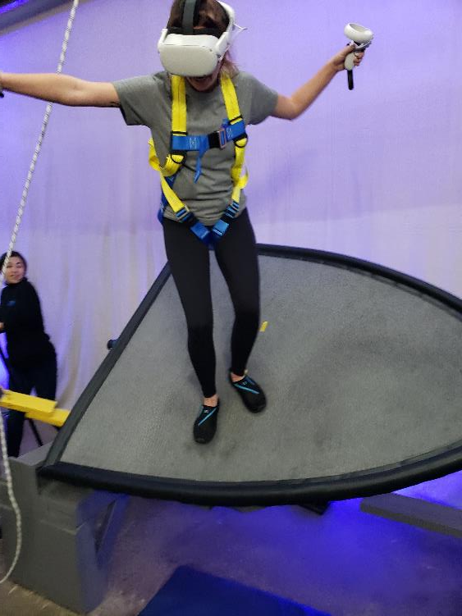
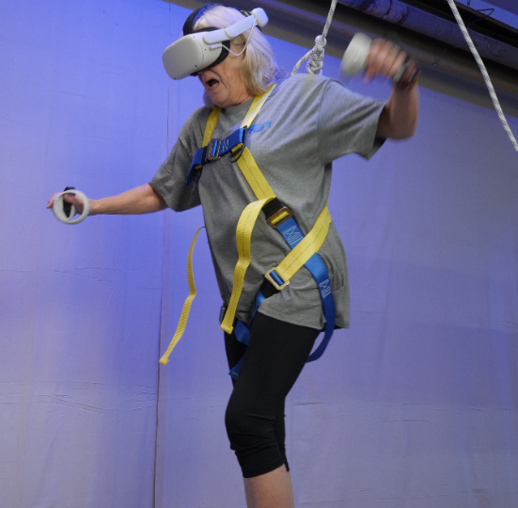
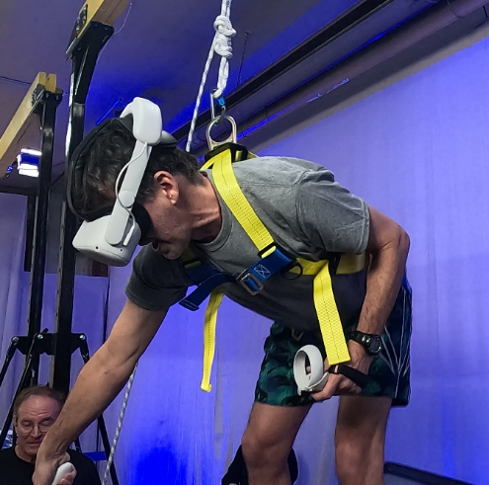
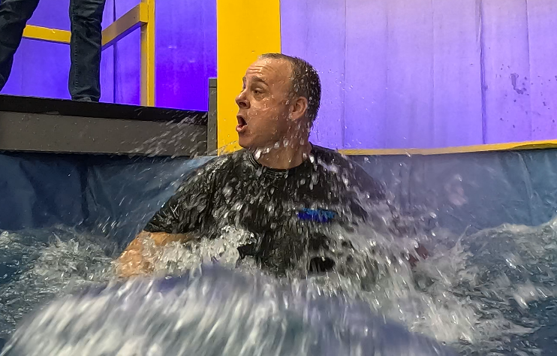
How We Measured –
Physical Reactions
Notes:
For all the experiences, we used a combination of 7 GoPros and cameras to record the participants’ physical reactions.

Slide 8
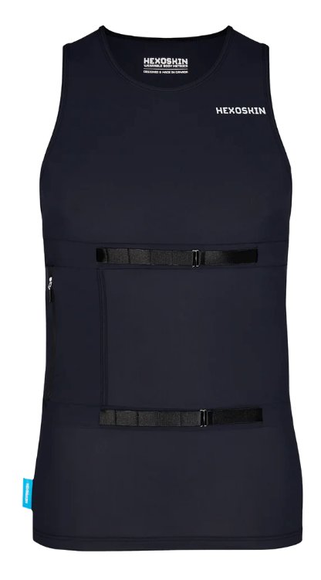
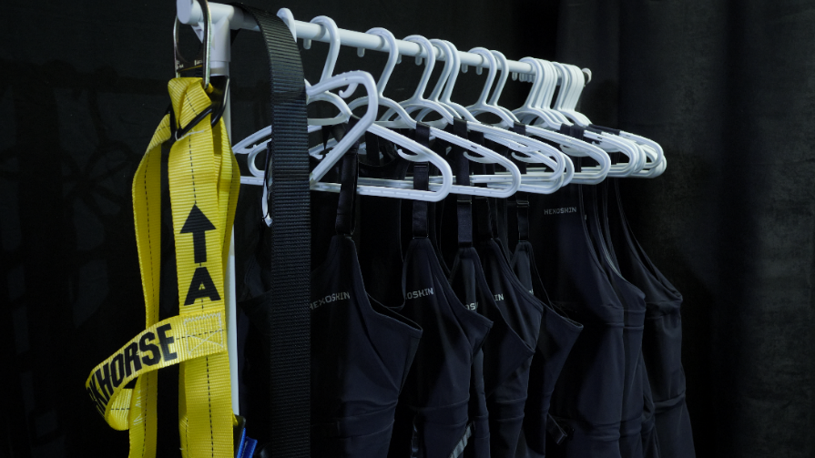
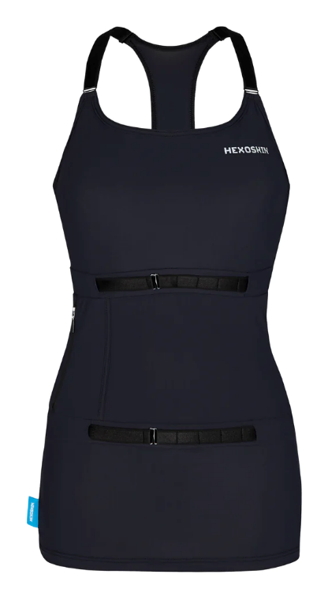
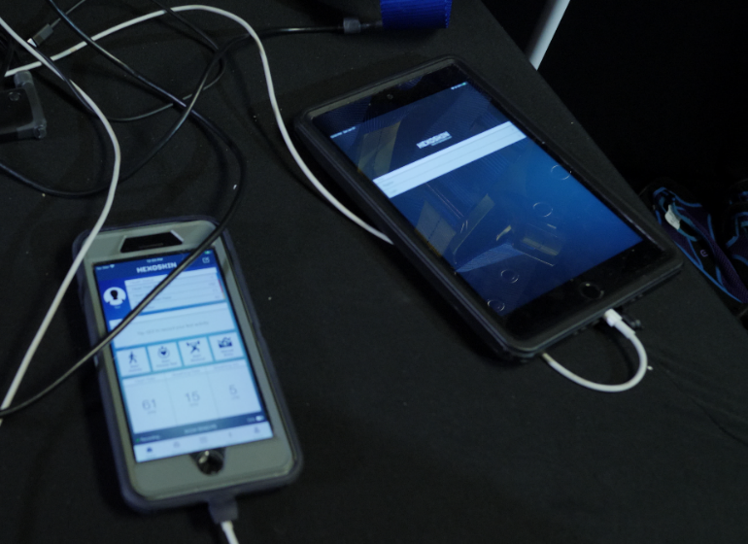
Physiological Data Measuring – Hexoskin
Notes:
During the experiences, physiological reactions were also recorded using smart technology garments called Hexoskin shirts. These shirts have three sensors built into their design: two thoracic sensors and one abdominal sensor. The Hexoskin continuously collects 1-lead electrocardiogram (ECG) data at 256 Hz and is equipped with two respiratory inductive plethysmography (RIP) sensors operating at 128 Hz each, as well as a 3-axis accelerometer at 64Hz. This setup generates a high-resolution dataset with over 42,000 data points per minute.

Slide 9
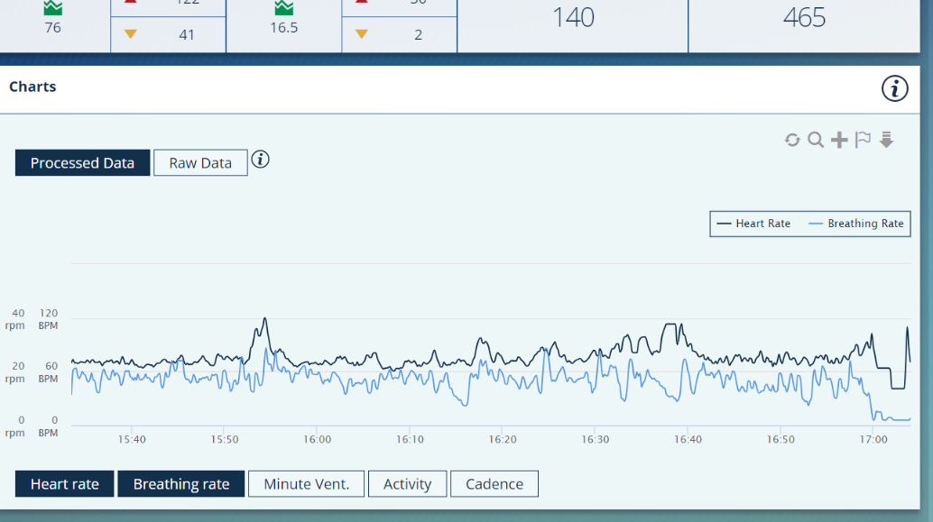
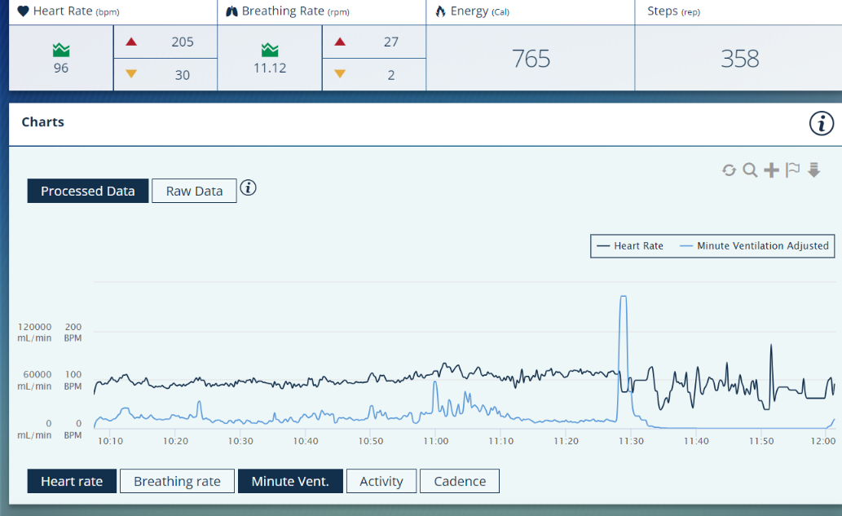
Hexoskin Data
Notes:
All the data collected during the participants' experiences was uploaded into the Hexoskin software, which enabled us to process and export the raw data for analysis. Each participant was assigned a unique code to ensure that all data records were kept separate and organized.

Slide 10
Analysing the Hexoskin Data
Legend
VT = Tidal Volume or Breath Size
SUP = SUP VR
FB = Fishing Boat VR
WW = Warm Water Dunk Tank
CW = Cold Water Dunk Tank
Notes:
With all this data available, what does it mean? Dr. Gord Giesbrecht’s team reviewed the data and determined that breath size, also known as tidal volume, provided the clearest results. In the graph above, the blue represents the baseline average breath size while the participant was “resting”, and the teal represents the average maximum breath size during the dunking or tipping of the vessel.
The results show that the surprise experiences caused a measurable gasp-like response in the participants. For the VR SUP and fishing boat scenarios, there was an average 4-fold increase in breath size. In the dunk tanks, there was an average 6.5-fold increase.
So, what can we take away from this data? Humans have a natural GASP, or increased inhalation size, when surprised. Unexpectedly falling into water, regardless of the temperature, can cause a very large inhalation. If the person’s head is submerged, this could mean inhaling water, which poses a serious risk.

Slide 11
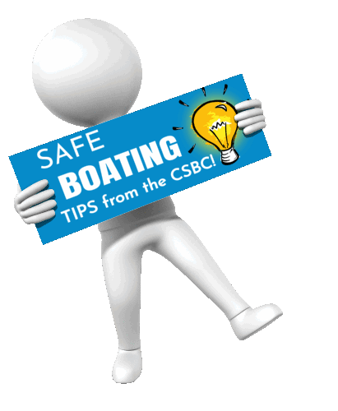
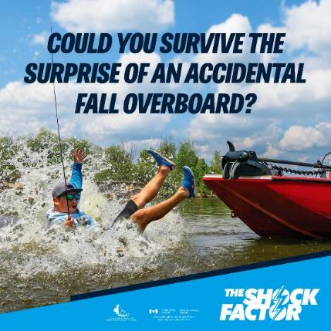
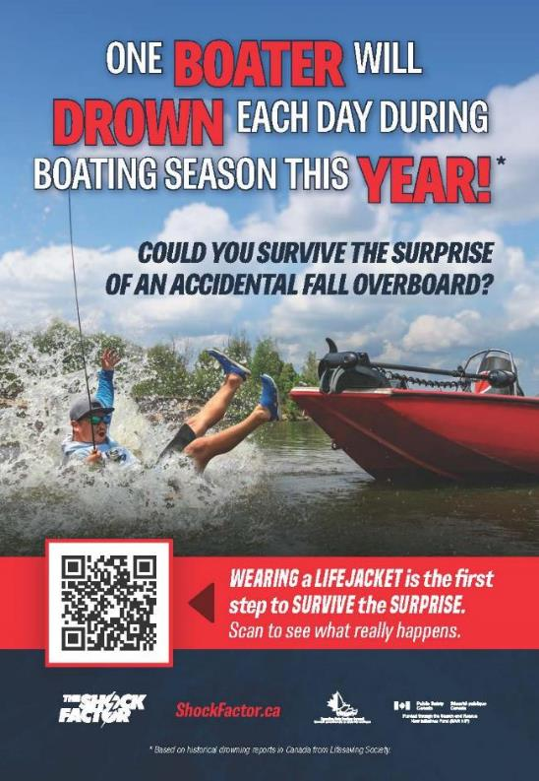
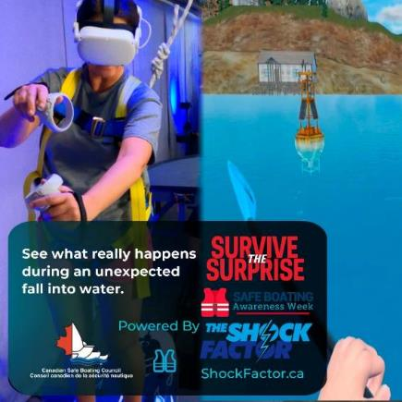
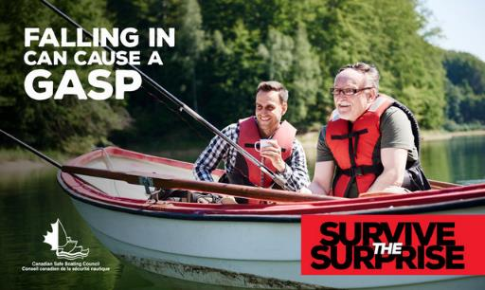
Sharing the Message
        Social Media
Marketing Campaign
Notes:
How did we move forward with all this information?
The message about the dangers of the GASP reflex no matter what the water temperature is and the importance of always wearing a lifejacket became the focus of the out-of-home advertising campaign and the theme in the social media posts.

