Slide 1



Research That Floats (“RTF”)
Lifejacket Wear Research &
Communications Outreach Opportunities
      Prepared for: Canadian Safe Boating Council & Partners
      Prepared by: McCullough Associates, Gadd Research & Playsafe Productions
        Date: March 2023
Gadd Research

Slide 2
Presentation Flow / Contents
Slide #
Introduction 3
RTF Observational Research Approach & Learning 6
RTF Lifejacket Wear Public Education Campaign 28
RTF Campaign Evaluation 35
RTF Observed Lifejacket Wear Rates Before & After Campaign 50
RTF Campaign – Local Markets Toolbox & Opportunities for Roll-out 62
Call to Action 74

Slide 3
Introduction

Slide 4
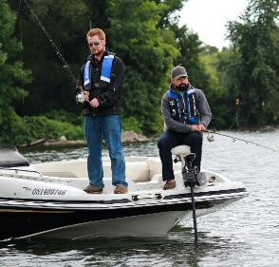
‘Research That Floats’ Project Objectives
The overall RTF desired outcome is to identify how to increase lifejacket wear among recreational boaters, to help reduce drownings.
Measure and share Lifejacket Wear Rates for Canadian Boaters on inland lakes.
Actual observed lifejacket wear rates, over 2 boating seasons.
Develop and test a Lifejacket Wear public education / communication campaign.
To determine if it can change boaters’ lifejacket wear behaviour.
Share the RTF results and learning broadly, among boating safety stakeholders.
Notes:
Lifejacket wear rates were measured in the summers of 2021 (baseline) and 2022 (after campaign implemented).
We will show you the Campaign that was developed and tested.

Slide 5
RTF Key Project Elements
Conducted a robust baseline aerial observational lifejacket wear rate research study.
Developed and implemented a Lifejacket Wear public education / communication campaign, in the inland lake test areas.
Conducted a second year of aerial observational lifejacket wear research, during and after the implementation of the campaign.
Conducted an On-Water intercept research survey to further understand boater lifejacket wear attitudes and evaluate the impact of the campaign.
Share the RTF results and learning broadly, among boating safety stakeholders.
Notes:
We have completed #’s 1 through 4, and are sharing the results with you in this presentation.

Slide 6
RTF
Observational Research
Approach

Slide 7
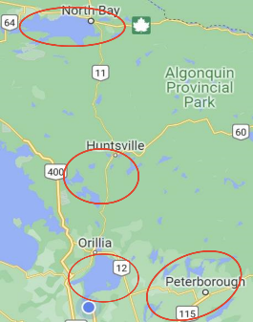
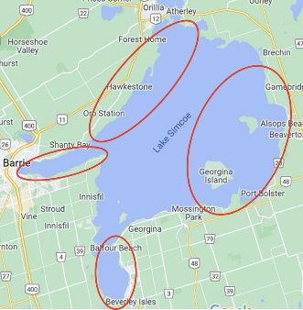
RTF Observational Research – Recreational Boaters & their Lifejacket Wear
Where: Selected Ontario inland lake regions:
  Nipissing Lakes, Almaguin, Muskoka & Haliburton Lakes, Lake Simcoe, Kawartha Lakes
  Each region sub-divided into more specific sections
Who: All recreational boaters in these lake regions, with particular focus on:
  Fishers in small (< 6 meters) powerboats
  Pleasure boaters in small powerboats
  Paddlers, in Canoes, Kayaks and Stand-Up Paddleboards (SUPs)
When: July to mid-September 2021 and 2022 peak boating seasons in central Ontario, focusing on weekends when on-water boater traffic is high.
How Many: Large robust sample sizes – 11,847 boaters in 2021 and 11,812 in 2022.
Notes:
Where was the research work done? …In south central Ontario on inland lakes.
Canadian boater populations are largest in Ontario.
Inland lakes historically have had the greatest number of Canadian boating drownings.
Lake Simcoe has its southern shores withing 60 km of Toronto. With a size of almost 750 Square kms it is a very busy boating destination. We divided Simcoe into 4 research areas. Cook bay, Kempenfelt bay, and Northern and east central lake Simcoe, both of which are part of the Trent Severn waterway, stretching from lake Ontario north and west to Lake Huron. The other 3 lake regions were similarly divided into 4 sub-areas.
Who: All recreational boaters were included, with emphasis on 3 dominant high risk groups…
When: July to mid-September summer 2021 baseline data collection and summer 2022 after the campaign.
How Many: Very large #’s of boaters were observed and recorded – almost 12,000 in each of the 2 summer periods.

Slide 8
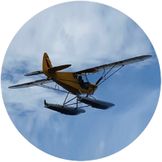
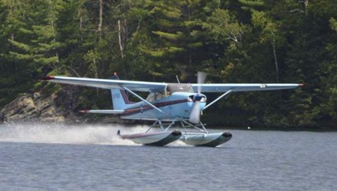
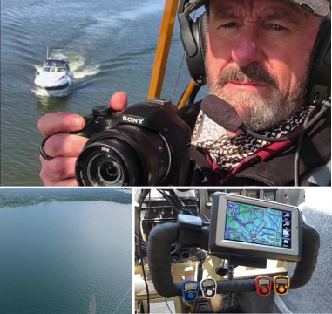
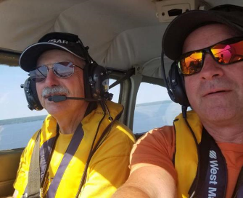
RTF Observational Research – Recreational Boaters & their Lifejacket Wear
How: Aerial Observation from two float equipped light aircraft:
  Crew of 2 for each flight – pilot, observer / photographer.
  High rez pic’s taken of boats on the lakes below, with high quality, geo-referenced, gyro-stabilized cameras.
  Also recorded site / location data, as well as influencing risk factors information, such as temperature, weather, wind, water / wave conditions, etc.
Notes:
How: Here is the fun part. Instead of the more traditional ‘observation from shore methodology’, boaters were observed ‘in situ’ … where they boat and how they boat, out on-the-water. To do that, two float-equipped aircraft were used:
The one in the northern lakes, is the blue Cessna that is one of the assets used by BAYSAR search and rescue out of North Bay.
The yellow Cub is the aircraft used in the southern lakes.
Each aircraft conducted each flight with two-aboard .. A pilot and observer / photographer.
These aircraft flew the target lakes and took pictures of the subject vessels with extremely high quality, geo-referenced, gyro-stabilized cameras.
Plus they were tasked with collecting weather information, wind and wave conditions, and other data re: issues that might affect life jacket wear.
All personnel were well trained on how to get the best camera shots and were required to undergo a performance testing period for both capturing and analyzing the pictures to obtain the required large number of data points.

Slide 9
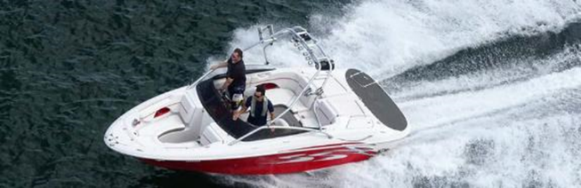
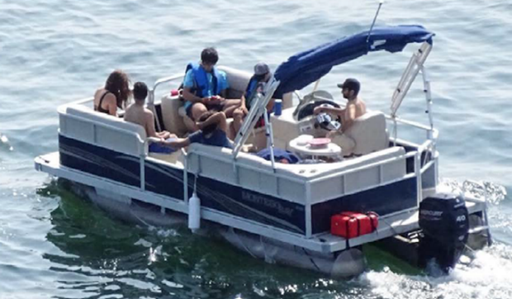
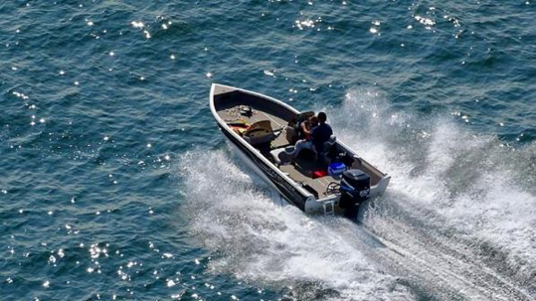
RTF Observational Research – Recreational Boaters & their Lifejacket Wear
How (cont’d):
  Crystal clear pics, with bursts from a variety of angles
  ... Enabling identification of Boat details, activities, Boater age & gender, operator vs. passenger roles, and Lifejacket wear status.
Notes:
The results were crystal clear pictures… with a burst series from a variety of angles. With this method, it was relatively easy to identify boat details, and approximate age and gender of those aboard. BTW, the pictures are held secure and private and are not shared with anyone other than the research personnel. These examples were taken with agreeable subjects to demonstrate the methodology and / or with boat information and faces not identifiable.

Slide 10
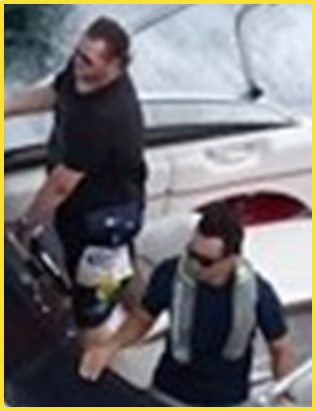
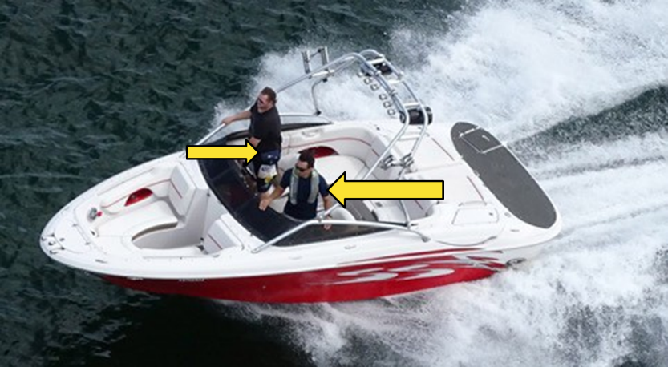
RTF Observational Research – Recreational Boaters & their Lifejacket Wear
How (cont’d):
  Check out this example pic… Boater characteristics, Lifejacket wear, and more, easily observed and identifiable.
Notes:
Check this picture out… In this picture, not only can lifejacket wear could be easily observed, but in the original higher resolution photo, you could tell that a pouch and collar style inflatable were being worn and even what brands of lifejackets were being worn.

Slide 11
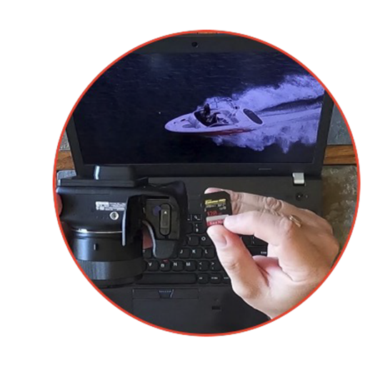
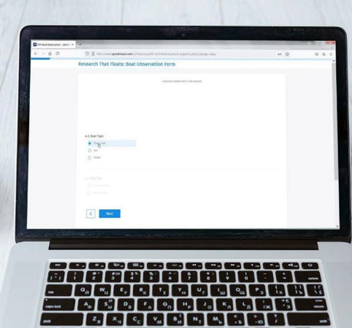
RTF Observational Research – Recreational Boaters & their Lifejacket Wear
Data Transfer, Consolidation and Analysis:
  At the end of each flight, the observers reviewed the file of pics taken, and entered data for each boat and boater into online data forms. Which were consolidated into the overall observational database by Gadd Research, for analysis and reporting.

Slide 12
Observational Research
Learning

Slide 13

Boater Profile: Most inland lakes boaters observed in both 2021 & 2022 were powerboaters (91%), with fewer paddlers (7%) and sailors (3%).
2022 & 2021 BOATER PROFILE: BOAT TYPE
Boat Type + Size (% of total boaters)
Boat Type (% of total boaters; Weighted*)
Small open powerboats, small runabouts and large runabouts were the biggest sub-groups, collectively accounting for two-thirds (64%) of total boaters.
64
Type of boat, boat type + size at time of observation
Base of Total Boaters: 2021 & 2022 (23663)
* The 2021 & 2022 boater samples were weighted to match the profile above.
**Base not large enough for analyzing /reporting Kite/Wind Surfers as a sub-group
Source – Aerial Study 2021 & 2022
Notes:
Most boaters observed were powerboaters, of whom two-thirds were in runabouts (large & small) and small open powerboats.

Slide 14
Two-thirds (65%) of powerboaters were in small boats < 6 meters in length, with the majority (63%) on-the-move. The most common activity was pleasure boating, followed by fishing (including ‘on-the-move with intent to fish’).
2022 & 2021 POWERBOATER PROFILE: BOAT SIZE, OPERATION & ACTIVITY (WEIGHTED)
Powerboat Size (% of powerboaters)
Powerboat Operation (% of powerboaters)
Powerboat Activity (% of powerboaters)
Power boat size, operation, activity at time of observation
Base of Total Powerboaters: 2021 & 2022 (21423)
Source – Aerial Study 2021 & 2022
14

Slide 15
Close to two-thirds (61%) of all Boaters were male; and 8 in 10 were adults aged 18 to 64 yrs. Just over one-third (38%) were operators; only 10% were alone; and just under half (46%) were on boats with 4+ occupants.
2021 & 2022 BOATER PROFILE: GENDER, AGE, POSITION IN BOAT & NUMBER OF OCCUPANTS
Gender of boaters (% of total boaters)
Age of boaters (% of total boaters)
Position & # of boaters (% of total boaters)
14
Gender, age and position in boat at time of observation
Base of Total Boaters: 2021 & 2022 (23663)
Source – Aerial Study 2021 & 2022
15

Slide 16
LJ Wear Rates: Overall, 24% of boaters were wearing lifejackets – usually the traditional buoyant type. Lifejacket wear rates were much higher for Paddlers (60%) and Sailors (47%) than Powerboaters (21%).
By boat type (% boaters in each boat type by lifejacket wear)
2021 & 2022 BOATER PROFILE:
LIFEJACKET WEAR STATUS
 | Powerboaters | Powerboaters excl. PWC | Paddlers | Sailors
 | 21 | 18 | 60 | 47
 | 19 | 16 | 58 | 39
 | 2 | 2 | 1 | 8
 | 75 | 78 | 38 | 50
 | 4 | 4 | 2 | 3
Lifejacket Wear Rate (% of total boaters)
Powerboaters (excluding PWC) have an even lower wear rate of 18%.
Lifejacket /PFD status at time of observation
Base of Total Boaters: 2021 & 2022 (23663), Powerboaters (21423), Powerboaters excl. PWC (20624), Paddlers (1662), Sailors (3578)
Significantly higher / lower than other boat types at 95%
Source – Aerial Study 2021 & 2022
16

Slide 17
Powerboater lifejacket wear rates are very low across boat types, except PWCs and Inflatables.
2021 & 2022 Lifejacket / PFD Wear
(% of powerboaters)
LIFEJACKET / PFD WEAR: BY POWERBOATERS - % wearing lifejacket / PFD
Lifejacket / PFD wear rates were low across all sizes/types of powerboaters except PWCs (95%) and Inflatables/rafts (54%).
Even lower for large powerboaters >6m (14%) than for small powerboaters <6m (20%).
While still low, there was a somewhat higher rate of wear for small open powerboaters <6m (24%) than for small & large runabouts, pontoons and cabin cruisers.
Lifejacket /PFD status by boat type at time of observation
Base of Total Powerboaters: 2021 & 2022 (21423), Power excl. PWC (20624), Power <6m (13217), Power 6m+ (7407), PWC (799), Inflatable (176), Small open power (5120), Small runabout (6174), Large runabout (3927), Large pontoon (2392), Small pontoon (1645), Large cabin cruiser (801)
Significantly higher / lower than other boat types at 95%
Source – Aerial Study 2021 & 2022
17

Slide 18
Kayakers, Canoeists and Sailors in small sailboats have high levels of lifejacket wear. However, SUP wear rate is relatively low (only 39%).
LIFEJACKET / PFD WEAR: BY PADDLERS & SAILORS - % wearing lifejacket / PFD
2021 & 2022 Lifejacket / PFD wear (% of paddlers & sailors)
Large sail boater wear rates are much lower and more in line with powerboater wear rates.
Lifejacket /PFD status by boat type at time of observation
Base of Total Paddlers: 2021 & 2022 (1662), Kayak (723), Canoe (452), Other, (129), SUP (358), Total Sailors (311), Small sailboat (310), Large sailboat (268)
Significantly higher / lower than other boat types at 95%
Source – Aerial Study 2021 & 2022
18

Slide 19
Overall, lifejacket wear by activity was somewhat higher for Fishing than for Pleasure & High Speed boating. Also higher for Water skiing / Wakeboarding (due to higher youth participation). Powerboating lifejacket wear rates were higher across activities, in small (<6m) open power boats, although still below 30%.
Activity + Boat Type (% of powerboaters
participating in activity by boat type)
 | 17
 | Small Open Power (< 6m) | Small Runabout (< 6m) | Pontoon
 | 24 | 18 | 13
 | 30 | 18 | 11
 | 21 | 13 | 21
 | 19 | 13 | 20
 | 25 | 13 | 22
 | 17 | 19 | 5
 | 38 | 29 | 18
LIFEJACKET / PFD WEAR RATE:
ACTIVITY & BOAT TYPES
Activity (% of total Powerboaters excl. PWC)
Activity + boat type at time of observation
Base of Total Power excl. PWC: 2021 & 2022 (20624), Pleasure (10897), Net: Fishing / Intent to fish (5856), Fishing (4474), Intent (1382), HS (1771), WS (1808); Sm. Open (5120), Pleasure (1368), Net: Fishing / Intent to fish (3498), Fishing (2640), Intent (858), HS (147), WS (90); Sm. Runabout (6174), Pleasure (3347), Net: Fishing / Intent to fish (1185), Fishing (962), Intent (223), HS (851), WS (678); Pontoon (4037), Pleasure (3151), Net: Fishing / Intent to fish (657), Fishing (483), Intent (174), HS (62), WS (119)
Significantly higher / lower than other boat types at 95%
Significantly higher / lower within boat type at 95%
Source – Aerial Study 2021 & 2022
19

Slide 20
There was much higher wear for children and teens, than for adults 18+ yrs.
No difference in LJ wear rates for males vs. female; slightly higher for Passengers vs. Operators.
Much higher LJ wear for solo boaters alone vs. 2+ occupants, largely due to paddlers & PWCs.
LIFEJACKET / PFD WEAR: BY AGE, GENDER, # OF OCCUPANTS, POSITION
% wearing lifejacket / PFD
2021 & 2022 Lifejacket / PFD wear % across Total boaters
Estimated age, gender, # of occupants, position in boat at time of observation
Base 2021, 2022 of Total (11847, 11816), Children (872, 817), Teens (745, 784), Adults (9450, 9260), Seniors (581, 620); Male (7292, 7217), Female (4140, 4128); One occupant (1112, 1111), 2+ occupants (10735, 10705); OP (4584, 4432), PSGR (7263, 7384), Adult OP (4391, 4191), Adult PSGR (5640, 5689), Teen PSGR (657, 681), Child PSGR (856, 809)
Significantly higher / lower than other type of boater at 95%
Source – Aerial Study 2021 & 2022
20

Slide 21
The top reasons for wearing a lifejacket, beyond the expected general answers (to be safe; usually wear one), are: to set a good example for others (18%); lets me relax (14%); concerned about drowning (13%); in case I unexpectedly fall in water (12%); and can’t swim (12%).
On-Water Part 1 Interview: Reasons for wearing a lifejacket when out on boat
% of boaters wearing a lifejacket when interviewed (n=110)
Reasons for wearing a lifejacket were largely consistent across demographics, boat type, size & activity as well as weather conditions.
Source – 2022 On-Water Survey - Part 1 Interview: Q8. Can I ask why you made that choice, to wear a lifejacket?
Notes:
This information is from the On-Water Survey interviews conducted with boaters, not from the Aerial Observational research, but in the same lake regions. Gives us insight into why boaters’ LJ Wearing behaviour is what it is.

Slide 22
Reasons for not wearing a lifejacket were more varied than reasons for wearing. Top reasons: too hot / uncomfortable (30%); in safe boat (26%); do not usually wear (25%); can put on if needed (24%); have it in boat (22%); strong swimmer (21%); and water is calm (20%).
On-Water Part 1 Interview: Reasons for not wearing a lifejacket when out on boat
% of boaters not wearing a lifejacket when interviewed (n=219)
More females said they’re too hot / uncomfortable to wear (39%) than men (25%), while more men said they do not usually ever wear one (29%) and it gets in the way (13%).
Those in bigger over 6 meters power boats were more likely to say they’re in a big / safe / steady boat (44%) than those in under 6 meter (13%).
More of those in boats with 2+ passengers said they liked to use the lifejacket as a pillow (10%) versus single operators (0%).
Source – 2022 On-Water Survey - Part 1 Interview: Q9. Can I ask why you made that choice, to not wear a lifejacket?
Notes:
Again, from the On-Water interviews with boaters… boaters have many ‘excuses’ for not wearing their lifejacket.
Some of these reasons were also top barriers to wearing lifejackets in the CSBC’s major 2014 quantitative research study investigating Canadian boaters’ safety behaviours: only needed in risky conditions, uncomfortable / too hot to wear, in a big / safe / steady boat, water is calm.
Other reasons seem to be ‘higher on the excuses list’ than in 2014 – not worried about falling in / something serious happening, other people could rescue me, I’m a strong swimmer, can put one on if needed.

Slide 23
The strongest reasons encouraging Boaters to wear a lifejacket are to help mitigate risky conditions, being comfortable, and because “it’s the smart thing to do”.
On-Water Part 2 Online: Boater attitudes to wearing a lifejacket / PFD
% of total boaters (n=329): 10 Point Scale: Strongly agree -10 to Strongly disagree -1
Top 3 box % Strongly agree
“I wear my lifejacket / wearing a lifejacket…”
Half or more of boaters also strongly agree with other reasons for wearing a lifejacket, including:
  Because I won’t be able to put it on if I fall into the water.
  Buying time to be rescued
  To set a good example
Source – On-Water Survey - Part 2 Online Survey: Q16. Thinking about your own behaviour and attitudes when it comes to being safe while boating, to what extent do you disagree or agree with each of the statements below?
Notes:
Again, from the On-Water interviews with boaters…
As in the CSBC’s 2014 research study, boaters know that wearing their Lifejacket is ‘the smart thing to do’.
But, they usually don’t, unless… there are situational cues (e.g. risky water/save/weather conditions); or they want to set a good example for children.
Or, as we also see here, if they become convinced of other risks, including…they won’t be able to put their lifejacket on after they fall into the water… which is a key trigger in the Research That Floats ‘Within Reach’ communications campaign. More on that later…

Slide 24
How Risk Factors Contribute to Lifejacket Wear
“Situational Awareness (SA) is the perception and awareness of individual, task, and environmental factors within one’s environment, as well as the understanding of its meaning and future implications”.*
The RTF observational data collected during 2022 was assessed in a ‘stepwise statistical regression analysis’, as first conducted by JSI Research & Training Institute, to analyze risk factors affecting USA Life Jacket Wear Rates.*
  The Situational Awareness conditions below were pre-identified, for which RTF observational data was available.
  Conditions/ Risk Factors that might influence lifejacket wear were classified as “Risky” and “Not Risky” (see below); and analyzed statistically to identify the risky conditions that are most strongly associated with adult lifejacket wear rates for each boat type.
  While the USA study included all powerboaters, paddlers and sailors, this RTF analysis focused in on 18+ yrs adult powerboaters, given their low lifejacket wear rates in Canada.
Condition | “Risky” | “Not Risky”
Boater Activity | Fishing or high speed or water skiing/wakeboarding | Pleasure
Air Temp. | Cooler air (<24C) | Warmer air (>25C)
Child on board | Child <12 yrs. present | No child <12 yrs. present
Wind & Water | Light chop or rough water condition or 5+ MPH wind | Calm and <5 MPH wind
Boat Movement Status | Underway | Not underway
# of boaters | Single operator/ Alone | 2 + boaters
*Source: USA Life Jacket Wear Rate 2018 Observation Study, Feb 2019, JSI Research &Training Institute, for the US Coast Guard.
24
Notes:
In simple terms, the ‘stepwise statistical regression analysis’ identifies which risk factor is most associated with higher lifejacket wear. After that #1 risk factor is then removed, which risk factor is next most associated with higher Lifejacket wear. That is the #2 ranked risk factor. And so on. The result is a rank ordering of the tested risk factors regarding how much they contribute to higher wearing of lifejackets by boaters.
Two variables were also removed from the model:
Passenger versus Operator, due to high multicollinearity with Single vs. 2+ boaters.
Teens 13 to 17 yrs on board, due to high multicollinearity with child under 12 yrs on board.

Slide 25
The top risk factor associated with higher LJ wear for all powerboats (both in total & for small <6M) is Activity – specifically fishing / high speed / WS*. Cool air temp, child on board and light chop / rough water / 5MPH+ wind are also associated with higher LJ wear, although ranked slightly differently for total versus small powerboats.
How Risk Factors Contribute to Lifejacket Wear in RTF Lake Regions: 2022
Condition | “Risky” vs. “Non Risky” | Total powerboaters excl. PWC | Small open / runabout (<6M)
 |  | 2022 | 2022
1. Boater Activity | Fishing / high speed / WS* vs. Pleasure | 1 | 1
2. Air Temperature | Cooler air (<24C) vs warmer air (25+C) | 2 | 3
3. Child on board | Child present vs. no child | 4 | 2
3. Wind & Water | Light chop / rough / 5MPH+ wind vs. calm / <5MPH wind | 3 | 4
Boat Movement | Underway vs. not underway
# of boaters | Single/Alone vs. 2+ boaters
Boat movement and # of boaters on board were not associated with changes in LJ wear.
* WS = Water Skiing / Wakeboarding
25
Notes:
Stepwise Selection: 1 = Top factor added to model contributing to increased lifejacket wear, 2 = second factor, 3 – third factor, 4 – fourth factor. Note: If a risk factor does not have a number assigned to it, that means their contribution is not statistically significant at the p-value threshold set and thus they were not included in the model.

Slide 26
Summary
Boater Profile: Most inland lakes boaters observed were powerboaters (91%), with fewer paddlers (7%) and sailors (3%).
  Two-thirds (65%) of powerboaters were in small boats < 6 meters in length, with the majority (62%) on-the-move. The most common activities were pleasure boating, followed by fishing.
  Close to two-thirds (61%) of all Boaters were male; and 8 in 10 were adults aged 18 to 64 yrs. Just over one-third (38%) were operators; only 10% were alone.
LJ Wear Rates: Overall, 24% of boaters were wearing lifejackets – usually the traditional buoyant type.
Lifejacket wear rates were much higher for Paddlers (60%) and Sailors (47%) than Powerboaters (21%).
  Powerboater lifejacket wear rates are very low across boat types (except PWCs and Inflatables), including small (<6M) open powerboats (24%), small runabouts (18%), large runabouts (15%) and pontoon boats (13%).
  Kayakers (67%), Canoeists (64%) and Sailors in small sailboats (68%) have high levels of lifejacket wear. However, SUP wear rate is relatively low (only 39%).
  Lifejacket wear by activity was somewhat higher for Fishing (19%) than for Pleasure & High Speed powerboating (16%).
  Adults 18-64 yrs (18%) & Seniors 65+ (10%) have much lower LJ wear rates than children under 13 yrs (85%) & teens (51%).
Boaters perceive differing levels of risk, depending on boating situations. The top risk factor associated with higher LJ wear for powerboats is Activity, specifically fishing, high speed & Wakeboarding / Waterskiing. Followed by Cool air temperature, having a child on board, and choppy / rough water and wind..
Top reasons for not wearing a lifejacket are boater beliefs that: LJ are too hot / uncomfortable (30%); they’re in a big / safe / steady boat (26%); they do not usually wear (25%) and can put on if needed (24%); it’s in the boat / only need to have it in the boat (22%); they’re a strong swimmer (21%) and the water is calm (20%).
However, half or more of boaters also strongly agree that wearing a LJ: ‘buys me time to rescued if I fall out’; ‘prepares me in case of the unexpected’; makes sense because ‘it is hard to get back into the boat if you fall out’; and ‘if I’m not wearing it, I won’t be able to put it on if I fall into the water’.
26

Slide 27
Conclusions
There are major opportunities to increase low lifejacket wear rates among Canadian boaters.
  Especially among Powerboaters who are: Fishing in small open powerboats and runabouts; Pleasure boating in runabouts as well as small open powerboats; and High Speed boaters. Also Paddlers on Stand-up paddleboards.
  Especially Adults, including seniors.
Activity, boat type and age are key drivers of differences in LJ wear rates.
…Compounded by boater perceptions of differing levels of risk depending on situational cues – what Activity they are engaged in, the Weather (cooler air temperatures, water/wave and wind conditions) and whether there is a child on board.
The ‘Within Reach’ boater education / communications campaign was designed to confront some of the key boater perceptions that contribute to low lifejacket wear, including:
  Falling into the water from your boat could happen, even from a stable boat; and if it does, wearing your Lifejacket can protect you from some problems, that boaters agree are significant risks, if a fall does happen…
  The fall overboard may be sudden & unexpected; it could be hard to get back into the boat; and ‘if I’m not wearing it,
  I won’t be able to put it on after I fall into the water.
27

Slide 28
The RTF Lifejacket Wear
public education / communication
Campaign

Slide 29
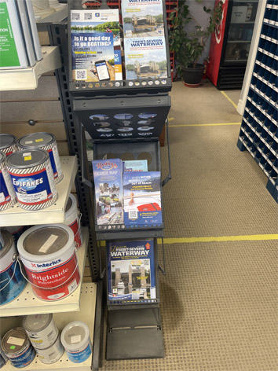
RTF Boater Education / Communication Campaign
Develop a lifejacket wear communication campaign
What campaign elements were developed:
  Ad campaign creative
  Media and marketing materials
  Social Media
  Events
Notes:
The starting point for developing the Campaign, was the research learning re: key boater perceptions that contribute to low lifejacket wear ( as mentioned on the previous slide).
Several creative messaging options were developed, seeking the best way to communicate a convincing message for the campaign.
Ad campaign media included Pattison outdoor signage as well as local media placements. Posters and other Marketing Materials were displayed at marinas, boat launches, locks, etc.
Social Media posts were designed to complement the ad campaign by exploring the reasons and excuses why boaters wear or don’t wear their lifejackets.

Slide 30
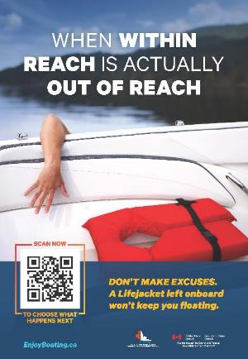
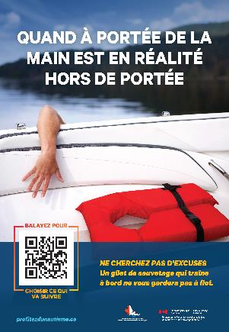
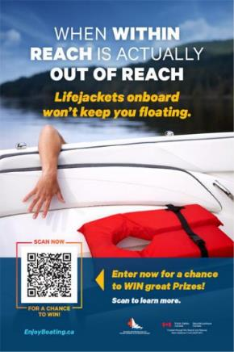
Campaign Creative Development
Several LJ wear messaging concept options researched ➔ Most motivating was ‘Within Reach’ ➔ Developed into full campaign.
Notes:
The first part of the outreach campaign development was the creative development. Research was done on several different educational advertising creative concepts, each with different messaging intended to motivate increased lifejacket wear. The ‘Within Reach’ concept scored the highest in the research as most motivating to boaters, and became the campaign messaging centre-piece.
This shows several versions of the final ‘Within Reach’ campaign posters.
‘Within Reach’ confronts one of the key reasons / excuses that people give for not wearing a lifejacket – they think… ‘I can reach it / put it on if I need it’. The combination of the visual and the text messaging makes boaters reconsider whether it is actually within reach in my boat, if something unexpected happens and I suddenly fall overboard, and am not already wearing my lifejacket.

Slide 31
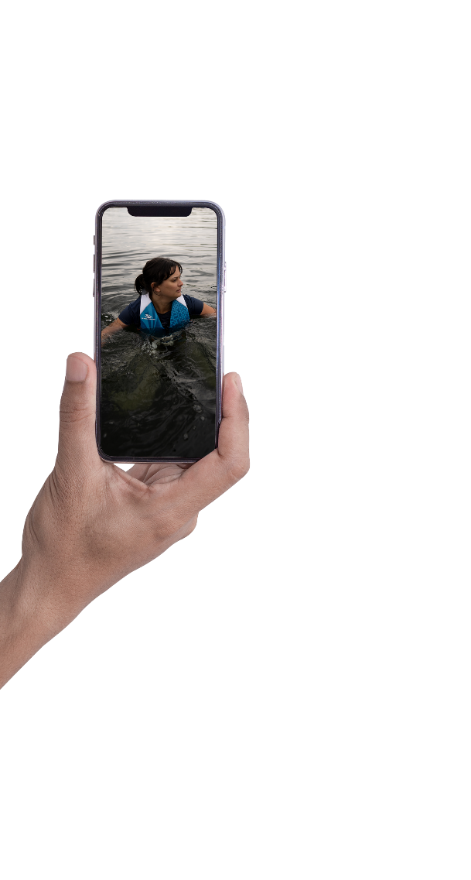
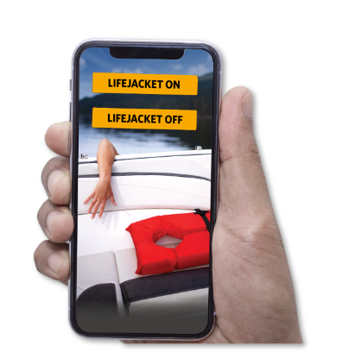
What Happens in the Poster – Scan Scenario
1- Intro Video
2 - User Choice – Videos
Notes:
People viewing the poster are encouraged to scan the QR code to see what happens next.
After scanning the QR, they see the intro video, which shows a person struggling to get back onto a boat. The viewer is provided the choice of seeing whether the person has a lifejacket on or not, and what happens under each scenario.

Slide 32
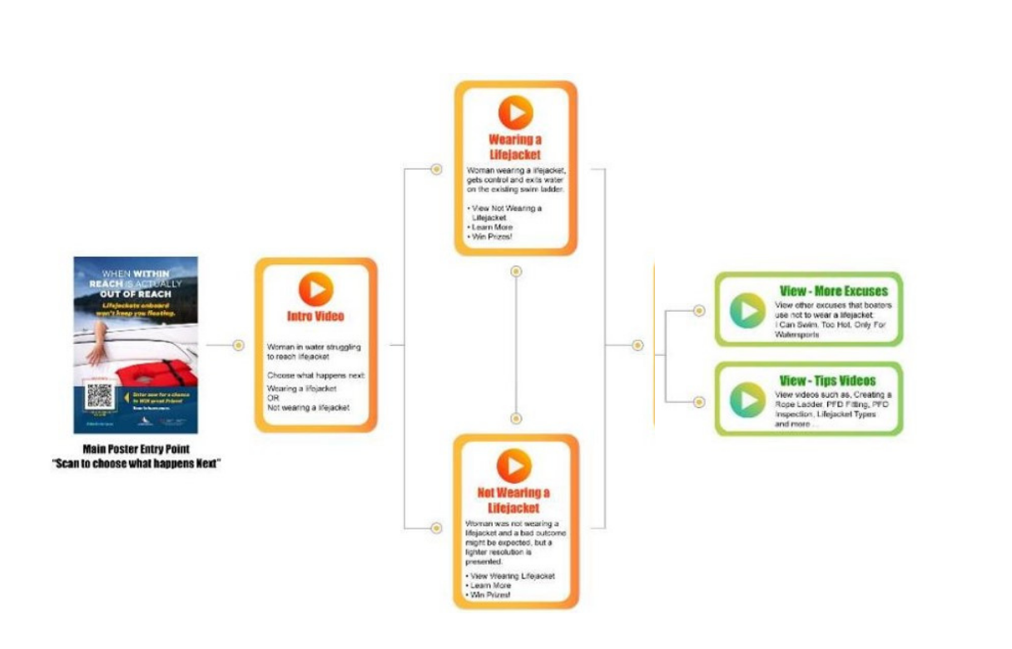
Campaign Flow: ‘Within Reach’ Poster entry
➔ Videos ➔ EnjoyBoating.ca website
Notes:
This is the flow of communications from the poster when a boater scans the QR code. The boater is provided a short video of the poster and is offered two choices. See what happens if the subject is wearing a lifejacket or NOT wearing a lifejacket. Wearing is easy.. The boater gets control, moves towards the back of the boat and exits. NOT wearing a lifejacket ! The expectation might be a dark outcome however.. We see the boater struggling and as the camera widens the ‘safety net’ …. (crew, rescue, etc) .. Is revealed with a narration that says.. ‘you didn’t think we would let anything happen to this person did you ?”

Slide 33
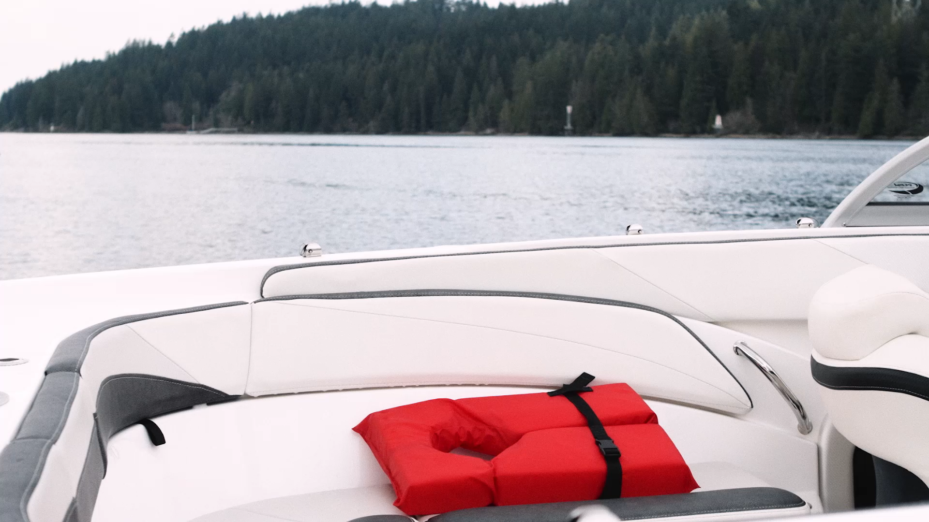
Intro Video seen after Scanning QR Code
Notes:
Here is the initial video that a consumer would watch when they first scan the QR code on a poster, hand out or other marketing materials

Slide 34
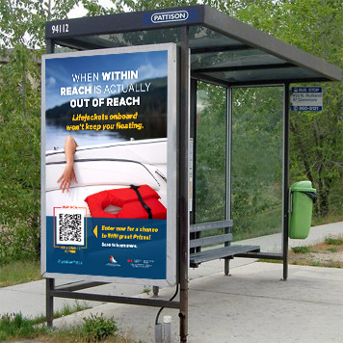
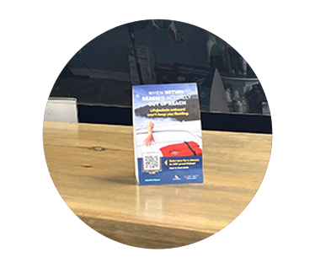
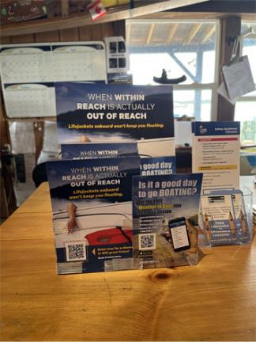
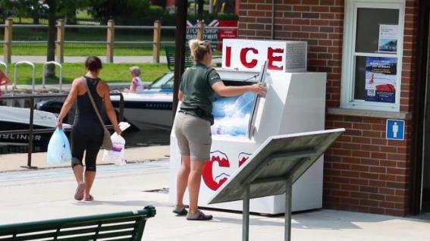
Our Messaging Got Out There!
As part of the research test market in 2022
Signs in 17 communities
Marketing Materials in 145+ marinas and local businesses
Signs in 5 Trent/Severn Lock Stations
Social Media Posts
34
Notes:
During the summer of 2022 the marketing materials were placed throughout the RTF regional locally targeted areas.
This included Marinas, Boat Launches, Bus Shelters, Street Level advertising, Marine Stores, Marina Service Departments, Restaurants
Signage sent to 17 Communities within our target areas and was dispersed to a variety of locations within them
Beaches, Parks, Community, Visitor, Tourism and Recreation Centres, Libraries, Conservation Centres etc…
Signage was put up at 5 Locking Stations along the Trent
In addition, there were 29 social media posts were shared with the CSBC boating community that were “boosted” to an audience within the RTF targeted research area

Slide 35
RTF Campaign Evaluation

Slide 36
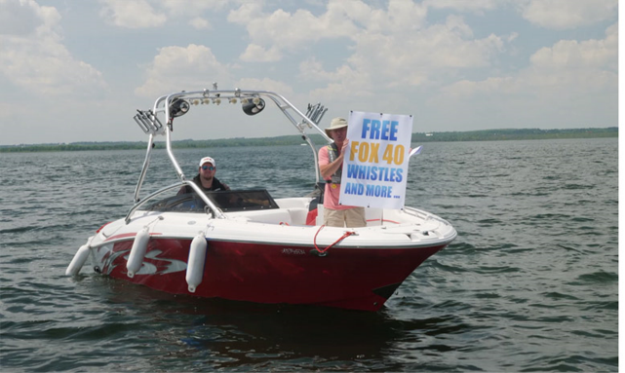
Research That Floats On-Water Boater Intercept Research
Research Objectives:
  To better understand Boaters’ attitudes toward wearing lifejackets, including why boaters are or are not wearing them (already covered earlier in this presentation)
  To evaluate how effective a local markets public education / communications campaign is, in changing boaters’ attitudes and motivating increased wearing of lifejackets.

Slide 37
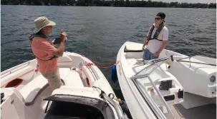
Research That Floats On-Water Boater Intercept Research
Research Approach:
  Where: Same 4 Ontario inland lake regions, as where the RTF Aerial Observational research was done.
  Who: Similar profile as for the RTF observational research – Inclusive of all recreational boaters, with focus on Fishers & Pleasure Powerboaters in small (< 6M) powerboats, and Paddlers (in canoes, kayaks, SUPs). Teens and adults 16+ years of age.
  When: Mid-July to mid-September 2022, after the RTF Campaign was implemented in the 4 lake regions.
  How:
    Trained On-Water intercept teams conducted “Part 1” observations and interviews with intercepted boaters; and invited boaters to also complete later a “Part 2” online survey. On-water interviews conducted out on the water as much as possible + on-shore locations as well (marinas, boat launches, locks, etc.). Interviewers included Nipissing U students, local boaters, fishing guides, OPP.
    Incentives offered to help encourage participation – a whistle, immediately upon completion of On-Water Part 1; and entry into high value contest draws for a suite of high value prizes (including GoPro camera, Drone, SUPs, Inflatable LJs, $100 gift cards), upon completion of Part 2 online. Data was weighted to be in-line with the aerial observational data profile, as much as possible.
  How Many: Achieved large sample size of 987 boaters for ‘Part 1’ On-Water intercept interviews. Of whom 329 went on to complete both Part 1 On-Water and the Part 2 Online survey.
Notes:
Where: Nipissing Lakes, Almaguin, Muskoka & Haliburton Lakes, Lake Simcoe, Kawartha Lakes. Each region sub-divided into more specific sections.

Slide 38

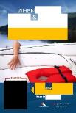
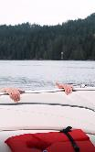
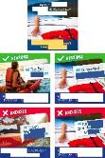
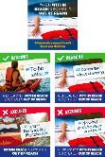
Just under one-third (29%) of surveyed boaters were Aware of the Within Reach campaign, when fully aided with visuals of the poster, entry video and social media.
8 in 10 of those Aware (23% of boaters) also had recognised the ‘blinded’ poster and / or social media.
Part 2 Online: Within Reach Total Campaign Awareness - % of total boaters (n=329)
Blinded Poster & Social Media
Fully Aided Poster, Entry Video & Social Media
Source – On-Water Survey - Part 2 Online Survey: : Q17. Have you seen any finished ads or posters like [this /these], during the past four months? /
Q19. Before completing this survey, had you seen this ad (video), or other ads (videos) similar to it, in the past four months?

Slide 39
The Within Reach poster & campaign performed strongly overall. With both those who had seen it in-market & those who had not. Especially for those Aware of the campaign in-market, who found the messages Relevant & Persuasive (more likely to wear my lifejacket more often).
Scorecard |  | Total | Aware of campaign | Not aware of campaign
Top 3 box % | Overall Rating (10 point scale) | 74 | 86 | 69
Message communication – Top 2 box % (Agree strongly / Agree) | You may not be able to reach your lifejacket and put it on if you fall into the water and need it | 88 | 90 | 86
 | Always wear your lifejacket at all time | 69 | 76 | 66
 | Scan the QR code on the poster to learn more information | 66 | 69 | 64
Key Measure Ratings - Top 2 box % (Agree strongly / Agree) | Captured & held attention | 58 | 64 | 56
 | Messages were believable | 79 | 83 | 77
 | Messages were relevant to me | 59 | 74 | 52
 | Made me more likely to wear my lifejacket more often | 43 | 57 | 37
 | Made me want to scan the QR code | 42 | 51 | 38
Bottom 2 box % (Disagree strongly / Disagree) | Irritated me / was annoying | 4 | 4 | 4
Significantly higher than other group(s) at 95% / 90% / 80% significance
Above standard
At standard
Slightly below standard
Well below standard
Source – On-Water Survey - Part 2 Online Survey: Rating of “Within Reach” advertising campaign

Slide 40
The Within Reach poster was rated very highly overall, with over one-third (38%) rating it 10 out of 10; and three-quarters (74%) rating it 8 to 10. Those Aware of the campaign in-market rated it even higher, but ratings also very high with those seeing it for the first time.
Boater rating of the Within Reach poster: Overall rating
% of total boaters (n=329), aware (n= 95), not aware (n=234) 10 Point Scale: Excellent = 10 to Very poor -1
Top 3 box %
74
86
69
Significantly higher than other group(s) at 95% / 90% / 80%
  Source – On-Water Survey - Part 2 Online Survey: Q22. How would you rate this poster ad overall, where 1 is 'very poor' and 10 is 'excellent'?

Slide 41
Message recall was very strong. The top two specific messages were wear a lifejacket (41%) & lifejackets save lives (30%). The specific ‘poster creative’ messages (of a lifejacket being out of reach, useless if not worn or not available when needed,) had lower specific recall, but laddered up to the broader intended messaging.
Within Reach poster: Unaided main message (Based on blinded Poster & Social Media)
% of total boaters blind aware (n= 75) Open ended response
Net Total Correct = 81
Sub-Net specific ‘poster creative’ correct playback = 19
Source – On-Water Survey - Part 2 Online Survey: Q18. Thinking of all of the ads / posters you have just seen as a single campaign, what was the main message?
41

Slide 42
The top aided message communicated by the Within Reach poster is “you may not be able to reach your lifejacket and put it on if you fall into the water” (57% strongly agree).
Boater rating of Within Reach poster: Aided messaging
% of total boaters (n=329) aware (n= 95), not aware (n=234) 6 Point Scale: Strongly agree - 6 to Strongly disagree -1
 | Total |  | Aware | Not Aware
 | Top 2 box % |  | Top 2 box %
 | 88 |  | 90 | 86
 | 69 |  | 76 | 66
 | 66 |  | 69 | 64
There was a difference in the strength of the “always wear your lifejacket at all times” message between those Aware in-market and those Not aware.
Significantly higher than other group(s) at 95% / 90% / 80%
  Source – On-Water Survey - Part 2 Online Survey: Q20. Thinking of all of the ads / posters / videos you have just seen as a single campaign, please indicate to what extent you agree or disagree that the ads you just saw communicated each of the following.
42

Slide 43
The Within Reach poster & its messages were Believable, Relevant and Captured & Held Attention. It did also have some Persuasion impact on future likelihood to wear a lifejacket, particularly with those who were campaign Aware in-market.
Boater rating of Within Reach poster: Communications Effectiveness key measure ratings
% of total boaters (n=329) aware (n= 95), not aware (n=234)
6 Point Scale: Strongly agree -6 to Strongly disagree -1
The poster also inspired some to want to scan the QR code, and in fact about 30% of those Aware of the campaign who had seen the poster in-market, said they did go ahead and scan the QR code.
 | Total | Bottom 2 box % |  | Aware | Not Aware
 | Top 2 box % | Bottom 2 box % |  | Top 2 box %
 | 58 | 8 |  | 64 | 56
 | 79 | 3 |  | 83 | 77
 | 59 | 9 |  | 74 | 52
 | 43 | 17 |  | 57 | 37
 | 42 | 22 |  | 51 | 38
 | 4 | 78 |  | 4 | 4
Note: Some already always wear a lifejacket and so said that messages were not relevant and it did not make them more likely to wear a lifejacket
Significantly higher than other group(s) at 95% / 90% / 80%
  Source – On-Water Survey - Part 2 Online Survey: Q23. Thinking only of the poster ad you have seen, how much would you disagree or agree that each of the following statements apply to this poster?
43

Slide 44
Just under one-in-three (30%) of those who saw the poster say they scanned the QR code.
Main reasons for not scanning QR code included general disinterest, too time consuming, don’t know how.
Whether boaters who saw poster scanned QR code
% of total boaters who saw either blind or full poster (n=77)
Reasons for disagreeing that poster “made me want to scan QR code”
% of total boaters disagree strongly / disagree / disagree somewhat (n= 107)
Source – On-Water Survey - Part 2 Online Survey: Q24. Did you scan the QR code on any of the occasions you saw this ad/poster? / Q23d. Why would you not scan the QR code shown in the poster?

Slide 45
Overall, both Poster and Social Media made strong contributions to campaign Awareness. Although the Entry Video contributed less to overall awareness, its role was more to add depth to the campaign story, rather than outreach.
Within Reach Campaign Awareness by Media - % of total boaters (n=329)
Blinded Poster & Social Media
Fully Aided Poster, Entry Video & Social Media
Source – On-Water Survey - Part 2 Online Survey: Q17. Have you seen any finished ads or posters like [this /these], during the past four months? /
Q19. Before completing this survey, had you seen this ad (video), or other ads (videos) similar to it, in the past four months?

Slide 46
The top sources of Within Reach campaign awareness were at marinas / lock stations / boat launches and online & social media.
Word of mouth, was also higher than expected, at 18%.
Part 2 Online: Where those Aware saw the Within Reach campaign - % of total boaters aware (n= 95)
Source – On-Water Survey - Part 2 Online Survey: Q21. Where did you see or hear any of these ads?

Slide 47
Campaign Impact on Lifejacket Wear:
Those Aware of the Within Reach campaign had higher LJ wear (37%) than those not aware (24%).
And there was higher LJ wear among Powerboaters Aware (39%) as well.
Part 1 Interview:
Observed % Wearing Lifejacket at time of interview
% of total boaters (n=329)
Part 1 Interview:
Observed % Wearing LJ: By boat type at time of interview
% of total powerboaters (281), PB Aware (82), PB Not aware (199),
Overall, about one-quarter (28%) of boaters were wearing a lifejacket at the time of their on-water interview – similar to the 25% observed wearing a LJ in the broader aerial observational research.
LJ wear was highest for paddlers (46%), lower for powerboaters (27%).
Significantly higher than other group(s) at 95% / 90% / 80%
Source – On-Water Survey - Part 1 On-Water Interview: Q7. Is the boater wearing a lifejacket or PFD? (As recorded by interviewer)

Slide 48
Boaters Aware of the Within Reach advertising claimed higher lifejacket wear currently & higher intended LJ wear in the future, vs. those Not aware.
However, there was no significant increase in current to intended LJ wear for either group.
Part 2 Online: How often boaters say they currently wear a lifejacket / will wear a lifejacket in future: While boating overall
% of total boaters (n=329), aware (n=95), not aware (n=234)
Current lifejacket wear while boating
Intended future lifejacket wear while boating
36
42
These patterns (i.e. higher LJ wear among those aware of the campaign; but no significant increases from current to intended LJ wear), were the same for Powerboaters and Paddlers, within boaters overall.
27
31
Significantly higher than other group(s) at 95% / 90% / 80%
Source – On-Water Survey - Part 2 Online Survey: Q9. Overall, how often do you wear a lifejacket when in a boat? /
Q14. How often do you think you will wear a lifejacket when in a boat in the future

Slide 49
Conclusions
The ‘Within Reach’ poster and campaign materials communicate very effectively with boaters.
  They get the intended message… ‘Wear your LJ all the time, to be ready for the unexpected, because you may not be able to reach it and put it on, if you fall into the water and need it’.
  The ‘Within Reach’ poster broke through to capture and hold boaters’ attention.
  The messages were believable, relevant, and persuasive in raising boater intentions to wear their LJ more often.
  The poster and social media made boaters want to learn more
  … almost one-third scanned the QR code.
However, in-market awareness of the campaign in the test areas was modest. Only 3 in 10 boaters in the test areas saw the campaign. This made it tough to ‘move the needle’ with boaters overall.
Need stronger in-market media presence (more poster placements, social media presence, in-market longer), to leverage the strong campaign creative materials.
49

Slide 50
RTF Observational Research
Lifejacket Wear Rates
Before & After Campaign

Slide 51
Year on year (YOY), lifejacket wear was steady for total boaters – 24% wearing a lifejacket in 2021, 25% in 2022 – which is not a statistically significant change.
There was a small YOY significant increase for powerboaters excluding PWC. No significant changes for paddlers and sailors.
LIFEJACKET WEAR RATE
% of total boaters
LIFEJACKET / PFD WEAR RATE: BY BOAT TYPE
Wearing buoyant / inflatable: % of boaters by boat type
No significant changes YOY for Kayak, canoe or SUP, within total Paddlers.
* Note: Only significant YOY increases or decreases at 95% / 90% level shown
Lifejacket /PFD status at time of observation
Base: Total Boaters 2021, 2022 (11847, 11816), Total Pwr (10711, 10712), Pwr excl. PWC (10228, 10396), Paddlers (825, 837), Sailors (311, 267)
Source – Aerial Study 2021 & 2022
51

Slide 52
Powerboater lifejacket wear rates continued to be very low across most boat types in 2022. LJ wear rates did increase YOY for large & small pontoons, and decreased YOY for PWC (although still very high in absolute).
LIFEJACKET / PFD WEAR RATES: BY TOTAL POWERBOATERS & TYPE OF BOAT - % wearing lifejacket / PFD
The increase in lifejacket wear in large pontoon rates may be linked to a higher number of children on board in 2022 as well as more observations in high wind and wave conditions.
The 2022 decrease in lifejacket wear for PWC was largely amongst adults 18+ yrs.
Lifejacket /PFD status by boat type at time of observation
Base 2021, 2022: Total PWR (10711, 10712), Pwr excl. PWC (10228, 10396), Power <6m (7728, 8243), Power 6m+ (4119, 3573), PWC (483, 316), Inflatable (100,76), Small open power (2929, 2191), Small runabout (2576, 3598), Large runabout (2202, 1725), Large pontoon (1188, 1204), Small pontoon (629, 1016), Large cabin cruiser (423, 378)
* Note: Only significant YOY increases or decreases at 95% / 90% level shown
Source – Aerial Study 2021 & 2022
52

Slide 53
There was a slight YOY decline in LJ wear in children up to 12 yrs and slight increase for teens 13 to 17 yrs, both tracing to powerboating.
There was no overall YOY change in LJ wear rates for males or females; nor for Alone vs. 2+ occupants; nor for Operators vs. Passengers.
LIFEJACKET / PFD WEAR: BY AGE, GENDER, # OF OCCUPANTS, POSITION
% wearing lifejacket / PFD
Lifejacket / PFD wear % across all boaters
Estimated age, gender, # of occupants, position in boat at time of observation
Base 2021, 2022 of Total (11847, 11816), Children (872, 817), Teens (745, 784), Adults (9450, 9260), Seniors (581, 620); Male (7292, 7217), Female (4140, 4128); One occupant (1112, 1111), 2+ occupants (10735, 10705); OP (4584, 4432), PSGR (7263, 7384), Adult OP (4391, 4191), Adult PSGR (5640, 5689), Teen PSGR (657, 681), Child PSGR (856, 809)
* Note: Only significant YOY increases or decreases at 95% / 90% level shown
Source – Aerial Study 2021 & 2022
53

Slide 54
There was a small YOY increase in lifejacket wear for power boats not underway.
LIFEJACKET / PFD WEAR: BY POWER BOAT MOVEMENT
% wearing lifejacket / PFD
Lifejacket / PFD wear % across all power boaters excl. PWC
The increase in YOY LJ wear for powerboats not underway traces to small runabouts.
Boat movement at time of observation
Base of 2021, 2022: Total Power excl. PWC (10228, 10396), Total underway (6396, 7040), Total not underway (4315, 3672)
* Note: Only significant YOY increases or decreases at 95% / 90% level shown
Source – Aerial Study 2021 & 2022
54

Slide 55
Reminder… We saw earlier that the top 4 risk factors associated with higher RTF LJ wear are:
1) Boater Activity, specifically fishing / high speed / waterskiing & wakeboarding.
2) Cooler air temperature.
3) & 4) Child on board; and Wind/Water conditions, specifically light chop / rough water / 5MPH+ wind.
How Risk Factors Contribute to Lifejacket Wear in RTF Lake Regions
Condition | “Risky” vs. “Non Risky” | Total powerboaters excl. PWC | Small open / runabout (<6M)
 |  | 2022 | 2022
1. Boater Activity | Fishing / high speed / WS* vs. Pleasure | 1 | 1
2. Air Temperature | Cooler air (<24C) vs warmer air (25+C) | 2 | 3
3. Child on board | Child present vs. no child | 4 | 2
3. Wind & Water | Light chop / rough / 5MPH+ wind vs. calm / <5MPH wind | 3 | 4
55
Notes:
Stepwise Selection: 1 = Top factor added to model contributing to increased lifejacket wear, 2 = second factor, 3 – third factor, 4 – fourth factor. Note: If a risk factor does not have a number assigned to it, that means their contribution is not statistically significant at the p-value threshold set and thus they were not included in the model.

Slide 56
By Activity, lifejacket wear increased YOY for fishing and water skiing on small runabouts (<6m); and for pleasure boating on small open powerboats.
For total powerboaters, lifejacket wear in total for each activity was steady YOY.
 | Small open power (< 6m) | Small runabout (< 6m) | Pontoon
 | 24 | 19 | 15 (+3)
 | 34 (+8) | 16 (-4) | 13
 | 20 | 15 (+5) | 23 (+5)
 | 19 | 15 (+4) | 21
 | 24 | 17 (+10) | 30 (+16)
 | n/a | 20 | n/a
 | n/a | 32 (+7) | 22
LIFEJACKET / PFD WEAR RATE: By ACTIVITY
Activity (% of total Powerboaters excl. PWC)
Lifejacket / PFD wear % across all power boaters
excl. PWC
n/a = small base size under 30
Activity + boat type at time of observation
Base of 2021, 2022: Total Power excl. PWC (10228, 10396), Pleasure (4829, 6068), Net: Fishing / Intent to fish (3165, 2691), Fishing (2419, 2055), Intent (746, 636), HS (1114, 657), WS (956, 852); Base 2022: Sm. open (2191), Sm. runabout (3598), Pontoon (2220)
* Note: Only significant YOY increases or decreases at 95% / 90% level shown
Source – Aerial Study 2021 & 2022
56

Slide 57
By Temperature, there was a small YOY increase in lifejacket wear for 20 to 24 C temps.
LIFEJACKET / PFD WEAR RATE: BY AIR TEMPERATURE
% wearing lifejacket / PFD
% of 2021 / 2022 Boater observations
- / 16
15 / 42
76 / 32
9 / 10
The YOY increase in LJ wear in 20-24 C cooler temperatures traced to powerboaters excl PWC and sailors.
In absolute, LJ wear was higher in cooler temperatures
24 C or less vs. warmer temperatures 25+ C.
LJ wear in Powerboats especially drops off as the air temperature goes up to 30 Celsius & beyond.
Regarding Water Temperature, there were no differences observed in LJ Wear in Warm (over 22C) vs. Cool (10-22C) water temps.
Lifejacket / PFD wear % across all boaters
n/a
Air Temperature at time of observation
Base 2021, 2022: Total boaters (11847, 11816), 30 plus Celsius (n/a, 1944), 25 to 29 Celsius (1855, 5028), 20 to 24 Celsius (8933, 3667), 19 and under Celsius (1059, 1165)
* Note: Only significant YOY increases or decreases at 95% / 90% level shown
Source – Aerial Study 2021 & 2022
57

Slide 58
In absolute, there was higher adult LJ wear when a Child was On Board a powerboat, in both 2021 (15%) and 2022 (14%), compared to no child on board.
LIFEJACKET / PFD WEAR RATES: ADULTS WITH CHILDREN / TEENS ON BOARD
2022 % of powerboaters by age by presence of U18 by type
(YOY change %*)
 | Small open power (< 6m)
 | 17
 | 29 (+7)
 | 18
Activity (% of powerboaters excl. PWC by age +
presence of U18 + type)
However, the slight overall YOY increase in powerboaters’ LJ wear, traced to a small increase in wear for Adults 18+ without a child on board.
There was a YOY increase in 2022 adult LJ wear when a child was on board for small open powerboats only, but not for any other types of powerboats.
Lifejacket / PFD wear % across all powerboaters
excl. PWC
Position and estimated age by power boat type at time of observation
Base 2021, 2022 of Total Power excl. PWC Total 18 + (8684, 8713), 18+ with U18 (1796, 2008), 18+ w/o U18 (6888, 6705)
* Note: Only significant YOY increases or decreases at 95% / 90% level shown
Source – Aerial Study 2021 & 2022
58

Slide 59
YOY lifejacket wear rates slightly increased for mild Winds of 5 to <10 MPH, but decreased for higher Winds of 10 to <15 MPH. In absolute, lifejacket wear was somewhat higher in Winds of 5+ MPH, compared to when it was calm.
LIFEJACKET / PFD WEAR RATE: BY WIND SPEED
% wearing lifejacket / PFD
% of 2021 / 2022 observations
48 / 27
42 / 37
10 / 32
- / 3
Lifejacket / PFD wear % across all boaters
The YOY increase in LJ wear in mild winds 5 to <10 mph traced to powerboaters excluding PWC.
Decreased YOY LJ wear in higher wind conditions 10 to <15 mph was observed for power boaters and sailors; paddlers had consistently high wear across all wind speeds.
Regarding Water / Wave Conditions, there was no YOY changes in LJ wear rates in calm or choppy water conditions, for total boaters, powerboaters, paddlers nor sailors.
Wind Speed at time of observation
Base 2021, 2022: Total boaters (11847, 11816), Net: Calm / Less than 5 MPH (5790, 3244), 5 to <10 MPH (4904, 4398), 10 to <15 MPH (1153, 3796), 15+ MPH (n/a, 366)
* Note: Only significant YOY increases or decreases at 95% / 90% level shown
Source – Aerial Study 2021 & 2022
59

Slide 60
Conclusions
The Within Reach campaign did have a positive impact on those who saw the campaign in-market, in terms of increasing both observed and intended lifejacket wear.
  The Within Reach campaign was strong creatively, and communicated effectively about meaningful boater attitudes regarding lifejacket wear.
  However broadscale impact was held back by modest campaign awareness and QR code scanning levels.
  As a result, in the RTF market-wide aerial Observational research, only a small increase in LJ wear was observed, among Powerboaters only.
Net, the research results indicate that a strong Public Education campaign, like Within Reach, can have some impact to increase LJ wear.
To achieve bigger increases in LJ Wear, two paths may have potential…
60

Slide 61
Conclusions
Two paths to consider…
Much stronger media outreach, to get higher awareness of the campaign among boaters.
  ‘Higher presence in a smaller local area’, is more likely to move the needle, at least in that area, than a broad-brush approach that only reaches a small proportion of boaters in a bigger region.
  In that sense, “less is more”.
Complement a strong public education campaign, like ‘Within Reach’, with stronger consequences for boaters if they do not wear a lifejacket.
  Public education just may not be able to dramatically improve LJ wear on its own. The modest change seen in this RTF test, has also been seen previously, for public education efforts to increase LJ wear.
    In USA tests, mandatory wear regulations and enforcement (supported by a communications campaign), achieved much higher increases in LJ wear than a public education campaign tested on its own.
In the meantime, we have an opportunity now, to leverage the ‘Within Reach’ campaign by reaching as many boaters as we can, with its meaningful messaging, to encourage more LJ wear.
61
Notes:
In the USA tests:
1. In 2007 to 2009, a concentrated local public education and communications campaign was implemented in California to encourage more lifejacket wear among recreational boaters. The campaign included radio advertising, promotions, marina events and an on-water campaign tour boat staffed by ambassadors who distributed educational material and promoted lifejacket wear.
During and after the campaign, the lifejacket wear rate in the test areas increased by 2 to 3% of boaters in the test area (from approximately 9% baseline to 11-12% during and post the test).
2. On the other hand, when mandatory wear regulations were implemented at 4 lakes in Mississippi in 2009 to 2011, the lifejacket wear rate increased from 14% baseline to 75% and was sustained after 3 years at almost 70%.
In this test, it was mandatory for all boaters on boats less than 16 feet long to wear lifejackets at all times; and all boaters on boats 16 to 26 feet to wear lifejackets when underway.

Slide 62
The RTF Campaign –
Local Markets Toolbox &
Opportunities for Roll-out

Slide 63
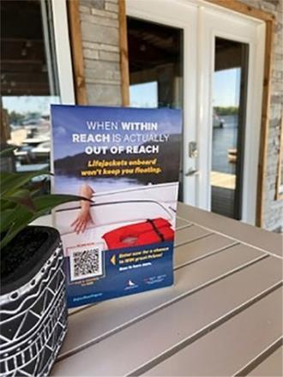
Creating Your Campaign
Plan your own “What”, “When”, “Who”, “Where” & “How”:
“What” - Focus on messaging that can be effective for you & your audience
“When” - Decide what time during the year and how long you will be promoting the campaign
“Who” - Think about who your target audience should be
63
Notes:
“Wearing your lifejacket” is important for safe boating, and can be encouraged by local campaigns. Want to plan your own campaign and event, start with the “What”, “When”, “Who”, “Where” & “How”:
“What” – This is the messaging of your campaign. Focus on messaging that can be effective for you & your audience. ‘Within Reach’ communicates “you may not be able to reach your lifejacket and put it on if you fall into the water”, so “always wear your lifejacket”.
“When” - Decide what time during the year and how long you will be promoting the campaign. Is Summer boating season in your area? Are there other seasonal local events that you can participant.
“Who” - Think about who your target audience should be or could be
Is it all recreational boaters? Or more specific?
Members of your marina or boating organization?
The general public in your community?

Slide 64
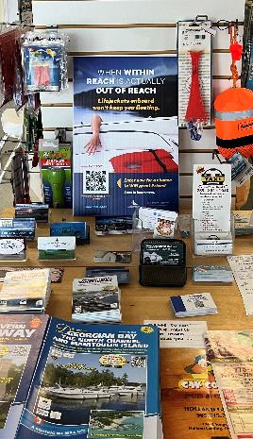
Creating Your Campaign
“Where” - Be focused on where you are looking to promote the campaign
“Partners” - Look within your community on who you wish to work with
“How” - For a successful campaign, you will need to identify what resources you have available
64
Notes:
“Where” - Be focused on where you are looking to promote the campaign
What boating areas / lakes/ geography?
Just your marina or organization??
“Partners” - Look within your community on who you wish to work with
Local marine enforcement agency?
Other local partners or other organizations?
People within your marina or organization?
“How” - For a successful campaign, you will need to identify what resources you have available
Including the ‘Within Reach’ campaign materials,
other CSBC materials, etc.
People resources, $’s.
When deciding where to promote your campaign, remember that sometimes “less is actually more”. Don’t overstretch and spread your resources too thin.
For a successful campaign or event, look at what personnel are available, how many physical materials are required, what are all the costs involved for the event or campaign

Slide 65
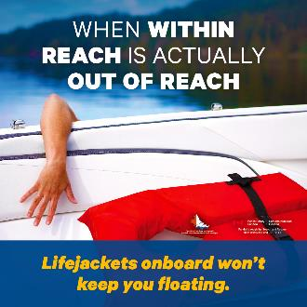
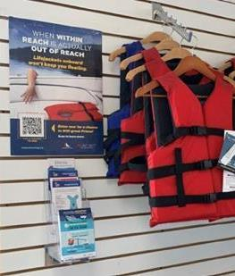
Within Reach Tool Box
What Marketing / Communications Materials are in the Tool Box:
Printed Materials
Digital Materials
Social Media
65
Notes:
There are different formats of marketing and communication materials that you can use for your own campaign, with printed material and digital materials – including poster images and graphics for sharing on social media

Slide 66
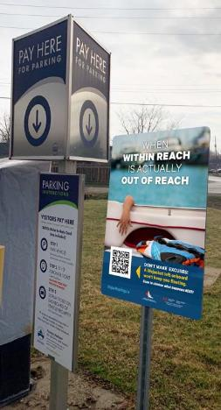
Within Reach Tool Box
  Printed Marketing Materials
    12 x 12 Outdoor Sign
    Poster (8 x 11 OR 12 x 18)
    Tent Card / Countertop Card
    Window Cling
    Postcard Handout
66
Notes:
There is a variety of printed marketing materials and sizes available. From rigid outdoor signs, to indoor materials. Choose what fits right for your business and campaign.
Access electronic files to print your own, or order printed copies (while quantities available, shipping extra)

Slide 67
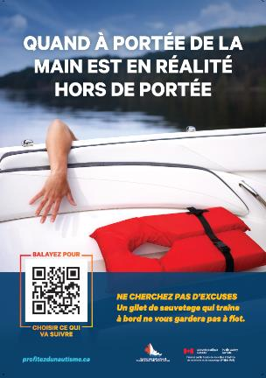
Within Reach Tool Box
  Digital Marketing Materials
  Can be shared online or be printed as needed – English and French
    Within Reach Poster
Notes:
Files that are print-ready are available for downloading from the enjoyboating.ca website. You can share these on your website, in newsletters or social media. You can also print them out as handouts for use in your campaign.

Slide 68
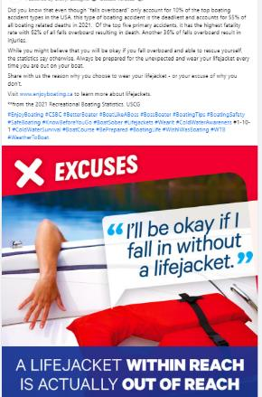
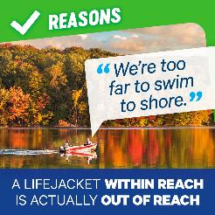
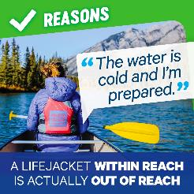
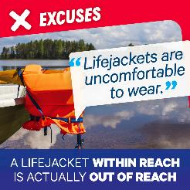
  Social Media
      Outreach to your followers
      Available Materials include:
      Within Reach Reasons to Wear
      Within Reach Excuses
      Suggested Text for social media Posts
Notes:
Take advantage of the ‘Within Reach’ Social Media images and suggested posts that are available.
Pick and choose posts that fit your boating clientele OR pick a mix of “popular” messages to share on your platforms.

Slide 69
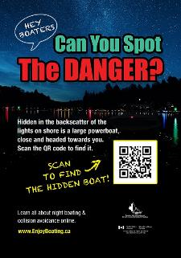
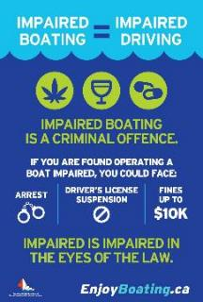
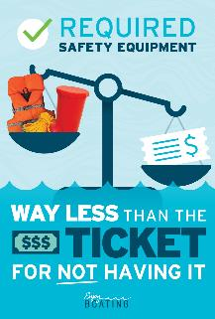
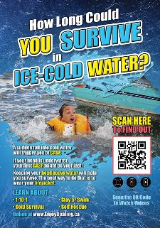
Additional Social Media Materials
      Available Materials include:
      Infographs
      Posters
      Suggested Text for Posts
Notes:
In addition to the Within Reach campaign, there are other graphics, including infographs and other posters, featuring boating safety messaging that can be used as social media posts, on your website, in newsletters or other outreach campaigns.

Slide 70
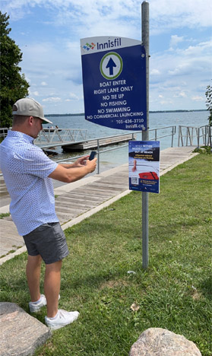
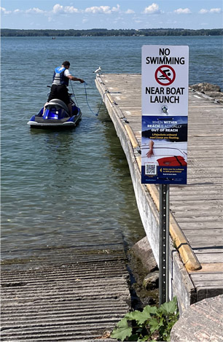
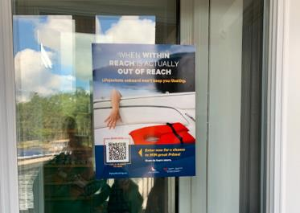
Ideas for Your Campaign
Tips to Consider:
  Throughout the boating season, longer exposure is more effective; start as early as possible
  Putting the outdoor signs at key locations around your marina – like gas dock, launches, entrances onto docks
  Window clings are removeable and can easily be moved around your windows and doors
Notes:
Here are a few tips to consider for any campaign that you may do…and these come from the success stories we heard from the partners who participated in the 2022 outreach project for the targeted research area.

Slide 71
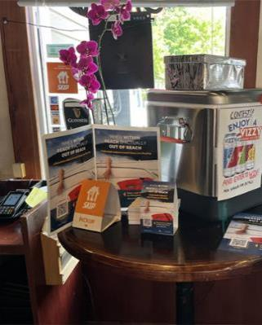


Ideas for Your Campaign
More Ideas to consider…
    Handing out the post cards to customers
    Displaying posters or tent cards in high traffic locations within your service centre, store or recreational centre
Notes:
Put any of your desired marketing materials in highly visible traffic areas. Think about all the possible touch points / locations within your business location that customers can see the messaging

Slide 72


Ideas for Your Campaign
More Ideas to consider…
Special Limited Time Events:
  Host a special event during Safe Boating Awareness Week, Free Fishing Week or Drowning Prevention Week
  Host “customer appreciation” events during the boating season
  Participate in local events around key Provincial/National celebrations – Victoria Day, Canada Day, Civic Holiday, Jean Baptiste Day, etc
72
Notes:
Think about different ways you can spread the message within your community. Whether you are hosting your own event, partnering with other local businesses or participating in events hosted by your local chamber of commerce

Slide 73


Ideas for Your Campaign
  Outreach with local Partners:
  Reach out to associations, local chambers of commerce, CPS, community partners to help you get the word out, work with you
Notes:
There are many different local partner options, several who may be hosting their own events that you can participate in.

Slide 74
Call to Action

Slide 75

Plan & Implement your own Campaign!
  Leverage our learning, order our materials, send them to your members or customers and implement your own local campaign
    It is that time of year again, when boaters are starting to think about getting back out on the water, and we want to ask you for your support in communicating “Within Reach” boating safety public education.
    ‘Enjoy Boating’ is a national outreach program that delivers boating safety messages and tips using Augmented Reality. The campaign and EnjoyBoating.ca are designed to enhance boater education by teaching better preparation, prevention and performance skills, and ultimately increase lifejacket wear rates among recreational boaters.

