Slide 1
Boating Safety in Australia Different Waters, Common Challenges
Howard Glenn
Chair
Australian Recreational Boating Safety Committee
General Manger
Office of Boating Safety & Maritime Affairs(OBSMA)
Transport for NSW

Slide 2
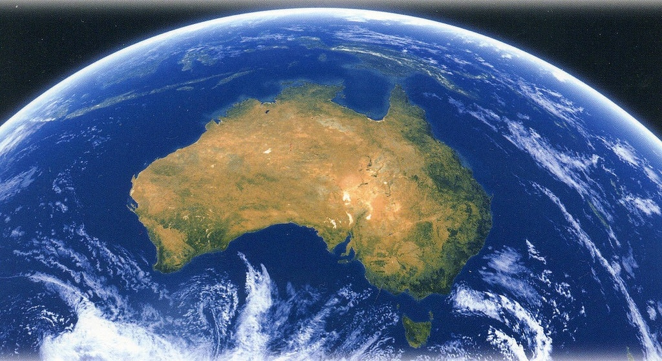
Population 22.5 million
7.2 million in New South Wales
5.57 million in Victoria
4.5 million in Queensland
2.4 million in Western Australia
1.65 million in South Australia
500,000 in Tasmania
300,000 in Australian Capital Territory
200,000 in Northern Territory
Australia’s land mass of 7.7 million sq km compared to Canada’s 10 million sq km (with a
population of 33 million) makes it the sixth largest country in the world. It is also the only one of the
largest six nations that is completely surrounded by water.

Slide 3
An estimated 5 million people go boating each year The east coast (NSW and QLD) accounts for almost 70% of all boating
NT
40,000
QLD
1,600,000
WA
500,000
SA
40,000
NSW
1,800,000
VIC
600,000
TAS
200,000

Slide 4
Boating fatalities snapshot Australia wide 5 years to 2012
While the popular boating states like NSW and QLD have had more fatalities. All the states have fairly low fatality rates per 100,000 registrations

Slide 5
5 year boating fatalities snapshot of NSW
All of the19 fatalities in 2011/12 were required to wear lifejackets according to legislation
Only 2 of the 19 deceased wore lifejackets but died due to high impact collision

Slide 6
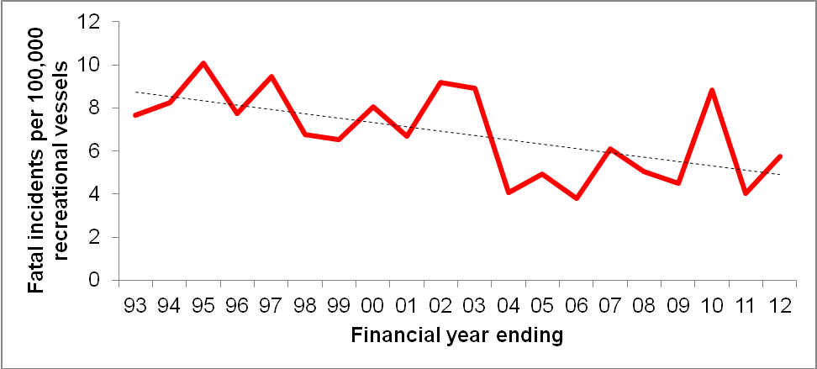
Long-term trend in fatality incidents in NSW

Slide 7
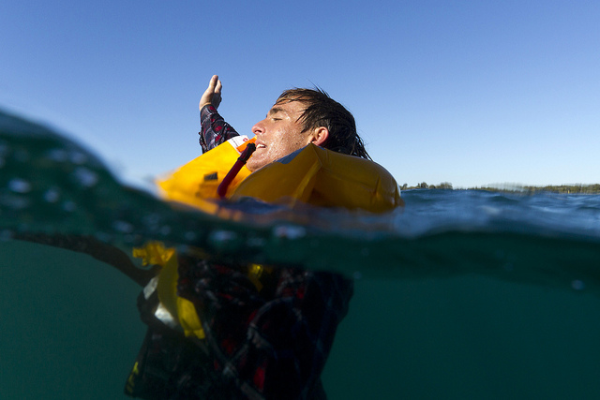
The importance of wearing a lifejacket
Drowning causes 2/3rds of boating fatalities in NSW
Less than 5% of drowning victims were wearing a lifejacket
Bar-crossing fatal incidents have fallen 64% since the introduction of compulsory wear rules in 2003

Slide 8
Australian Recreational Boating Safety Committee (ARBSC)
Established to co-ordinate national recreational boating activities
Comprises senior representatives of State and Territory maritime agencies
The ARBSC is chaired by the General Manager, OBSMA for 2011-12
Lifejackets are a feature throughout the work plan

Slide 9
Australia New Zealand Safe Boating Education Group (ANZSBEG)
Membership from all maritime jurisdictions in Australia as well as New Zealand.
Observer status is provided to the following:
Federal Bureau of Meteorology
Boating Industry Alliance Australia
Surf Life Saving Australia
Yachting Australia
Australian Communications and Media Authority
Chaired by OBSMA. Work plan includes:
Lifejackets maintenance, servicing and education as the major project

Slide 10
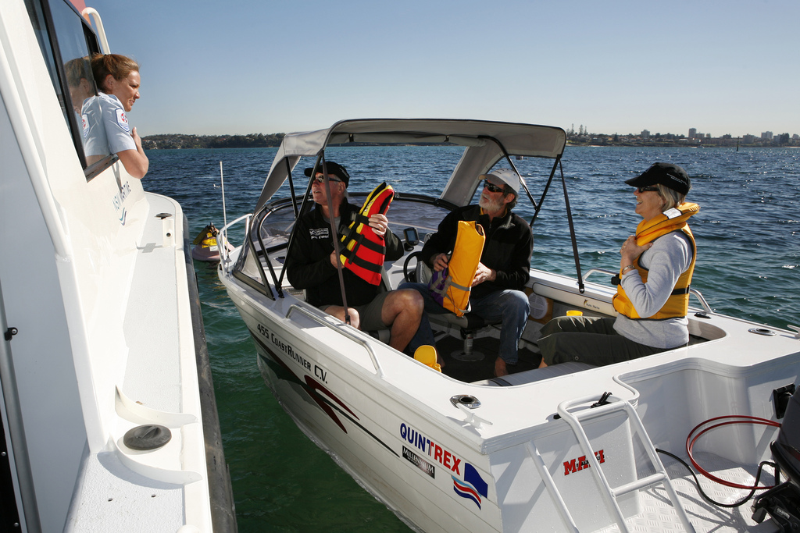
Lifejacket carriage
Lifejacket carriage is compulsory across all States except in Western Australia
where carriage is only required on open (ocean) waters

Slide 11
Boating safety strategies in NSW
Lifejacket website (www.lifejacketwearit.com.au)

Slide 12
Boating safety strategies in NSW
Television campaigns

Slide 13
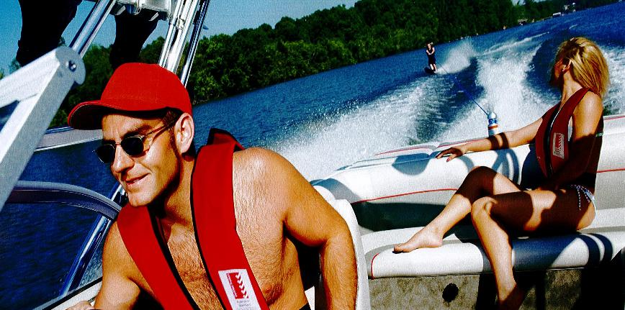
Boating safety activities in NSW
Education and compliance program
50,000 on-water vessel safety checks per annum
Random breath tests (NSW Water Police)
Safety partnerships
Lifejacket advertising campaign
Lifejacket loaner/gift program

Slide 14
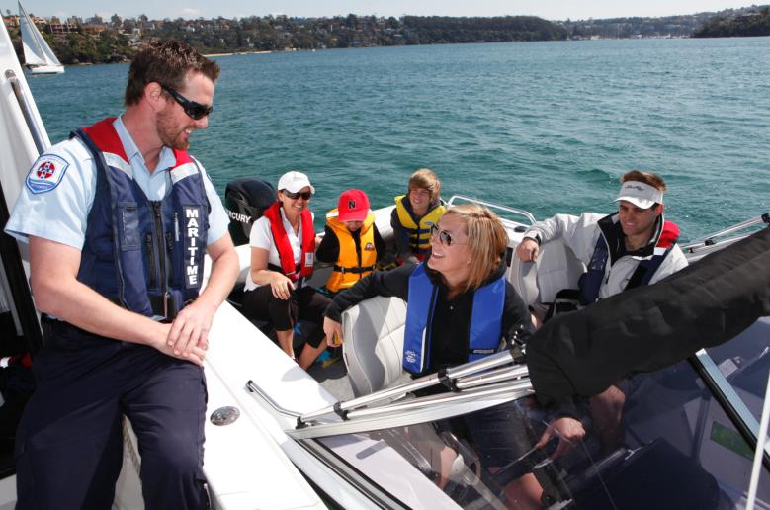
Boating safety initiatives in NSW
Lifejacket awareness campaign
Lifejacket wear initiative
Paddle craft safety campaign
On-water compliance reform
Boating safety plans
Safe boating education & communication strategy 2012-2015
National maritime safety law

Slide 15
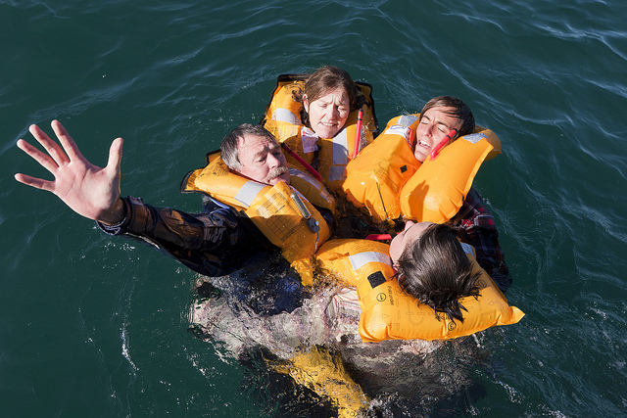
Registrations of interest (lifejacket supply & promotion)
Partnerships with industry
Standardized inflatable lifejacket servicing
Lifejacket replacement system ‘swap and go’
Improve lifejacket wear rate

Slide 16
NSW boating safety check compliance rate (recreational vessels incl. PWC)

Slide 17
Summary of lifejacket wear requirements

Slide 18
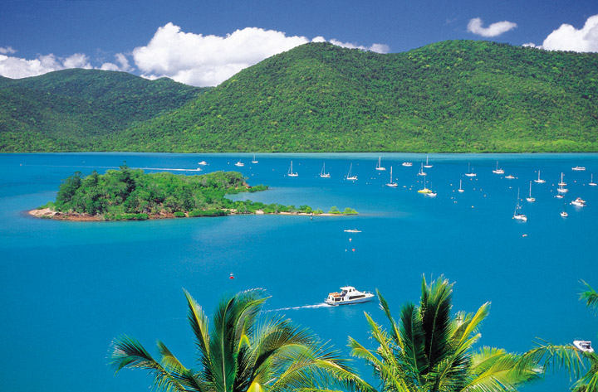
Different waters - Queensland
Tropical environment
Cyclone hazard in summer
Recreational boating occurs well offshore along Great Barrier reef
Remote areas popular with recreational boaters

Slide 19
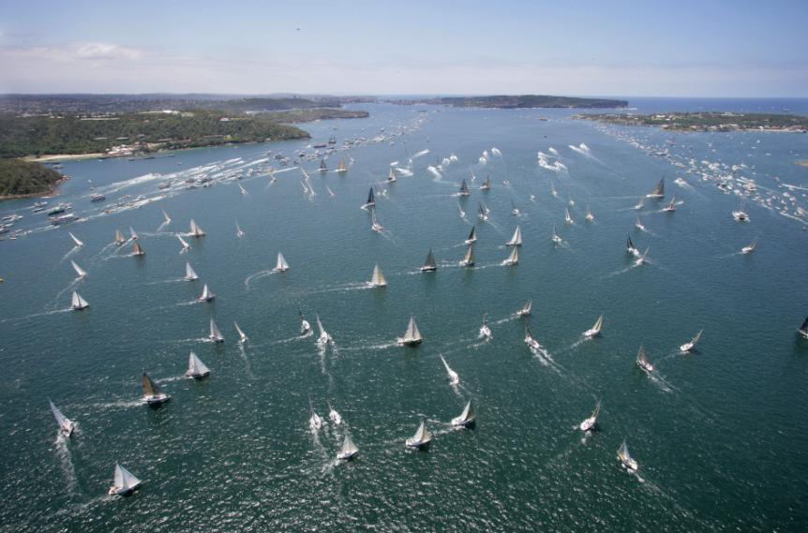
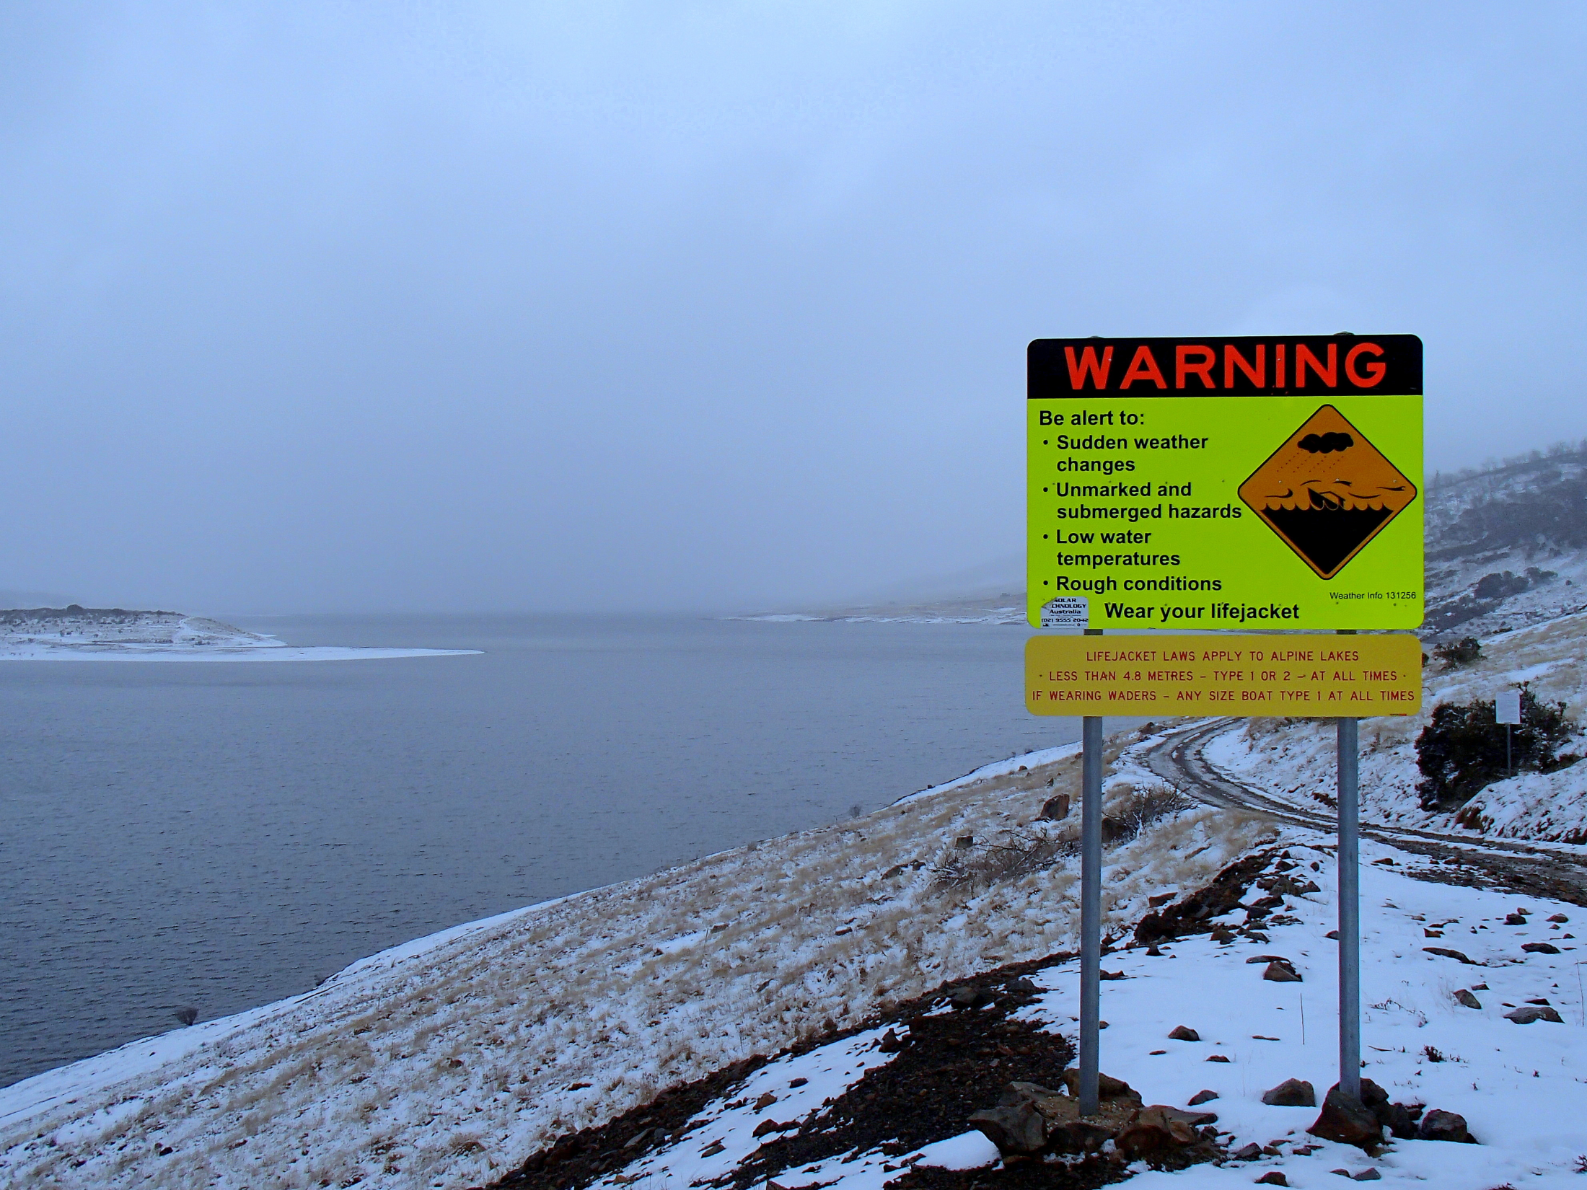
Different waters - New South Wales
Most populous State
Busy congested waterways
Frequent interaction of big ships, small boats & passive craft
Coastline fully exposed to Tasman Sea
Frequent aquatic special events
Subtropical to alpine boating environments

Slide 20
Office of Boating Safety and Maritime Affairs (OBSMA)
Established on 1 November 2011 to lead and direct the development and
implementation of strategic direction and policy and regulatory reform
initiatives. OBSMA is actioning the Government’s policy initiatives for boating
safety, maritime property and waterways management.
OBSMA sets the strategic directions for implementation by the service provider, Roads & Maritime Services.

Slide 21
Australia’s first ever International Marine Conference and Exhibition
Marine13 will, for the first time in Australia, bring together representatives of marinas, recreational boating and boating safety to the one event in Sydney.
Stakeholders from these various streams of the boating and marine industry will be able to share information and ideas in a bid to prepare the sector for challenges and growth into the future.
www.marine13.com
Principal partner

Slide 22
