Slide 1
Boating Safety –a New Zealand Perspective
Presentation to the CSBC Symposium
Alistair (Al) Thomson 25 September 2012

Slide 2
What I’m going to cover
Environment/Recreational boating profile
Fatality rates & target demographic
Previous campaign
Research
New campaign
Other programmes /partner projects

Slide 3
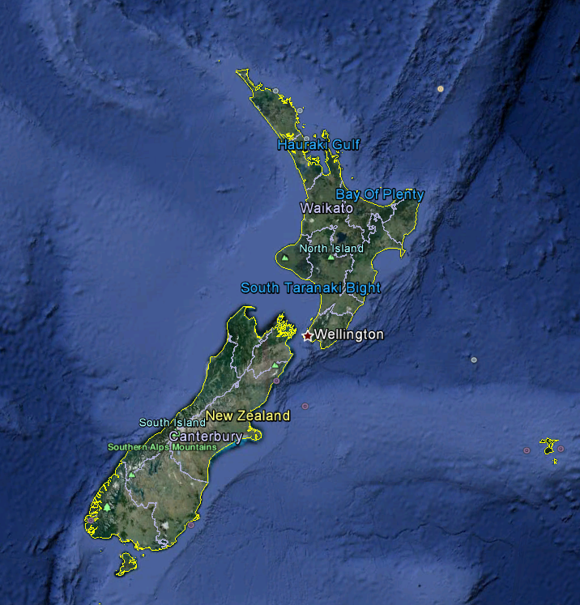
Environment
14,000KM of coastline
Tasman to the West and Pacific to the East
Exposed to southern ocean storms
Benign weather in summer

Slide 4
Environment
Beautiful scenery
Big Fish!

Slide 5
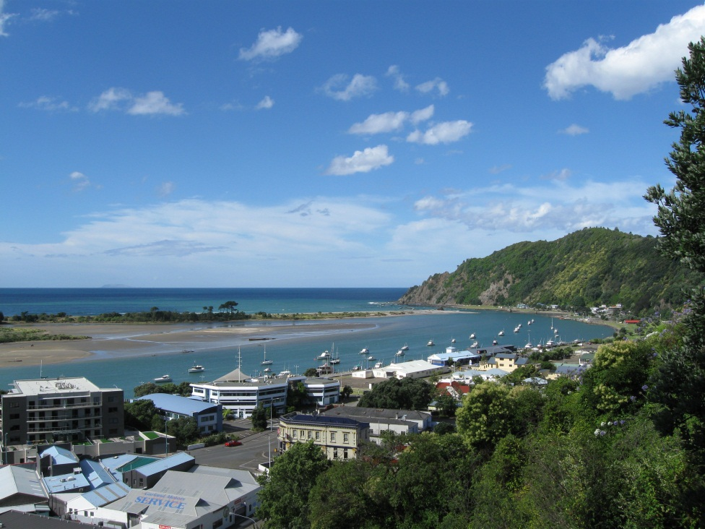
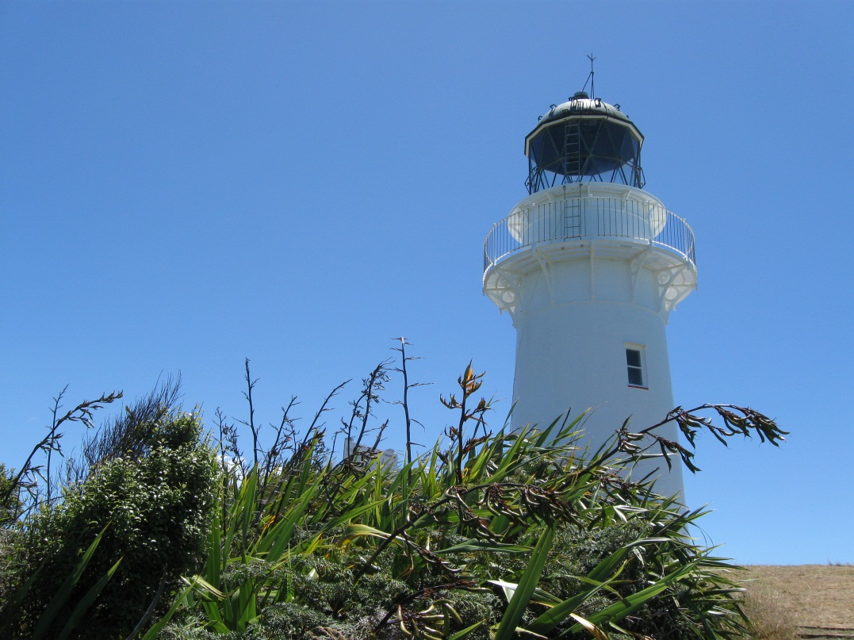
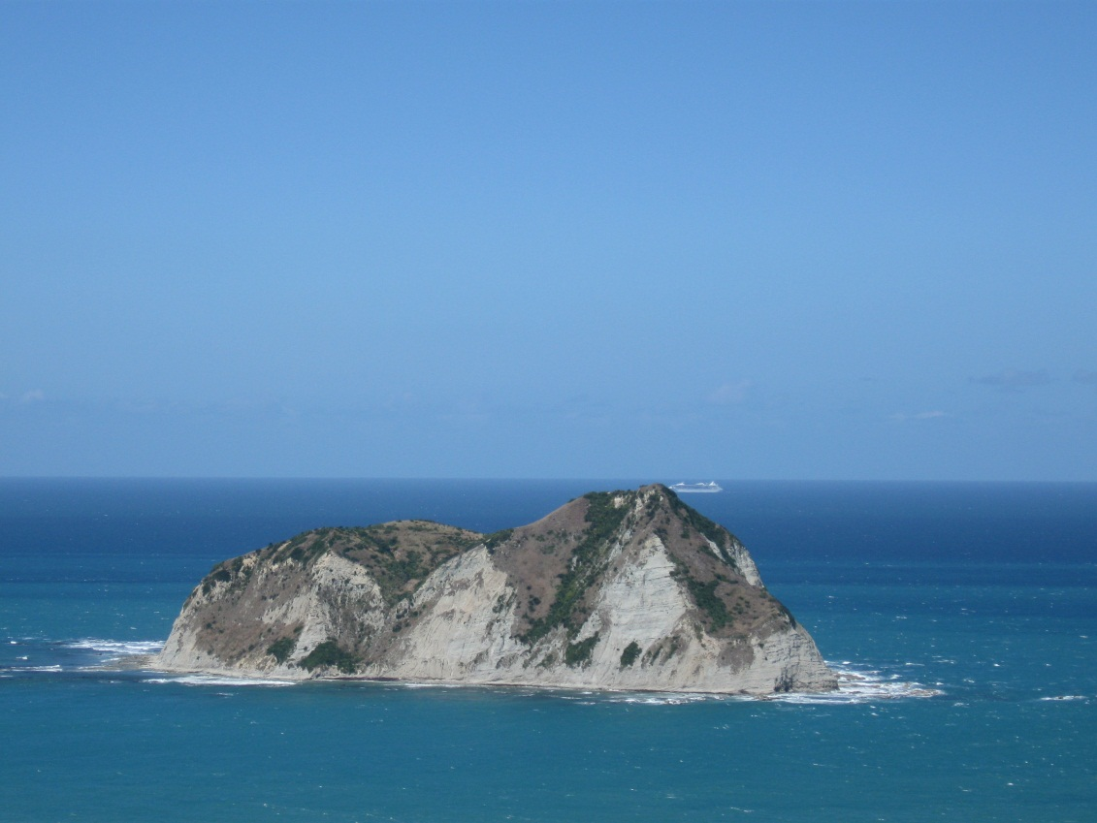
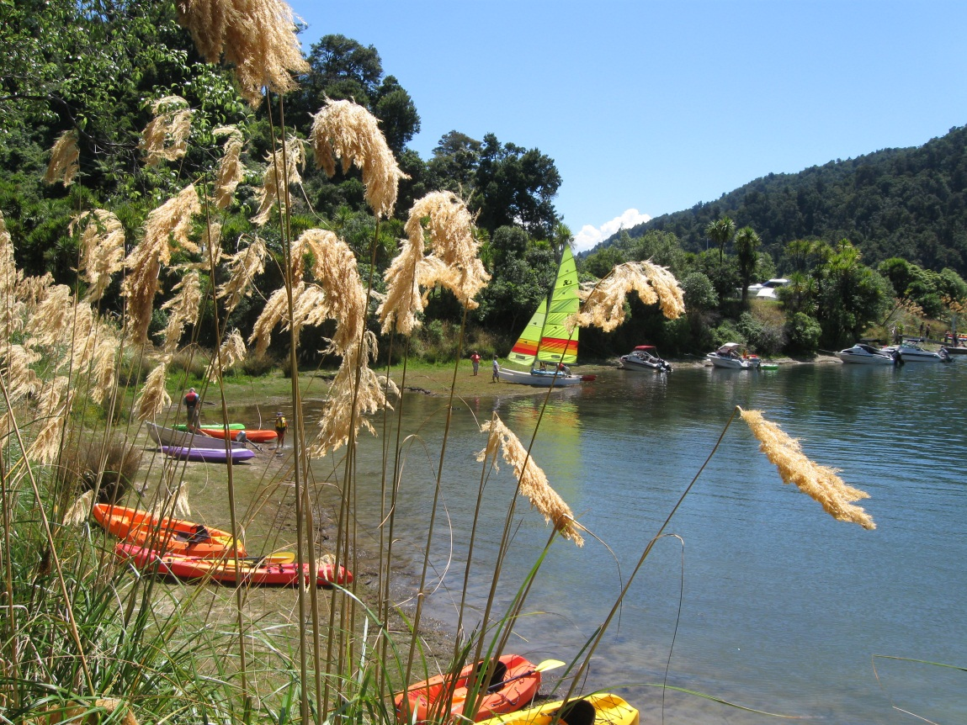
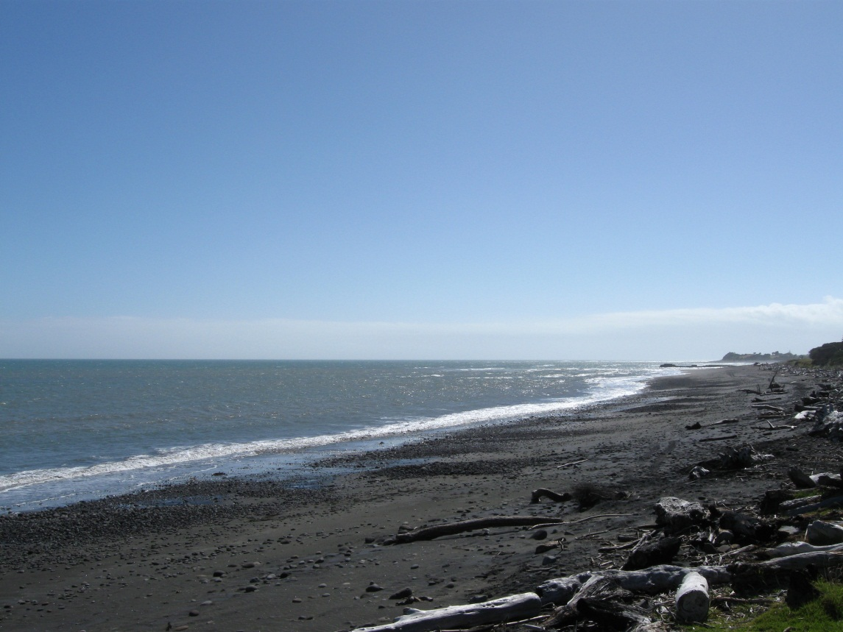

Slide 6
Multi jurisdictional environment
Maritime Rule 91-Navigation Safety-lifejackets must be carried
17 Regional Councils/Unitary authorities make navigation safety bylaws that can’t specify less than the national rule (MR91)
Wear rates are significantly higher in regions that have specified mandatory wear-annual boat ramp survey

Slide 7
New Zealand’s Recreational Boating Profile
We estimate 480,000 recreational vessels in NZ from kayaks to large cruising size vessels
1 in 3 participate in recreational boating activity
Majority of accidents and fatalities occur in the under 6 meter category

Slide 8
Fatality rates

Slide 9
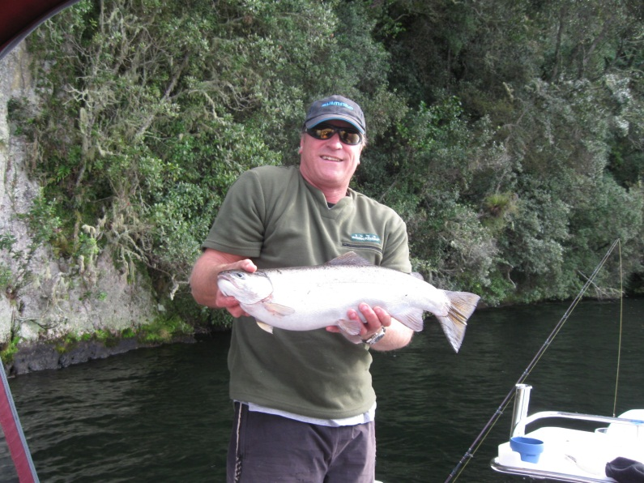
Our target demographic
Male
30-65
Fishing
Vessels 4-6 meters

Slide 10
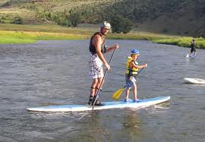
Emerging activities-SUP
Large numbers participating individually and in organised events
Currently forming our national position in relation to PFD/Lifejackets
Participants view is they are surfers and not paddlers

Slide 11
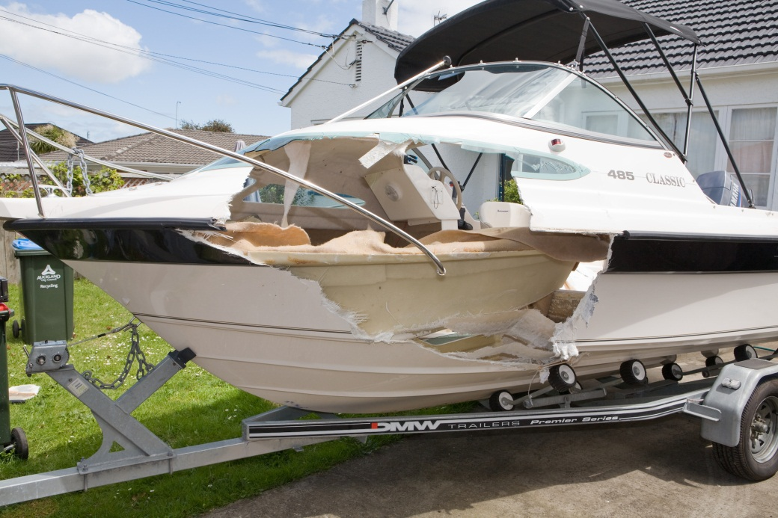
Emerging behavioral issues
Close quarters
Collisions
Lack of robust data

Slide 12
Strategy
2003 mandatory carriage and wear at times of heightened risk introduced
2007 review of pleasure boat safety strategy focused on four key messages; lifejackets, communications equip, weather and alcohol
Several campaigns focussing on key messages with differing degrees of success

Slide 13
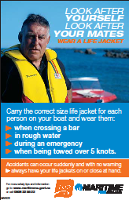
Our most successful TV commercial

Slide 14
Pine Tree-meads
We were very happy with the level of recall
After running for 3 years we still had 79% recall
Big question, how do we recreate a similar level of recall?

Slide 15
Funding
Fuel tax fund- recreational boaters pay approx. $40m/yr
$930 comes to MNZ/NPBSF for national campaign and associated forum member campaigns

Slide 16
The Research
Maritime NZ commissioned Ipsos (Synovate) to undertake a qualitative research study seeking insight into lifejacket use amongst our target demographic……
Getting to know the audience…..

Slide 17
The Research-context
What does boating / kayaking / jet-skiing represent for people?
How does it make people feel?
What does it mean to them emotionally? e.g. freedom, leadership, status, invincibility, etc
What do people associate this activity with?
What effect does this activity have on personal attitudes?
Do attitudes to life change when they are on the water?
What imagery reflects the experience of boating / kayaking / jet-skiing?

Slide 18
The boating / water experience

Slide 19
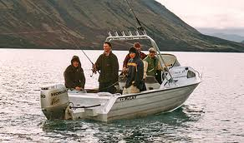
The boating Mindcloud™
Water
Escape
Kids
Adventure
Fishing gear
Open spaces
Bad weather
Sharing catch
Fresh air
Summer
Fishing
Cleaning up
Water sports
Costs
Fun
Swimming
Family time
Lifejackets
Lifestyle
Pleasure
Company
Safety checks
Friends
Sharing
Relaxation
Success
Positive
Negative
Neutral

Slide 20
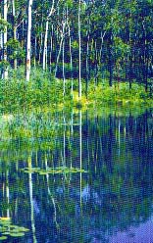
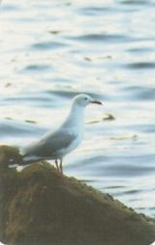
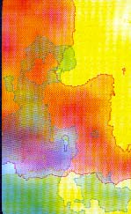
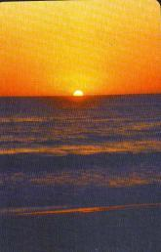
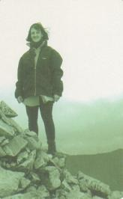
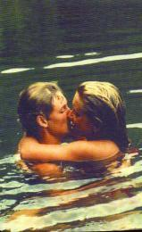
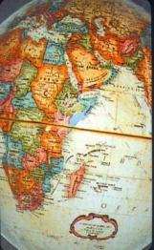
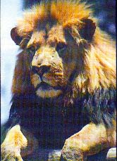
Further themes
Calm seas and a good day
Friendly skies
Achievement
Natural environment
Special moments
Time with loved ones
World adventure
Power / speed

Slide 21
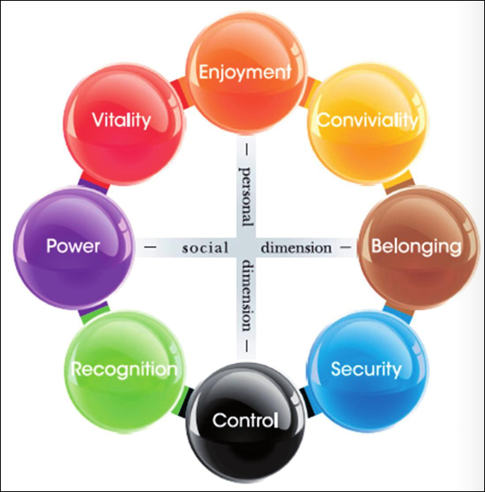
A model of human needs
Needs or desires are the basic motivations that drive behaviour
These 8 needs provide an emotional ‘compass’ for experiences – be they brand, service, product or activities
What needs or desires do you think boating delivers on, compared to lifejackets?
‘Release’
‘Self’ ‘ Others’
‘Control’

Slide 22
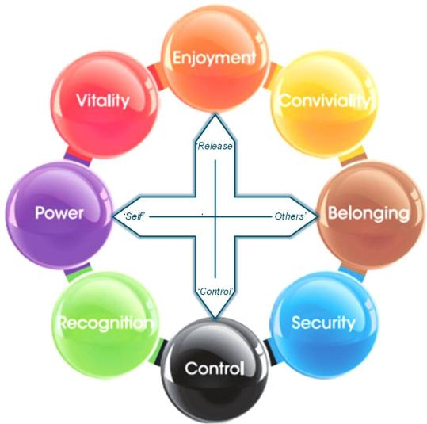
What needs ‘light up’ for boating?
ENJOYMENT | CONVIVIALTY | BELONGING | SECURITY | CONTROL | RECOGNITION | POWER | VITALITY
impulsive | happy | amiable | comforted | disciplined | unique | proud | daring
lively | cheerful | co-operative | reassured | efficient | expert | assertive | excited
vibrant | relaxed | accepted | secure | focussed | discerning | superior | bold
fresh | fun | equal | soothed | structured | individualistic | successful | dynamic
outgoing | friendly | sociable | calm | ordered | competent | powerful | adventurous
pleasure | pleasant | comfortable | gentle | rational | self-assured | strong | stimulated
spontaneous | connected | harmonious | peaceful | practical | independent | respected | free

Slide 23
Conviviality is central to the boating experience
CONVIVIALTY
happy
cheerful
relaxed
fun
friendly
pleasant
connected
Men talk of how boating makes them feel relaxed
It is a release from their daily routine and obligations
They feel happy, re-energised
They feel connected to other people out with them (friends or family members) or to the elements
This need is about opening up emotionally and allowing others to share in the experience
Conviviality is about shared understanding and pleasures
Being open, inclusive, and collaborative are all important
Being judgemental works against this need

Slide 24
Belonging is a secondary need fulfilled
BELONGING
amiable
co-operative
accepted
equal
sociable
comfortable
harmonious
Men talk about the camaraderie of boating
Being surrounded by their mates
Belonging and accepted, equals
Fishing is a shared experience inextricably linked to boating
Belonging is about togetherness, brotherhood, taking care of others, traditions, and feeling good
Peer acceptance is a powerful tool for this need
Support, empathy, love, care, and true friendships tap into this need
An outsider telling people how to behave works against this need

Slide 25
Security is next
SECURITY
comforted
reassured
secure
soothed
calm
gentle
peaceful
Men talk about boating as though it is therapy
“When I head away from the shore I can feel my worries falling off me”
Boating is a soothing pastime
Boating takes away the stresses and strains of a hectic daily life
The security need is about withdrawing into a mental space free of worry and responsibility
Security is about being made safe from harm
Focusing on protection and safety is a perfect fit for this need
But forcing people to comply works against this need

Slide 26
Vitality exists as a minor need
VITALITY
daring
excited
bold
dynamic
adventurous
stimulated
free
Some men talked about the adventure of boating
Boating makes some men feel alive in a very energetic way
Boating is about ultimate freedom to explore and take on nature
An ultimate goal for some is to sail the world
Vitality is about stepping outside the comfort zone, taking a risk
This need is about complete freedom
To reflect this need you have to share the same passion
Holding them back works against this need

Slide 27
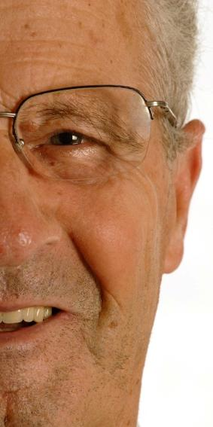
To summarise the emotions of boating
Boating is a relaxing pleasure that connects me with others (or with nature) through shared experiences
Boating is about me fitting in with good friends and family
Boating is my soothing therapy
Boating is an adventure
Of course these may be dialled up or down depending on the type of craft
e.g. kayakers often have a solo experience, so the lower order needs are dialled up – unless they kayak with others!
Boating is about thinking with the heart and enjoying life

Slide 28
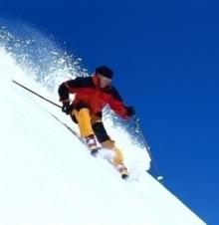
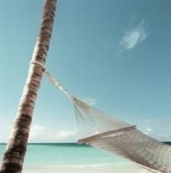
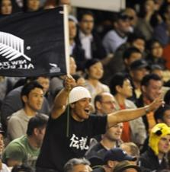
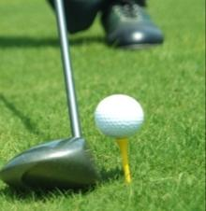
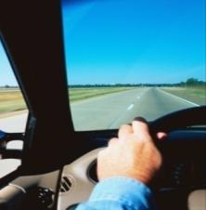
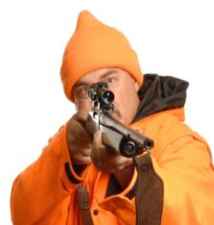
What else is like boating?
Ski trips Holidays Sports events Golf Road trips Hunting
All of these activities share a little of the same feelings that boating delivers
Away from ‘normal’ life
Back to nature, natural surroundings
Relaxation and shared passions
Belonging and equality
Security and therapy
Vitality and freedom, taking on a challenge
But nothing else truly compares...
Boating is a complete package
An absolute joy for those who take part

Slide 29
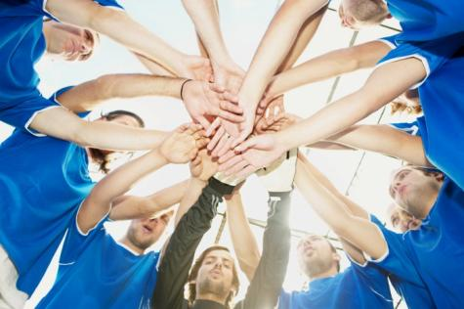
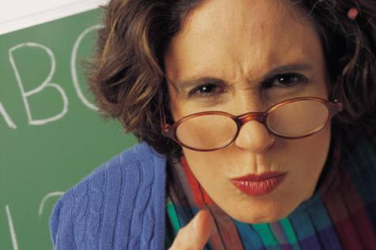
What have we learned about boating culture?
What we can do...
Be inclusive, persuasive, invite boaties to change, offer good role modelling
Be part of the culture, reflect the ‘group’ nature of boating, reflect the impact of what they do on other people in their lives (“advice from one who knows”)
Offer ways to make boating more soothing and relaxed
Show we understand the passion and thrill of boating
What we can’t do...
Act judgementally
Be an ‘outsider’ to the culture, telling them what to do
Force or demand compliance
Hold people back from enjoyment

Slide 30
Water safety and lifejacket behaviours and attitudes

Slide 31
Where lifejackets fit in the priorities
Wearers
Non-wearers
Checking the conditions and avoiding bad weather
Nobody places lifejackets at the top of the priorities
“If you have to wear a lifejacket, you shouldn’t be out there!”
Checking the conditions and avoiding bad weather
Ensuring you have communications on board in case of distress
Ensuring you have communications on board in case of distress
Wearing lifejackets
Limiting alcohol on board
Limiting alcohol on board
Wearing lifejackets

Slide 32
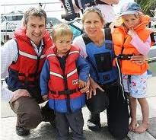
The lifejacket Mindcloud™
Safety
Wind break
Bad fit / tight
Law to have
Always on board
HOT!!
Visibility
Where are they stored?
Bright
Compulsory?
Optional to wear
Uncomfortable
Children
Cumbersome
Necessary evil
Wives
Important
One for all
Too bulky to fish in
Reassurance
Protective gear
Troublesome
Fit well
Emergency situation
Secure
Good condition
Essential
Have to replace often
Positive
Negative
Neutral
NZ standard
Cost

Slide 33
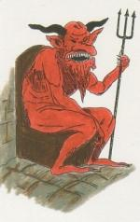
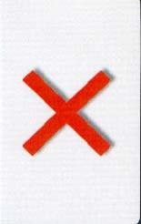
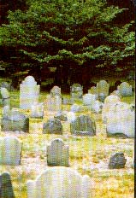
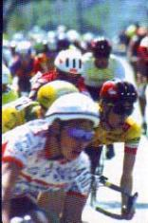
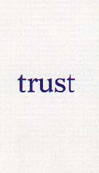
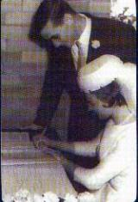
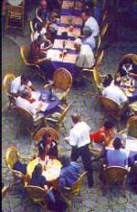
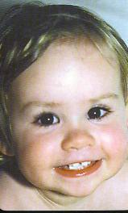
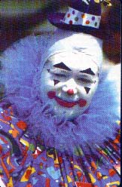
Further themes
Doom
Death
Disaster
Uncomfortable
Protective gear (like helmets)
Trusted to work
Protecting loved ones
Being there for loved ones
Idiot not to wear / idiot to wear

Slide 34
What needs ‘light up’ for lifejackets?
ENJOYMENT | CONVIVIALTY | BELONGING | SECURITY | CONTROL | RECOGNITION | POWER | VITALITY
impulsive | happy | amiable | comforted | disciplined | unique | proud | daring
lively | cheerful | co-operative | reassured | efficient | expert | assertive | excited
vibrant | relaxed | accepted | secure | focussed | discerning | superior | bold
fresh | fun | equal | soothed | structured | individualistic | successful | dynamic
outgoing | friendly | sociable | calm | ordered | competent | powerful | adventurous
pleasure | pleasant | comfortable | gentle | rational | self-assured | strong | stimulated
spontaneous | connected | harmonious | peaceful | practical | independent | respected | free

Slide 35
Control
CONTROL
disciplined
efficient
focussed
structured
ordered
rational
practical
Men talked about lifejackets as a ‘necessary evil’
Part of the required equipment, but they detract from the joyous experience of boating
To wear a lifejacket is almost an admission you are risk
And most men feel in command of the situation, i.e. not at risk
Men who have accepted lifejackets have accepted they are at risk or have to set a good example
They put up with the negatives to impose this control
Control is about rational structure and mature control of temptation or urges
Lifejackets as a concept impose structure and rationality onto the boating experience – no wonder there is a disconnect for some!

Slide 36
Security is next
SECURITY
comforted
reassured
secure
soothed
calm
gentle
peaceful
Men talk about lifejackets from a practical perspective
They know that they can save lives when the worst happens
Lifejackets make some men feel more secure when boating
For some, this extends only to having them on board!
But lifejackets are more accepted when men feel they are protecting their wives / kids
The security need is about withdrawing into a mental space free of worry and responsibility
When it’s about others, you are free from worrying about them
Security is about being made safe from worry and harm
The challenge is to transfer this from ‘protecting others’ to ‘protecting myself’

Slide 37
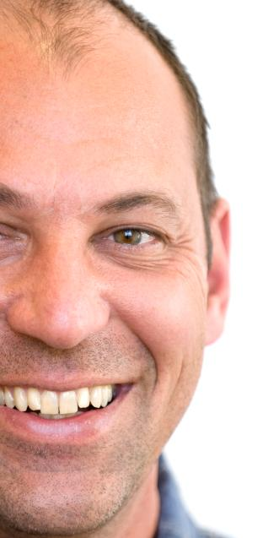
To summarise the emotions of lifejackets
Lifejackets are about me being responsible and rational – planning ahead
Lifejackets are about protection from harm
The challenge is to turn these into positive expressions that fit, or modify, the emotional culture of boating
Lifejackets are about thinking with the head and fearing the worst

Slide 38
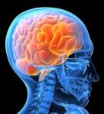
“You want to be free. A lifejacket restricts you...
...but it’s a necessary evil.”

Slide 39
Non-wearer behaviour (i)
Wear when the weather gets bad, not when it’s calm
Why?
Everyone realises the risks involved in bad weather
Wear it while craft is moving, remove it to fish
Why?
Greater risks when moving, less risk when stopped
Too bulky to wear while fishing
Expensive lifejackets get dirty and smelly if worn fishing
Don’t wear it at all, but have it ‘nearby’
Why?
Perceive that the lifejacket is needed if the craft is sinking – so have time to put on
Don’t wear close to shore or in harbour, only wear when in open sea
Why?
Believe I can swim to shore
Water very calm

Slide 40
Non-wearer behaviour (ii)
Wear when ‘going over the bar’, then remove
Why?
Widely acknowledged risk when heading out over a bar
Skipper does not wear, but passengers do
Why?
Skipper has faith in his own skills and knowledge of the area and conditions
But feels obligated to protect passengers
Take cue from skipper, don’t wear
Why?
Trust the skipper to not do anything risky or put us in danger
We know how to swim!
Use a wetsuit instead
Why?
Believe a wetsuit provides enough buoyancy
An accepted cultural norm

Slide 41
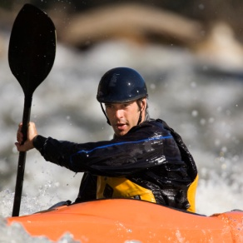
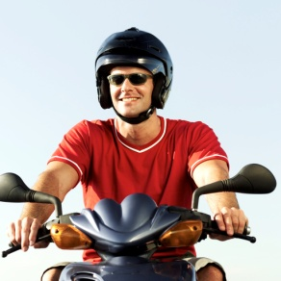
Type of craft helps or hinders
The difference between boats and kayaks is a bit like the difference between cars and motorcycles
Lower in the water
Closer to the water
Slower moving
Less visible
The bigger the boat, the easier it is to feel safer than you are
Have a heightened sense of danger & vulnerability

Slide 42
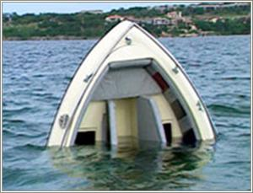
What about near-misses?
The experience of a near-miss is not a sure-fire driver to wearing lifejackets in the future!
The most harrowing tales of near-misses came from the men who were least likely to wear a lifejacket
There are obviously some very powerful drivers to not wearing

Slide 43
Knowledge
All boaties are aware that they should carry a sufficient number of lifejackets on board and know where they are
They know that lifejackets can save lives when people enter the water
But not all believe they should wear them if ‘nothing is wrong’ and the weather is fine
Lack of knowledge is not the problem
Emotional needs and perception of risk are
“You’re fishing and having a few beers... lifejackets just don’t come into it.”

Slide 44
Key barriers
“If they could make one that was as thin as a t-shirt, I’d wear it”
Lifejackets
NO
Uncomfortable
Uncool – not part of the crowd
Insulting to the skipper
Don’t perceive a risk
Total confidence as a skipper
Confidence – swimming ability
“I am really comfortable in the water”
“No one ever says it – you just sense it”
“Nothing will happen here – we’ll be right”
“It’s an admission of failure”
“It’s anticipating failure”

Slide 45
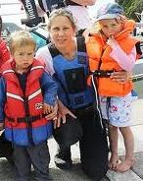
Non-wearers
Wearing lifejackets represents security and nurturing of others
I want to protect people on my craft who can’t look after themselves
Mainly for kids and wives
Friends know where they are and can make their own decisions
When it comes to me – wearing lifejackets means I need to be controlled or lack faith in the skipper
I’m enjoying myself – where is the emergency?
He knows what he is doing
I know what I am doing and managing the risk so I decide not to wear one

Slide 46
Key motivators
“I was brought up wearing – my dad raced yachts”
Lifejackets
YES
Nervousness on the water
A no-argument requirement (e.g. kayak)
A heightened sense of the risk
To set an example, lead by example
Found a comfortable option
Retailer or expert advice
Taught early
Rules at boating club
Skipper insists
“I just feel more comfortable and secure”
“If the skipper gives one to me I wear it”
“They have real strict rules”
“It’s just not worth it”
“He told me he wouldn’t sell without lifejackets, and I had to wear them”
“No one is above harm”
“I found one of those inflatable ones”
“The kids say if I’m not wearing one, why should they?”

Slide 47
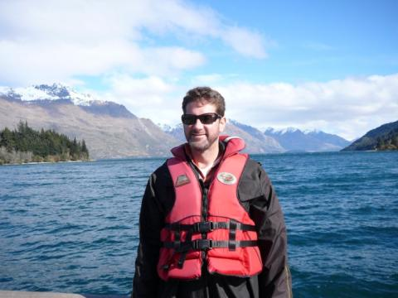
Wearers
Wearing lifejackets represents security for everyone
I want to protect all people on my craft, and that includes me
I feel better knowing I am protecting people
When it comes to me – wearing lifejackets means I am more in control of the situation, more responsible
I can feel more comfortable knowing that nothing bad will happen

Slide 48
The wearer’s view of the non-wearer
Loose / undisciplined
Irresponsible
Don’t think of others
Selfish
Macho
Dumb / clown
Risk taker
Uninformed / unaware
Inconsiderate
Overconfident
‘Bloody idiots’
Can’t educate them
Selfish / arrogant
A liability on those around them
Don’t think of consequences
Many assume it is men under 40 who are the culprits!
The sense that they are ‘a liability on others’ could be a useful angle

Slide 49
The non-wearer’s view of the wearer
‘Heart ‘– initial emotive response
Over-cautious
A bit weak
Not playing the game
Lacks confidence
Annoying ‘boy scout’
Goody two shoes
Nerd
BUT
‘Head’ – considered response
Actually, good on this person
Each to their own – there is no reason why they shouldn’t wear it
They are making me think twice – we are seeing more people wearing them
Attitudes appear to be changing
Is the head slowly starting to outweigh the heart?

Slide 50
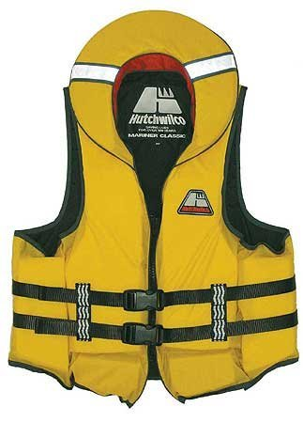
Summing up lifejackets
Lifejackets are not considered the priority of boating safety
Weather and conditions are most recognised
The emotional motivations to wear a lifejacket run counter to the culture and emotional needs of boating
Need to find a way to make an accepted part of the boating experience
This may take time, a long-term goal
Perception of risk is a big issue
Boaties have an unrealistic impression of risk and abilities
Attitudes to non-wearers can be very strong
Can we leverage this peer pressure?
Once converted, wearers can become strong advocates

Slide 51
The Research
Reinforced and articulated what we were thinking
Justified different approach

Slide 52
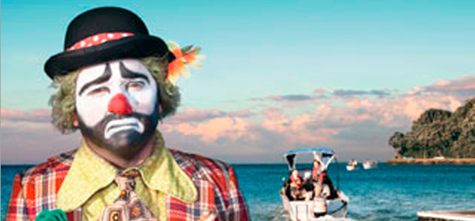
The Research
The research resulted in the ‘Don’t be a Clown, wear a lifejacket” campaign, and was cited by the judges as “a world class case study in demonstrating what great qualitative research and teamwork can deliver.”

Slide 53
TV Commercial

Slide 54
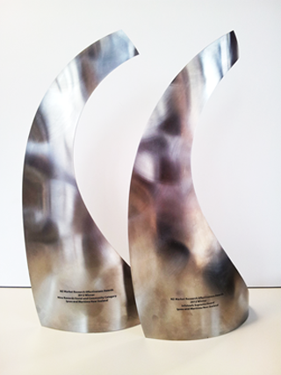
The Research
Social and community –Platinum award winner
Supreme award-New Zealand-National Market Research Awards

Slide 55
Other projects and interventions
Boating Safety in NZ-Youtube Channel
Folau Malu-Polynesian Day Skipper programme
Boating Safety Code-NZSAR/Coastguard
Water Safety New Zealand-drowning prevention programmes-Key messages
Coastguard Boating Education Courses
National Forum member initiatives

Slide 56
Maritime NZ YouTube Channel
Over 700,000 views
Over 3 hours of material
36 modules including introduction
Further modules in the pipeline
Commercial channel just launched

Slide 57
Folau Malu (Journey Safely)
Identifies community champions
Equip with safety messages
Polynesians talking to Polynesians
Accredited as boating education tutors to deliver dayskipper in language streams (Samoan & Tongan)
5 ministers across 10 denominations
120+ people from pacific community through programme

Slide 58
Boating Safety Strategy 2007
Existing evidence based strategy focused on four key messages, lifejackets, communications equipment and Weather
All key contributing factors to recreational boating fatalities to varying degrees, Lifejackets continue to be #1
Lack of fixed level flotation continues to feature in fatalities

Slide 59
2012-2013 Strategy review
Look back at accidents and fatalities since previous review – analysis of factors
Continued focus on lifejackets
Exploring other interventions, build standards across new build fleet including imports
Research tells us that compulsion doesn’t work

Slide 60
Thank you

